Slide 1
“A turn of the screw?” The changing division of labour in British universities and the re-engineering of academic work
Giulio Marini, CGHE Centre for Global Higher Education, Institute of Education UCL, London, UK {g.marini@ucl.ac.uk}
William Locke, CGHE Centre for Global Higher Education, Institute of Education UCL, London, UK
Celia Whitchurch, CGHE Centre for Global Higher Education, Institute of Education UCL, London, UK
CHER 2017 – Jyväskylä, Finland

Slide 2
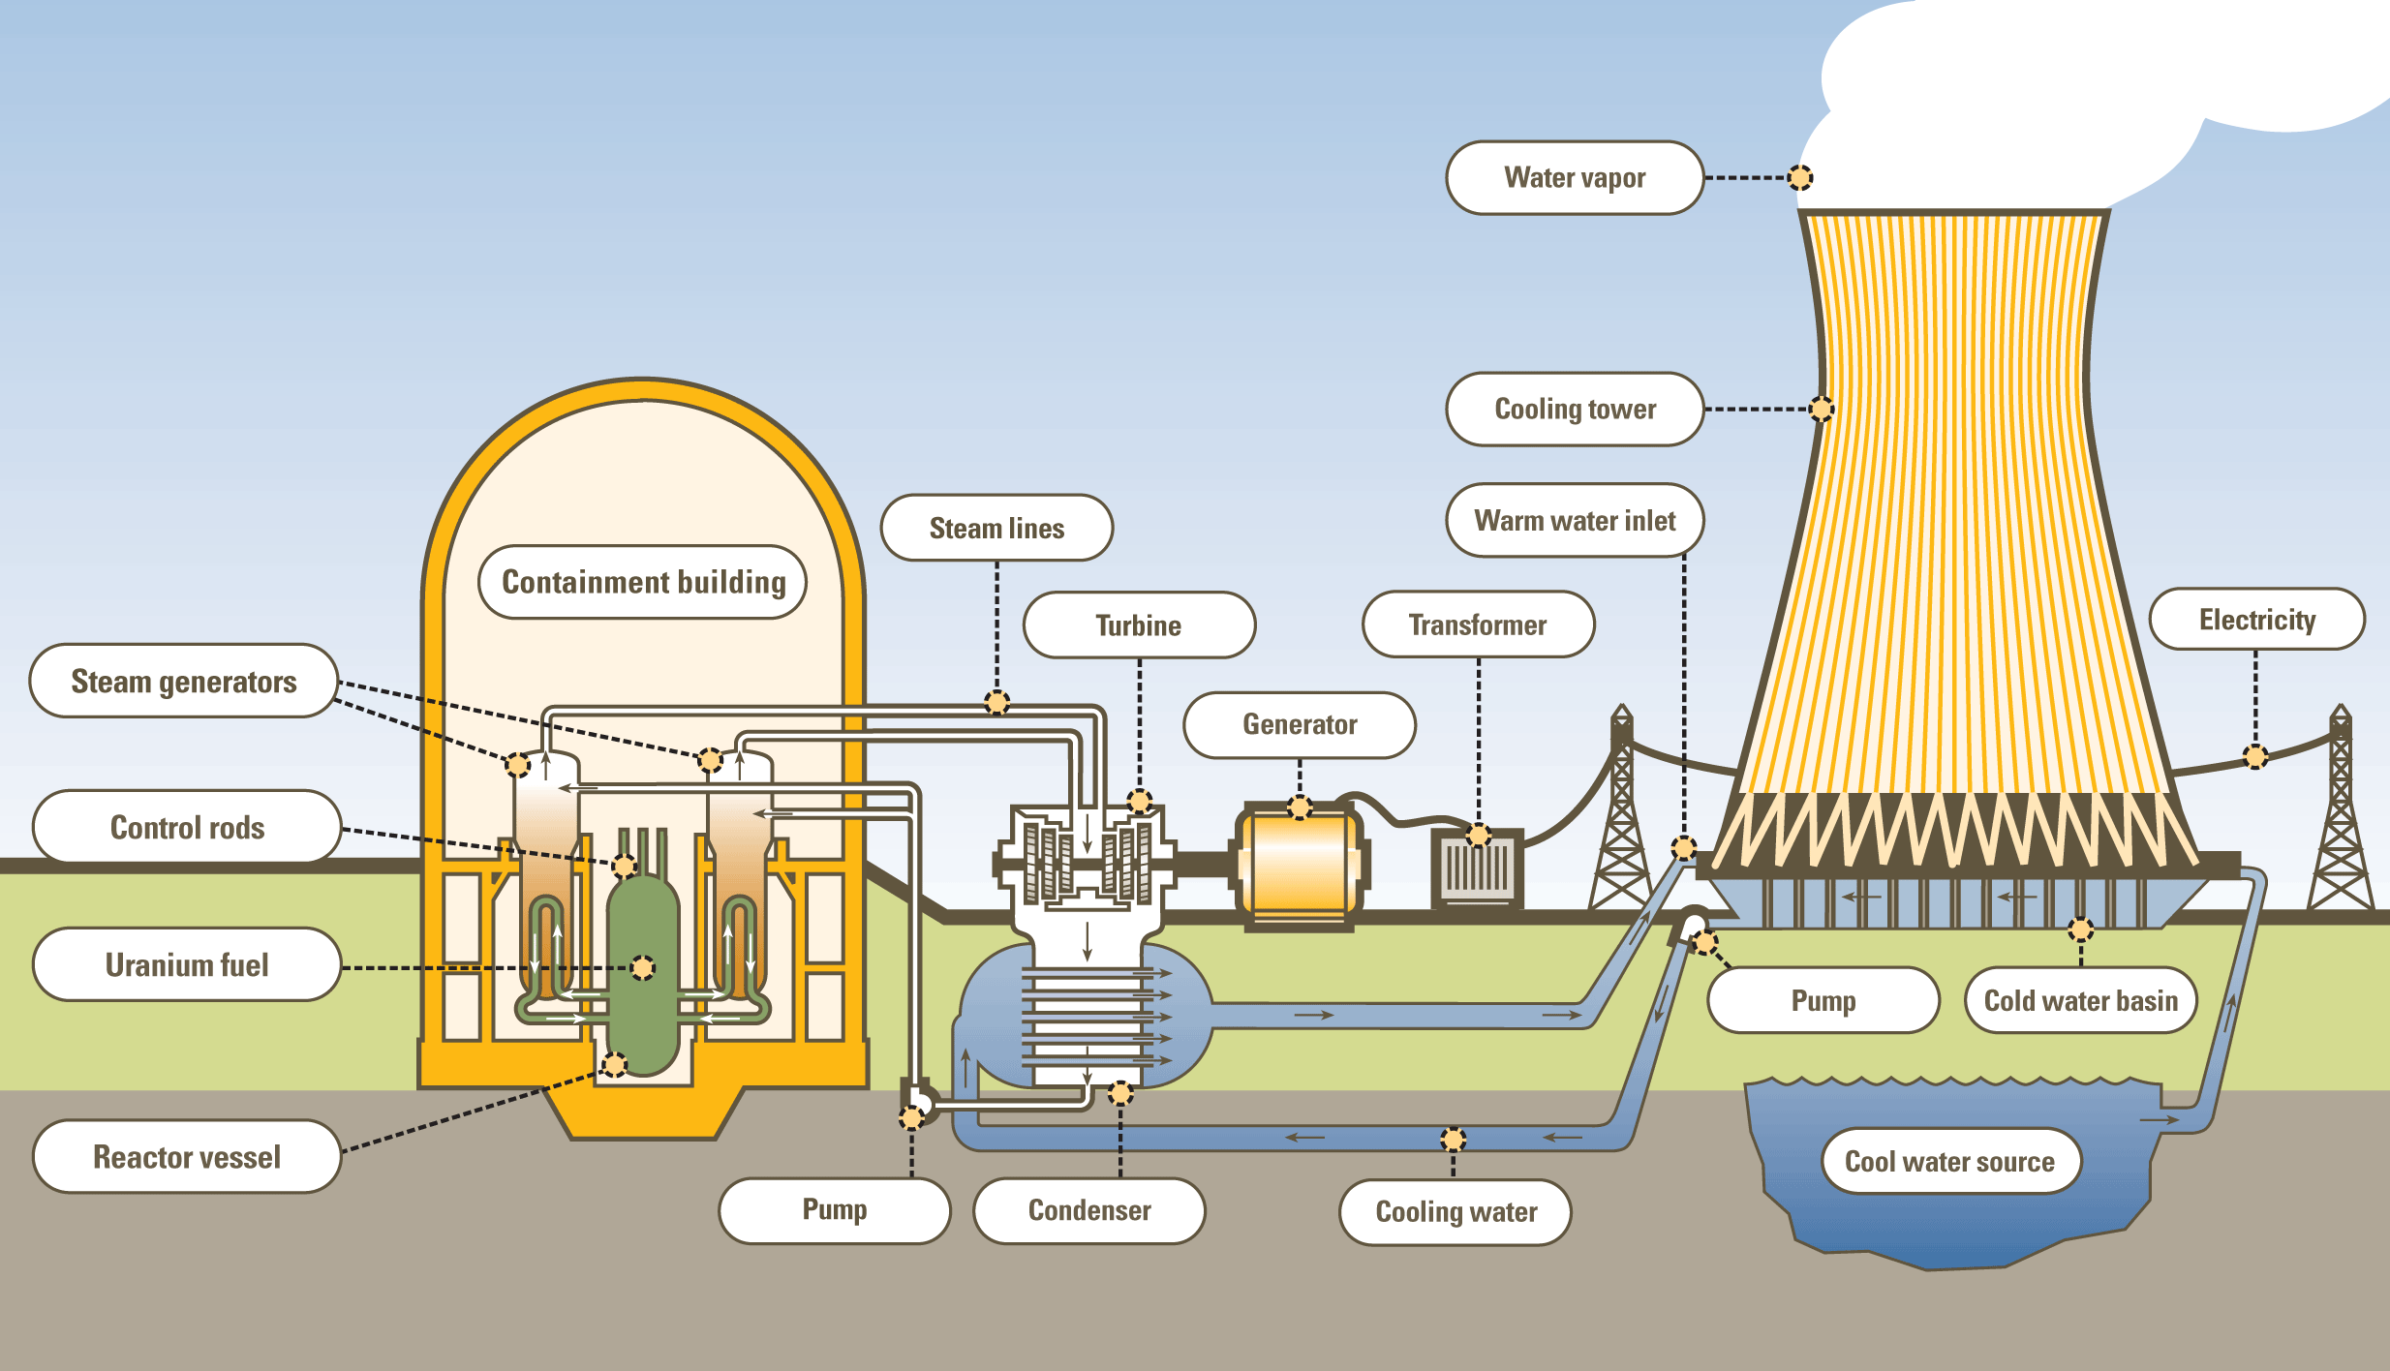
Re-engineering through over-engineering
Over-engineering is by definition excessive and deleterious
In some cases it is apt to “over-engineering” (nuclear plants)
According to Neo-Institutionalism, “under-engineering” would be more optimal in Education

Slide 3
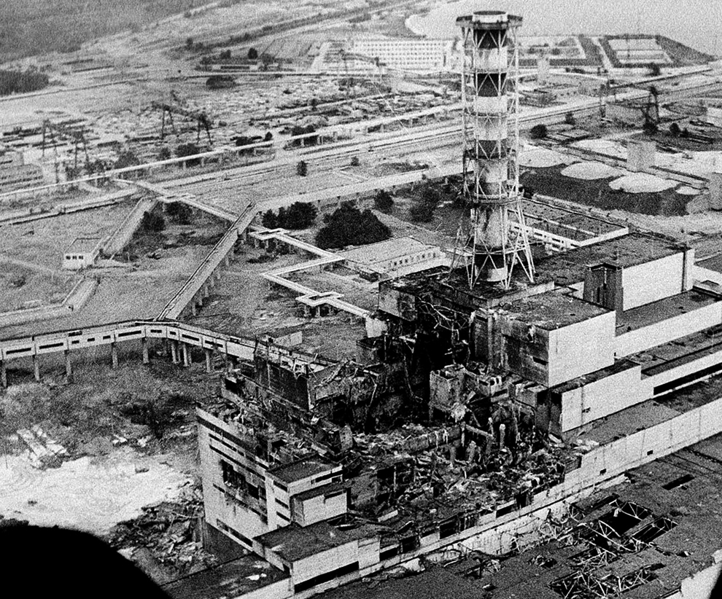
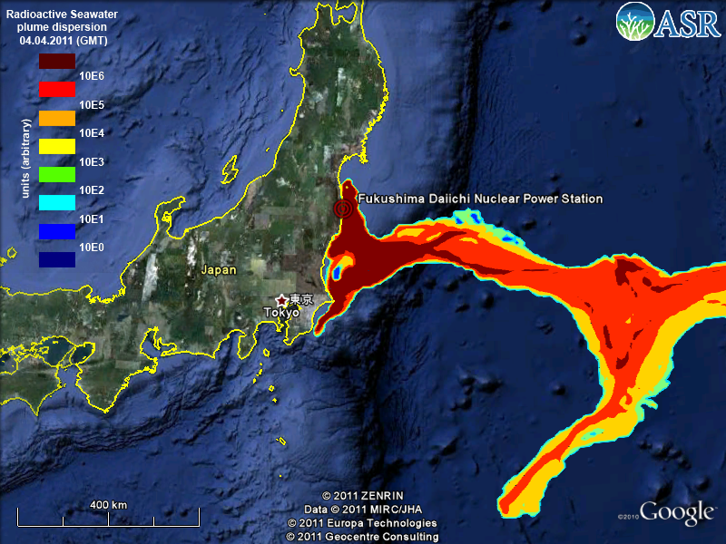
What does happen if over-engineering fails where it is desirable?

Slide 4
Over-Engineering in “normal” organisations and in HEIs (“not normal organisations”)
According to neo-institutionalism, educational institutions find their legitimation in sharing values, not in complying with rules (i.e. Tayloristic or Fordist division of labour). So, the organisation of labour goes beyond the Weberian bureaucracy; a university may be left as an “anarchic-like” organisation, or it may be an organised anarchy while having a bureaucratic backbone.
Under-engineering would appear the optimal choice.
But reality is different, as the UK (and in other Anglo-Saxon countries) progressively has a “hands-on” attitude to the “production & assessment” of research and teaching.
According to recent literature, based in the UK:
“although facilitative relationships may be seen simply as a helpful addition, they are in practice more likely to be a pre-requisite, and indeed that a lack of such relationships can have a disproportionately negative effect. Furthermore, when relationships are not taken into account in the implementation of institutional policy, this can create what might be seen as a ‘blind spot’” (Whitchurch and Gordon, 2017; both italic and underline ours)
Hence, the more you pursue some tightening (i.e. division of labour), the more it appears that you have to devise complex organisational counter-balancing arrangements (i.e. creating relationships or, at least, facilitating them).

Slide 5
A hypothesis
“Over-engineering” is defined as a process of pursuing efficiency and efficacy by means of (also) increasing the division of labour and making HEIs more “tightly interdependent” and less “loosely coupled”.
Over-engineering is driven by the game of metrics and competition (the logic of national and global excellence).
It requires institutional autonomy at HR level in typical HR issues.
It presupposes – at a non normative base – that there might be a bar or threshold above which the undesired counter-productive consequences of this “pursuit of excellence” exceeds the desired ones. Example from literature: HEIs as “dumb organisations made up of smart people” expected to become “smart organisations” vs. the risk of “making academic dumbly personnel” (Fuller 2016: “The Academic Caesar”).
The application of this concept implies a trade-off between tighter implementations in HR:
It acknowledges both effectiveness of “new practices” and some (hidden and unknown) limits dictated from the uncertainty of technology which is intrinsic in both Research and Teaching (neo-institutionalism)
Tentatively, we’ll try to use our study to detect when an institutional system ought to stop increasing complexity in order to minimize “risks of failures”, or when the trade-off emerges (if any trade-off will be met).

Slide 6
Research Questions
In what ways are academic roles and identities diversifying?
What are the implications for individuals and institutions, locally and globally?
What tensions and/or synergies arise from this diversification, for instance between individual aspirations and institutional missions, structures and processes?
How are such tensions being managed and resolved in optimal ways for individuals and institutions?

Slide 7
Research Design
2017: first qualitative phase with 8 interviewees in 8 HEIs in UK
2018: launch of a quantitative survey in those 8 HEIs
2019: second qualitative phase (longitudinal: same people re-interviewed)
At this stage only the pilot is done and interviews have been scheduled since September
A “positional” CGHE Working Paper is about to be released at www.researchcghe.org

Slide 8
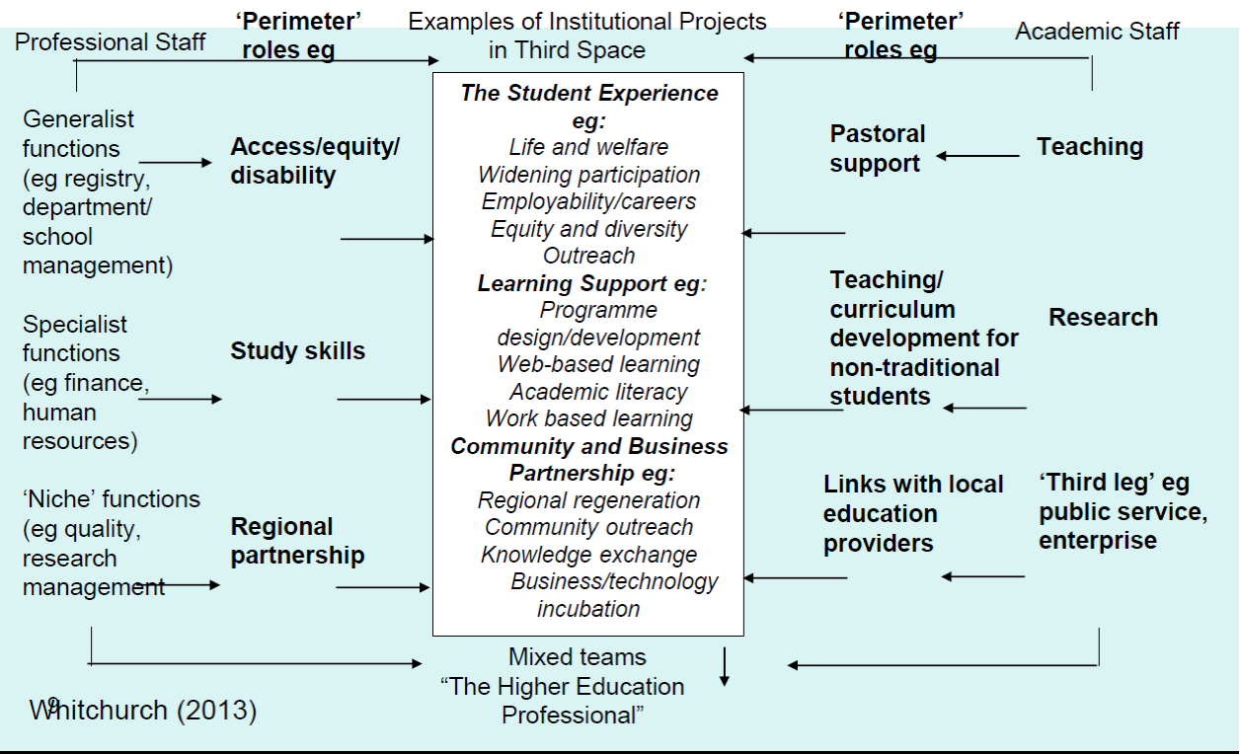
Back to context & literature: What the “Third Space” is?

Slide 9
Some secondary data
Secondary data are precious, but by definition they don’t see the “Third Space”, which can be detected only with primary data (whether qualitative or also quantitative)
Nevertheless, it is the case to look at them

Slide 10
A detail of “Non Academic”: They may be “anything” Source: HESA
 | 2014/2015
 | Academic |  | Non Academic
Managers, directors and senior officials | 495 | 0.2% | 11175 | 5.4%
Professional occupations | 196465 | 99.1% | 38865 | 18.9%
Associate professional and technical occupations | 1365 | 0.7% | 45830 | 22.3%
Administrative and secretarial occupations ("Clericals" for Academic) | 10 | 0.0% | 67595 | 32.9%
Skilled trades occupations |  |  | 6500 | 3.2%
Caring, leisure and other service occupations |  |  | 7175 | 3.5%
Sales and customer service occupations |  |  | 2145 | 1.0%
Process, plant and machine operatives |  |  | 1660 | 0.8%
Elementary occupations |  |  | 24550 | 11.9%
 | 198335 | 100.0% | 205495 | 100.0%

Slide 11
A more detailed comparison between academic and non academic (2014/5). Source: HESA
 |  | %Part-timers | %F | Average Age | % White
Managers, directors and senior officials | Academic | 15.2% | 39.0% | 51 | 89.9%
 | Non Academic | 12.0% | 53.1% | 47 | 90.4%
Professional occupations | Academic | 33.1% | 45.0% | 44 | 78.8%
 | Non Academic | 21.8% | 57.0% | 43 | 85.4%
Associate professional and technical occupations | Academic | 30.0% | 45.4% | 44 | 86.4%
 | Non Academic | 23.7% | 53.4% | 41 | 84.3%
Administrative and secretarial occupations ("Clericals" for Academic) | Academic | 50.0% | 50.0% | 38 | 50.0%
 | Non Academic | 35.3% | 81.4% | 45 | 85.6%
Skilled trades occupations | Academic | nil | nil | nil | nil
 | Non Academic | 12.8% | 19.4% | 41 | 87.2%
Caring, leisure and other service occupations | Academic | nil | nil | nil | nil
 | Non Academic | 46.6% | 55.6% | 40 | 84.0%
Sales and customer service occupations | Academic | nil | nil | nil | nil
 | Non Academic | 44.1% | 69.2% | 47 | 81.8%
Process, plant and machine operatives | Academic | nil | nil | nil | nil
 | Non Academic | 15.4% | 16.9% | 46 | 83.4%
Elementary occupations | Academic | nil | nil | nil | nil
 | Non Academic | 66.0% | 58.1% | 42 | 78.9%
Total | Academic | 33.0% | 45.0% | 44 | 78.9%
 | Non Academic | 32.2% | 62.7% | 42 | 84.6%

Slide 12
Some first evidence from the pilot (qualitative stage)
HR may decide to participate or not in this research on behalf of the whole HEI (!)
Academics suffer from not being recognised “academic” in institutional jargon… meanwhile being actually both R&T. Division of labour sometimes is only official. L.M.s may incentive comprehensive performance.
People undertake PhD programs without having a clear idea why, ending up questioning why they do so. Consequences are a transformation of Beruf into “Better than waiting doing nothing”; inflation of the title; necessity to look outside academia (which reinforces HR necessity).
Complexity + necessity to raise funds let emerge some momentum for some type or professionals
Some professionals are self-confident in what they do (they truly believe to be effective in being supportive); conversely “academics” suffer “Impostor syndrome” and also reckon many professionals as “people whom to do a smooth job with [in order to meet them the less possible]”. Both “academics” and “professionals” are very different in moods and career trajectories, although converging in a “common Third Space”.
Professionals look empowered and gratified; academics look alienated from their traditional status (i.e. tamed cats or “roosters in Taylorised rearing”), although with many opportunities to prove one’s talent.
Easier career perspective in professional tracks, due to novelty of figures. Certificates and tracks are still unclear
Academics don’t know anymore what a career is like
Organisational Development (OD) may serve to provide functions previously supposed to be run by a supervisor (i.e. mentoring, coaching, career trajectories, etc.). There is a divide between juniors and seniors (only the younger cohorts recognise new functions held by HR)
HR units are both “consultants” (in the sense that they serve units) and institutional strategy implementers. Unclear what does prevail.
Professionals are becoming more structured… professionally (as a set of figures):
ARMA (Association of Research Managers and Administrators)
Institutional “Transforming our Professional Services (TOPS)” programmes.
VITAE, non-profit programme, part of The Careers Research and Advisory Centre (CRAC), a governmental derivation.

Slide 13
Some preliminary apparent paradoxes
Division of labour from contractual duties (increase division of labour & creation of new figures) vs. Actual performances (going beyond one’s duties and working time)
What is liked by “professionals” is not liked by “academics”: the Third Space is not about new contracts, it is deeper in the core of academia work and it is pivotal.

Slide 14
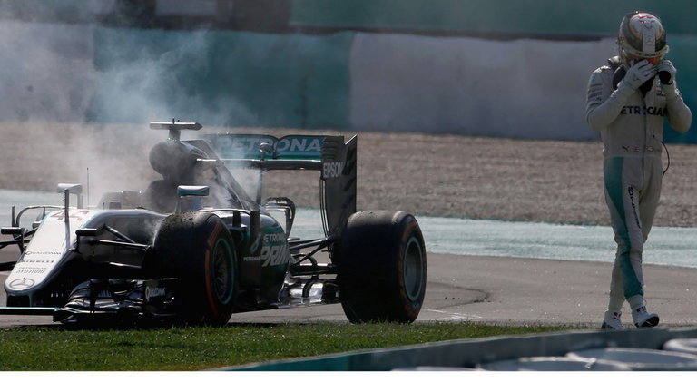
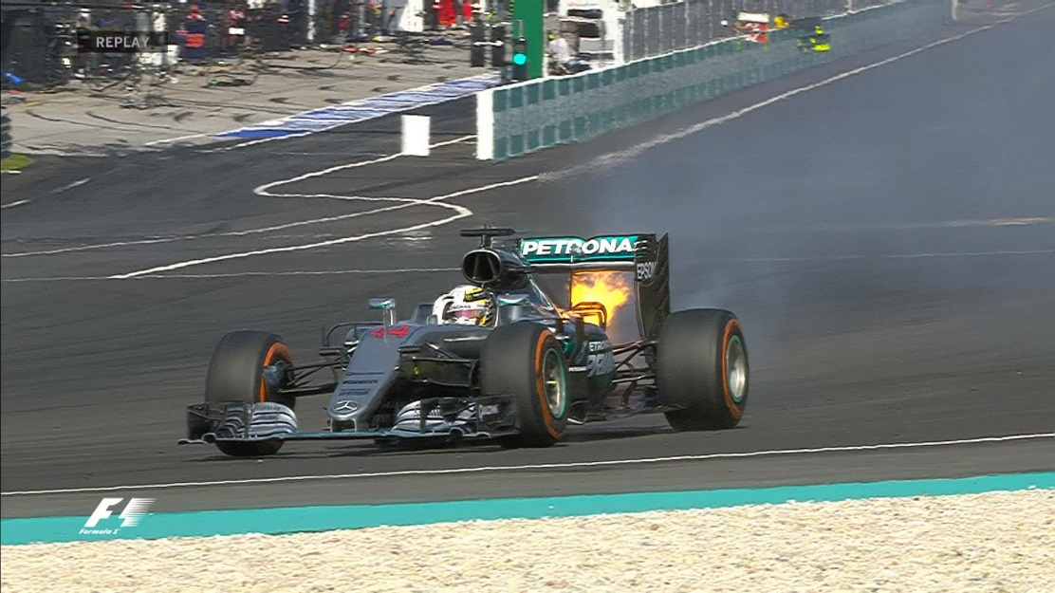
A preliminary conclusion
To tighten the fabric of universities by means of “screwing” it may represent a sort of “over-engineering” in relation to its “core nature”. It is not about increasing safety; it is about boosting productivity. Not necessarily to devise labour to boost performance has no limits. Overtaking limits is risky. We assume this can be detected empirically
If higher education is really a loosely coupled system, tightened institutions should find a way to loosen themselves again, although some consequences in this process might be appreciated. You may well continue burning and racing as well (“ongoing tensions in critical relationships”)

Slide 15
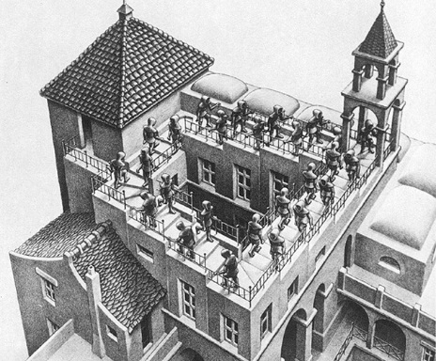
A turn of screw in an Escher mode?

