Slide 1
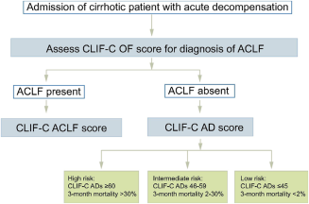
Novel approaches and therapeutics in acute‐on‐chronic liver failure
Liver Transplantation
Volume 22, Issue S1, pages 14-19, 26 OCT 2016 DOI: 10.1002/lt.24621
http://onlinelibrary.wiley.com/doi/10.1002/lt.24621/full#lt24621-fig-0002
Notes:
Proposed algorithm for diagnosis and risk stratification of ACLF and AD. Data from Jalan et al. (2014) and Jalan et al. (2015).
IF THIS IMAGE HAS BEEN PROVIDED BY OR IS OWNED BY A THIRD PARTY, AS INDICATED IN THE CAPTION LINE, THEN FURTHER PERMISSION MAY BE NEEDED BEFORE ANY FURTHER USE. PLEASE CONTACT WILEY'S PERMISSIONS DEPARTMENT ON PERMISSIONS@WILEY.COM OR USE THE RIGHTSLINK SERVICE BY CLICKING ON THE 'REQUEST PERMISSIONS' LINK ACCOMPANYING THIS ARTICLE. WILEY OR AUTHOR OWNED IMAGES MAY BE USED FOR NON-COMMERCIAL PURPOSES, SUBJECT TO PROPER CITATION OF THE ARTICLE, AUTHOR, AND PUBLISHER.

