Slide 1
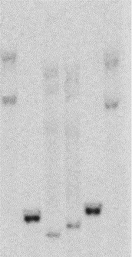
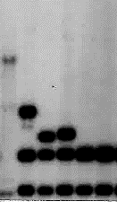
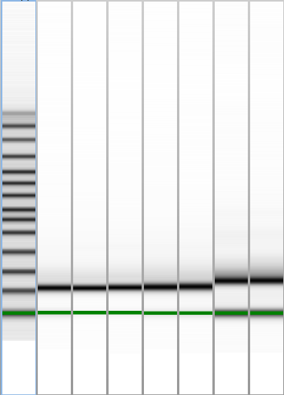

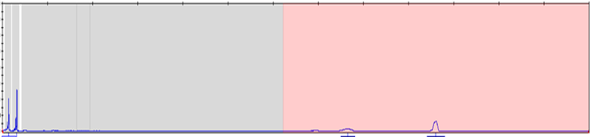
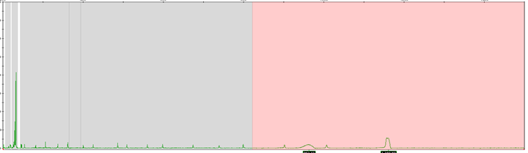

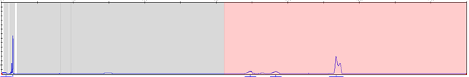
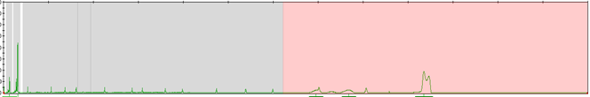
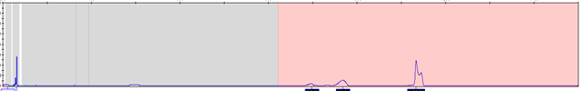
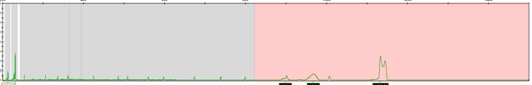
(A)
11,694 Omni SNP#5
microdeletion
14,321 Omi SNP#3
Figure 1.
~80
bp
CGG (n)
EcoRI 11,114
EagI 13,549
EroRI
16,342
HindIII 10,883
NruI 13,450
HindIII 16,107
PstI 13430
PstI 14,461
14,461
CpG island
13,925
Pfxa3 probe
5’ epigenetic boundary
FMR1 transcription
13,950
23,770
24,027
5’
FREE1
FREE2
3’
CGG (n)
ASFMR1 promoter
13,227
13,440
13,758
14,192
27,322
NruI
13,862
14,012
23,715
23,767
23,931
EagI
Exon 1
Intron 1
Exon 2
Intron 2
ASFMR1 transcription
HpaII
HpaII
Targeted by Amplidex mPCR
PstI only
(B)
NruI / HindIII
EagI / EcoRI
(C)
(D)
FREE1
FREE2
1 2 3 4 5 6
1 2 3 4 5 6 7
Case’s buccal
N- Male 1
Case’s buccal
Blank
N- Male 2
N- Male 1
Case’s blood
Case’s salival
Case’s blood
Case’s salival
N- Male 2
7,7Kb
400
846 CGG M.
7,1Kb
6.5Kb M.
763 CGG M.
250
4.7Kb M.
6.1Kb M.
2.83Kb
1 2 3 4 5 6 7 8 9 10 11
5.2Kb M.
5,1Kb.
46 CGG M.
4.9 Kb
(E)
46 CGG M.
Control digestion
HpaII methylation specific digestion
200 400 600 800 1000 1200 1460
200 400 600 800 1000 1200 1460
4.5Kb.
FM UM.
4.4 Kb
1.63Kb
1.57Kb; 220 CGG.
8000
8000
FM UM.
Blood
65% M.
6000
6000
210 CGG
4000
Blood
4000
1.33Kb
74% M.
55% M.
140 CGG
2000
2000
1.2Kb
0.0
0.0
100 CGG confirmed
by PCR
Fluorescence Units (FU)
3.0 Kb
1.0Kb
8000
Buccal
8000
6000
Buccal
94% M.
2,9Kb.
2.8 Kb
30 CGG
4000
6000
2.7 Kb.
30 CGG UM.
4000
93% M.
94% M.
30 CGG UM.
2.6 Kb
0.84Kb
2000
2000
2.5Kb
0.0
0.0
N-male
0.80Kb
N- Male
8000
8000
6000
Saliva
59% M.
FM- female
PS8
Control
probe
N- female
Saliva
6000
53% M.
FM- female
PM- female
N-male
PM- female
4000
4000
Case’s blood
Case’s blood
Case’s buccal
2000
2000
64% M.
Case ‘s PM/FM
Mother’s blood
0.0
0.0
>200 CGG.
>200 CGG.

Slide 2
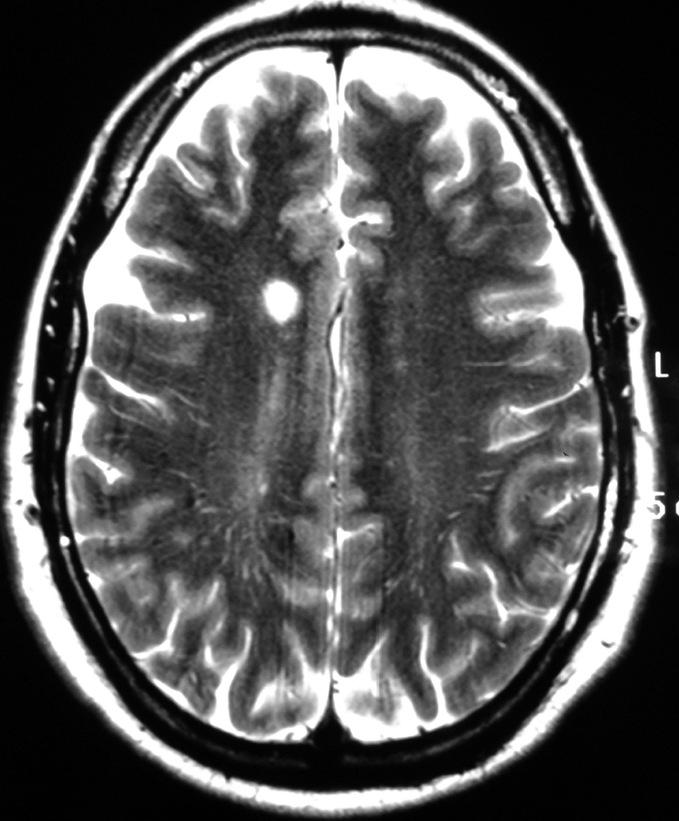
Figure 2.
(A)
(C)
Mean FREE2 methylation output ratio
0.47
0.46
0.41
0.43
(B)
0.39
FMR1 mRNA (au)
0.0
Control
PM
Case blood
Case PBMCs

