Slide 1
Private Rights, Public Goods, Social Duties
Privacy: the right to be left alone or the freedom to be yourself?
Public goods: common interests and the collective good
Social duties: living together in harmony or living well?

Slide 2
Privacy
‘No man is an Island, entire of himself…. Therefore do not send to ask for whom the bell tolls, it tolls for thee.’ John Donne (1624)
‘I never said, ‘I want to be alone.’ I only said, ‘I want to be left alone.’ There is all the difference.’ Greta Garbo
Respect for ‘Private and Family Life’ Article 8, European Convention on Human Rights

Slide 3
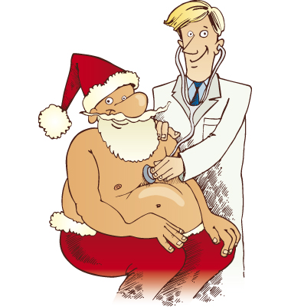
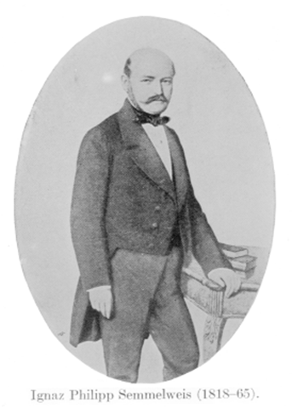
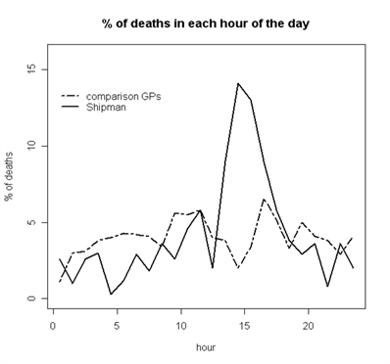
How are ‘My’ Health Records Mine? Whose else are they?

Slide 4
Public Goods?
Common interests in which we all share equally
Clean air, water, security
possibly added to by status, e.g. as patients we share an interest in safety in health services
Collective interests that may benefit us differentially but with overall net positive effects
‘Public health’, health services
Personal interests that we all hold, but independently:
life, health….

Slide 5
Public Goods?
No conflict, so maximise?
Common interests in which we all share equally
Clean air, water, security
possibly added to by status, e.g. as patients we share an interest in safety in health services
Collective interests that may benefit us differentially but with overall net positive effects
‘Public health’, health services
Personal interests that we all hold, but independently:
life, health….
Negotiated trade offs?
Constraints and/or trade Offs?

Slide 6
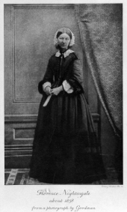
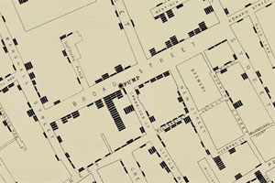
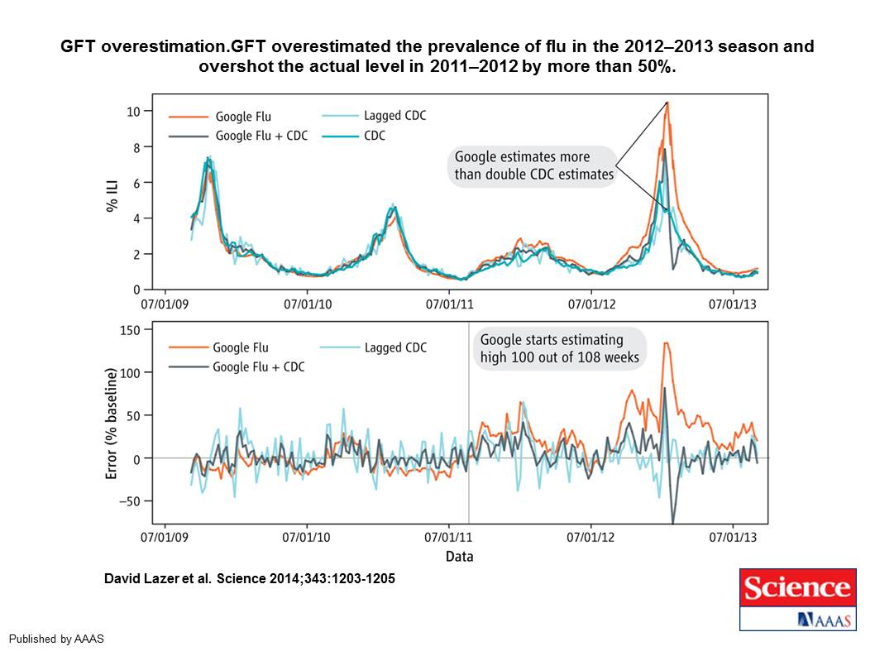
Information Saves Lives

Slide 7
Social Duties
To respect the rights and freedoms of others
Refrain from harm,
What about limiting their chances? Helping them?
Solidarity: Are we all better off if we collaborate?
‘Enlightened self-interest: I give up a little freedom for a bigger gain (what’s in it for me?)
Reciprocity: giving something back in return for what I have received.
Two problems… Free Riding…. Uncertain Futures

Slide 8
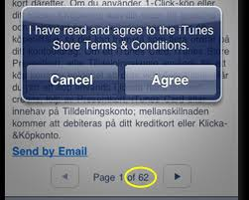
What is it worth to you?

