Slide 1
Methods for the analysis of atrophy at a regional level: advantages and pitfalls
Gerard R. Ridgway, PhD
UCL Institute of Neurology
Email Ged@cantab.net for slides or questions

Slide 2
Overview
From global to regional to voxel-wise methods
Focusing on voxel-based morphometry
Some more general statistical points
Didactic but also critical

Slide 3
Advantages of atrophy measurement
Sensitive in vivo marker of pathology
  ~5x fewer subjects required to power a drug trial cf. MMSE
    n per arm for 90% power to detect 20% effect over 12 months
    Using MMSE, n = 1898; Using brain volume (BSI) n = 375
    Ridha et al., 2008, Journal of Neurology, vol.255, no.4, 567-574
Early marker of change prior to clinical symptoms
  Increased brain atrophy rates in cognitively normal older adults with low cerebrospinal fluid Aβ1-42. Schott et al., 2010, Annals of Neurology, vol.68, no.6, 825–834

Slide 4
But don’t just take my word for it…
Quoting Michael W. Weiner :
“Structural imaging with MRI has been shown to be the most robust and sensitive measure of change in control subjects, MCI, and AD.
Rates of brain atrophy, especially in the hippocampal region, correlate with changes of memory and other cognitive functions.
Structural MRI is now widely used in clinical trials”
From: Commentary on “Biomarkers in Alzheimer's disease drug development.” The view from Alzheimer’s Disease Neuroimaging Initiative.
Weiner, 2011, Alzheimer’s and Dementia vol.7, no.3, pages e45-e47

Slide 5
But don’t just take my word for it…
Quoting Michael W. Weiner :
“Structural imaging with MRI has been shown to be the most robust and sensitive measure of change in control subjects, MCI, and AD.
Rates of brain atrophy, especially in the hippocampal region, correlate with changes of memory and other cognitive functions.
Structural MRI is now widely used in clinical trials”
From: Commentary on “Biomarkers in Alzheimer's disease drug development.” The view from Alzheimer’s Disease Neuroimaging Initiative.
Weiner, 2011, Alzheimer’s and Dementia vol.7, no.3, pages e45-e47

Slide 6
Advantages of regional atrophy measurement
Disease and disease-stage specificity
  Whole brain atrophy in Ageing, AD, SD, HD, PD, MS, TBI, …
Treatment-process specificity (?)
  “Antibody responders had greater brain volume decrease … not reflected in worsening cognitive performance … possibility that volume changes were due to amyloid removal”
  Fox et al. Effects of Aβ immunization (AN1792) on MRI measures of cerebral volume in Alzheimer disease. Neurology, 2005, vol.64 no.9 1563-1572

Slide 7
Methods of regional atrophy measurement
Manual region of interest (ROI) volumetry
Automatic segmentation, e.g. label propagation
Voxel-based or statistical parametric mapping
  Including VBM, TBM, DBM, …
Vertex-based analysis on extracted surfaces
  Cortical thickness, gyral depth, gyrification/curvature, …
…
Notes:
Cortical thickness etc. harder for methodologists to implement, but easier for neurologists to use and interpret
Pitfalls mostly special cases of those for VBM
Though note T1w MRI shows myeloarchitectonic borders, not cytoarchitectonic ones

Slide 8
Advantages of manual ROI volumetry
Unambiguous and straightforward interpretation
  If this seems a trivial advantage, wait for later slides!
(Potentially) well characterised sources of error
  Intra-rater, inter-scan, inter-rater, (inter-protocol?)
Provides a basis for automation and/or evaluation
  E.g. Good et al., 2002, Neuroimage, vol.17, no.1, 29-46

Slide 9
Pitfalls of manual ROI volumetry
Subjectivity – not always possible to blind rater
Time and expertise constrain the number of ROIs
Often know disease’s key ROIs, but not those with
  Greatest differences among variants
  Highest rates of change (most atrophied may plateau)
  Most benefit from (candidate) drug treatments
Some boundaries poorly defined/inferred in MRI
Different ROI protocols can confound comparisons
  Especially if little overlap among studies of rare patients
Notes:
Drug treatment for e.g. AD might differently affect hippo and posterior cingulate, given their very different microstructure

Slide 10
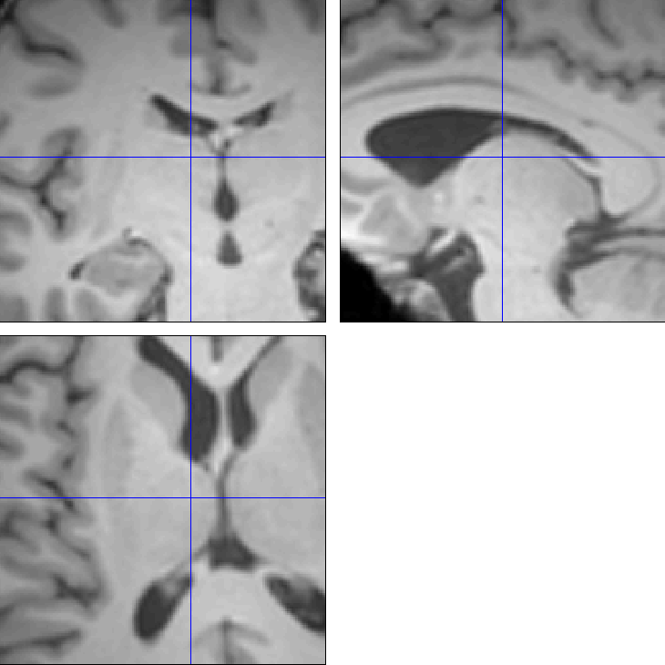
Pitfalls of manual ROI volumetry – example
Where is the boundary of the thalamus?
Even if you think you are confident, would someone else agree?
Are we interested in the whole thalamus, or a subregion/nucleus?
  Or regions it connects?
Notes:
For third point, focus on time-consuming aspect of multiple subregions and/or connected regions, will return to subregional differences as a motivation for SPM later

Slide 11
Segmentation Propagation using non-rigid registration
Well-performing automatic segmentation method
Relates to other non-rigid registration approaches
Several refinements published, others in progress
  Collins et al., 1995, HBM, vol.3, no.3, 190-208
  Rohlfing et al., 2004, IEEE TMI, vol.23, no.8, 983-994
  Wolz et al., 2010, Neuroimage, vol.49, no.2, 1316-1325
  Leung et al., 2010, Neuroimage, vol.51, no.4, 1345-59

Slide 12
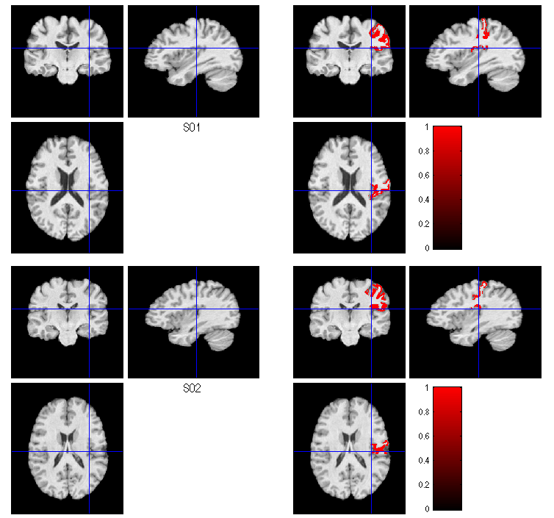
Segmentation Propagation using non-rigid registration
Consider two manually segmented images
  from Christensen et al’s www.nirep.org
S01
S01
Label
S02
S02
Label
Notes:
Right post-central gyrus

Slide 13

Segmentation Propagation using non-rigid registration
Consider two manually segmented images
  from Christensen et al’s www.nirep.org
We can register one image to the other
  and transform its labels
S01
S01
Label
S01
Warped
S01
Warped Label
Notes:
Right post-central gyrus

Slide 14

Segmentation Propagation using non-rigid registration
Consider two manually segmented images
  from Christensen et al’s www.nirep.org
We can register one image to the other
  and transform its labels
Labels can be thus propagated to subjects without manual labels
S01
S01
Label
S02
S01 Warped Label
Notes:
Right post-central gyrus

Slide 15
Spatial normalisation and atlases
Can register one or more labelled images to each unlabelled image to segment that image
Alternatively, register all images to a common reference (standard space or group-wise average)
Multiple segmentations in this space yield a probabilistic atlas (or a prior for further refinement)

Slide 16
Pros and cons of automatic segmentation
Exactly reproducible
Avoids subjective bias
Benefit of combining multiple estimates
Potential for more severe random failures
Potential for other systematic biases
Less benefit from neighbouring objects or related features
Notes:
Though note that reg-based seg-prop benefits more from neighbourhood information than many other auto segmentation methods

Slide 17
Pitfalls of ROI volumetry – example, revisited
Where is the boundary of the thalamus?
Are we interested in the whole thalamus, or a subregion/nucleus?
  Or regions it connects?

Slide 18
Motivating voxel-based analyses
The multitude of regions and/or lack of clear boundaries and/or multiple scales of interest motivate segmentation propagation ad absurdum
  If non-rigid registration works near perfectly, could propagate single voxel labels between images
Following spatial normalisation, perform voxel-wise statistical (parametric) mapping (SPM)
  Either study residual “mesoscopic” differences
  Or look at voxel-wise volume change

Slide 19
Residual differences and the boundary shift integral (BSI)
Differences in voxel intensity after imperfect (e.g. rigid or affine) registration underpin the BSI
  Intensity differences due to noise should cancel
  Intensity differences due to boundary shifts should reflect volume changes
  Freeborough et al., 1997, IEEE TMI, vol.16, no.5, 623-9
Also relates to “old-fashioned” VBM without Jacobian modulation, but first, Jacobians…

Slide 20
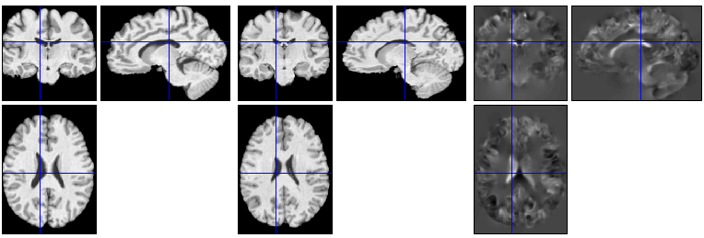
Voxel-wise volume change:
Jacobians of non-rigid transformations
S01
S02
Jac from 2 to 1
Dark voxels are smaller in S01
Mid-grey voxels are unchanged
Bright voxels are larger in S01

Slide 21
Voxel-wise volume change:
Jacobians – intuition behind the mathematics
Consider the centre point of three points in a line
If all three translate the same amount along that line, the “size” of the centre point is unchanged
If the point on the right translates more to the right than the point on the left, the centre one stretches
This corresponds to a positive local gradient of the transformation: ∆Transformed / ∆Original

Slide 22
Voxel-wise volume change:
Jacobians – intuition behind the mathematics
  Along one dimension (the line of points) the derivative is ∆Transformed / ∆Original
  In 3D, the gradient consists of 9 partial derivatives, which form a 3x3 Jacobian matrix or tensor
  The determinant of the matrix gives the 3D volume change
  See also – http://tinyurl.com/JacobianTutorial
Notes:
If no change (identity transformation), diagonal elements 1, off-diagonals 0

Slide 23
Longitudinal tensor-based morphometry or voxel-compression mapping (VCM)
Longitudinal non-rigid registration more accurate
  Within-subject changes < between-subject variability
Motivates separate registration procedures
  Analyse spatially normalised longitudinal Jacobians
  Scahill et al., 2002, PNAS, vol.99, no.7, 4703
    Aside: note this paper separates expansion and contraction, which I would not recommend, because group differences in variance could erroneously yield group differences in means

Slide 24
Pitfalls of tensor based morphometry
Shares those of seg.-prop. (non-rigid registration)
  Potential for more severe random failures
  Potential for other systematic biases
More complicated interpretation
Adds the major problem of lack of ground truth or gold standard for voxel-wise correspondence
  No characterisation of accuracy or bias across the brain
  Complex and often poorly (or not at all) characterised variation in sensitivity and specificity across the brain
    Pereira et al., 2010, Neuroimage, vol.49, no.3, 2205-2215

Slide 25
Tensor- and deformation-based morphometry
(TBM and DBM)
Both the Jacobian and its determinant are tensors
  Tensor-based morphometry is basically just SPM of Jacobian determinants
  Or related measures, see e.g.
  Lepore et al., 2008, IEEE TMI, vol.27, no.1, 129-141
Deformation-based morphometry is either SPM or multivariate statistical analysis of the translations
  Ashburner et al., 1998, HBM, vol.6, no.5/6, 348-357

Slide 26
Mass-univariate, mass-multivariate and global multivariate statistical analysis
TBM (and VBM) typically perform univariate statistical analysis at every voxel
Generalised TBM, and some forms of DBM perform low-dimensional (e.g. 3 to 9) multivariate analysis at every voxel
Ashburner’s DBM does 1 global multivariate test
  Requires dimensionality reduction (from >1000s to 10s)
  Global multivariate patterns much harder to interpret

Slide 27
Multiple comparison correction and associated pitfalls
SPM performs a statistical test at every voxel
  Significantly inflated risk of (familywise) type I errors
  But not as inflated as #voxels, because of correlations
Important to control a suitable error rate
  E.g. familywise error (FWE) or false discovery rate (FDR)
  And to understand what it means (with FDR, you expect to be reporting false positives if you have true ones too)
  And to be careful with small volume correction (SVC) if using it!
  See also: Ridgway et al., 2008, Neuroimage, vol.40, no.4, 1429

Slide 28
Voxel-based morphometry
(VBM)
In essence VBM is Statistical Parametric Mapping of segmented tissue volume or “density”
  “Density” = tissue-volume per volume of smoothing kernel
  Not interpretable as neuronal packing density or other cytoarchitectonic tissue properties, though changes in these properties may lead to VBM-detectable differences
Without Jacobian modulation, studies differences in tissue segments not removed by imperfect registration
VBM with Jacobian modulation is tissue specific TBM

Slide 29
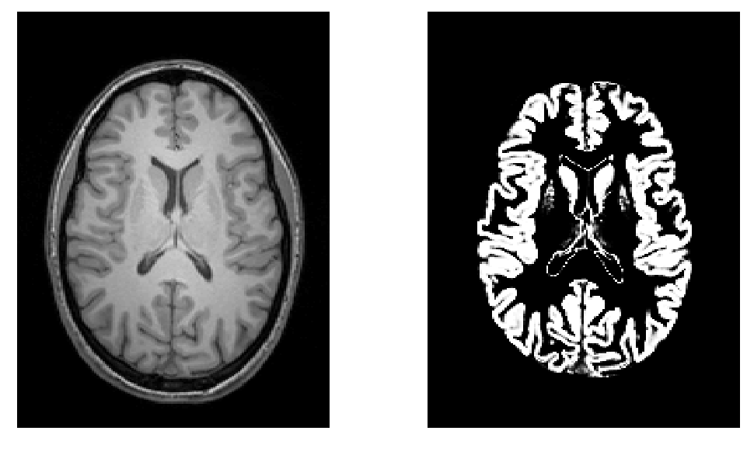
Voxel-based morphometry
Seg + smoothing kernel like a locally weighted ROI
  Figure from John Ashburner’s morphometry slides
  http://www.fil.ion.ucl.ac.uk/spm/course/slides11/

Slide 30
Advantages of voxel-based morphometry
Compared to TBM, lessens problem of expanding CSF cancelling adjacent GM atrophy
Segmentation might be more accurate than
non-rigid registration (?)
Pragmatically: easy to use, performs very well
  Many highly cited papers

Slide 31
Pitfalls of voxel-based morphometry
Shares all those of listed for TBM and segmentation propagation (non-rigid registration)
Adds additional complications regarding
  Intensity or contrast differences
    See also: Salat et al., 2009, Neuroimage, vol.48, no.1, 21-28
  Mis-segmentation or mis-registration
  Changes in folding
  …

Slide 32
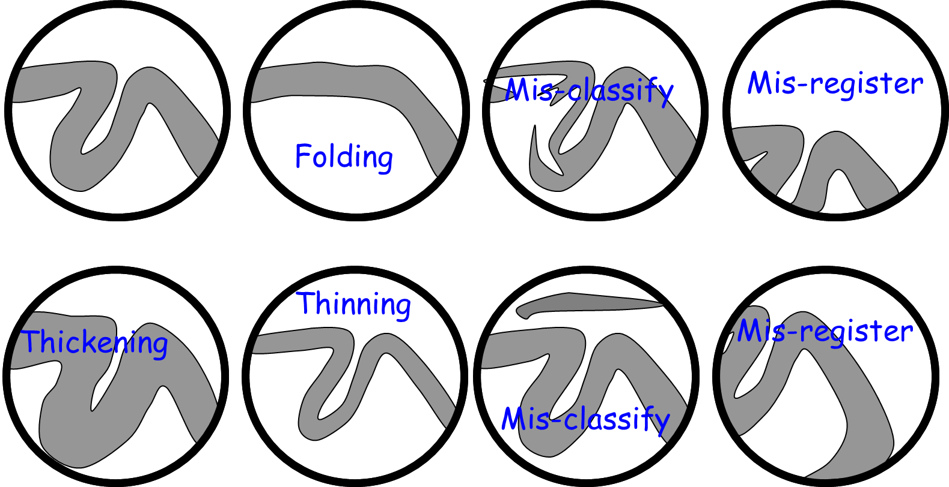
Pitfalls of voxel-based morphometry
  Figure from John Ashburner’s morphometry slides
  http://www.fil.ion.ucl.ac.uk/spm/course/slides11/

Slide 33
Pitfalls of voxel-based morphometry
Adds additional complications regarding
  …
  Potential exclusion of atrophy from mask
    Ridgway et al., 2009, Neuroimage, vol.44, no.1, 99-111
    http://www.fil.ion.ucl.ac.uk/spm/ext/#Masking
  Low variance regions / mis-location of maxima
    Reimold et al., 2005, JCBFM, vol.26, no.6, 751-759
    http://www.fil.ion.ucl.ac.uk/spm/ext/#MASCOI
    Acosta-Cabronero et al., 2008, Neuroimage, vol.39, no.4, 1654

Slide 34
Pitfalls of voxel-based morphometry
Summary
VBM is sometimes described as
“unbiased whole brain volumetry”
Regional variation in registration accuracy, sensitivity & specificity
Segmentation problems, issues with analysis mask
Intensity, folding, etc. plus difficulty in interpretation
But significant blobs probably still indicate meaningful systematic effects!

Slide 35
Longitudinal voxel-based morphometry
Often attempt to exploit within-subject registration
  E.g. Draganski et al., 2004, Nature, vol.427, 311-312
Or a hybrid of VBM and longitudinal TBM
  E.g. Hobbs et al., 2010, JNNP, vol.81, no.7, 756
Both methods add a serious additional pitfall
  Asymmetries in within-subject reg. could induce bias
    Thomas et al., 2009, Neuroimage, vol.48, no.1, 117-125
    Yushkevich et al., 2010, Neuroimage, vol.50, no.2, 434-445
    Fox et al. (in press) DOI:10.1016/j.neuroimage.2011.01.077
Notes:
Mention Reuter and Fischl’s work in FreeSurfer

Slide 36
Adjustment for “nuisance” variables
Anything which might explain some variability in regional volumes of interest should be considered
  Age and gender are obvious and commonly used
    Consider age+age² to allow quadratic effects
  Site or scanner if more than one (NB factor, not covariate!)
  Interval in longitudinal studies
    Some “12-month” intervals end up several months longer…
Total grey matter volume often used for VBM
  Changes interpretation when correlated with local volumes
  Total intracranial volume (TIV/ICV) often better (check if correl.)
Barnes et al., 2010, Neuroimage, vol.53, no.4, 1244-1255

Slide 37
Adjustment for global GM volume
Figure from John Ashburner’s Morphometry slides http://www.fil.ion.ucl.ac.uk/spm/course/slides11/
(ii) is globally thicker, but locally thinner than (i)
either of these effects may be of interest to us.

Slide 38
Common statistical pitfalls
Absence of evidence =/= evidence of absence
  E.g. amygdala atrophy p=0.07 does not imply spared
Difference in significance =/= significant difference
  E.g. hippocampus p=0.03 and amygdala p=0.07 unlikely to differ
  Controls vs Group A significant, controls vs Group B not similarly does not imply Group A differs from B
    Group B could even be more different if higher variance or lower n
Particularly common problems in SPM/VBM, etc.
  Remember that absence of a blob could just mean p=0.0501!
    Poldrack et al., 2008, Neuroimage, vol.40, no.2, 409-414
    Ridgway et al., 2008, Neuroimage, vol.40, no.4, 1429-1435

Slide 39
Further reading
(particularly related to pitfalls)
Ashburner & Friston, 2000, Neuroimage, vol.11, no.6, 805-821
  http://dx.doi.org/10.1006/nimg.2000.0582
“VBM should not be used …” / “Why VBM should be used …”
  Personally, I don’t find these particularly helpful, but for completeness:
  http://dx.doi.org/10.1006/nimg.2001.0770
  http://dx.doi.org/10.1006/nimg.2001.0961
Davatzikos et al., 2004, Neuroimage, vol.23, no.1, 17-20
  http://dx.doi.org/10.1016/j.neuroimage.2004.05.010
  (More of a critique of mass-univariate SPM than VBM per se, but interesting)
Mechelli et al., CMIR, vol.1, no.2, 105-113
  http://www.fil.ion.ucl.ac.uk/spm/doc/papers/am_vbmreview.pdf
Ridgway et al., 2008, Neuroimage, vol.40, no.4, 1429
  http://dx.doi.org/10.1016/j.neuroimage.2008.01.003
Henley et al., 2010, AJNR, vol.31, no.4, 711-719
  http://dx.doi.org/10.3174/ajnr.A1939

Slide 40
Methods for the analysis of atrophy at a regional level: advantages and pitfalls
Gerard R. Ridgway, PhD
UCL Institute of Neurology
Email Ged@cantab.net for slides or questions

