Slide 1


Urban Ethnography- A Methodological Reorientation in Human Geography
Dr Raktim Ray | Lecturer (Teaching)
raktim.ray@ucl.ac.uk
Development Planning Unit
University College of London
@raktimplan

Slide 2
How do we see what we see?
Ontology vs Epistemology
Ontology generally means the ‘theory of being’ (Sayer, 1997): How do we perceive reality?
Epistemology: how to acquire knowledge about reality
Reality is socially constructed
Human agency as a set of discursive power relations and social events (Proctor, 1998)
Social is always an emergent reality, which is iterative and revises its own practices and agencies (Gorski, 2013)

Slide 3
How do we see what we see?
Emic vs Etic perspectives
Emic are those taken by a researcher who is a member of the community being studied.
Etic perspectives are those taken by a researcher who is an outsider to the community being studied.
Why do we need to understand insider vs outsider debate?
personal bias
social reality is constructed
contextual and lived experiences
impact on knowledge production

Slide 4
Comparative Advantage and Disadvantage
Insider perspective
Easy access
Understanding of contingent process
Non-voyeuristic perception
High expectations due to shared positions
Ambiguous boundary
Taken for granted
Other personal, social or situational attributes

Slide 5
Comparative Advantage and Disadvantage
Outsider perspective
Non-biased observations
Consideration of micro details
Consent
‘Detached gaze’ and otherness
Inaccessibility
Exotification of self
Antagonism

Slide 6
How positionality is constructed
Gendered politics of knowledge production (de Silva and Gandhi, 2018)
Researcher as subjected being and reflexive understanding (Sultana, 2007)
﻿Positionality constantly varies in relation to the participants
“I was sitting in the office of the local councillor and discussing the recent eviction in Salt Lake as a part of my ethnographic fieldwork. A middle-aged man Asim entered into the office and sat next to the councillor, listened to our discussions also commented on why hawkers of Kolkata do not deserve any rehabilitation. The final part of the discussion was related to the ‘(il)legal’ Bangladeshi migrants in the squatters of the Salt Lake. Our conversation was about to end, and I was preparing to leave the office. Asim suddenly told me even the person with whom you were speaking and having tea last Sunday is also from Bangladesh.” (Ray, 2020)

Slide 7
Research Methods
Research Questions and Logics of Inquiry
Research design primarily focuses on what to investigate and how to investigate
Systematic logics behind different research design
Inductive vs Deductive
Inductive: Drawing inferences from observations in order to make generalisations.
Data collection and analyses happens without any preconceptions
Deductive: Putting a rule/ theory’s predictions to test
Data collection and analyses are conducted to test the hypothesis
Logic of Inquiry | Paradigm | Objective | Method
Inductive | Social constructivism/ Relativism/ Interpretivism | To develop theories through generalisation principles | Observation>Identifying similar patterns>induce universal laws
Deductive | Positivism | Formation of hypothesis and to test theories | Develop hypothesis> Test it against identified parameters> Contribute to existing theory
Adapted from Potter, 2006

Slide 8
Research Methods
Transduction
transformative operation through iterations (Kitchen and Dodge, 2005)
whole and part are constitutive of each other
follows a circular/networked path of inquiry
makes theory generative and iterative
Logic of Inquiry | Paradigm | Objective | Method
Transduction | Critical realism | Theory is multi-layered and generative | Ordinary observation> >Identifying similar patterns>theory testing> specific observation>relational theory building

Slide 9
Qualitative Research Method
Five types:
case study: single case or a case bounded by time and place (Creswell, 1998)
ethnography study: studies an entire group that shares common practices and focus on everyday activities
phenomenological study: focus is on the participant’s perceptions of the event or situation and the study tries to answer the question of the experience
grounded theory study: examines people’s actions and interactions without any preconceived hypothesis; identifies emerging common patterns
content analysis: a detailed and systematic examination of the contents of a particular body of materials for the purpose of identifying patterns, themes, or biases (Leedy and Ormrod, 2001)
autoethnography: focuses on self subjectivities
feminist research method: analyses through a gendered lens; involves a critique of unexamined assumptions about women and dominant forms of knowing and doing (Burns and Walker, 2005)
intersectionality: analyses interlocking structures of oppressions with a focus on understanding how a subject is produced through various intersections (Mohanty, 2003; Crenshaw, 1989; Lorde, 1984; bell hooks, 19981)

Slide 10
Doing Ethnography
Ethnography provides tools to unpack the complexities of the social and spatial world created by human actions (Herbert, 2000).
reflexive understanding
focus on the participant’s perspective to certain actions (Hammersley, 2006)
analytical perspective on human actions and meanings
flexible approach
Critique:
territorial approach, lack of temporality
biased observations
ahistorical- lack of understanding of spatial metaphors (Hart, 2006)
ethnography of location vs ethnography of circulation (Roy, 2012; Holston, 2008)
Critical Ethnography
challenges the ‘detached gaze’ of ethnography and engages with the contingent forms of reality
relational understanding through the dialectical relationships between the production of knowledge and history (Hart, 2004, 2006)
articulation: dynamic as the conditions and processes are always in motion
networked mobilisation of power (Allen, 2003, 2009)

Slide 11
Doing Ethnography- Methods
Participant observation: critically examines assumptions and theories; understands the interrelationship of practices, histories and ideologies (Shah, 2017)
Semi- structured interviews: flexibility, embodied everyday experiences of the respondents and makes the interview as an iterative process (Rabionet, 2011)
Oral Histories: interconnectedness of personal memory, public events and lived imageries (Thomson, 2007; Sandercock, 2003)
Visual ethnography: challenges the despatialised and disembodied view of the world and helps to unpack spatial fantasies, desire and dislocations (Rose, 2014; Puwar, 2009, Crang, 2003)
Autophotography: participant generated imageries (Lombard, 2013)
Digital Ethnography: technology-enabled ethnography, virtual connections; computer-mediated social interaction

Slide 12
Digital Ethnography
Virtual Ethnography
Digital Ethnography
Online Ethnography
Netography
Cyber Ethnography
effectively gather data about digital communities
using multimedia approach
boundaries as relational
decipher spatiality that is designed by software infrastructures
status of images as representations and the flow of everyday life (Pink, 2015)
“Digital ethnographies are self-reflexive analytical practices aimed at portraying lives and stories, transgressing objectified urban representations, and creatively expressing meaningful narratives” (Sandercock & Attili 2010:26)

Slide 13
Ethics in Digital World
Invisible presence: ‘cyberstealth’ (Ebo, 1998)
Digital spaces are not neutral space rather extension of colonial relations
Sometimes ‘records’ exotica or marginalises ethnic others (Murthy, 2008)
Becoming consumable in digital medium image, text, narratives do not lose their politics rather reconfigues
“social media configures post-traumatic imagery for the purposes of sustaining colonial amnesia” (Dar, 2020: 141)
How to do digital research ethically?
requires new procedures
collaborative ways through a mutual learning process (Sandercock & Attili 2010)
defining co-responsibility and acknowledging existing power relations
designing ‘principled space’ collaboratively (Hanalei Ramos)

Slide 14
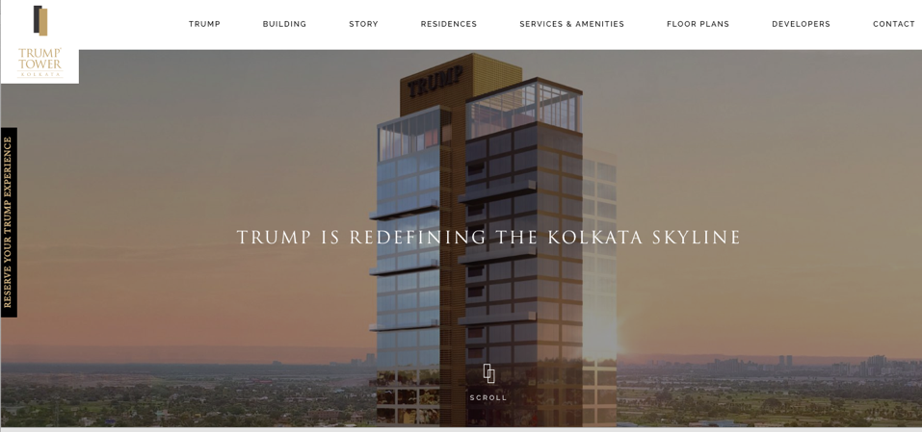
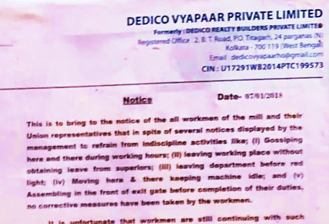
Visual and or Narratives
Diasporic capital
The reasons mentioned for this were: gossiping; leaving working place without permission; leaving department before red light; moving here and there and keeping machine idle; assembling in front of the exit gate before finishing work. From the narrative of the notice, it is clearly understood that the allegations are fabricated.

Slide 15
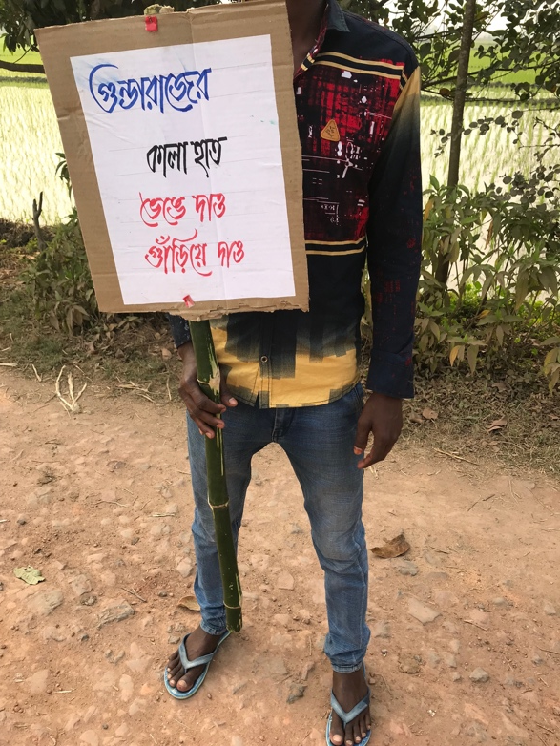
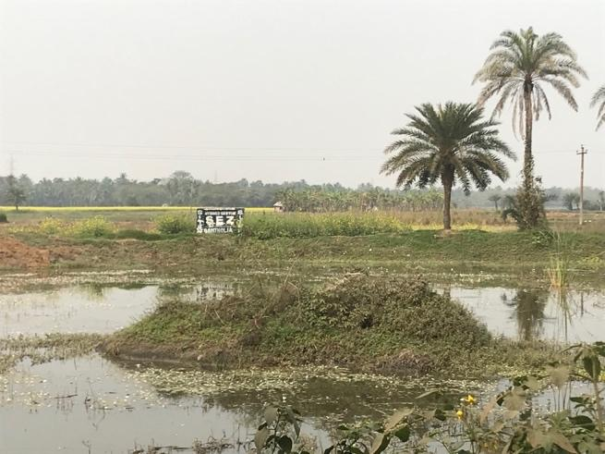
Visual and or Narratives
“We as taxpayers have a right to live in a clean & pollution free surrounding…….Bidhannagar is ours and we not only have a duty but also a right to protect it from becoming an unplanned, dirty and chaotic township”.
Adhocness of the ordinary: Assemblage of body, material and action
Land waiting for conversion

Slide 16
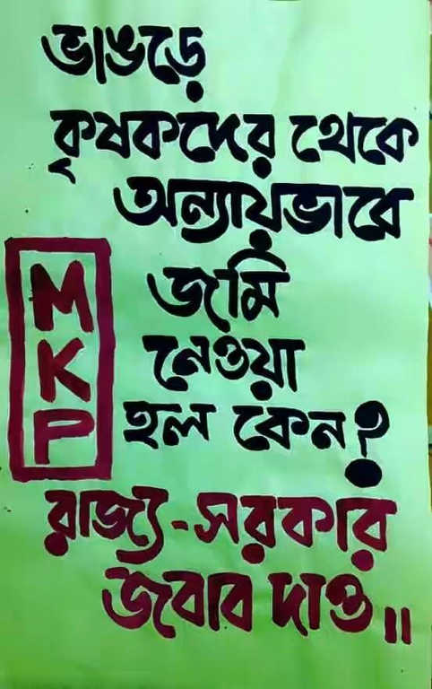
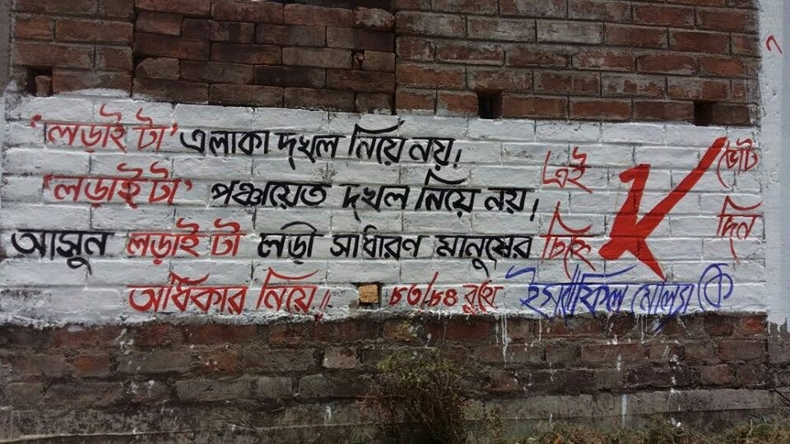
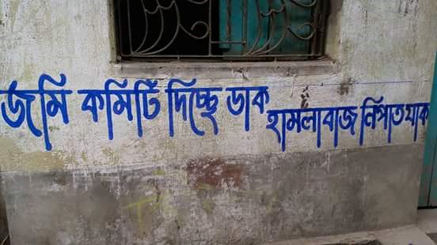
Visual and or Narratives
Mid 2016
Early 2017
Mid 2018
Anti-power grid, Anti land grabbing
Anti-local tyrant
Electoral democracy

Slide 17
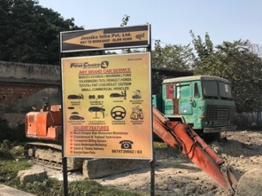
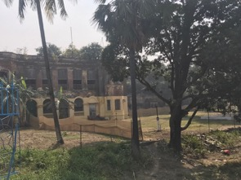
Visual and or Narratives
L1
R1
L2
R2
L1: Dilapidated R1: Inexplicit Commercial Use
L2: Explicit commercial use R2: Inexplicit Commercial Use

Slide 18
Thank you
The Bartlett Development Planning Unit
34 Tavistock Square
London WC1H 9EZ www.bartlett.ucl.ac.uk/dpu

