Slide 1




The role of primary care PriDem project - Primary care-led post diagnostic Dementia Care: developing evidence-based, person centred sustainable models for future care
Dr Sarah Griffiths
Senior Research Fellow and Study Manager
PriDem Workstream 4
Twitter: @PriDemProject
Bedfordshire NHS Memory and wellbeing service 2nd Luton and Bedfordshire Memory Services Conference: 22/06/2022

Slide 2
PriDem Core Team
Overall lead | Leading on workstream 4
Professor Dame Louise Robinson | Professor Greta Rait
Claire Bamford | Professor Kate Walters
Dr Greta Brunskill | Jane Wilcock
Dr Alison Wheatley | Dr Sarah Griffiths
 | Emily Spencer
 | Federica D’Andrea

Slide 3
Outline
Background to PriDem programme
PriDem intervention development phase
Current Workstream 4: Feasibility and implementation study
Challenges of embedding the intervention in primary care
Learning from recruitment phase
Next steps PriDem
‘Forward with Dementia’

Slide 4

Dementia care: policy shift to primary care
World Alzheimer’s Report | 2011 | Role of primary care underused
World Alzheimer’s Report | 2016 | Current model unsustainable/ inequitable
NICE Dementia guidance | 2018 | Primary care shift
World Alzheimer’s Report | 2022 | ?

Slide 5
PriDem programme: 2018-2023
Evidence based, person-centred primary care led
Acceptable and feasible
Sustainable
Post-diagnostic care: ‘holistic, integrated continuing care in the context of declining function and increasing needs of family carers’
Team: Newcastle, UCL, Manchester & Brighton Universities, LSE, Dementia UK

Slide 6

PriDem Six Workstreams
Global evidence synthesis + national mapping
National practice: qualitative studies
3. ‘Good practice’ model development
4. Testing in ‘real world’ settings
Economic evaluation
Translation into policy and practice
‘Dementia Care Community’ (PPPI)
Developing and evaluating complex interventions
Meaningfully engaging stakeholders

Slide 7
Evidence synthesis (3 reviews)
Most promising model:
PCP case management
Specialist lead situated in primary care
Dementia expertise available - users AND providers
Patient/carer self management
Care network/ good links social care +community services
Structured, formal collaborations
e.g. shared care pathway, shared care plan

Slide 8
BUT…reality of national practice
Survey and qualitative interviews/focus groups
HUGE variation in provision
Focus on information provision
Limited provision of specific ‘minority subgroup’ support
50% of services planned to change in next 5 years
Funding sources: major challenge to sustainability
Lack of integration e.g. lack of shared care pathways; data sharing
Primary care concerns: lack of capacity, skills and willingness
Overall picture: INEQUALITY, INSTABILITY, FRAGMENTATION AND FRAGILITY

Slide 9
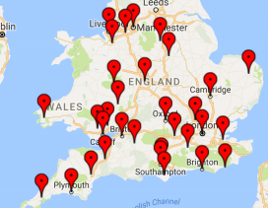
Good practice: Six case studies
Core components
Point of contact for PLWD/carer/providers
Services joined up
Support for non-specialists
Ongoing, holistic review and care planning
Implementing post-diagnostic support for people living with dementia in England: a qualitative study of barriers and strategies used to address these in practice

Slide 10



WS3: The PriDem intervention
Developing systems
Clinical dementia lead
People with dementia & their families
Resources
Delivering tailored care & support
Building capacity & capability
Stakeholders

Slide 11
Baseline mapping: local services against PriDem components of care & NICE recommendations
Review transitions & information sharing
Create a local integrated dementia care pathway
Identify named point of contact
Clinical dementia lead
Developing systems
Improved understanding of local services & how to access them
Overview for commissioners, highlighting gaps & duplication
Shared understanding of post-diagnostic support in dementia
Resources

Slide 12
Develop formal, holistic review & care planning
People with non-complex needs managed by generalists + support
Support management of people + complex needs
Clinical dementia lead
Delivering tailored care & support
Tailored assessment, information provision & management
Improved consistency & quality of reviews
Ensure timely access to appropriate interventions
Resources

Slide 13
Develop a GP practice dementia team
Improve access to specialist advice
Upskill generalist staff
Mentoring/Formal training
MDT meetings
Clinical dementia lead
Building capacity & capability
Increased awareness/understanding of dementia
Improved skills of generalist staff
Increased self-efficacy & confidence of staff
Tiered system within the practice
Resources

Slide 14


WS4: feasibility/implementation study taking place in…
Barnet: three GP practices, one PCN
Newcastle: Four GP practices, three PCNs
NB target was 16-20 GP practices overall

Slide 15
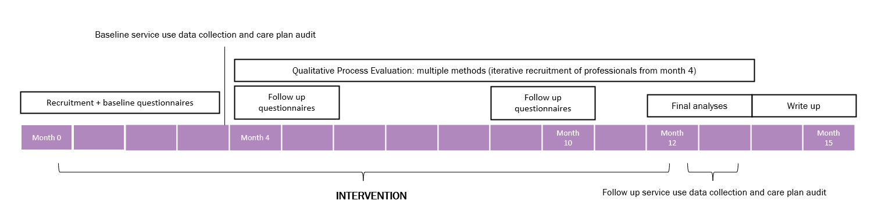
Timeline

Slide 16
What are we researching? How?
Barriers and facilitators to implementing this approach over 12 months
Early signs of impact for patients, carers and professionals (target recruitment is 80 PLWD across participating practices in the SE and NE)
Interviews
QoL outcome measures with people living with dementia and carers
Care plan audit: consistency and quality of care plans

Slide 17
Primary care challenges | Solutions
FOR STUDY SET-UP Enthusiasm about the research BUT… concerns about capacity to take part | Building relationships over time Reducing burden on practices e.g., NHS Confidentiality Advisory Group approval Highlighting benefits e.g., ‘The CDL will provide mentorship alongside informal/formal bespoke training’ OUTCOME: 5 months from initial meetings to first GP practice recruited
FOR THE INTERVENTION Embedding CDLs into practices Wanting someone to manage the caseload | Planting the seed Working with enthusiastic staff to make small changes Clinical skills as a hook Doing some of the work and sharing outcomes with GPs OUTCOME: 3-4 months in, SE and CDLs are starting to change minds and make an impact.

Slide 18
Insights from recruitment
People really want to talk
High level of unmet need
Lack of peer support
PLWD in denial – challenge of engagement/problem for carers
Cynicism that research can improve things
Loneliness

Slide 19
Intervention highlights so far
Mapping services in Newcastle and Barnet
Improving referral routes
Evaluating dementia review and care planning processes
One stop shop dementia reviews
EMIS alerts
Drop in sessions for patients, carers and staff (advice on cases)
Identifying staff training needs and tailoring training accordingly
Exploring support for those who are housebound

Slide 20
PriDem next steps
Interviews with CDLs, supervisor, PLWD, carers
Observations of the intervention in practice
Ongoing intervention supervision reflective notes
Care plan audit baseline data
Ongoing dissemination

Slide 21
Alzheimer’s Europe conference 2022, abstracts accepted:
Including people living with dementia in research and making it a positive experience
PriDem intervention: the experiences of people living with dementia and their carers
Liverpool dementia and ageing forum, abstract submitted:
‘Post-pandemic, primary care led dementia support: Preferences and values of people living with dementia and carers in the PriDem Study’

Slide 22
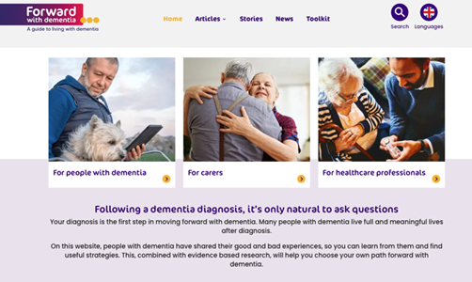

Slide 24
Website: https://www.forwardwithdementia.org/en Email: forwardwithdementia@ucl.ac.uk Twitter: @ForwardDementia Instagram: https://www.instagram.com/forwardwithdementia_gb/ Facebook: https://www.facebook.com/ForwardDementiaGB You Tube: Forward with dementia International
Notes:
Do follow us on social media or contact us if you would like to know more about how the site was developed about our evaluation or our next steps in developing social care supports for care workers

Slide 25
PriDem publications
Frost R, Walters K, Aw S, Brunskill G, Wilcock J, Robinson L, Knapp M, Harrison-Dening K, Allan L, Manthorpe J, Rait G and on behalf of the PriDem Study project team. Effectiveness of different post-diagnostic dementia care models delivered by primary care: a systematic review British Journal of General Practice 2020; 79 (695): e343-e441. DOI: https://bjgp.org/content/early/2020/05/18/bjgp20X710165
Frost R, Walters K, Wilcock J, Robinson L, Harrison-Dening K, Knapp M, Allan L, Rait G. Mapping post diagnostic dementia care in England: an e-survey. Journal of Integrated Care June 2020 ISSN: 1476-9018 https://www.emerald.com/insight/content/doi/10.1108/JICA-02-2020-0005/full/html?skipTracking=true
Frost R, Rait G, Wheatley A, Wilcock J, Robinson L, Harrison-Dening K, Allan L, Banerjee S, Manthorpe J, Walters K on behalf of the PriDem Study project team. What works in managing complex conditions in older people in primary and community care? A state-of-the-art review. Health and Social Care June 2020;28:1915-1927 DOI: 10.1111/hsc13085
Frost R, Rait G, Aw S, Brunskill G, Wilcock J, Robinson L, Knapp M, Hogan N, Harrison-Dening K, Allan L, Manthorpe J, Walters K and on behalf of the PriDem Team. Implementing post diagnostic dementia care in primary care: a mixed methods systematic review. Aging and Mental Health September 2020 (online) https://doi.org.10.1080/13607863.2020.1818182
Wheatley A, Bamford C, Brunskill G, Harrison-Dening K, Allan L, Rait G, Robinson L, The Pridem Study project team. Task-shifted approaches to post diagnostic dementia support: a qualitative study exploring professional views and experiences. BMJ Open 2020;10:e040348. Doi:10.1136/bmjopen-2020-040348
Wheatley A, Bamford C, Brunskill G, Booi L, Harrison-Dening K, Robinson L, on behalf of the PriDem study team. Implementing post-diagnostic support for people living with dementia in England and Wales: A qualitative study of barriers and strategies used to address these in practice. Age and Aging 2021; afab114, https://doi.org/10.1093/ageing/afab114
Booi L, Wheatley A, Brunskill G, Banerjee S, Manthorpe J, Robinson L, Bamford C. Outcomes valued by people living with deentia and their care partners: protocol for a qualitative systematic review and synthesis. BMJ Open 2021; 11:e050909 DOI:10.1136/bmjopen-2021-050909
Brunskill G, Wheatley A, Bamford C, Booi L, Costello J, Herbert J, Tucker S, Robinson L, on behalf of the PriDem study project team. How do we meaningfully engage stakeholders in developing a best practice approach to post-diagnostic dementia support? Accepted for publication in Journal of Dementia Care
Bamford C, Wheatley A , Brunskill G, Booi L, Allan L, Bannerjee S, Harrison Dening K, Manthorpe J, Robinson L, on behalf of the PriDem study team. Key components of post-diagnostic support for people with dementia and their carers: A qualitative study. PLOS One 2021, https://doi.org/10.1371/journal.pone.0260506
Wheatley A, Poole M, Robinson L, on behalf of the PriDem study team. Changes to post-diagnostic dementia support in England and Wales during the Covid-19 pandemic: a qualitative study. BMJ Open 2022;12:e059437. doi: 10.1136/bmjopen-2021-059437
Tuijt,, R., Rees, J., Frost, R., Wilcock, J,. Manthorpe, J., Rait, G., Walters, K. Exploring how triads of people living with dementia, carers and health care professionals function in dementia health care: A systematic qualitative review and thematic synthesis. Dementia 2020 20;3 1080-1104 https://doi.org/10.1177/1471301220915068
Tuijt R, Rait G, Frost R, Wilcock J, Manthorpe J, Walters K. Remote primary care consultations for people living with dementia during the COVID-19 pandemic: experiences of people living with dementia and their carers. British Journal of General Practice 2021 71 (709): e574-e582. DOI: https://doi.org/10.3399/BJGP.2020.1094
Tuijt R, Frost R, Wilcock J, Robinson L, Manthorpe J, Rait G, Walters K Life under lockdown and social restrictions - the experiences of people living with dementia and their carers during the COVID-19 pandemic in England BMC Geriatrics 2021, 301 https://bmcgeriatr.biomedcentral.com/articles/10.1186/s12877-021-02257-z

