Slide 1
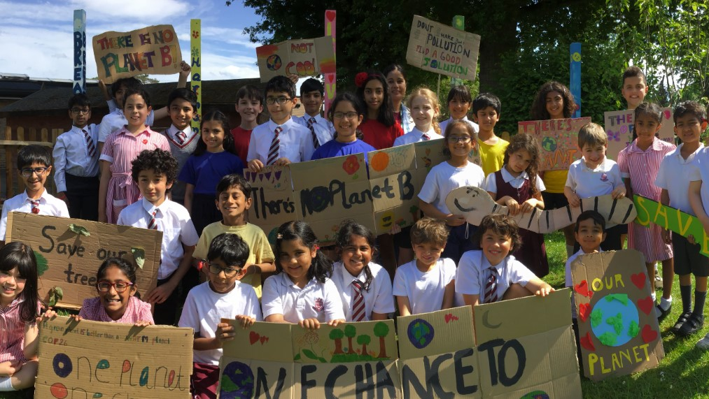
Climate Change and Sustainability Education ITE Framework: Reconceptualising preservice teachers’ subject knowledge in Climate Change and Sustainability Education.
Nasreen Majid, Jo Anna Reed Johnson, Sarah Marston, Andrew Happle
University of Reading, United Kingdom

Slide 2
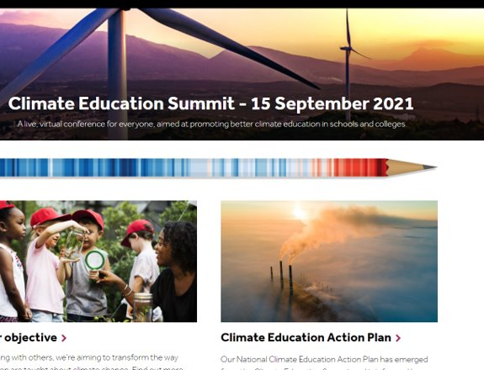
Some Context
How could we harness the attention on climate in 2021 to do something about a major issue for the UK – improving climate-education for 8-18 year olds?
There are lots of brilliant organisations trying to improve climate-education and wonderful resources – but a huge lottery for young people
Change is needed now and is needed at scale – it needs multiple organisations working together
A summit was a brilliant way to bring a team together to address the issue

Slide 3
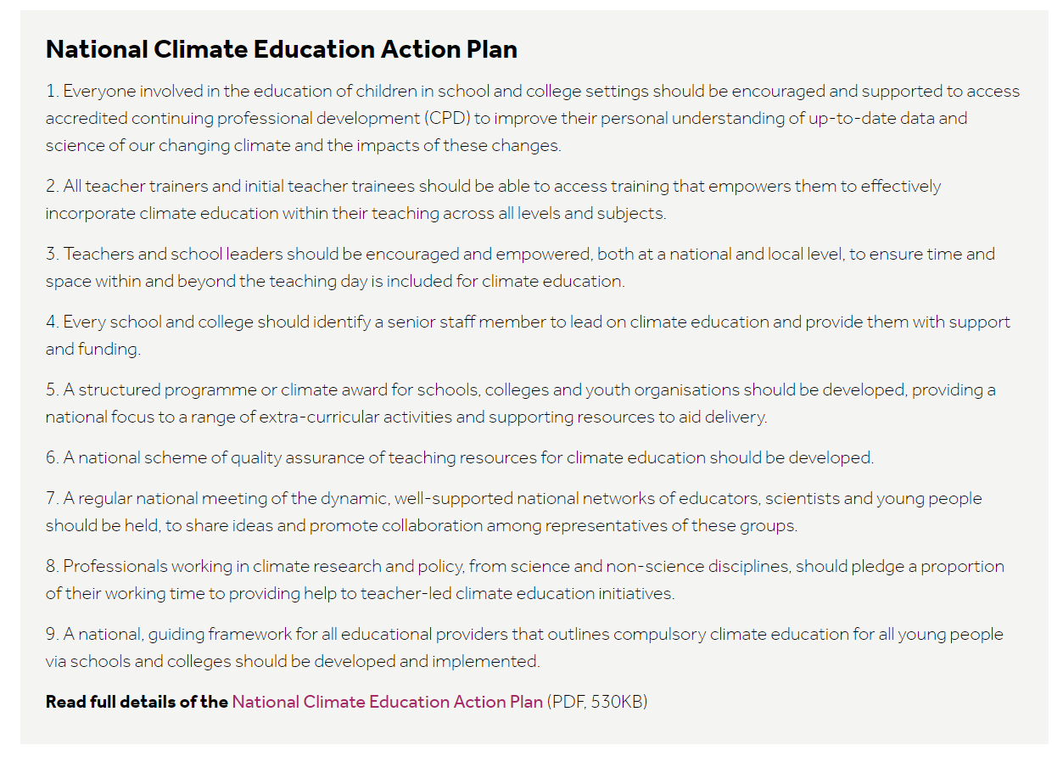
The National Climate Education Action Plan

Slide 4
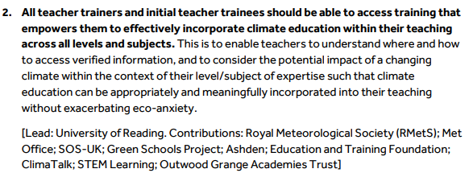
Details of Action Point 2

Slide 5
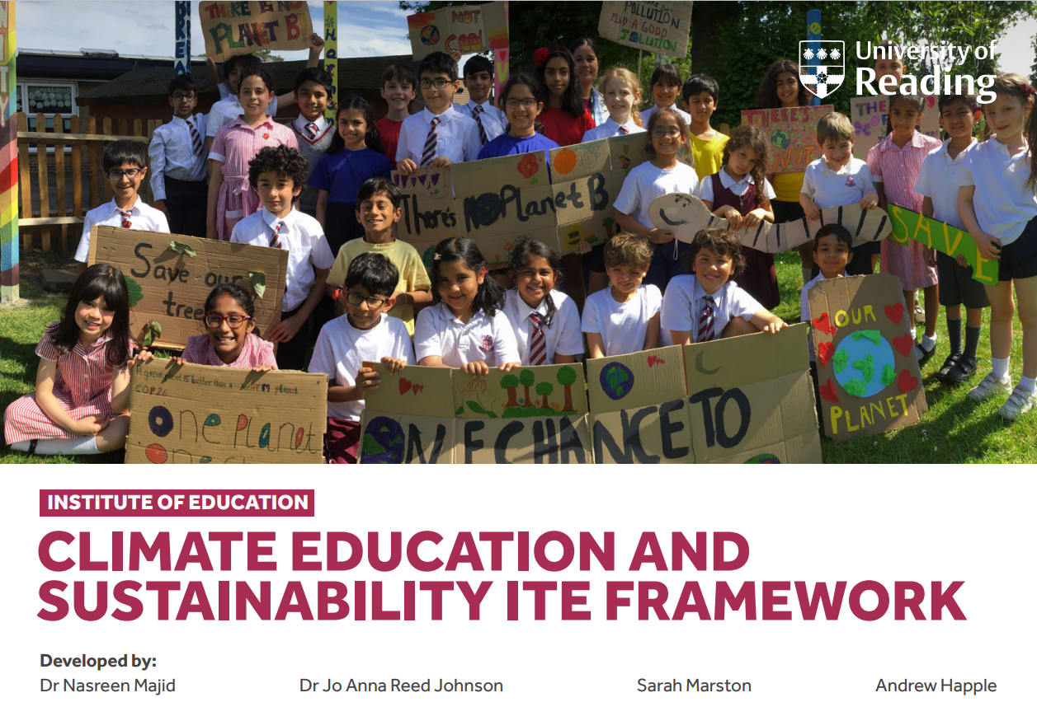

Slide 6
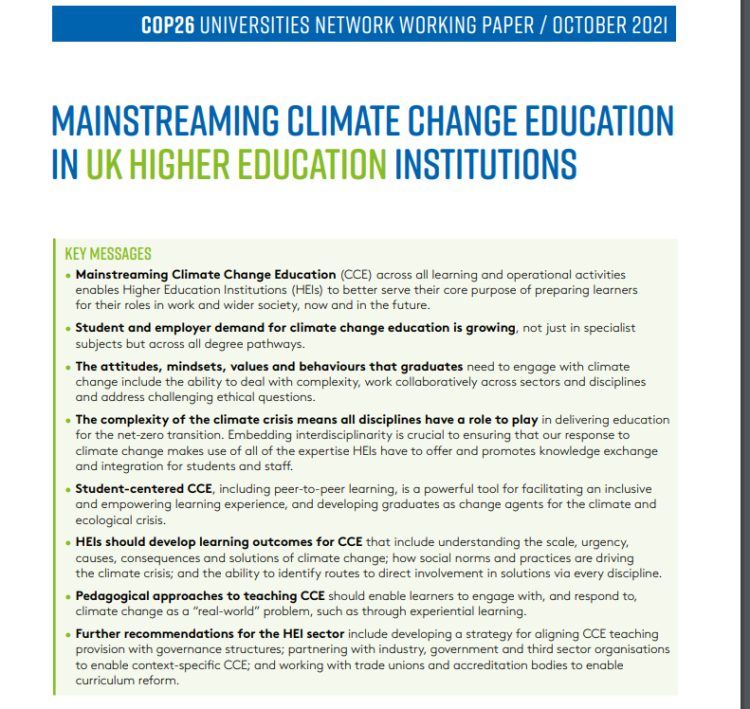
Thew, H., Graves, C., Reay, D., Smith, S., Petersen, K., Bomberg, E., . . . Worsfold, N. T. (2021). Mainstreaming climate education in Higher Education Institutions. COP26 Universities Network Working Paper. Paper presented at the COP26, Glasgow. ​

Slide 7
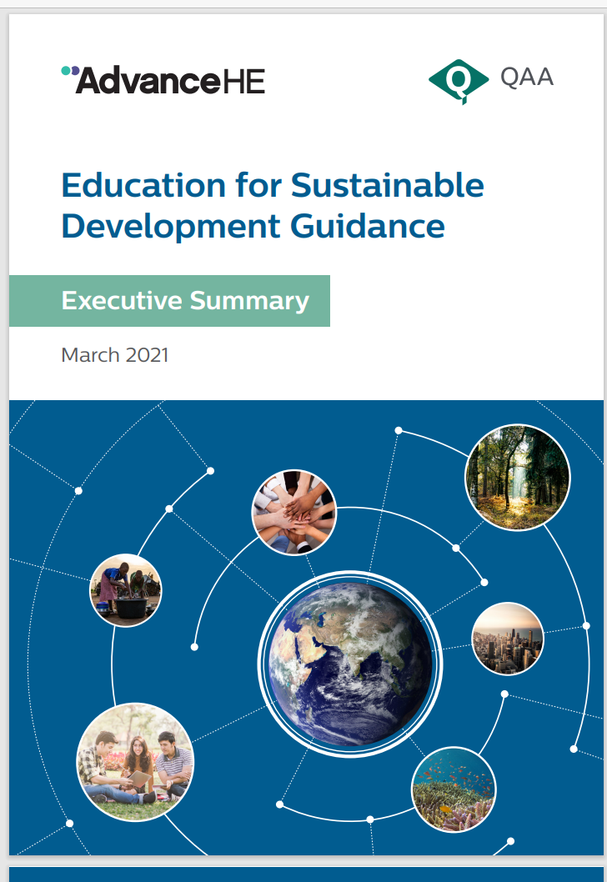

Slide 8
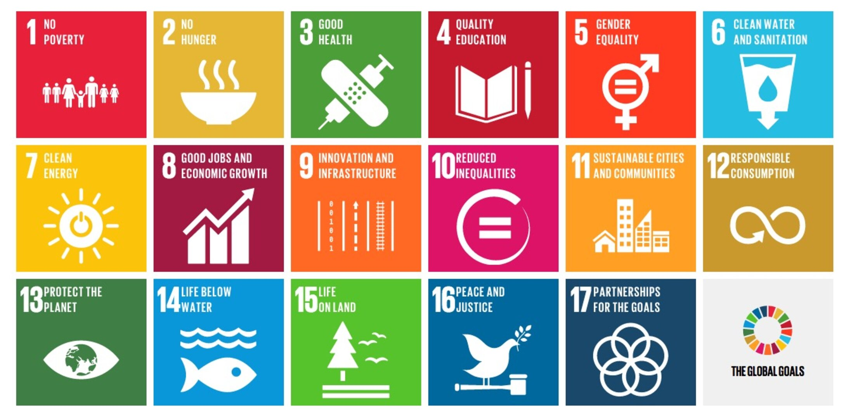

Slide 9
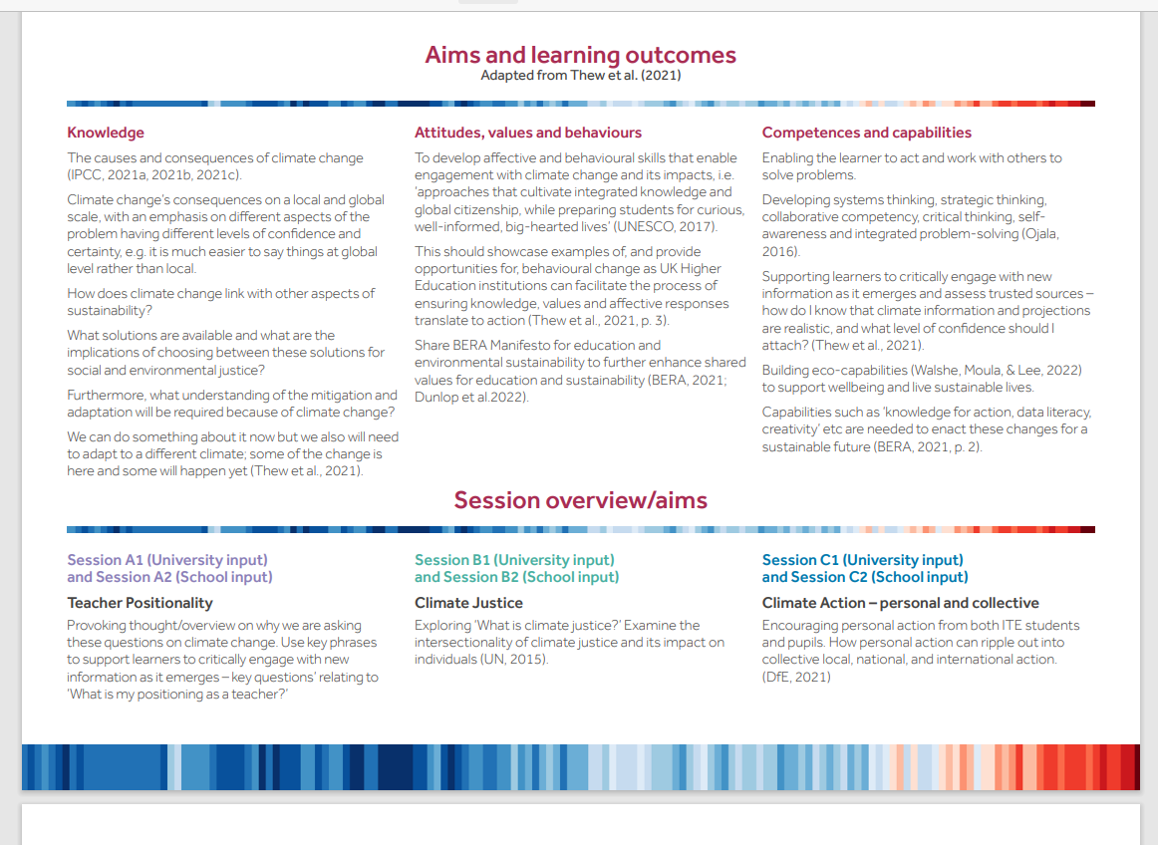

Slide 10
Delivery Structure
Trainees take away the ideas and create a session/ sequence of sessions to try out wit their pupils.
Each strand of the framework will have input at the university.
School
University

Slide 11
Implementation: Pilot (2022-23)
UoR ITE Framework
Early Years
Primary Education
Secondary Education
Three HEIs part of the pilot

Slide 12
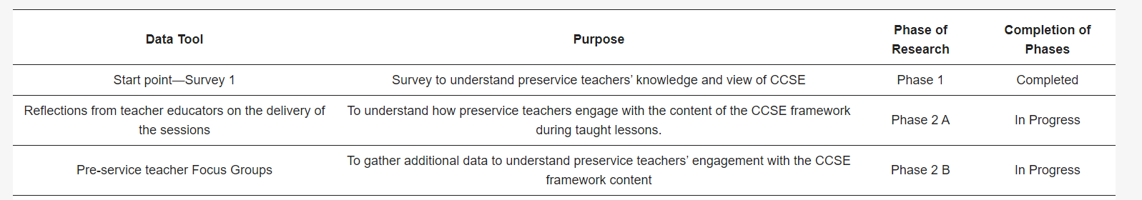
Phases of the research

Slide 13
Context
Three universities in England
Two in the South- southwest and southeast and one in the Northwest
All ITE phases took part in the survey
All public, research universities
71 preservice teachers completed the survey

Slide 14
Example of survey questions (total of 10)
What is your current understanding about climate and sustainability?
Have you developed this understanding through your formal education or through your own research?
Do you feel the teaching of climate change needs to be prioritised in schools and why?
Which subject(s) do you think is/are the best fit for climate and sustainability education and why?
If you could design a curriculum for climate and sustainability education, what would be the areas of priority in this curriculum? List up to 5?

Slide 15
Results- Preservice teacher Knowledge
84% preservice teachers had some knowledge and understanding of CCSE. This knowledge was gained through six key areas: newspapers, social media, YouTube, their university studies, school and from personal research.
However, this was at a surface level sharing concepts such as the five Rs (refuse, reduce, reuse, refill and recycle).
Did see the teaching of CCSE as a social responsibility and the need for it to be embedded across all curriculum subjects.
Indicated wanting to understand and develop further knowledge and understanding to teach CCSE effectively in their settings

Slide 16
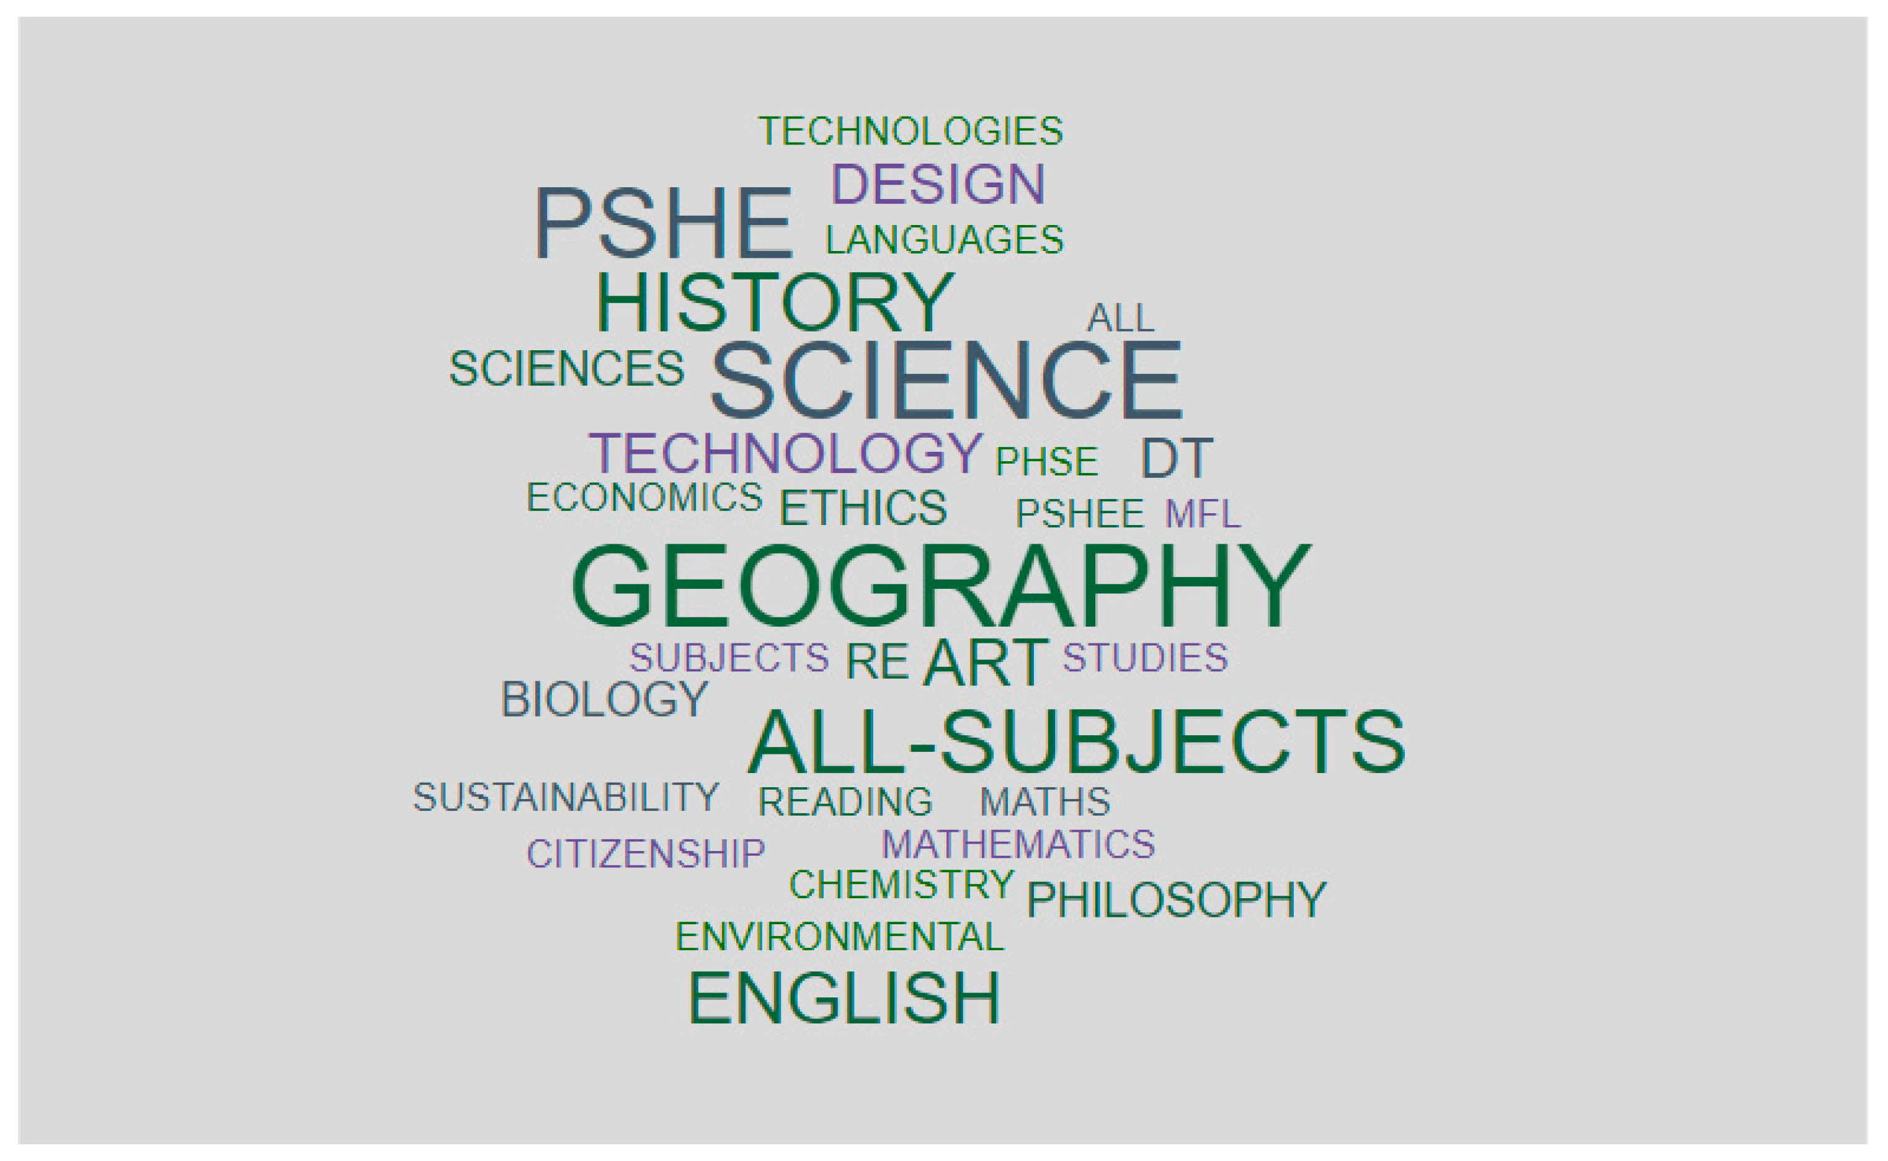
Preservice teachers' opinion of subjects CCSE could fit within.

Slide 17
Results-Preservice Teacher Attitudes, Values and Behaviours
-
95% of the participants agreed with the statement that ‘teaching of climate change needs to be prioritised in schools'.
A feeling of urgency was shared in responses with a sense of their responsibility as future educators to inform this change in schools and settings.
Preservice teachers shared the fact that the pupils they are teaching will bear the burden of the crisis; therefore, equipping them with the skills needed to tackle the crisis was a priority for them as future educators.
They valued the need to incorporate CCSE as part of their training.

Slide 18
Results-Preservice Teachers’ Competencies and Capabilities
58.2% indicated that they were either not confident or only slightly confident in teaching the subject.
Lack of subject knowledge in CCSE to teach it effectively came across clearly in the data.
Further responses indicated that although preservice teachers felt that they knew quite a lot about environmental and sustainability issues through their own research, they would not be able to turn that knowledge into structured lessons for their pupils, hence indicating the need for training to support the development of this Pedagogical Content Knowledge (PCK).

Slide 19
Implications and next steps
Preservice teachers are in favour of being taught CCSE as a discreet area of study within their ITE programmes.
The knowledge and understanding of teaching climate justice came across as weak- hence the need to develop its teaching through each subject.
Subject specific development of CCSE ideas came across as weak, hence the need of showcasing professional learning opportunities to highlight and showcase how CCSE could be developed within each subject area. UCLs 'Teaching for Sustainable Futures' good example of developing these skills with preservice teachers.
Timing- preservice teachers indicated incorporating CCSE training in the latter part of an ITE course or as an Early Career Teacher would be most effective, so that the individual is aware of what is already being done in school settings.

Slide 20
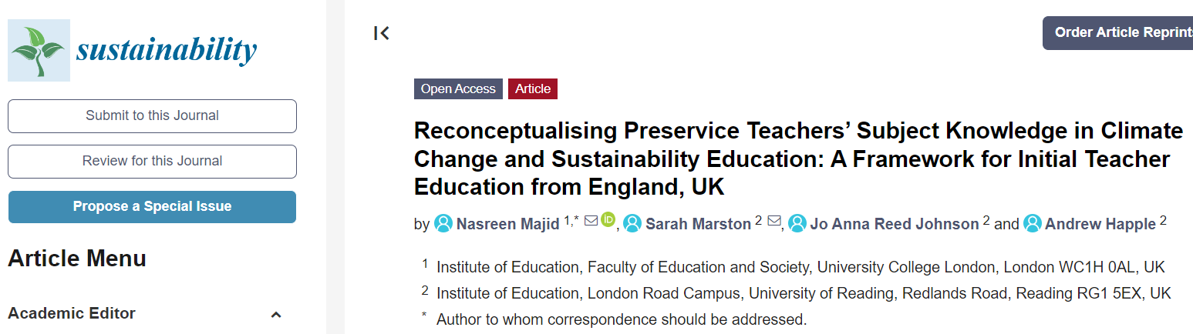
Published paper August 23 in Sustainability

Slide 21
Framework
The framework can be downloaded from the University of Reading central publications repository. Link in the research paper.

