Slide 1



The profile of language impairments in children with cerebral palsy: a scoping review
Dr Michelle McInerney
Lecturer in Speech & Language Therapy
University College London (UCL)
Dr Amanda Brignell, Senior Lecturer, ACU, Melbourne
Dr Wendy Pearce, Honorary Fellow of Australian Catholic University
Dr Lucy Pepper, Lecturer in SLT, UCL
Dr Gill West, Lecturer in Language & Cognition, UCL
Ms. Anne Barrett, Clinical Specialist SLT, Cork University Hospital, Cork

Slide 2
Acknowledgement of Country
The Australasian Academy of Cerebral Palsy and Developmental Medicine acknowledges and pays respect to the Traditional Custodians and Elders, past and present, of the Gimuy Walubara, Yidinji and Yirrganydji land and peoples.
We also acknowledge Elders past and present of the different lands where virtual conference attendees are joining from today, and celebrate the continuation of cultural, spiritual and educational practices of Aboriginal and Torres Strait Islander peoples.
Gimuy Walubara (pronounced ghee-moy-wah-lu-burra) Yidinji (pronounced Yidinjee) and Yirrganydji (pronounced Irikandji)

Slide 3
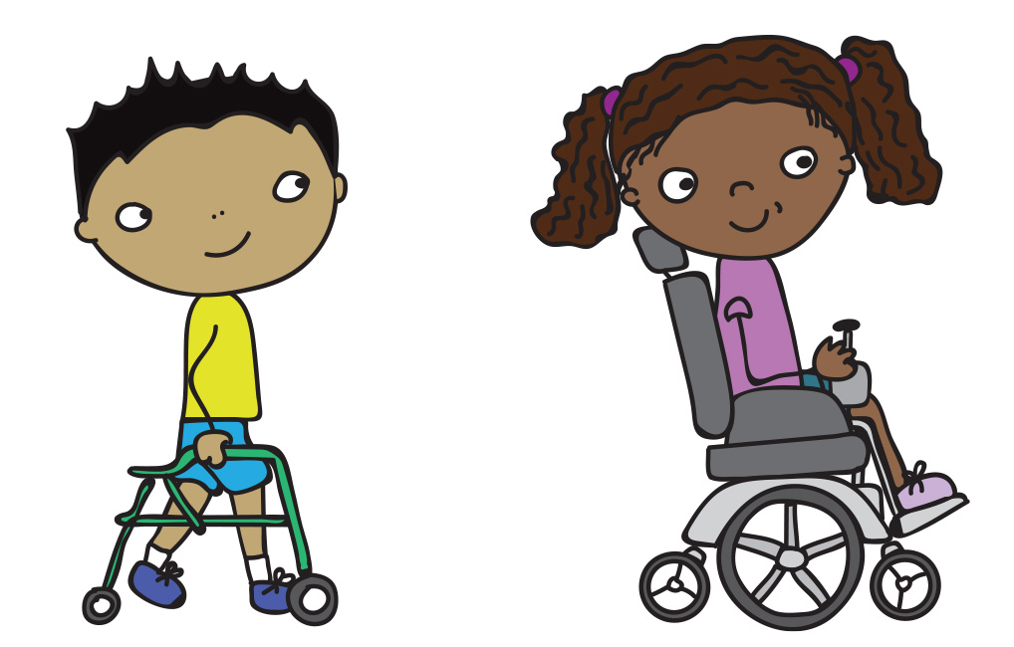
Background and rationale
Language= primary means through which we communicate meaning AND facilitates daily activities and social participation
36-74% of children with CP aged 4-6 yrs experience language impairments (LI) (44% -co-occurring receptive and expressive LI)
+Cognitive and gross motor function impairment = increase LI
Repercussions of LI have far-reaching and serious consequences:
Hinders academic progress
Restricts social participation
Can contribute to mental health challenges
Research describing LI in children with CP is limited= direct implications for accurate diagnosis; and timely assessment and treatment of language and communication skills.
Mei et al., 2016, ACPR, 2018, Parkes et al., 2010, Hancock et al., 2023
Notes:
Image for slide: child with cerebral palsy - Search Images (bing.com)
Language is
Currently no best practice guidelines

Slide 4
Aim and research questions
To identify and describe the nature of LI in children with CP
Primary Research Questions
Secondary Research Questions
What is the nature of LI, inclusive of form (morphosyntax), content (semantics) and use (pragmatics), and varied modalities (e.g., spoken, written literacy and AAC), in children with CP from 0-18 years?
Are specific types of LI associated with different sub-classifications of CP e.g., spastic vs dyskinetic, hemiplegic vs. Quadriplegic, GMFCS level etc.?
Are LI in children with CP described
at a body functions and structure (BFS)- level, activity, or participation level of health?
What assessment tools or methods have been used to measure language in children with CP?

Slide 5
Methods
Registered with OSF
Search strategy
Eligibility
Study selection
Data extraction and synthesis
JBI
PRISMA- ScR
ICF CY
Pilot DE form
Variables: Description of participants, nature of LI
3 reviewers
Studies in all languages
from 1980s to 2023
Seven E-databases
Grey literature
TI + AB screening: 2 reviewers
Exported to Endnote
Imported to Covidence
Children (0-18 yrs)
CP diagnosis
Identified LI
Peters et al, 2020, Tricco et al, 2018, World Health Organization, 2007

Slide 6

Results
Studies
11,113 227 64 (n=2283)
Pcpts
LI in each study; 0-18 yrs; Most frequent age range: 4-6 yr olds
LI
Modalities: Oral language, n=40; AAC, n=15; Written language, n=12
Mix of research designs (quantitative, n =60)
Sample sizes small <55
Functioning details relevant to language not always reported e.g. Intellectual, speaking
Domains: Receptive language (n=41), expressive language (n=32)
ICF CY: LI mostly described at BFS-level (b16700 & b16710)
EL- CELF, EOWPVT, BST
RL- PPVT, TROG, TACL, RDLS
Tools/ Measures:
CP description varied
No association with sub-type/ classification
Largest focus on semantics pragmatics syntax
Cohort, n =17
Single subject research design, n=12
USA (n=21)
Sweden (n=11)
Australia (n=5)
PLS-4
Notes:
From an initial yield of 11,113 studies- 227 full text were assessed for eligibility and 64 were included
Mix of research designs but most were quantitative in nature- journal articles
Total number of study participants speaking or non-speaking:
Non-speaking = 195
Speaking = 464
Unclear = 653
Not reported = 394
Ref for image: globe - Search Images (bing.com)

Slide 7
Points for reflection….
++variability in reporting of participant information- CP, IQ, speaking vs. non-speaking etc.
LI= +heterogeneity in profiles
Consider using assessment methods/ outcome measures that target activity and participation
Conclusion = a range of language-domain impairments across childhood and cannot yet say if sub-classification of CP is +/ - associated with different impairments
Notes:
In Pt re. variability in CP description – use example that gross motor impairment was described in different way e.g., GMFCS, Gross motor scale, mild moderate/ severe CP
Chapter 1-INTRODUCTION TO RESEARCH | PPT (slideshare.net)
Reporting - Free of Charge Creative Commons Handwriting image (thebluediamondgallery.com)
Free Images : communication, chat, chatting, app, social, network, internet, people, information, speech, technology, bubble, talk, message, discussion, meeting, text, online, speak, feedback, student, college, messenger, Animated cartoon, illustration, clip art, animation, graphics, gesture, fictional character 3100x1999 - Mohamed Hassan - 1587939 - Free stock photos – PxHere
Can an iPad app Evaluate a Child's Speech and Language - Pros and Cons of App Based Assessment (speechbuddy.com)

Slide 8
Key take home messages…….
Clinical
Respect that each child with CP is on their own unique language journey – Respond early children’s language development needs to be screened , assessed and monitored early using robust methods beyond an impairment level
Speech pathology assessment: Comprehensive data needs to be collected and reported on CP diagnosis and its comorbidities
Community
Parents of children with CP can advocate for language assessment early
Researchers need to consider minimum standards in reporting when completing language-based studies
Notes:
All 64 studies highlighted some degree of LI across childhood in children with CP
Researcher pt – minimum standards and how these are defined/ described e.g. criteria for speaking/ non-speaking

Slide 9
References
Bishop, D. V. M. (Dorothy V. M. ). (2003). The test for reception of grammar : TROG-2 / [by D.V.M. Bishop]. (Version 2). Pearson Assessment.
Carrow-Woolfolk, E. (1985). TACL-R test for auditory comprehension of language / Elizabeth Carrow-Woolfolk. (Rev. ed.). Pro-Ed.
Dunn, L. M., & Dunn, D. M. (2007). Peabody Picture Vocabulary Test--Fourth Edition (PPVT-4) [Database record]. APA PsycTests. https://doi.org/10.1037/t15144-000
Edwards, S., & Reynell, J. (1997). Reynell developmental language scales III / Susan Edwards ... [et al.]. (3rd ed.). NFER-NELSON.
Hancock, A., Northcott, S., Hobson, H., & Clarke, M. (2023). 319 Speech, language and communication needs and mental 320 health: the experiences of speech and language thera321 pists and mental health professionals. International Journal 322 of Language & Communication Disorders, 58(1), 52-66. 323 https://doi.org/10.1111/1460-6984.12767
Martin, N. & Brownell, R. (2023). (EOWPVT-4) Expressive One-Word Picture Vocabulary Test, Fourth Edition. WPS.
Mei, C., Reilly, S., Reddihough, D., Mensah, F., Pennington, L., & Morgan, A. (2016). Language outcomes of children with cerebral palsy aged 5 years and 6 years: a population‐based study. Developmental Medicine and Child Neurology, 58(6), 605–611. https://doi.org/10.1111/dmcn.12957
Renfrew, C. (2010). Bus Story Test- Revised Edition. . 1st Edition. Routledge.
Semel, E. M., Wiig, E. H., & Secord, W. (2006). CELF 4 UK : Clinical evaluation of language fundamentals / Eleanor Semel, Elisabeth H. Wiig, Wayne A. Secord. (4th UK ed.). Harcourt assessment.
Parkes, J., Hill, N., Platt, M.J., & Donnelly, C. (2010). 350 Oromotor dysfunction and communication impairments in 351 children with cerebral palsy: a register study. Develop352 mental Medicine & Child Neurology, 52(12), 1113-1119. 353 https://doi.org/10.1111/j.1469-8749.2010.03765.x 354 Paul, R., Norbury, C., & Gosse, C. (2017). Language D Tricco, A.C., et al. (2018). ‘PRISMA Extension for Scoping Reviews (PRISMA-ScR): Checklist and Explanation’. Annals of internal medicine, 169(7), 467–473. https://doi.org/10.7326/M18-0850 .
Peters, M.D.J., Marnie, C., Tricco, A.C., et al. (2020). 356 Updated methodological guidance for the conduct of 357 scoping reviews. JBI Evidence Synthesis, 18, 2119-2126. 358 https://doi.org/10.1111/jbies-20-00167
Tricco, A.C., Lillie, E., Zarin, W., O’Brien, K.K., Colquhoun, 369 H., Levac, D., Moher, D., Peters, M.D.J., Horsley, T., Weeks, 370 L., Hempel, S., Akl, E.A., Chang, C., McGowan, J., Stew- 371 art, L., Hartling, L., Aldcroft, A., Wilson, M.G., Garritty, 372 C., Lewin, S., Godfrey, C.M., Macdonald, M.T., Langlois, 373 E.V., Soares-Weiser, K., Moriarty, J., Clifford, T., Tunc¸alp, 374 O., & Straus, S.E. (2018). ‘PRISMA Extension for Scop- ¨ 375 ing Reviews (PRISMA-ScR): Checklist and Explanation’. 376 Annals of Internal Medicine, 169(7), 467-473. Available: 377 https://doi.org/10.7326/M18-0850 378 Mary Watson, R., & Pennington, L. (2015). Asses
World Health Organization; World Health Organization. (2008). International Classification of Functioning, Disability and Health: ICF. Geneva: World Health Organization
Zimmerman, I. L., Steiner, V. G., & Pond, R. E. (2008). Preschool language scale : fourth edition, UK / Irla Lee Zimmerman, Violette G. Steiner, & Roberta Evatt Pond. (4th ed.). Pearson PsychCorp.

Slide 10

Michelle McInerney: m.mcinerney@ucl.ac.uk

