Slide 1


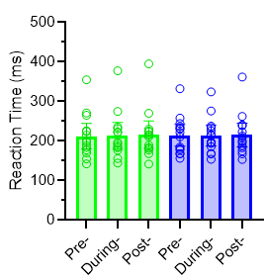
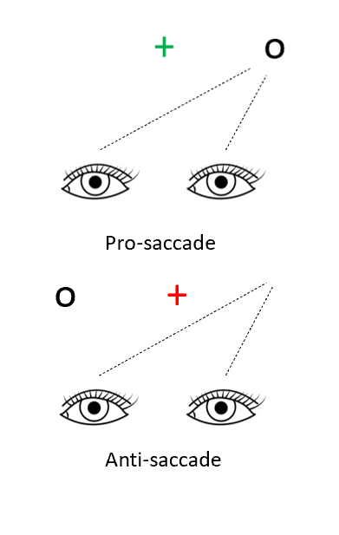
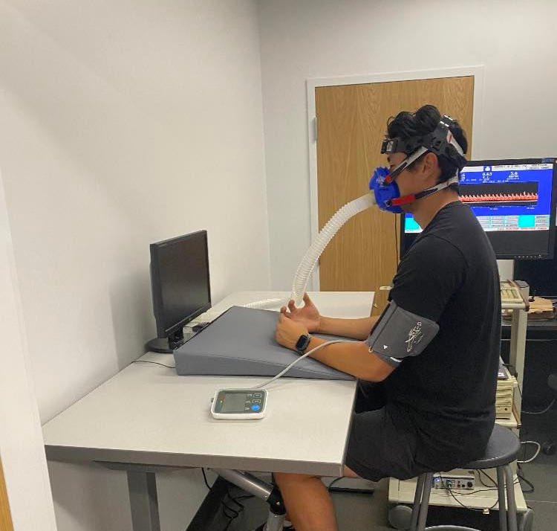
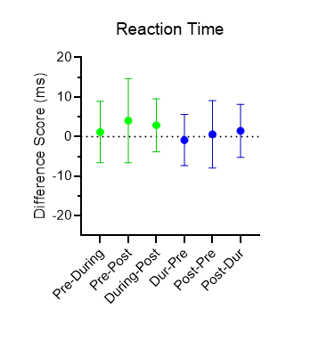
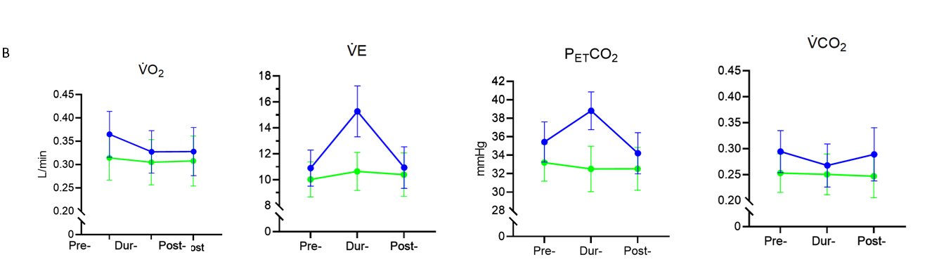
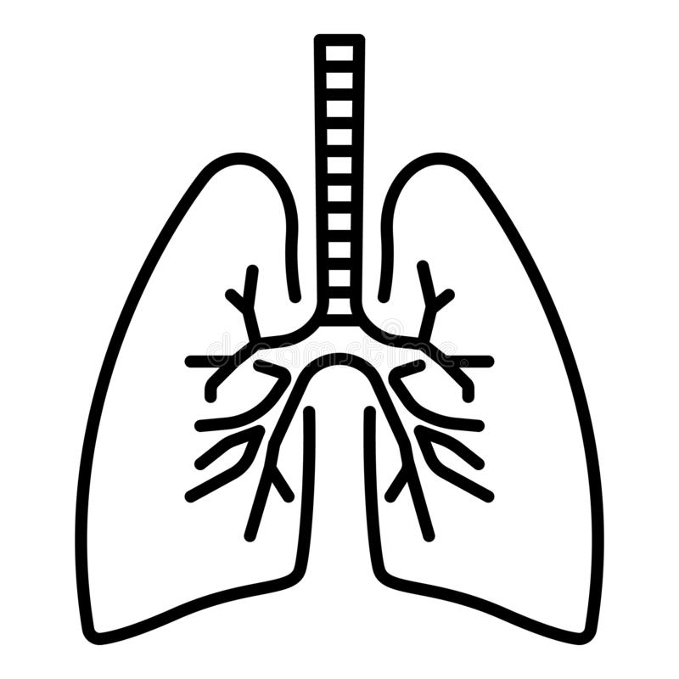

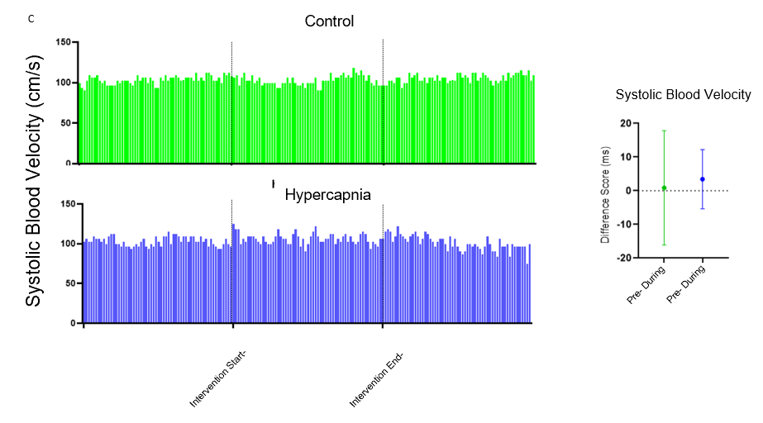

A 2.5% Hypercapnic Environment Affects Ventilation but not Blood Velocity or Executive function
Mustafa Shirzad¹, James Van Riesen² ,Benjamin Tari¹, Nikan Behboodpour¹, & Matthew Heath^{1,2,3}
¹School of Kinesiology, ² Graduate Program in Neuroscience, ³Canadian Centre for Activity and Aging Western University, London, ON, Canada
Abstract
The nominal operational limit set by NASA for CO₂ concentration on a spacecraft/habitat is markedly greater than normocapnic air (i.e., 0.04%) and when combined with a reduced O₂ environment has been shown to elicit a range of adverse symptoms (e.g., headaches) and the subjective sense of task-based performance decrements. Our group previously demonstrated that acute exposure to 5% CO₂ (i.e., hypercapnic environment) increased cerebral blood flow and resulted in a surprising post-hypercapnic executive function (EF) benefit. Notably, our previous work did not examine EF during the hypercapnic exposure. The present work examined metabolic, cortical hemodynamic and EF responses (via the antisaccade task) prior to, during and immediately following a 10-min hypercapnic exposure at 2.5% CO₂ and during a same-duration normocapnic control condition. Results indicated that the hypercapnia condition produced a baseline to steady-state increase in ventilation (V̇E) and end-tidal CO2 (PET CO₂) but did not alter blood velocity through the middle cerebral artery. Most notably, our measure of EF taken during and after the hypercapnic exposure did not vary from baseline (ps>0.76) and did not vary from performance during the normocapnic control condition (ps>0.59). Hence, although a 10-min exposure to hypercapnic produced a salient cardiorespiratory response it did not affect our measure of cortical hemodynamics, nor did it impede the efficiency and effectiveness of an oculomotor-based measure of EF.
Results
A
Antisaccade Reaction Time
D
E
Hypercapnia
Control
- 10 min -
- 10 min -
- 10 min -
A) Antisaccade reaction time (RT) control (green) and hypercapnic (blue) conditions.
B) O2 consumption (V̇O2), CO2 output (V̇CO2) and ventilation (V̇E) and end-tidal CO2 (PET CO2) for control (green) and hypercapnic conditions.
C) Systolic blood velocity (BV) from the middle cerebral artery sampled pre-, during and following hypercapnia (blue) and the control (green) conditions
D) Instructions on completing a pro- and antisaccade task.
E) Example of set up used during hypercapnic and control conditions.

