Slide 1



Teacher Resilience and Wellbeing: the challenges for Teacher Education
Association for Partnership in Teacher Education
Dr d’Reen Struthers
National Chair APTE

Slide 2
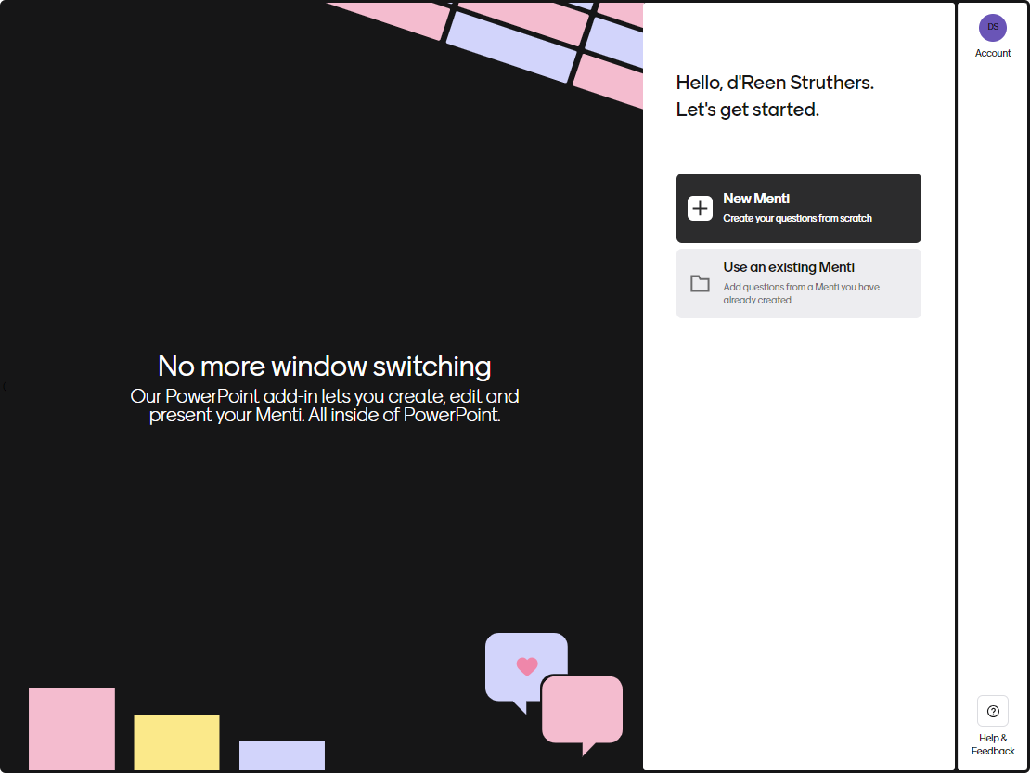
What is our motivation for the focus on Resilience and wellbeing?

Slide 3
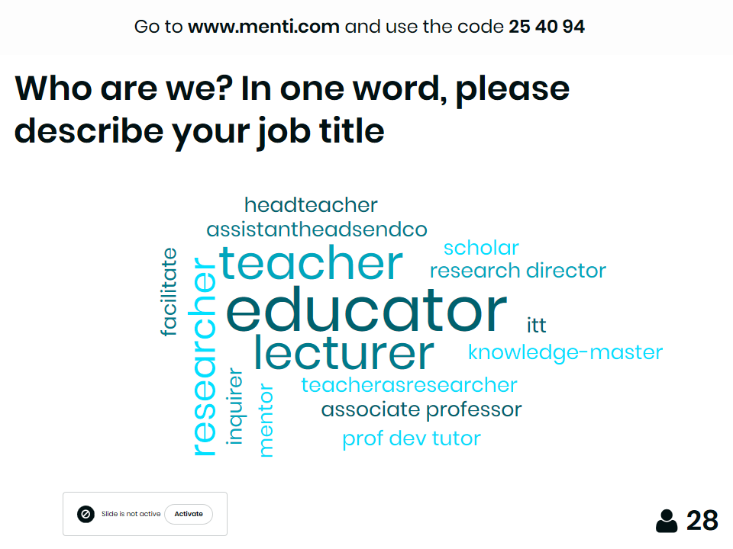

Slide 4
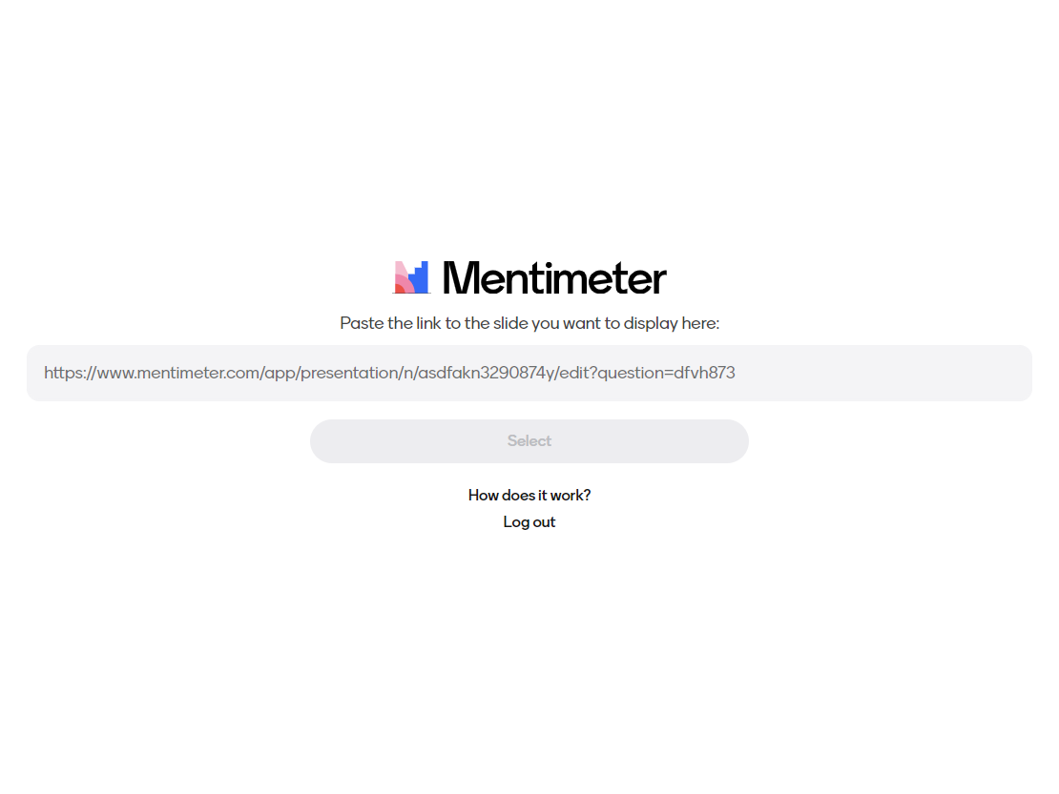

Slide 5


What is our motivation for the focus on Resilience and wellbeing?
How are we defining resilience?
What do our programmes consist of?
How effective are they?
Short term- long term?

Slide 6
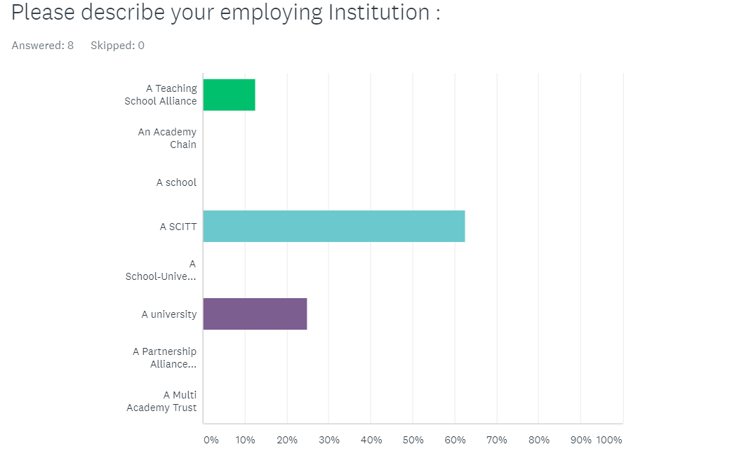

Slide 7
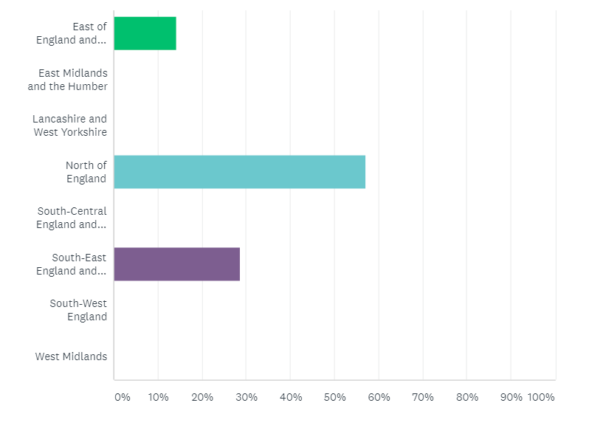

Slide 8
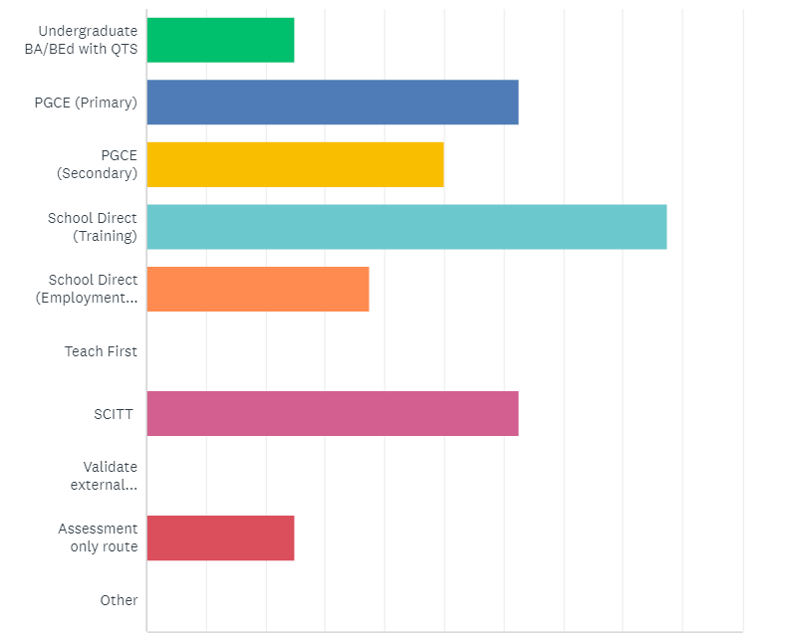

Slide 9
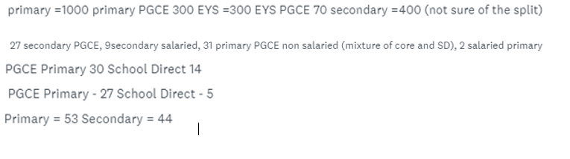

Slide 10
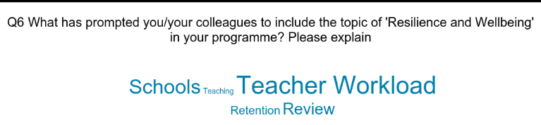
The reasons behind our sessions are two-fold; one relates to concerns about student resilience and well being during a very demanding and busy training year. Also, there has been a body of work carried out within our LA around pupil resilience and well being that we have been able to incorporate within our taught programme. A resource pack in relation to SEMH is being used in schools.
The increase in stress that trainees now witness in schools during their placements. The need to prepare trainees to be able to maintain their optimism, resilience and sense of vocation in a school system where accountability and over-regulation often militate against the reasons they choose teaching as a career. The limited progress made at national level on retaining good teachers. The lack of drive evident in many schools to implement the recommendations made by the teacher workload review groups illustrate the cleft stick schools currently find themselves in. The funding and inspection regimes dictate the agenda for most head teachers and make workload reduction a much lower priority.

Slide 11
What is going on in schools makes it very difficult for beginning teachers.
…. Can we bring individual and institutional well-being into better balance?

Slide 12
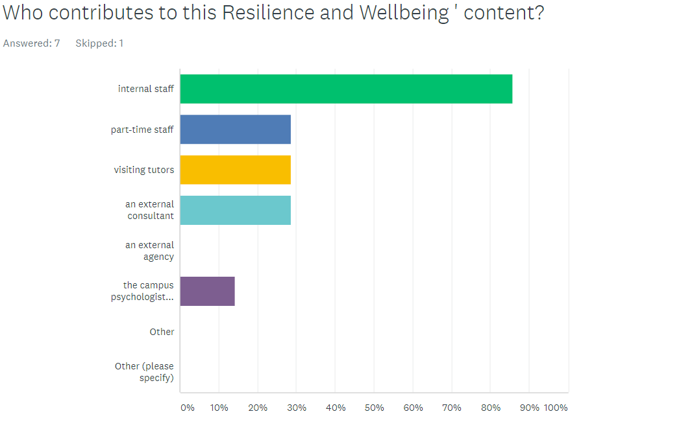

Slide 13
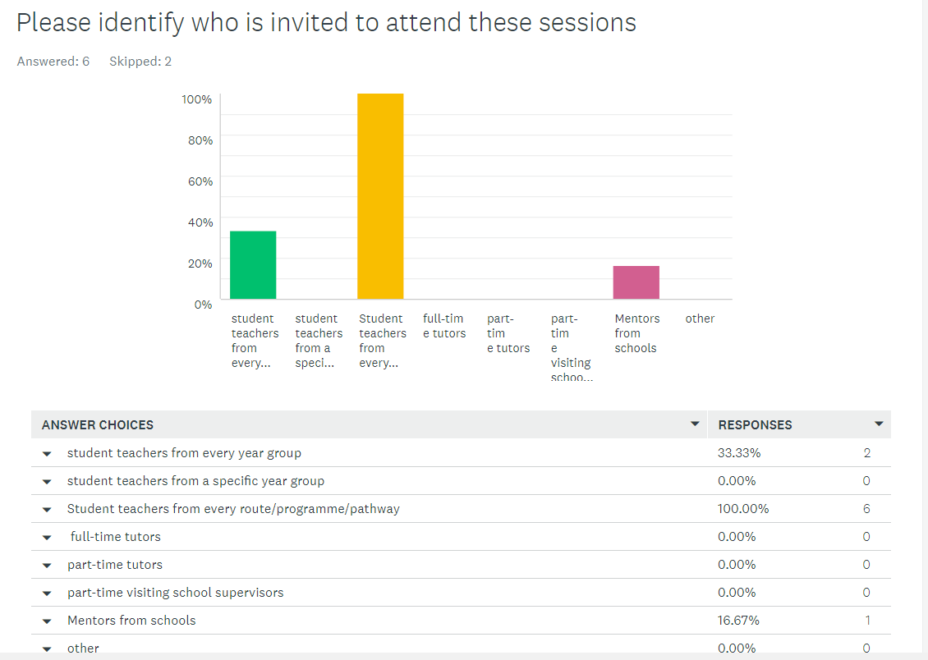
Student teachers from every route/programme/pathway
2
6
1
student teachers from every year group

Slide 14
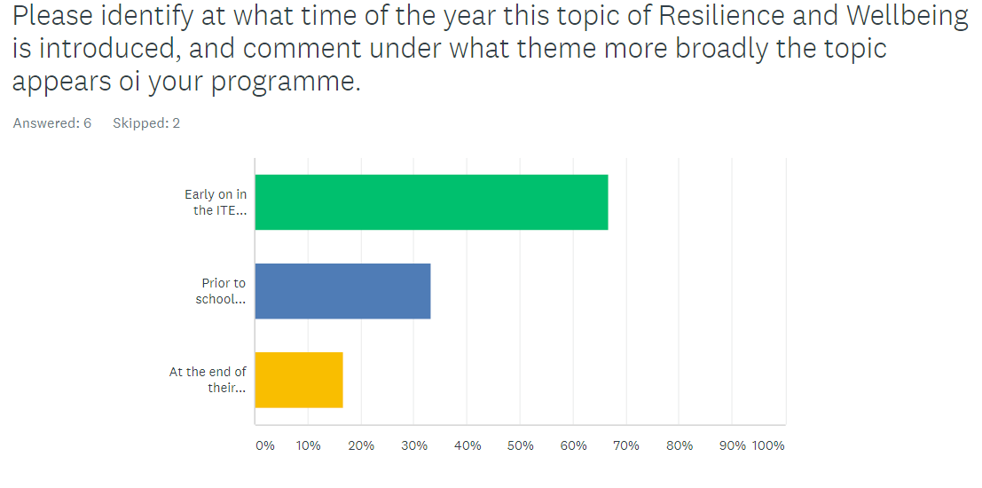
in
we studying it in our professional development sessions.
Workload management and "surviving and thriving"

Slide 15
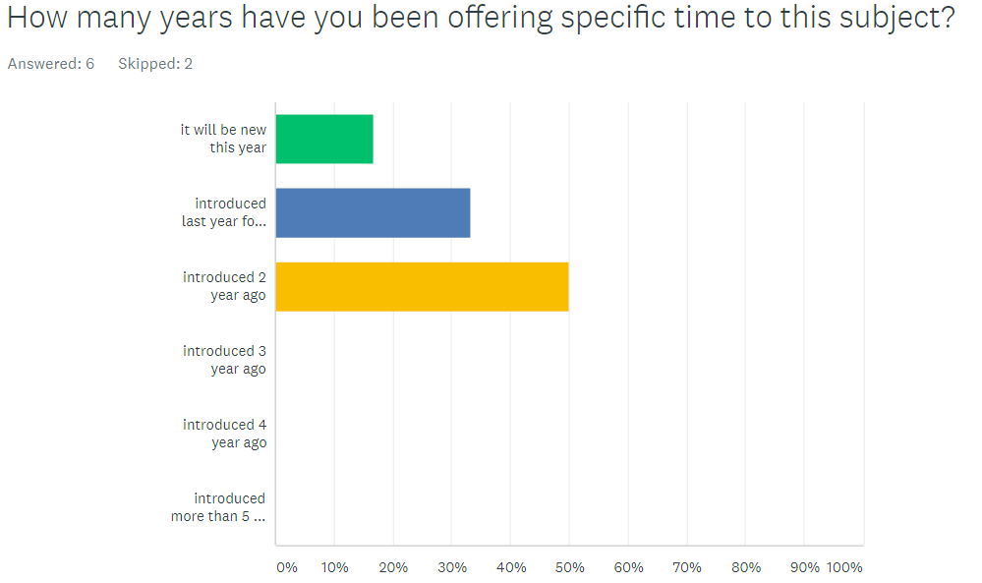

Slide 16
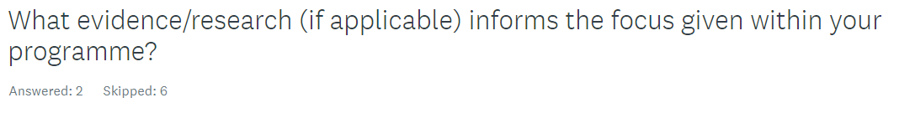
Programme evaluations and partnership feedback.
NEF Five ways to Wellbeing DfE Policy paper update on Reducing Teacher Workload (2017)

Slide 17
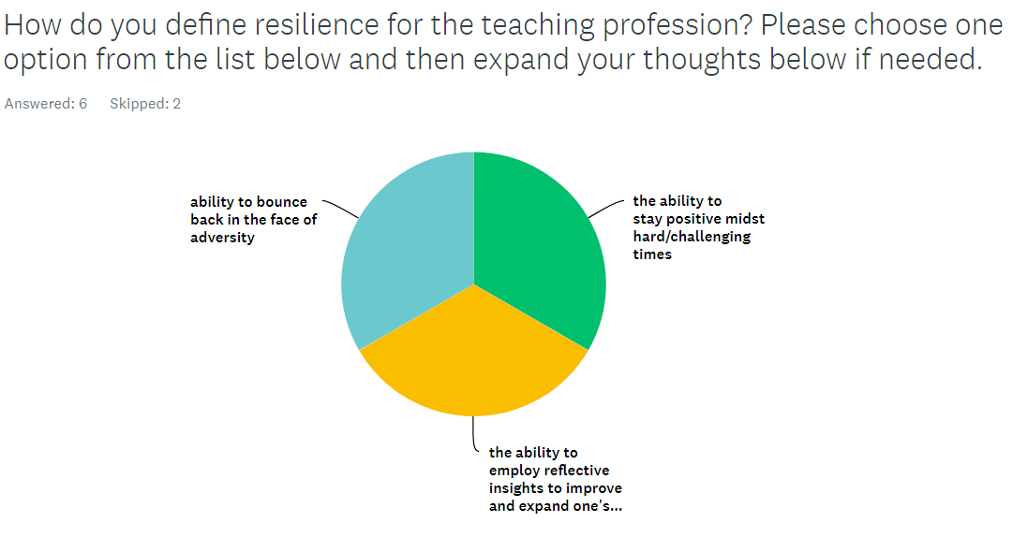
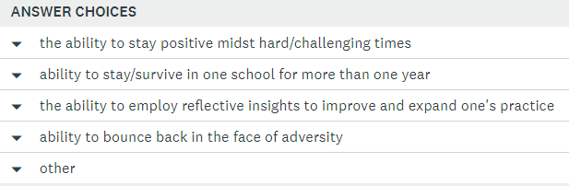


Slide 18
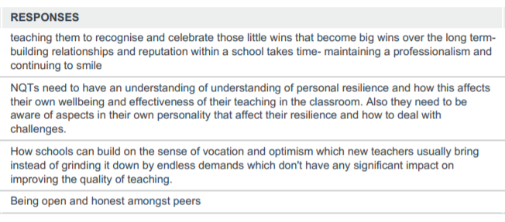
Psychological - Metacognition
Social construction – improving agency
Assertiveness – agentic voices

Slide 19


Need to explore more fully….
With your help:
More interviews
Document analysis of course content
Collecting data from students.
Longitudinal survey -Alumni
To collaborate in the research team
To share in the publications arising
To ensure research informed practice

Slide 20
Please complete our APTE survey
(If you want to become more involved (from telephone interview to research partner) please indicate at the end of survey, your details)
https://www.surveymonkey.co.uk/r/Resilience_wellbeing_APTE

Slide 21
With the tension between what is healthy and sustainable for individual teachers increasingly set against the needs of the institutions they work in, teacher educators must also grapple with resilience’s counter-concept: resistance.
The question for my colleagues and me is whether we teacher educators should be seeking to prepare teachers for the way schools are (adapting to institutions) or focus on preparing new professionals for the ways schools could and should be (transforming institutions)?
Struthers, d. (2018). Professional Resilience and wellbeing (forthcoming). In Dutaut, J-L and Rycroft-Smith, L (Eds.), Flip the System UK: A Teachers’ Manifesto. London: Routledge.

Slide 22
But if over-emphasised by teacher educators…
Rooted in adolescent psychology as the capacity for young people to adapt and success in trying life circumstances, it now excessively frames teacher professionalism as the ability to remain in one’ job.
It accepts adversity as the ‘new normal’ of teaching
It frequently masquerades as a set of coping mechanisms to promote teacher well-being, when it primarily benefits educational institutions at the expense of the individual teacher ... leading to unsustainable professional circumstances.

Slide 23
Are we seeking to prepare teachers for the way school are (adapting to institutions) or is the focus on preparing new professionals for the ways schools could and should be (transforming institutions)?
…. Can we bring individual and institutional well-being into better balance?
innovating sustained and reciprocal university–school partnerships

Slide 24
