Slide 1
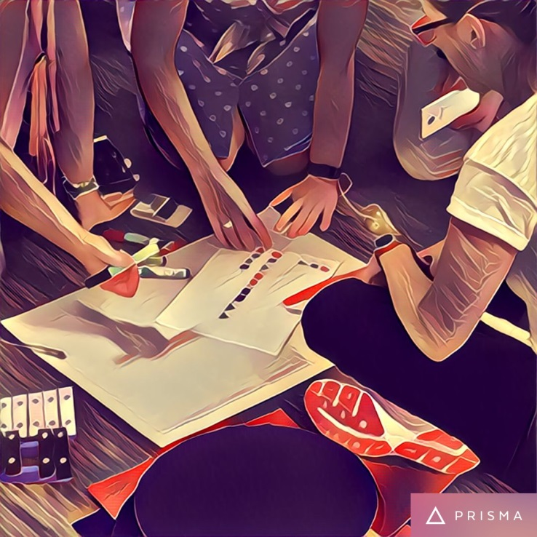
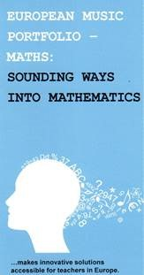
Sounding Ways into Mathematics: Working in the English Primary School Context
Professor Graham Welch
on behalf of the research team,
Caroline Hilton and Dr Jo Saunders
UCL Institute of Education

Slide 2
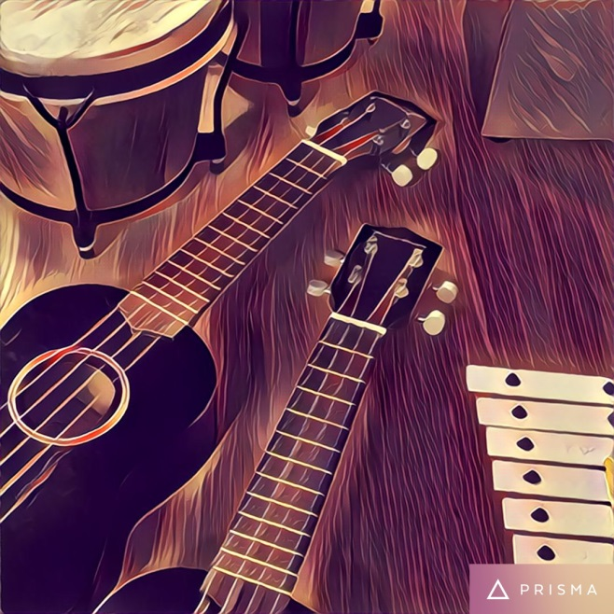
Music and maths both use patterns and structures such as progression and symmetry
According to Marcus du Sautoy:
‘Rhythm depends on arithmetic, harmony draws from basic numerical relationships, and the development of musical themes reflects the world of symmetry and geometry’.
The project has sought to explore some of these ideas in our learning and teaching.

Slide 3
Models of Integration
Barnes (2015) identified at least five common and contrasting ways of using more than one subject to respond to a problem, theme or issue.
These styles of cross-curricular teaching and learning have different aims, depend upon a range of planning strategies and result in different learning opportunities:
Tokenistic
Hierarchical
Multidisciplinary
Interdisciplinary
Opportunistic

Slide 4
Experiences of integrated music and mathematics activities (School 1, Year 3 pupils)
Observations of integrated music and mathematical learning and teaching activities revealed greater opportunities for inclusion for those pupils who may otherwise have struggled to engage with mathematical learning
3 children with special educational needs, who usually receive 1:1 support from a classroom assistant, were able to participate independently
The language barriers which were often a problem for children with English as an additional language, were less problematic when the children had another way of expressing their thinking

Slide 5
Experiences of integrated music and mathematics activities (School 2, Year 5 pupils)
Observations of these learning and teaching activities revealed greater opportunities for a range of learning styles (as well as some challenges).
Children had little experience of music and inititially found it hard to keep a rhythm going
Issues linked to multiplicative relationships were represented through musical activity and provided the children with a meaningful context within which to discuss the issues raised
The introduction of musical instruments added another dimension and made it easier to see and hear the musical/mathemtical patterns

Slide 6
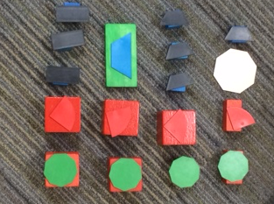
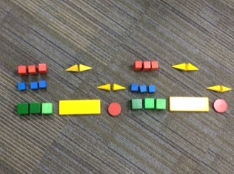
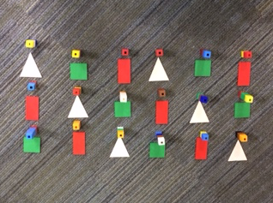
Primary teachers in England: Investigating transformations through Music and Maths
Primary teachers (from early years, special educational needs and mainstream primary settings) created graphic scores with 3D shapes. The musical material was manipulated using transformations and the compositions performed. The symbolisation represented pitch, rhythm, dynamic and duration amongst other musical elements.

Slide 7
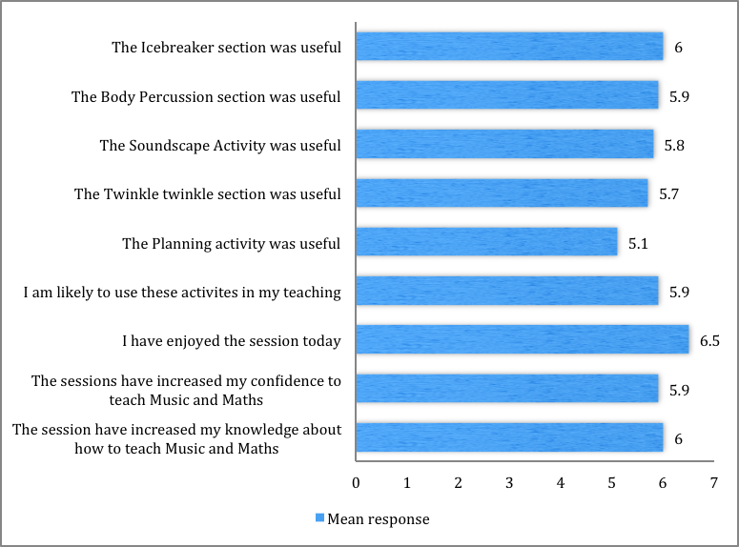
Primary teachers in England: reflecting on the first day of the National Workshop
Sixteen teachers took part in the first of two day-long national workshops. An evaluation was completed at the close of the workshop. Participants responded to a series of statements using a 7 point Likert scale.
Teachers positively engaged with the activities and were given opportunities to talk through how to adapt the tasks to the particular needs of their pupils.
The teachers reported that they felt more confident to approach these activities within their classrooms and that their knowledge about how to approach Music and Mathematics in an integrated approach had increased.

Slide 8
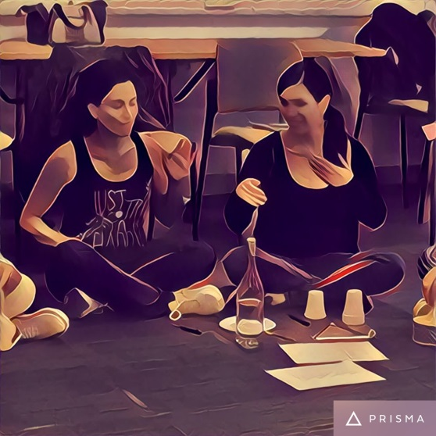
Primary teachers in England: reflecting on using Music and Maths in the classroom
Following the first workshop, teachers experimented with the activities in their own classrooms. During the second workshop, they shared their experiences and further learning.
Greater awareness of ‘where the Maths is’ in an activity, for example explicit use of patterns to support a composition activity, or using number lines and prediction to create polyphonic rhythms
Reflecting upon current practice and better of understanding how integrated Music and Maths can be used to include those pupils who are often excluded
Gaining a shared language that begins to bridge the musical and mathematical learning in the curriculum
Working more closely with colleagues with different strengths to plan and deliver interdisciplinary activities.

Slide 9
Sounding Ways into Mathematics: Working in the English Primary School Context
Professor Graham Welch
on behalf of the research team
Caroline Hilton caroline.hilton.14@ucl.ac.uk
and Dr Jo Saunders jo.saunders@ucl.ac.uk
UCL Institute of Education

