Slide 1
Understanding pre- and post-pandemic patterns of journeys to work, using the 2021/22 Censuses
Paper presented at RGS-IBG Annual Conference 2023
#RGSIBG2023
Dr Oliver Duke-Williams
o.duke-williams@ucl.ac.uk
@oliver_dw
www.ucl.ac.uk/dis/people/oliverdukewilliams

Slide 2
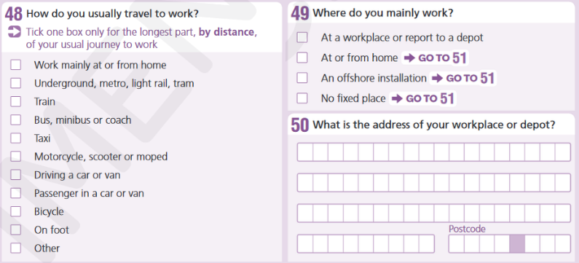
Census questions about travel to work
How do you usually travel to work?
Where do you mainly work?
What is the address of your workplace or depot?

Slide 3
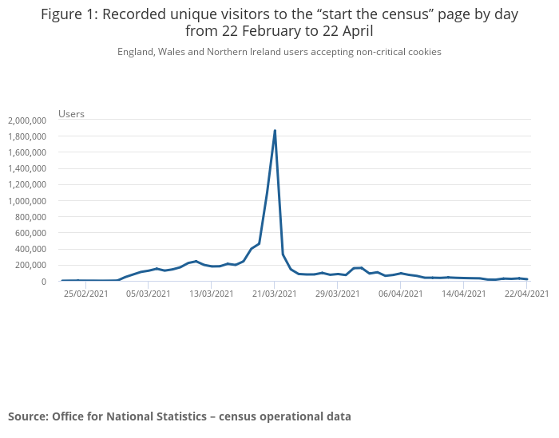
Census timing (England & Wales; N. Ireland)
8 March ('21): Step 1
Schools in England
reopen for primary
and secondary
school students.
Recreation in an
outdoor public
spaces will be
allowed between
two people.
‘Stay at home’ order
remains in place
Source: https://www.instituteforgovernment.org.uk/sites/default/files/timeline-coronavirus-lockdown-december-2021.pdf
Notes:
Census taken during period when 'stay at home' order was in place (but during phased reduction of restrictions ('stay at home' ended 29/03/22)
Note that the live portal opened 22/2/21 and by early March was getting significant use. 22/2/21 also date of publication of 'roadmap' for lifting restrictions

Slide 4
Census questions: pandemic adjustments
Paper form fixed
  Question wording including instructions could not be changed
Electronic form
  Questions could not be changed
  Instructions could be modified
  Guidance could be updated

Slide 5
The census workplace dilemma
How should people respond to workplace questions?
  'New normal' status
  Guidance on electronic form updated

Slide 6
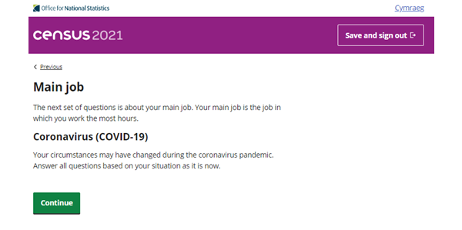

Electronic form: interstitial pages
Source:
https://www.ons.gov.uk/census/censustransformationprogramme/questiondevelopment/updatestocensus2021onlinequestionnaireguidancecoronaviruscovid19pandemicimpacts

Slide 7
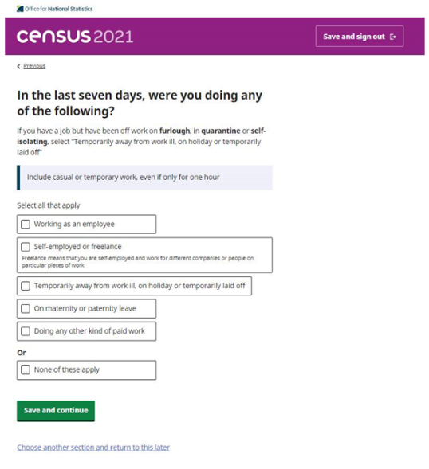
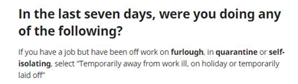
Electronic form: instructions
Source:
https://www.ons.gov.uk/census/censustransformationprogramme/questiondevelopment/updatestocensus2021onlinequestionnaireguidancecoronaviruscovid19pandemicimpacts

Slide 8
Question guidance (my emphasis)
How to answer if the coronavirus (COVID-19) pandemic has affected where you mainly work
If you're currently working and the coronavirus pandemic has affected where you mainly work, select the answer that best describes your current circumstances.
If you're away from work on furlough, in quarantine or self-isolating, answer about where you mainly worked before being away.
Source:
https://webarchive.nationalarchives.gov.uk/ukgwa/20210321073548/https://census.gov.uk/help/how-to-answer-questions

Slide 9
Types of data
Aggregate data: published (England and Wales; Northern Ireland)
Experimental matrices: published (E&W)
Microdata – to come
Flow data – to come
Longitudinal data – to come

Slide 10
Travel to work: previous decades (UK)
Method of travel to work | 1991 | 2001 | 2011
Work mainly at or from home | 6% | 9% | 11%
Tube / light rail etc | 2% | 3% | 4%
Train | 4% | 4% | 5%
Bus, minibus, coach | 10% | 7% | 7%
Motor cycle, scooter or moped | 2% | 1% | 1%
Driving a car or van | 54% | 55% | 54%
Passenger in a car or van | 8% | 6% | 5%
Taxi or minicab | n/a | 1% | 1%
Bicycle | 3% | 3% | 3%
On foot | 12% | 10% | 10%
Other | 1% | 1% | 1%
TOTAL | 1,890,169 | 23,527,884 | 26,526,336
1991 data from a 10% sample…
Source: 1991 Census: OPCS, NISRA, GRO(Scotland); 2001 & 2011 Census: ONS, NRS, NISRA
Notes:
These are a set of cross-sections, showing mode of travel to work for people in the UK, with each column summing to 100%
If we focus on the active modes, we see that the take level has remained quite consistent over time; but are these the same sorts of people, making the same sort of trips?

Slide 11
2021 headline figures (E&W)
Method used to travel to workplace | Observation | % of all persons | % of persons in employment
Work mainly at or from home | 8,671,722 | 15% | 31%
Underground, metro, light rail, tram | 505,311 | 1% | 2%
Train | 529,461 | 1% | 2%
Bus, minibus or coach | 1,160,990 | 2% | 4%
Taxi | 200,490 | 0% | 1%
Motorcycle, scooter or moped | 128,849 | 0% | 0%
Driving a car or van | 12,524,571 | 21% | 45%
Passenger in a car or van | 1,083,447 | 2% | 4%
Bicycle | 569,295 | 1% | 2%
On foot | 2,113,657 | 4% | 8%
Other method of travel to work | 285,873 | 0% | 1%
Not in employment or aged 15 years and under | 31,823,877 | 53% | n/a
Source: 2021 Census, ONS

Slide 12
2021 headline figures (Northern Ireland)
Method used to travel to workplace | Observation | % of all persons | % of persons in employment
Mainly at or from home | 153,523 | 8% | 19%
Driving a car or van | 510,150 | 27% | 63%
Passenger in a car or van | 39,509 | 2% | 5%
Car or van pool shared driving | 5,332 | 0% | 1%
Bus, minibus or coach (public or private) | 22,569 | 1% | 3%
Taxi | 8,055 | 0% | 1%
Train | 7,656 | 0% | 1%
Motorcycle, scooter or moped | 1,467 | 0% | 0%
Bicycle | 6,475 | 0% | 1%
On foot | 52,476 | 3% | 6%
Other method | 6,566 | 0% | 1%
No code required | 1,089,397 | 57% | n/a
Source: 2021 Census, NISRA

Slide 13
Interpreting results
The headline observation shows working from home growing significantly
Is this effect 'real'? Will it be persistent?

Slide 14
Comparing 2011 and 2021
Method of travel to work | 2011 exc. WFH (UK) | 2021 exc. WFH & n/a (E&W)
Work mainly at or from home | 0% | 0%
Tube / light rail etc | 4% | 3%
Train | 5% | 3%
Bus, minibus, coach | 8% | 6%
Motor cycle, scooter or moped | 1% | 1%
Driving a car or van | 59% | 66%
Passenger in a car or van | 5% | 6%
Taxi or minicab | 1% | 1%
Bicycle | 3% | 3%
On foot | 11% | 11%
Other | 1% | 1%
TOTAL | 24,138,966 | 19,101,944
Source: 2011 Census, ONS, NRS, NISRA; 2021 Census, ONS

Slide 15
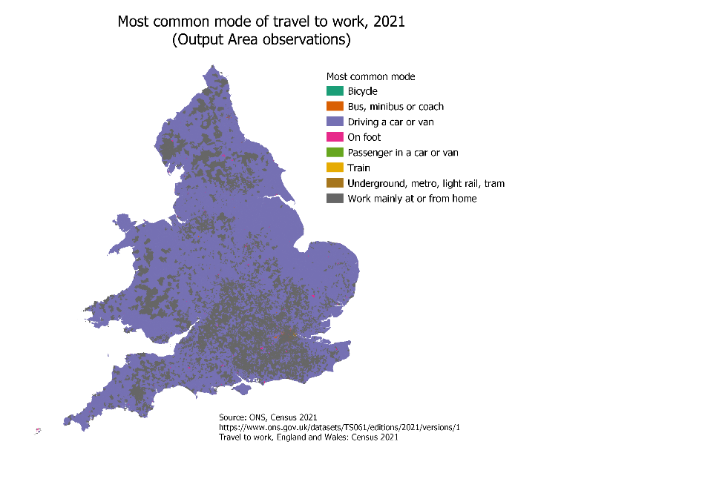

Slide 16
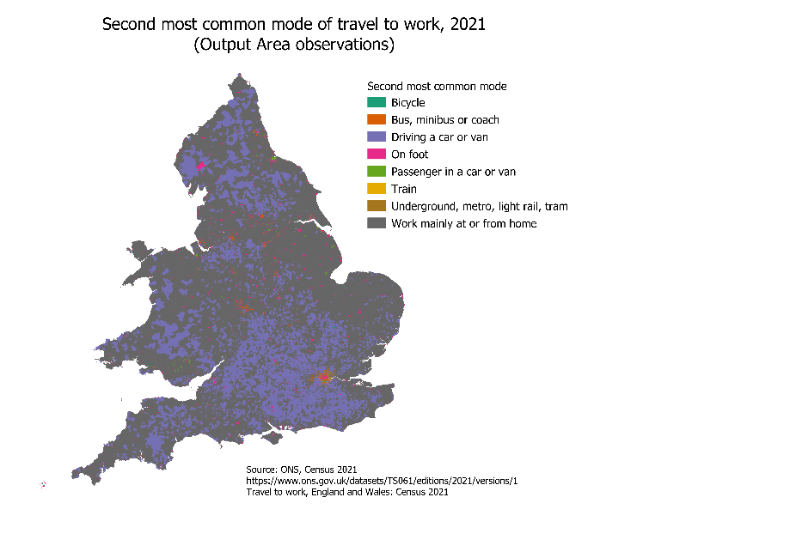

Slide 17
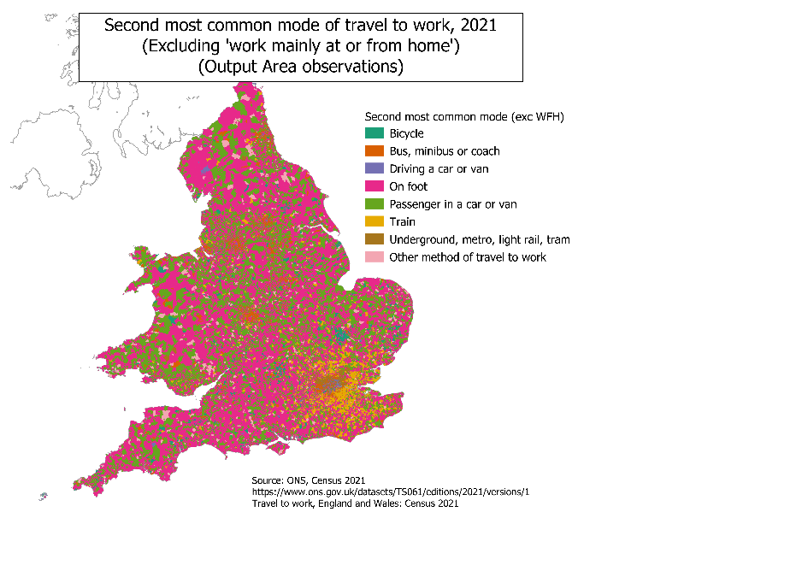

Slide 18
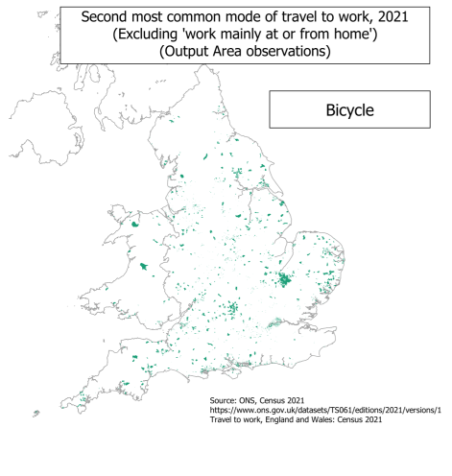
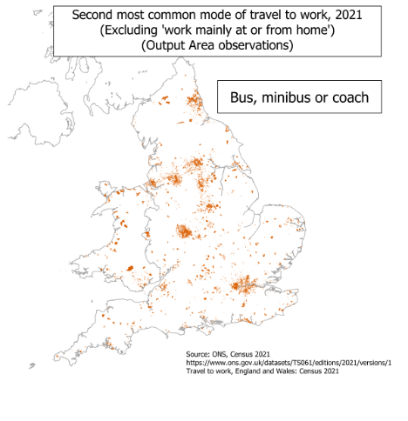

Slide 19
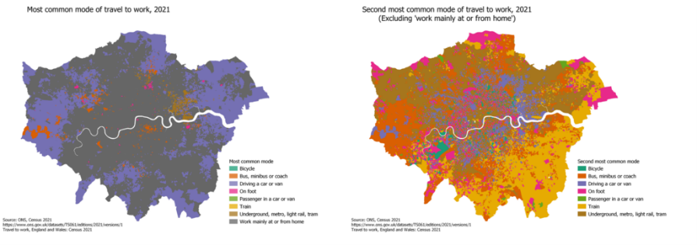
Most common and second most common modes: London detail

Slide 20
Border issues
Census in Scotland taken in 2022
In 2011
  c. 29,000 people working in Scotland, living rest of UK
  c. 17,000 people working in rest of UK, living in Scotland

Slide 21
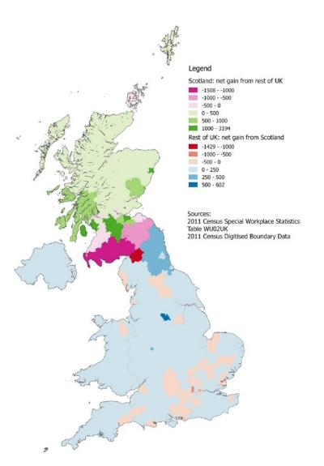
Cross border balances
(2011)
Effects mainly proximate to border, but not entirely

Slide 22
ONS travel to work matrices
Estimated matrices were published in June
  Inter-MSOA, England & Wales (7201x7201)
  Estimated with and without pandemic effects
  Marked as experimental statistics
  Estimated using gravity model, using 2011 SWS data for calibration
    Chen et al (2023) https://datasciencecampus.ons.gov.uk/projects/technical-report-estimation-of-travel-to-work-matrices/

Slide 23
ONS travel to work matrices
Typical sparse origin-destination matrices
  c. 52M MSOA to MSOA cells
  96% of cells have value of 0; 99% have value ≤ 5
  45% of people are accounted for by cells of value ≥ 50
Notes:
Figures for the 'with pandemic' matrix, 'no pandemic' has similar characteristics

Slide 24
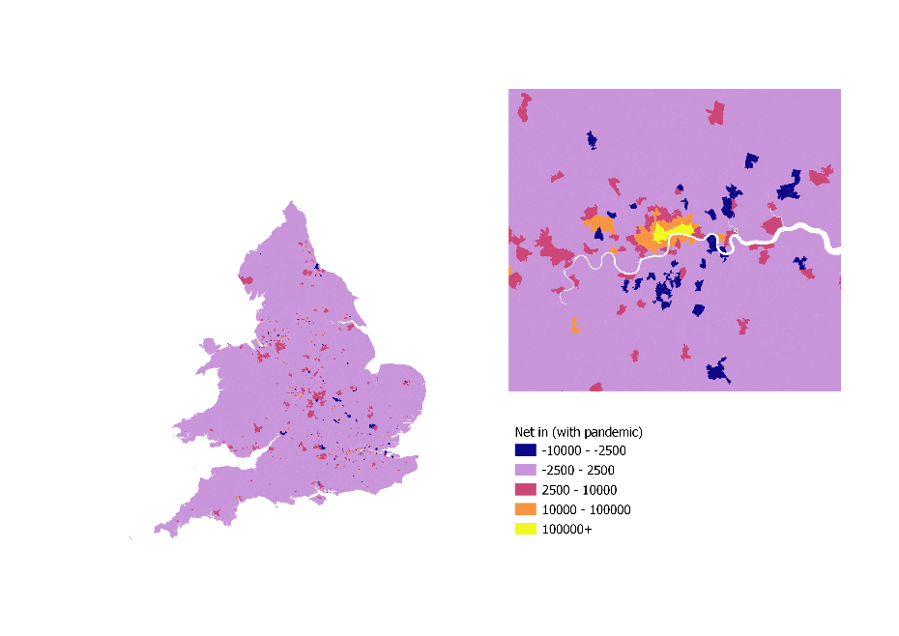
Experimental jtw: 'with pandemic'
Source: https://www.ons.gov.uk/releases/estimationoftraveltoworkmatricesenglandandwales

Slide 25
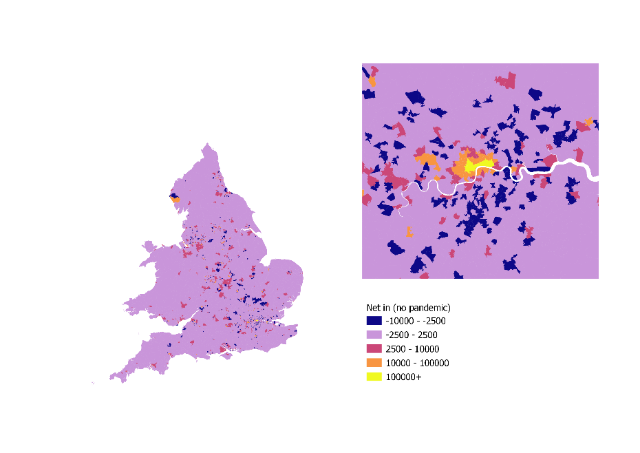
Experimental jtw: 'no pandemic'
Source: https://www.ons.gov.uk/releases/estimationoftraveltoworkmatricesenglandandwales

Slide 26

Source: https://www.ons.gov.uk/releases/estimationoftraveltoworkmatricesenglandandwales

Slide 27
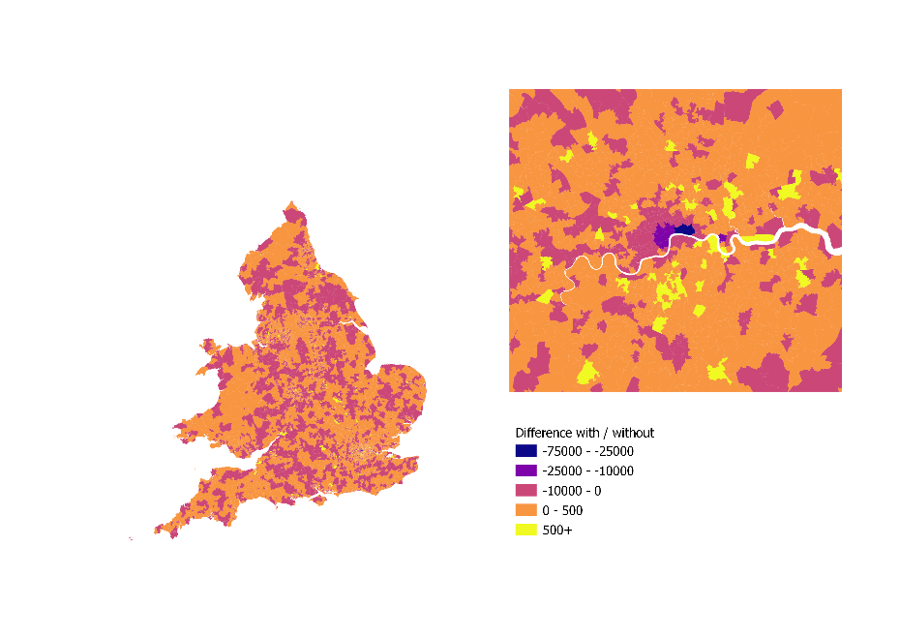
Experimental jtw: differences
Source: https://www.ons.gov.uk/releases/estimationoftraveltoworkmatricesenglandandwales

Slide 28

ONS Longitudinal Study
?
?
?
?
A linked census and life events data for a 1% sample of the population of England and Wales
Four (undisclosed) birth dates = 4/365 sample size
  Census data also cross-sectionally include other household members
Notes:
The LS is build around a 1% sample of persons in England and Wales; it covers all ages – new borns and new migrants with a qualifying birth date automatically become part of the sample.

Slide 29
Mode of transport, 2011
Mode in 2001, by mode used 2011
Mode of transport, 2001
Same mode both years
Mode in 2011, by mode used 2001
Notes:
Longitudinal data allows us to look at changes that can't be picked up in cross-sectional data
The central diagonal in this table shows people who have kept the same mode of transport over ten years;
rows show what happened in 2011 to those in a given mode in 2001
First, we look at transitions in mode of transport to work between 1991 and 2001

Slide 30
Stability 1991-2001 (England and Wales)
 |  | Mode in 2001 |  |  |  |  |  |  |  |  |  | Total
 |  | Train | Tube | Bus | Drive car/van | Passenger car/van | Taxi/Minicab | Motorcycle | Bicycle | On foot | Works at/from home
Mode in 1991 | Train | 37% | 5% | 5% | 35% | 3% | 0% | 1% | 1% | 4% | 9% | 5411
 | Underground/Tube/Metro | 15% | 32% | 7% | 28% | 2% | 0% | 1% | 2% | 4% | 9% | 3015
 | Bus/Minibus/Coach(public or private) | 3% | 2% | 27% | 38% | 10% | 1% | 1% | 2% | 11% | 5% | 11410
 | Drive car/van | 2% | 1% | 1% | 78% | 2% | 0% | 1% | 1% | 3% | 10% | 84083
 | Passenger car/van | 2% | 1% | 8% | 51% | 19% | 1% | 1% | 2% | 9% | 6% | 9969
 | Motor cycle/Scooter/Moped | 1% | 1% | 4% | 56% | 4% | 1% | 17% | 6% | 6% | 6% | 2301
 | Pedal cycle | 2% | 1% | 4% | 41% | 5% | 0% | 2% | 28% | 10% | 6% | 4496
 | On foot | 2% | 1% | 8% | 37% | 7% | 1% | 1% | 3% | 33% | 7% | 15025
 | Mainly at home | 1% | 1% | 2% | 37% | 3% | 0% | 0% | 1% | 7% | 47% | 6693
Total |  | 4845 | 2330 | 7173 | 88755 | 6985 | 594 | 1562 | 3699 | 11239 | 15221 | 142403
28% of those cycling in 1991 still cycled 2001; most had become car drivers
Similar story for those walking to work
Source: ONS Longitudinal Study, https://doi.org/10.57906/z9xn-ng05
Notes:
This table shows the proportion of people in the sample with a given transport mode in 1991 who used various modes they used ten years later in 2001: the rows sum to 100%
So, of those who cycled in 1991, 28% also cycled in 2001
Conversely, a higher proportion – 41%- of the 1991 cyclists were car divers in 2001.

Slide 31
Stability 2001-2011 (England and Wales)
For each 2001 mode
most common 2011 outcome
second most common 2011 outcome
 |  | Mode in 2011 |  |  |  |  |  |  |  |  | Total
 |  | Train | Tube | Bus | Driving a car or van | Passenger in a car or van | Motorcycle | Bicycle | On foot | Work mainly at or from home
Mode in 2001 | Train | 41% | 6% | 4% | 32% | 2% | 1% | 2% | 5% | 7% | 6324
 | Tube/Metro/Light rail/tram (E&W) | 17% | 33% | 8% | 24% | 2% | 1% | 3% | 5% | 7% | 3849
 | Bus/Minibus/Coach | 5% | 3% | 27% | 39% | 8% | 0% | 2% | 12% | 3% | 10638
 | Drive car/van | 2% | 1% | 2% | 82% | 2% | 1% | 1% | 4% | 5% | 93087
 | Passenger car/van | 3% | 1% | 8% | 53% | 20% | 1% | 2% | 10% | 3% | 10522
 | Motor cycle/Scooter/Moped | 4% | 2% | 3% | 56% | 4% | 19% | 6% | 4% | 3% | 1840
 | Bicycle | 3% | 1% | 4% | 43% | 4% | 2% | 30% | 10% | 3% | 4415
 | On foot | 3% | 2% | 7% | 40% | 6% | 1% | 3% | 34% | 4% | 14621
 | Works at/from home | 3% | 1% | 2% | 54% | 3% | 0% | 1% | 7% | 28% | 14035
Total |  | 7381 | 3428 | 7323 | 105507 | 6879 | 1248 | 4053 | 13075 | 10437 | 159331
30% retention rate for cyclists
34% retention rate for walkers
Source: ONS Longitudinal Study, https://doi.org/10.57906/z9xn-ng05
Notes:
This is the equivalent for the period 2001-2011
Here, for each 2001 mode, the most common 2011 has been shaded (and the second most common shown with lighter shading)
As before, car drivers are most likely to retain the same mode; motor cyclists least likely
Train & tube users tend to retain same mode – everyone else switches to car driving!

Slide 32
Effects of moving home…
We can look at people
  Employed or self employed in both 2001 and 2011
  Who moved between 2001 and 2011
  Who drove to work in 2001
Notes:
Does the destination make any difference to whether they switched to active modes of travel?

Slide 33
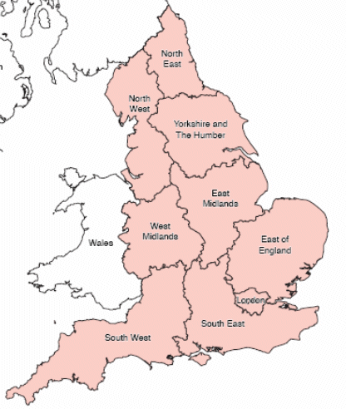

Car-commuters in sample in 2001, who moved to (from anywhere) or within, a region 2001-11
… of which, those who were active commuters in 2011
 |  | East Midlands | East of England | London | North East | North West | South East | South West | Wales | West Midlands | Yorkshire and The Humber
Moved to |  | 866 | 1053 | 656 | 193 | 592 | 1653 | 1121 | 395 | 618 | 584
Moved within |  | 3547 | 4528 | 2160 | 1786 | 5110 | 7126 | 4349 | 2134 | 4211 | 3880
Moved to |  | 21 | 61 | 114 | 11 | 28 | 112 | 96 | 18 | 28 | 42
Moved within |  | 164 | 251 | 309 | 81 | 235 | 352 | 291 | 69 | 137 | 171
Moved to |  | 2% | 6% | 17% | 6% | 5% | 7% | 9% | 5% | 5% | 7%
Moved within |  | 5% | 6% | 14% | 5% | 5% | 5% | 7% | 3% | 3% | 4%
Source: ONS Longitudinal Study, https://doi.org/10.57906/z9xn-ng05
Notes:
Both people who move within and to London were more likely to become cyclists.

Slide 34
Acknowledgements
The permission of the Office for National Statistics to use the Longitudinal Study is gratefully acknowledged, as is the help provided by staff of the Centre for Longitudinal Study Information & User Support (CeLSIUS). CeLSIUS is funded by the ESRC under project ES/V003488/1. The authors alone are responsible for the interpretation of the data.
This work contains statistical data from ONS which is Crown Copyright. The use of the ONS statistical data in this work does not imply the endorsement of the ONS in relation to the interpretation or analysis of the statistical data. This work uses research datasets which may not exactly reproduce National Statistics aggregates

