Slide 1
CUMULATIVE EXPOSURE TO OVERWEIGHT/OBESITY SINCE CHILDHOOD AND COGNITIVE FUNCTION IN MIDLIFE: LONGITUDINAL EVIDENCE FROM THREE BRITISH BIRTH COHORTS
Scott T. Chiesa PhD ^{1,2}
Alzheimer’s Research UK David Carr Fellow
Victoria Garfield^{1,2}, Tom Norris³, Marcus Richards^{1,2}, and Alun D Hughes^{1,2}
¹ UCL Institute of Cardiovascular Science, London, UK
² MRC Unit for Lifelong Health and Ageing at UCL, London, UK
³ UCL Division of Surgery and Interventional Science, London, UK

Slide 2
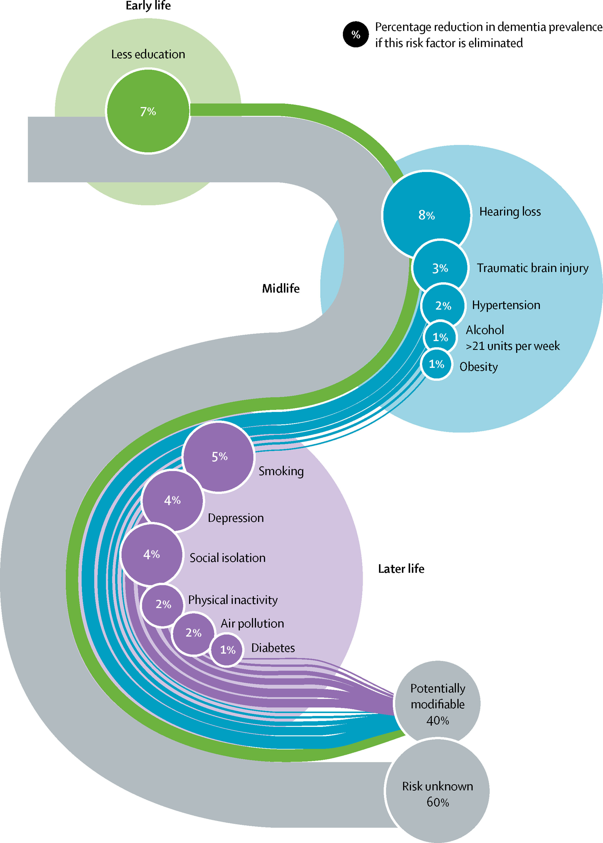
BACKGROUND
Increasing recognition of role that modifiable risk factors may play in the development of dementia
Obesity in mid-life now regarded as top modifiable risk factor for Alzheimer’s and other dementias (Nianogo et al JAMA 2022)
Limited evidence addressing role of life-long exposure to overweight/obesity prior to mid-life
Previous studies limited by combination of factors such as cross-sectional nature, lack of cumulative exposure, lack of reproducibility
Livingston et al 2020
Notes:
In recent years there has been an increasing recognition of the role that modifiable RFs may play in the development of AZ and other dementias, and a recent study published in JAMA last year has suggested that out of all of these risk factors, obesity is likely the top modifiable factor today, in the US at least. Relatively few studies have previously focused on the impact of O/O in the 50 or so years prior to this point, however, which is perhaps surprising for a number of reasons. Firstly, we know that obesity tracks across the lifecourse, and so people who are obese in mid-life are very likely to have been exposed to this excess adiposity for decades before this point. Secondly, we know from other diseases such as heart or renal disease that this cumulative exposure can greatly increase disease risk in the later years. And finally, with regards to dementia, we know that some early-life factors such as education do have the ability to impact future dementia risk through changes in cognitive ability that are evident by midlife. In the limited studies that have addressed this question, many have been limited by a number of often unavoidable factors such as cross-sectional study designs, lack of repeat measures across early-life, or a lack of any form of reproducibility of results.

Slide 3
AIM
To investigate whether cumulative exposure to overweight/obesity (O/O) in the early decades of life is associated with differences in cognitive function by mid-life
Notes:
The aim of the study I’m about to talk you through, however, is to use three longitudinal and harmonised British birth cohorts to investigate whether.

Slide 4
METHODS
Follow-Up Time: 1946 – 1999 | n = 2131
Follow-Up Time: 1958 – 2008 | n = 9385
Follow-Up Time: 1970 – 2016 | n = 8226
Notes:
Three studies in question were each commenced 12 years apart and consist of

Slide 5
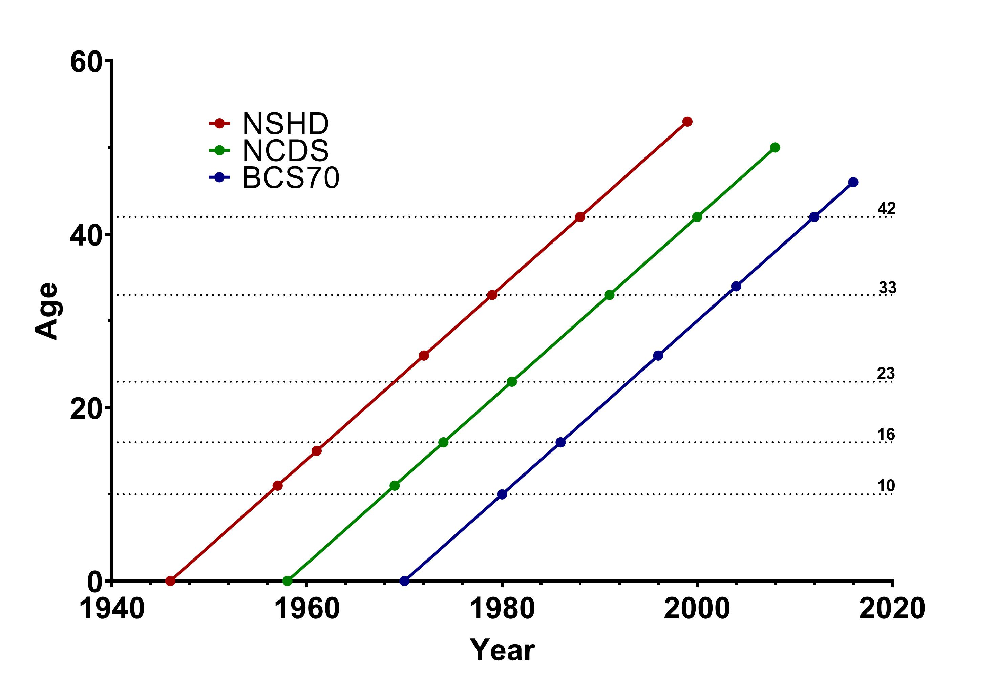
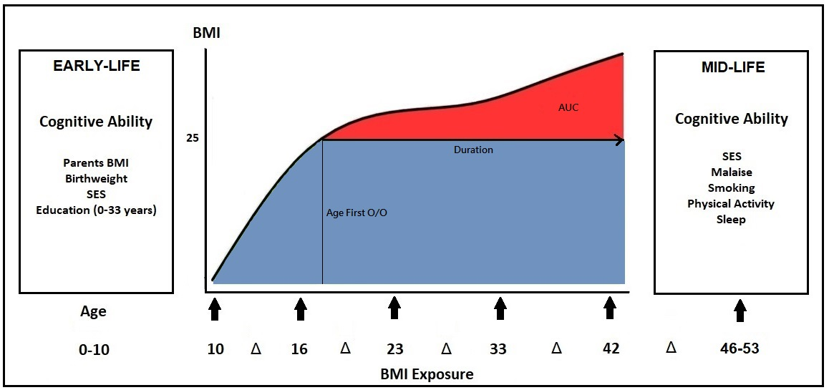
METHODS
EXPOSURES
Up to 6 measures of BMI (either directly measured or self-reported) available between childhood and mid-life
Various metrics investigated
BMI change between ages
BMI at distinct ages
Duration of time spent O/O
Cumulative exposure to O/O
Individual child->adult BMI trajectories modelled using restricted cubic splines with mixed effects
* Malaise and sleep not available in NSHD
Notes:
One of the major advantages of these studies is the frequency and timing of visits, that allows our exposure, in this case BMI, to be harmonised across cohorts. Graph on top right shows a basic timeline of each study, where BMI was either directly measured or self-reported on up to 6 occasions. Although slight variations in timings, can see that in each cohort these occurred at ~10,16, etc years. With these measures, able to not only investigate associations of BMI at different ages and changes between those ages, but by using a mixed effects model incorporating cubic splines we were able to model individual child to adult BMI trajectories for every participant, allowing us to also test associations of duration of time spent either O/), or cumulative exposure which was assessed using the AUC for total time spent over the overweight threshold.

Slide 6
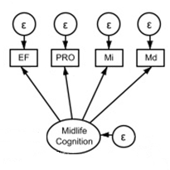
METHODS
OUTCOMES
Latent measure of general cognitive function at ages 46-53 estimated from four harmonised tests assessing:
Immediate and delayed memory recall (verbal learning/word list recall test)
Executive function (animal naming)
Processing speed (timed letter search/cancellation test).
* Malaise and sleep not available in NSHD
Notes:
For our outcomes, all cohorts had near identical measures of EF, PRO, and Mi/Md measured within a few years of the age 50 mark, from which we then calculate a latent underlying g factor which from here on I’ll refer to as cognitive ability.

Slide 7
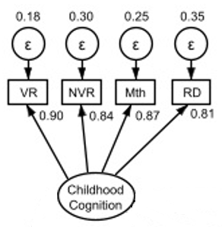
METHODS
COVARIATES
Midlife
Smoking
Physical Activity
Socioeconomic Status
Malaise
Sleep
Early Life
Parents BMI
Birthweight
Socioeconomic Status
Childhood Cognitive Ability
Highest Educational Attainment
* Malaise and sleep not available in NSHD
Notes:
Range of covariates present both in mid-life to assess if various contemporary factors associated with long-term exposure may skew any relationships, and from early-life to see if anything we see if potentially confounded by factors in childhood/adolescence. So, for midlife have….. With regards to statistical tests used, will describe as I go.

Slide 8
RESULTS
Variable | Cohort
 | n | NSHD | n | NCDS | n | BCS
Characteristics
Age (years) | 2131 | 53 ± 0 | 9385 | 50 ± 1 | 8226 | 46 ± 1
Sex (% female) | 2131 | 49 | 9385 | 51 | 8226 | 52
Ethnicity (% white) | 2131 | 100 | 9072 | 98 | 7129 | 97
BMI Exposures
Ever O/O (%) | 2121 | 42 | 9352 | 51 | 8136 | 60
Age First O/O (years) | 885 | 28 (21 – 34) | 4750 | 26 (21 – 32) | 4908 | 26 (20 – 31)
Total Duration O/O (years) | 885 | 11 (5 – 18) | 4750 | 14 (7 – 19) | 4908 | 14 (9 – 20)
Cumulative Exposure to O/O (AUC) | 774 | 10 (5 – 17) | 4716 | 18 (4 – 50) | 4895 | 26 (8 – 68)
Cognitive Outcomes
Executive Function Immediate Recall Delayed Recall Processing Speed | 2131 2131 2131 2131 | 24 ± 7 6 ± 2 8 ± 2 279 ± 76 | 9385 9385 9385 9385 | 22 ± 6 7 ± 1 5 ± 2 334 ± 89 | 8226 8226 8226 8226 | 24 ± 6 7 ± 1 5 ± 2 346 ± 85
Comparable demographics between cohorts
Age ~ 50 years old
50% female
White ethnicity
Evidence of secular effects in O/O status
Later cohorts have higher prevalence O/O
Later cohorts have higher burden of O/O
Comparable cognitive results between cohorts
- Harmonised tests to allow comparisons

Slide 9
RESULTS
 | NCDS
 | Model 1 |  | Model 2 |  | Model 3
 | Beta (95%CI) | p | Beta (95%CI) | p | Beta (95%CI) | p
BMI Gain Between Ages
Age 10-16 | -0.07 (-0.12, -0.02) | 0.005 | -0.04 (-0.11, 0.03) | 0.249 | 0.02 (-0.04, 0.08) | 0.477
Age 16-23 | -0.14 (-0.18, -0.10) | <0.001 | -0.09 (-0.13, -0.05) | <0.001 | 0.00 (-0.06, 0.06) | 0.962
Age 23-33 | -0.01 (-0.06, 0.04) | 0.691 | -0.02 (-0.06, 0.02) | 0.266 | -0.02 (-0.07, 0.03) | 0.422
Age 33-42 | -0.03 (-0.07, 0.01) | 0.191 | -0.03 (-0.07, 0.01) | 0.107 | 0.02 (-0.03, 0.07) | 0.421
Age 42-46 | -0.05 (-0.11, 0.01) | 0.065 | -0.06 (-0.10, -0.01) | 0.028 | 0.01 (-0.04, 0.05) | 0.764
BMI at Distinct Ages
Age 10 | 0.01 (-0.02, 0.04) | 0.397 | 0.02 (-0.01, 0.05) | 0.182 | 0.00 (-0.04, 0.04) | 0.916
Age 16 | -0.02 (-0.05, 0.01) | 0.149 | 0.00 (-0.04, 0.03) | 0.838 | 0.01 (-0.03, 0.06) | 0.577
Age 23 | -0.10 (-0.12, -0.07) | < 0.001 | -0.05 (-0.08, -0.02) | <0.001 | -0.01 (-0.04, 0.05) | 0.748
Age 33 | -0.07 (-0.11, -0.04) | < 0.001 | -0.05 (-0.08, -0.02) | 0.001 | -0.01 (-0.06, 0.03) | 0.574
Age 42 | -0.07 (-0.10, -0.04) | < 0.001 | -0.05 (-0.08, -0.02) | <0.001 | 0.01 (-0.03, 0.06) | 0.574
Age 46 | -0.06 (-0.09, -0.03) | <0.001 | -0.06 (-0.09, -0.03) | <0.001 | 0.01 (-0.03, 0.04) | 0.755
Model 1: Minimally-adjusted
BMI gain in adolescence and high BMI after adolescence associated with lower mid-life cognitive function
Model 2: Adjustment for mid-life covariates
Attenuation of effect sizes but patterns broadly maintained
Model 3: Adjustment for early-life covariates
All effects attenuated to null
Model 1 = Adjustment for sex
Model 2 = Model 1 + further adjustment for mid-life covariates (SES, malaise [not NSHD], smoking status, physical activity levels, sleep duration [not NSHD]).
Model 3 = Model 2 + further adjustment for early-life covariates (mother’s and father’s BMI, birthweight, childhood SES, childhood cognitive ability, highest educational level achieved).
Multiple linear regression models with multiple imputation used to account for missing data. n = 9385.
Notes:
So what did we find. So as not to overload with data, going to show results here only NCDS as largest and ‘middle’ cohort, then will expand later out to other cohorts. So these are linear regressions with MI used to account for any missing values, using BMI gain between ages and BMI at distinct ages as exposures and midlife cognitive ability as outcome. Three models created, first minimally adjusted etc

Slide 10
RESULTS
 | NCDS
 | Model 1 |  | Model 2 |  | Model 3
 | Beta (95%CI) | p | Beta (95%CI) | p | Beta (95%CI) | p
Duration of Overweight/Obesity
Never O/O | Ref | Ref | Ref | Ref | Ref | Ref
< 5 years | 0.03 (-0.07, 0.14) | 0.567 | 0.03 (-0.07, 0.13) | 0.578 | 0.03 (-0.08, 0.14) | 0.622
5-10 years | -0.03 (-0.13, 0.07) | 0.530 | -0.04 (-0.13, 0.06) | 0.422 | 0.02 (-0.09, 0.13) | 0.744
10-15 years | -0.05 (-0.16, 0.04) | 0.253 | -0.02 (-0.11, 0.07) | 0.610 | 0.01 (-0.10, 0.12) | 0.844
15-20 years | -0.23 (-0.32, -0.13) | < 0.001 | -0.16 (-0.25, -0.07) | <0.001 | -0.06 (-0.18, 0.06) | 0.308
20-30 years | -0.28 (-0.41 -0.15) | <0.001 | -0.22 (-0.35, -0.10) | 0.001 | 0.00 (-0.18, 0.19) | 0.963
Per 10 years | -0.12 (-0.15, -0.07) | <0.001 | -0.09 (-0.12, -0.04) | <0.001 | -0.03 (-0.09, 0.02) | 0.308
Cumulative Exposure to Overweight/Obesity Between Ages 10 - 40
Never O/O | Ref | Ref | Ref | Ref | Ref | Ref
Q1 | 0.04 (-0.06, 0.14) | 0.405 | 0.03 (-0.06, 0.13) | 0.468 | 0.03 (-0.07, 0.12) | 0.595
Q2 | -0.04 (-0.14, 0.06) | 0.402 | -0.04 (-0.13, 0.06) | 0.435 | 0.00 (-0.10, 0.10) | 0.988
Q3 | -0.09 (-0.19, 0.01) | 0.066 | -0.06 (-0.15, 0.03) | 0.216 | 0.01 (-0.10, 0.11) | 0.859
Q4 | -0.21 (-0.31, -0.11) | < 0.001 | -0.15 (-0.25, -0.06) | 0.002 | -0.05 (-0.17, 0.06) | 0.365
Q5 | -0.29 (-0.41 -0.18) | <0.001 | -0.23 (-0.34, -0.11) | <0.001 | -0.07 (-0.23, 0.10) | 0.427
Per 1SD | -0.12 (-0.16, -0.08) | <0.001 | -0.09 (-0.13, -0.05) | <0.001 | -0.03 (-0.09, 0.03) | 0.305
Model 1: Minimally-adjusted
Duration of O/O and total cumulative exposure to O/O in early-life associated with lower mid-life cognitive function
Model 2: Adjustment for mid-life covariates
Attenuation of effect sizes but patterns broadly maintained
Model 3: Adjustment for early-life covariates
All effects attenuated to null
Model 1 = Adjustment for sex
Model 2 = Model 1 + further adjustment for mid-life covariates (SES, malaise, smoking status, physical activity levels, sleep duration)
Model 3 = Model 2 + further adjustment for early-life covariates (mother’s and father’s BMI, birthweight, childhood SES, childhood cognitive ability, highest educational level achieved).
Multiple linear regression models with multiple imputation used to account for missing data. n = 9385.

Slide 11
RESULTS
EQUIVALENT RESULTS FOR NSHD AND BCS70 COHORTS
 | Model 1 |  |  |  |  |  | Model 2 |  |  |  |  |  | Model 3
 | NSHD |  | NCDS |  | BCS |  | NSHD |  | NCDS |  | BCS |  | NSHD |  | NCDS |  | BCS
 | Beta (95%CI) | p | Beta (95%CI) | p | Beta (95%CI) | p | Beta (95%CI) | p | Beta (95%CI) | p | Beta (95%CI) | p | Beta (95%CI) | p | Beta (95%CI) | p | Beta (95%CI) | p
BMI at Distinct Ages
Age 10 | 0.05 (-0.01, 0.12) | 0.108 | 0.01 (-0.02, 0.04) | 0.397 | 0.00 (-0.03, 0.03) | 0.806 | 0.04 (-0.02, 0.10) | 0.173 | 0.02 (-0.01, 0.05) | 0.182 | 0.01 (-0.02, 0.04) | 0.567 | 0.06 (0.00, 0.11) | 0.056 | 0.00 (-0.04, 0.04) | 0.916 | 0.03 (-0.01, 0.06) | 0.143
Age 16 | 0.03 (-0.03, 0.10) | 0.298 | -0.02 (-0.05, 0.01) | 0.149 | -0.04 (-0.09, 0.00) | 0.042 | 0.03 (-0.03, 0.09) | 0.363 | 0.00 (-0.04, 0.03) | 0.838 | -0.03 (-0.07, 0.01) | 0.131 | 0.04 (-0.01, 0.10) | 0.101 | 0.01 (-0.03, 0.06) | 0.577 | 0.01 (-0.02, 0.05) | 0.444
Age 23 | -0.06 (-0.12, 0.01) | 0.094 | -0.10 (-0.12, -0.07) | < 0.001 | -0.07 (-0.10, -0.04) | <0.001 | -0.03 (-0.09, 0.03) | 0.392 | -0.05 (-0.08, -0.02) | <0.001 | -0.04 (-0.08, -0.01) | 0.008 | 0.05 (-0.02, 0.11) | 0.162 | -0.01 (-0.04, 0.05) | 0.748 | 0.01 (-0.04, 0.06) | 0.642
Age 33 | -0.12 (-0.18, -0.06) | <0.001 | -0.07 (-0.11, -0.04) | < 0.001 | -0.10 (-0.14, -0.07) | <0.001 | -0.07 (-0.13, -0.01) | 0.016 | -0.05 (-0.08, -0.02) | 0.001 | -0.07 (-0.10, -0.04) | <0.001 | 0.02 (-0.04, 0.07) | 0.582 | -0.01 (-0.06, 0.03) | 0.574 | -0.03 (-0.08, 0.02) | 0.198
Age 42 | -0.13 (-0.19, -0.07) | <0.001 | -0.07 (-0.10, -0.04) | < 0.001 | -0.10 (-0.13, -0.07) | <0.001 | -0.09 (-0.14, -0.03) | 0.003 | -0.05 (-0.08, -0.02) | <0.001 | -0.07 (-0.10, -0.03) | <0.001 | -0.01 (-0.06, 0.05) | 0.822 | 0.01 (-0.03, 0.06) | 0.574 | 0.01 (-0.07, 0.09) | 0.810
Age 46 | -0.10 (-0.15, -0.04) | 0.001 | -0.06 (-0.09, -0.03) | <0.001 | -0.11 (-0.14, -0.08) | <0.001 | -0.08 (-0.13, -0.02) | 0.006 | -0.06 (-0.09, -0.03) | <0.001 | -0.07 (-0.10, -0.04) | <0.001 | 0.00 (-0.05, 0.05) | 0.955 | 0.01 (-0.03, 0.04) | 0.755 | -0.02 (-0.04, 0.01) | 0.220

Slide 12
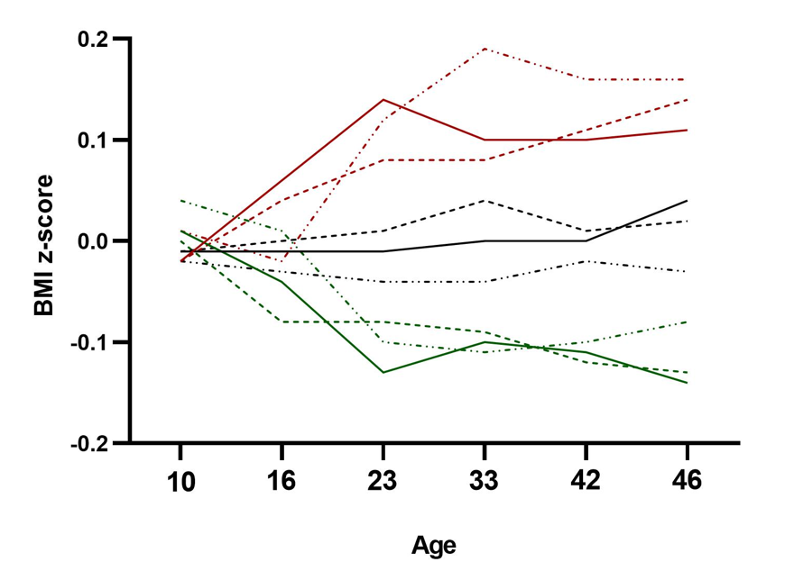
RESULTS
Low Childhood Cognitive Ability
Middle Childhood Cognitive Ability
High Childhood Cognitive Ability
NSHD
NCDS
BCS70
Childhood cognition found to be early-life factor explaining largest proportion of outcome variance
Supports previous claims of potential reverse directionality for BMI – cognition relationship in early-life
Childhood cognitive ability predicts similar BMI trajectories to those associated with midlife cognitive ability in previous analyses
Simple line graph connecting mean predicted values of BMI z-score at each age based on tertile of childhood cognitive ability at age 10.
Notes:
So when looking at which early-life factor contributed the most to this attenuation, found that childhood cognitive ability explained largest variance, which supports .. When plot this relationship in the opposite direction which childhood cognition as exposure and BMI as outcome, what we see is virtually same pattern as that seen for adult cognition, in that a low cognitive ability in childhood is associated with higher weight gain as they transition to adulthood, and then a maintained increased BMI from that point on. So this graph is a fairly rudeimentary basic line graph connecting effect sizes for difference in BMI at each age in each cohort depending on tertiles of childhood cog. To test this potential reverse directionality in a bit more of a robust way, turned to a SEM

Slide 13
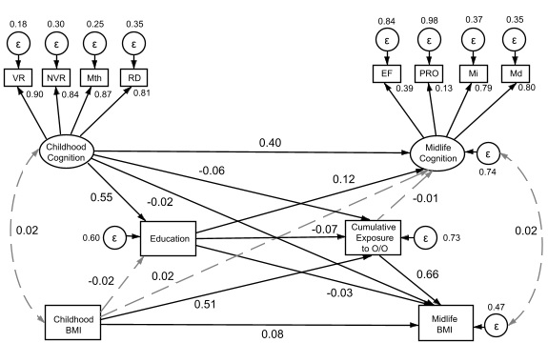
RESULTS
Structural Equation Modelling (SEM)
Temporal design
Investigation of direct and indirect paths
Allows for stability of cognitive ability over time
NCDS
All variables adjusted for sex and childhood SES. Data presented as standardised estimates. Maximum likelihood with missing values used to account for missing data. Dashed grey line indicates non-significant path. Black line indicates p < 0.05.
Notes:
For anyone unfamiliar with SEM, this diagram essentially shows effect sizes for relationships between exposures and outcomes through both direct and indirect paths. The temporal design of the model – whereby childhood factors on the left occur before highest education level is reached, which in turn occurs before max exposure to O/O is reached, which precedes midlife measures, allows us to infer direction of relationship. Lots going on here, but most important thing to note is that we found no impact of any early-life BMI measure on later cognition, but we did see multiple direct and indirect paths linking early childhood cognition to later O/O

Slide 14
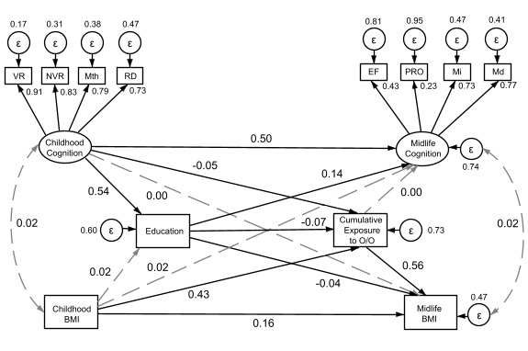
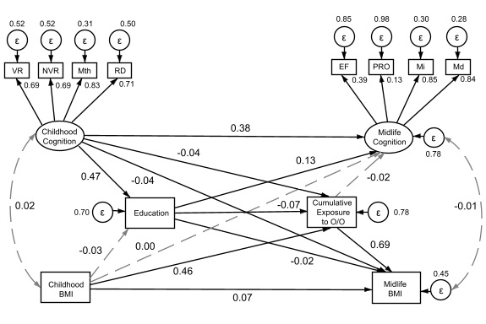
RESULTS
Evidence suggests presence of both direct and indirect paths linking early-life cognitive ability to mid-life overweight / obesity, but not vice versa
NSHD
NCDS
BCS70
All variables adjusted for sex and childhood SES. Data presented as standardised estimates. Maximum likelihood with missing values used to account for missing data. RMSEA = 0.06 / 0.06 / 0.05, CFI = 0.95 / 0.95 / 0.96, TLI = 0.91 / 0.92 / 0.93 for NSHD, NCDS, and BCS70, respectively. Dashed grey line indicates non-significant path. Black line indicates p < 0.05. Cognitive ability scores expressed as latent variables derived from harmonised cognitive measures consisting of VR, verbal reasoning; NVR, non-verbal reasoning; Mth, mathematical ability; RD, reading ability in childhood; and EF, executive function; PRO, processing speed, Mi, immediate recall; Md, delayed recall in midlife.
Notes:
If we then expand this out to all of the cohorts, we see virtually identical results for all, both in significance of paths and in effect sizes.

Slide 15
CONCLUSIONS
The association between cumulative exposure to overweight/obesity in early-life and lower cognitive function in mid-life likely arises due to a persistently lower cognitive ability from childhood, which in turn is associated with an increased risk of becoming overweight or obese earlier and for longer.

Slide 16
Thank you
Victoria Garfield
Tom Norris
Marcus Richards
Alun D Hughes
^{NCDS and BCS70 Cohorts}
^{David Stanley Carr & Family}
MRC Unit for Lifelong Health and Ageing at UCL
@MRCLHA
www.ucl.ac.uk/mrc-lha

