Slide 1
Active Tasks and Test-Potentiated Learning: What Works and Why?
Shaun Boustani and Caleb Owens

Slide 2
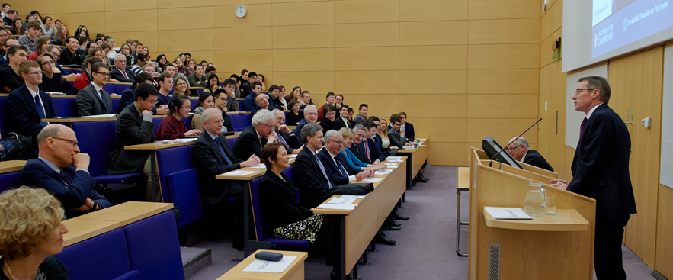
A bit of background…
Calls for Educational Innovation (Blumenfield & Paris, 2004; Karmel and Carroll, 2016; OECD, 2016)
Effective teaching techniques (Dunlosky et al., 2013; Freeman et al., 2014)
Classic (Didatic) vs Modern (Active)
Notes:
I am not going to speak about these explicitly throughout my talk, but I’d like them to be undercurrents and noted as themes which provide reason as to why I am carrying out the research I have.

Slide 3
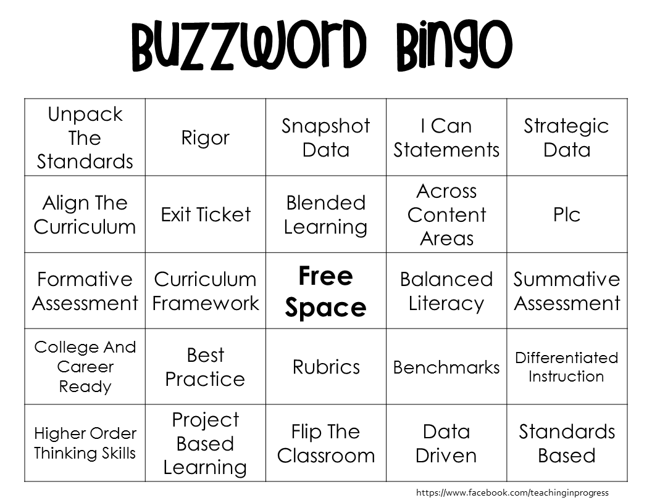
What is ‘active learning’?
The latest learning buzzword?
Active learning defines a set of teaching practices which aim to increase student-educator interaction and engagement with materials (Freeman et al, 2014; Prince, 2004).
Notes:
Active learning defines a set of teaching practices, tools and techniques which aim to increase student-educator interaction and student engagement with materials. In general, active learning involves the replacement of the passive didactic style of teaching with in-class activities and discussion where students meaningfully interact with material (Freeman et al, 2014; Prince, 2004).

Slide 4
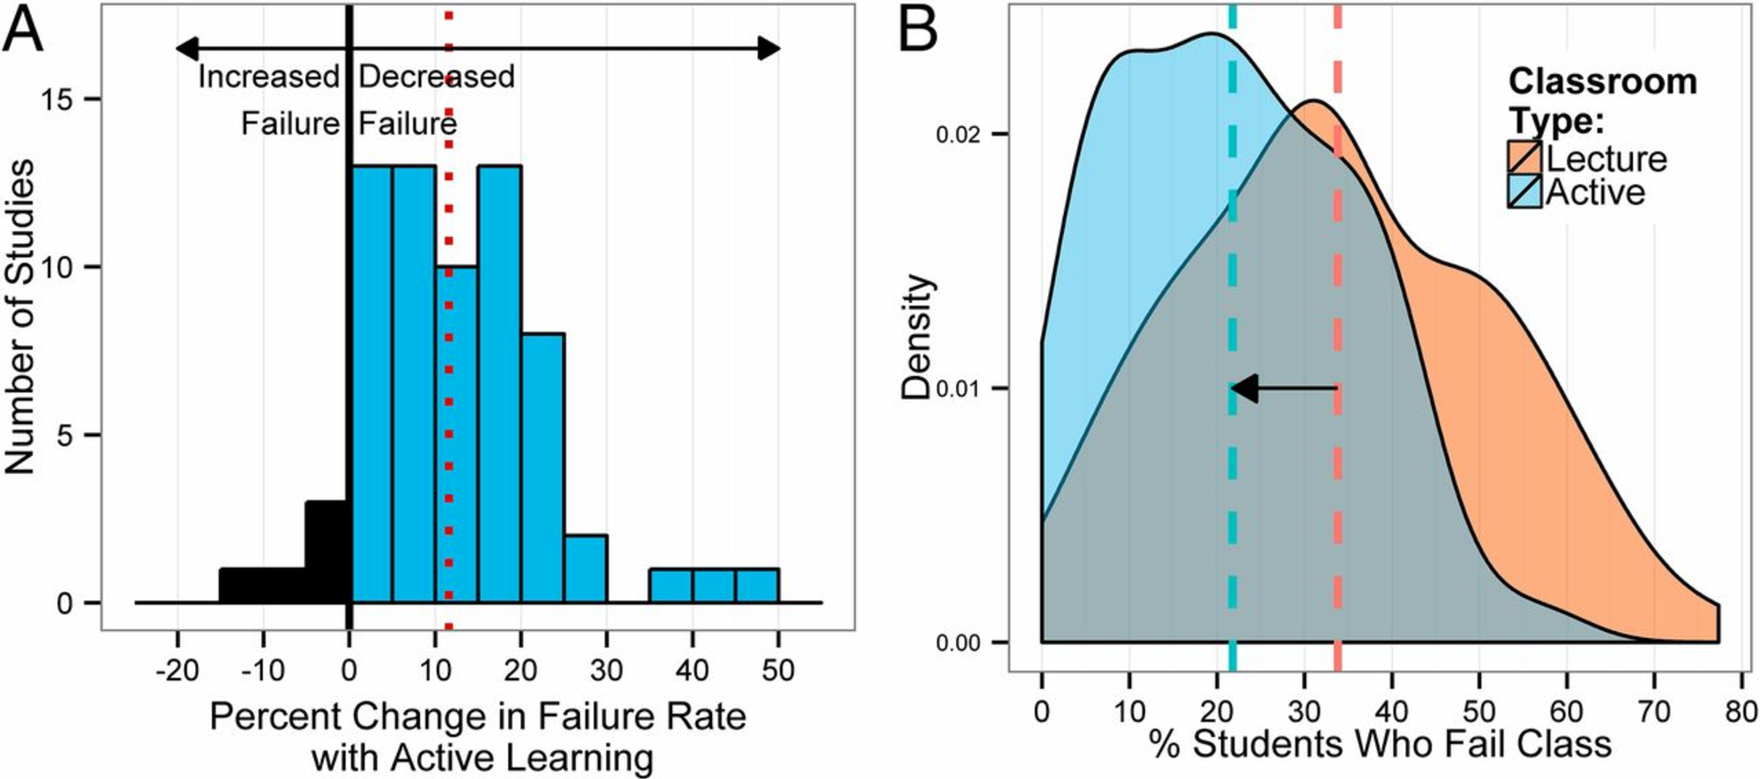
Review of Active Learning
Freeman et al. (2014) have provided the most comprehensive and current review of active learning in STEM subjects.
About 12% decrease in fail rate
About a 6% increase in overall grades (the difference of a B to a B+)
Notes:
Active learning defines a set of teaching practices, tools and techniques which aim to increase student-educator interaction and student engagement with materials. In general, active learning involves the replacement of the passive didactic style of teaching with in-class activities and discussion where students meaningfully interact with material (Freeman et al, 2014; Prince, 2004).

Slide 5
It’s not all is good news…
Active Learning takes longer to do, is expensive, and difficult (Prince, 2004)
Often studies not well matched and limited in scope (Wieman, and Gilbert, 2013).
“Silo effect” (Freeman, 2014)
Are the benefits of active learning limited to what is tested?
Notes:
Active learning defines a set of teaching practices, tools and techniques which aim to increase student-educator interaction and student engagement with materials. In general, active learning involves the replacement of the passive didactic style of teaching with in-class activities and discussion where students meaningfully interact with material (Freeman et al, 2014; Prince, 2004).

Slide 6
Aims: Why is Active Learning effective?
Do the benefits of active learning only apply to tested materials (direct effects), or are there general benefits (indirect effects)?
Why? (possible mechanisms)
Notes:
Two general aims of the current research – 1. to figure out if there are indirect benefits, and 2. to determine by, or by what mechanism

Slide 7
One form of Active Task
Interpolated/Interval testing
Ask students to retrieve information after study (Dunlosky, et al., 2013)
Relies on testing effects (direct; Rowland, 2014), and testing-potentiated effects (indirect; Chan, et al., 2018)
Notes:
Interpolated task are one type of ask – asks you to answer questions about the content as you are using, some people have already begun using this in the lecture hall, but not a lot of research has analysed its effects – some suggest that it uses testing and potentiation effects

Slide 8
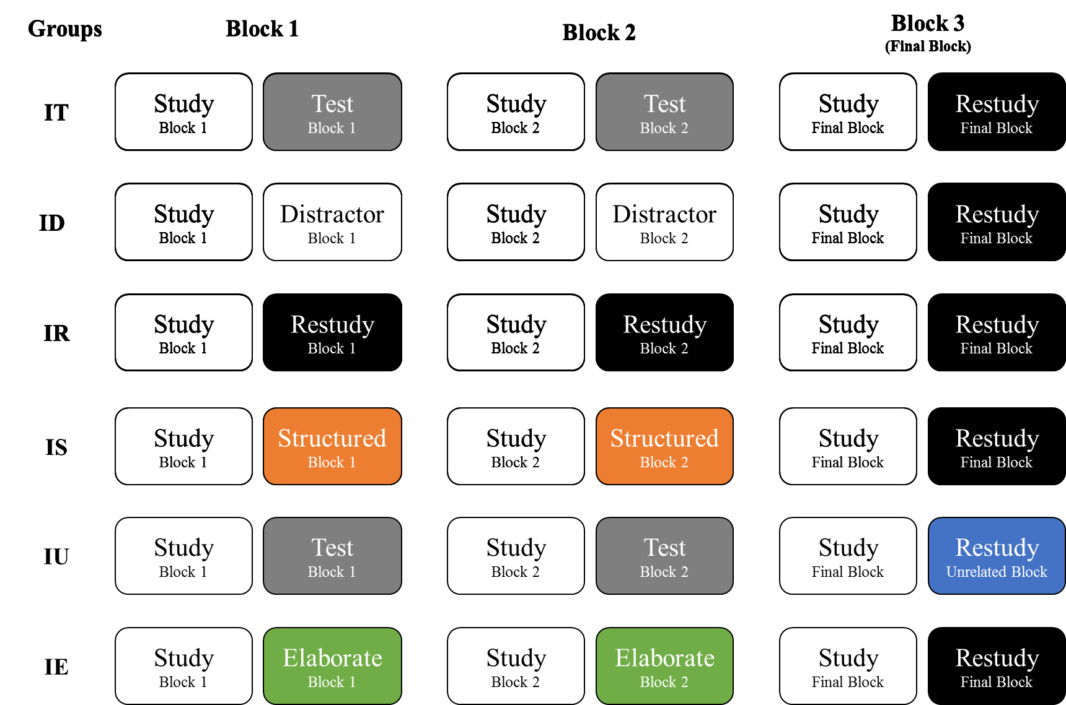
Current Research: Hypotheses & Methodologies
Active:
Passive:
Direct Effect
Test: Retrieval of video content
Distractor: Maths problem solving
Restudy: Reading of video content
Indirect Effect
Materials retaught using different styles
(memory for materials directly impacted)
Materials retaught using only restudy
(memory for materials indirectly impacted)
Notes:
It would make sense, right? If it were semantic, some research has suggested that retrieval increases the amount of semantic categorisation, (Chan, Manley, Davis, & Szpunarr, 2018) and we know from decades of research that elaboration can improve memory and is a high-efficacy tool, Dunlocky et al (2013) – perhaps when thinking about this from an educational perspective, increased understanding of Block 1 and Block 2 content enhances Final block content due to the greater overall understanding generated by retrieval – whether this be due to increased elaboration, semantic schema activation, easier categorisation, etc.
Throughout these three experiments we also manipulated minor details like content type, duration of lag, style of presentation, etc.

Slide 9
Task Examples
Maths Task (Distractor)
Retrieval (Test)
Reading (Restudy)
Notes:
Examples of task

Slide 10
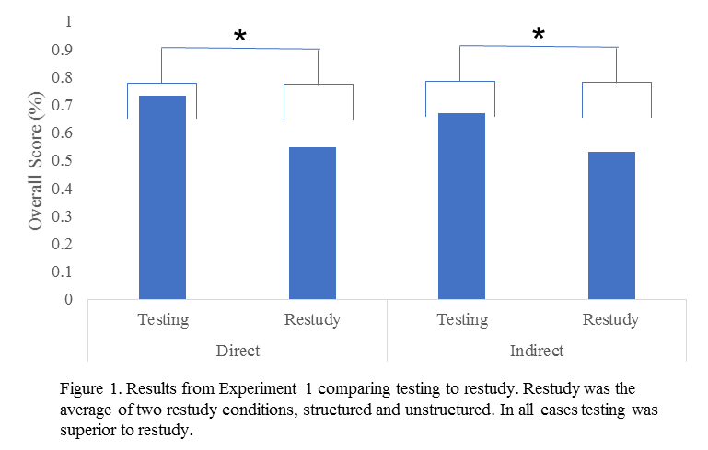
What about the findings?
Active:
Passive:
Direct Effect
Indirect Effect
Novel result – an active environment!
Good news for lecturers – don’t need to remake all your content (Yay!)
Easily predicted – testing works!
Supports existing testing effect research (Rowland, 2014)
Notes:
Some results - It would make sense, right? If it were semantic, some research has suggested that retrieval increases the amount of semantic categorisation, (Chan, Manley, Davis, & Szpunarr, 2018) and we know from decades of research that elaboration can improve memory and is a high-efficacy tool, Dunlocky et al (2013) – perhaps when thinking about this from an educational perspective, increased understanding of Block 1 and Block 2 content enhances Final block content due to the greater overall understanding generated by retrieval – whether this be due to increased elaboration, semantic schema activation, easier categorisation, etc.
Throughout these three experiments we also manipulated minor details like content type, duration of lag, style of presentation, etc.

Slide 11
Aims: Why is Active Learning effective?
Do the benefits of active learning only apply to tested materials (direct effects), or are there general benefits (indirect effects)?
No, there are general benefits which might be caused by an active environment
Why? (possible mechanisms)
Could be semantic, related to increased understanding
To assess this we ran three additional experiments
Notes:
Two general aims of the current research – 1. to figure out if there are indirect benefits, and 2. to determine by, or by what mechanism

Slide 12
Current Research: Hypotheses & Methodologies
Active:
Passive:
Experiment 1
Experiment 2
Experiment 3
Notes:
We ran three additional experiments, we compared different types of structure – with the assumption that changing structure would manipulate the clarity of semantic associations and improve restudy
We manipulated whether the final block – i.e. the new learning, or the indirect effect, was related to the original material – so we gave them a new video with different content – can’t really form deeper understanding if the content is changed.
And finally, introduced an elaboration task – which explicitly asked the participants to form these semantic associations, to generate more associations and cued.

Slide 13
Significance: Is the indirect effect semantic?
Taken together these results suggest that the fundamental benefits of the indirect effect are not semantically bound.
(i.e. greater overall understanding is probably not the main mechanism underlying the indirect effect)

Slide 14
Limitations and Future Direction
This is a lab study – need to move to classroom.
Underlying mechanisms need to be specified.
So, what is causing the effect? Metacognition? Strategy change? Attention? Motivation?
All points towards future studies using eye tracking and surveys!

Slide 15
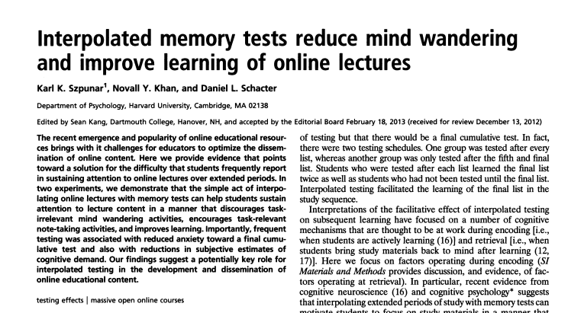
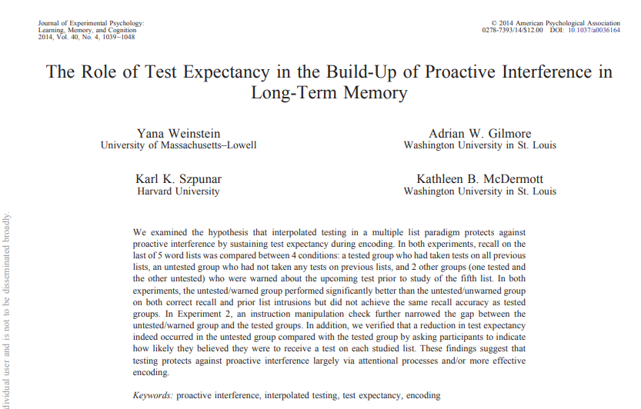
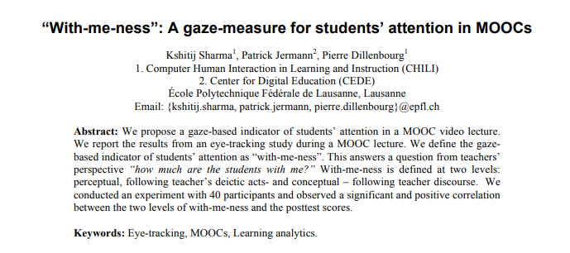
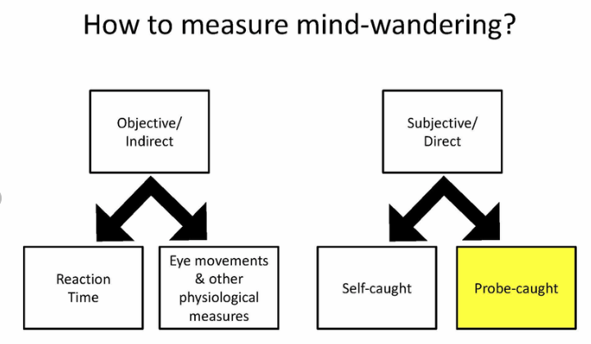
Mind wandering and attentional focus

Slide 16
Proactive Inhibition and Reset of Encoding
Block 1:
Cat
Dog
Fish
Human
Block 2:
Car
Truck
Sam
Batman
(Cat
Dog
Fish
Human)
Block 3:
Laptop
PlayStation
Work
Games
(Car
Truck
Sam
Batman)
(Cat
Dog
Fish
Human)
Experiment 3
Pastotter, B., Engel, M., & Frings, C. (2018).

Slide 17
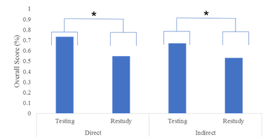
Active Learning Works! But How? Isolating Direct and Indirect Effects
Shaun Boustani
Background
Aims
Active Learning is a set of teaching styles which make students retrieve and interact with materials.
Dunlosky et al. (2013) and Freeman et al. (2014) have found that active learning is superior to passive styles on a range of outcomes.
However:
It is expensive and difficult to implement (Prince, 2004)
Existing research is not well controlled (Wieman, and Gilbert, 2013)
Doubt that the benefits generalise (Freeman et al., 2014)
To determine if the benefits of active learning only apply to tested materials (direct effects), or if there are more general benefits (indirect effects).
To discover if these effects are due to semantic factors.
Hypotheses
We expect that active learning does carry indirect effects, as demonstrated by forward testing effects (Wissman, Rawson, & Pyc, 2011). Therefore we hypothesise untested materials will be better remembered in active than passive conditions, it is also hypothesised that this is due to increased overall understanding.
Design and Method
Quantitative Research.
Participants were First Year Psychology Students recruited from SONA.
Three experiments
Experiment 1: Compared Active to Passive styles (Structured; Unstructured)
Experiment 2: Compared Semantically Related and Unrelated concepts
Experiment 3: Compared Active and Elaborative styles
Significance
First study to demonstrate the direct and indirect effects of intermittent testing (Active Learning) on passively taught information.
Demonstrates that the indirect effect is robust and large.
Provides three experiments demonstrating that this effect is not dependent on increased understanding of content throughout (i.e. is not semantically dependent),
Informs best practice for education.

Slide 18
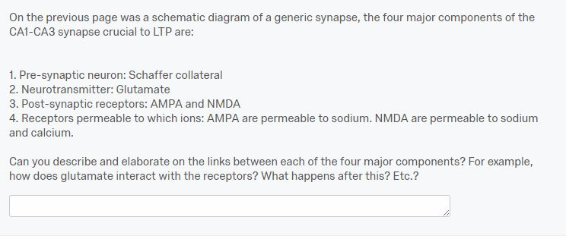
Task Examples (all)

Slide 19
Issues with Education
Current practices leave students disengaged, underprepared and unmotivated (Blumenfield and Paris, 2004)
Notes:
Job quality declining – down 20% from 2009
1/3 drop out, 60% don’t complete in the correct length
Funding is US federal and is from primary and secondary education
Although these are due to several socio-economic and cultural factors, part of the issue is how students are being taught, and where the spending has focused. It is often the case spending is wasteful, focusing on the latest buzzwords, such as engagement, or interactivity without proper understanding of mechanics

Slide 20
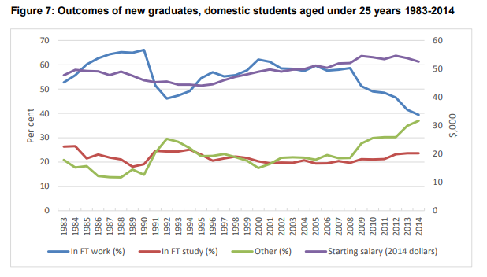
Job quality is declining - Under 40% of recent graduates are able to find full-time work (and this number is declining), and many are unable to find work in degree-related fields (Karmel and Carroll, 2016)

Slide 21
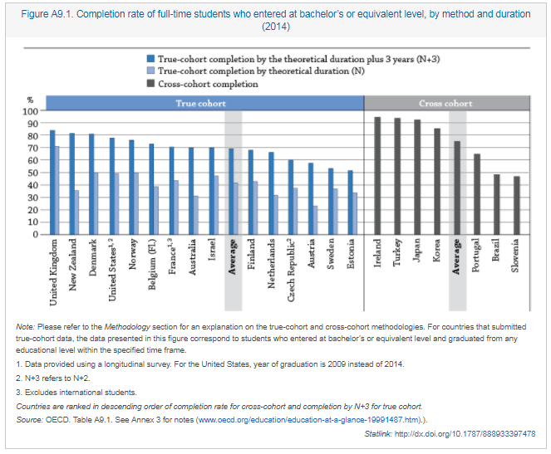
One in three will not finish their degrees, and only 40% finish their degrees in the estimated duration (OECD, 2016)

Slide 22
Review of the Classic Styles
Dunlosky et al. (2013) and Freeman et al. (2014) have reviewed the effectiveness of classic styles.
Concluded:
Disengaging
Inefficient
Outdated
Blumenfield and Paris (2004) the current state of education leaves students underprepared for the workforce.
Notes:
Dunlosky et al. (2013) have reviewed this approach and concluded that they fail in teaching students the required skills to function appropriately in the workforce.
Freeman et al. (2014) in their comprehensive review of teaching styles concluded that the classic style is disengaging, inefficient and outdated.
Both argue these failures are due to an inability to implement psychological principles in the classroom.
Evidently, this is partly due to the complex nature of learning materials in lectures, the constrained workloads and time available to educators, and a limited capacity to innovate within often bureaucratic institutions. However, some part of this is also due to the hesitancy of educators to adopt newer techniques. Perhaps due to the limited nature of the evidence surrounding them.

Slide 23
Why is this important?
Currently, there is very little evidence that there are consistent long-term effects to active learning which
1. Transmit across semesters/years
2. Generalise to other subjects (metacognition/meta-learning)
We know that active learning changes student evaluations. Students often report that they understand the benefits of active learning (whether they do is debatable).
However, does this come at the cost of genuine self-direction?
Does it reduce the efficacy in passive courses? (carrying a negative effect)
Is metacognition in some cases impeded?

Slide 24
Mechanisms
It is also equally possible that the concepts being taught are not inherently capable of leading to new understanding.
Although no studies have tested for metacognitive benefits….
A study has been conducted which used active learning to teach metacognition, which was assessed on the learning of ‘threshold concepts’
Huge benefits. It appeared that student learning abilities, and fundamental understanding of learning was improved (relative to a somewhat passive control), but also, the overall performance in the final exam was improved.
Seems to be an interaction effect where metacognition improved the understanding of threshold concepts which in turn carried a benefit to student understanding of the content.
Meyer, Knight, Callaghan, and Baldock, (2015)

Slide 25
Seems to be a lot of bias in the sample
Teachers want this to work
Questions based on content reinforced
https://www.ncbi.nlm.nih.gov/pubmed/22135373
https://www.ncbi.nlm.nih.gov/pmc/articles/PMC2592041/
http://www.lifescied.org/content/6/2/163.full.pdf+html
http://cs.adelaide.edu.au/users/ljiang/research/ResearchInComputerScienceEducation/5309358.pdf
41 vs 94 studies finding difference

Slide 26
We want to focus on a few things then
The effect of active learning on students moving from an active to a passive style
Metacognitive/generalisation variation in a class of active learners
Self-regulation/direction in learning
Discrete/Threshold Concepts

Slide 27
Current Research: Hypotheses & Methodologies
Active:
Passive:
Direct Effect
Indirect Effect
Experiment 1
Good news for lecturers – don’t need to remake all your content (Yay!)
So why is it effective?
Experiment 2
Experiment 3
Does the indirect effect observed depend on greater understanding of materials? (i.e. is the indirect effect semantically dependent)
Notes:
It would make sense, right? If it were semantic, some research has suggested that retrieval increases the amount of semantic categorisation, (Chan, Manley, Davis, & Szpunarr, 2018) and we know from decades of research that elaboration can improve memory and is a high-efficacy tool, Dunlocky et al (2013) – perhaps when thinking about this from an educational perspective, increased understanding of Block 1 and Block 2 content enhances Final block content due to the greater overall understanding generated by retrieval – whether this be due to increased elaboration, semantic schema activation, easier categorisation, etc.
Throughout these three experiments we also manipulated minor details like content type, duration of lag, style of presentation, etc.

