Slide 1
Introducing the ONS Longitudinal Study (ONS LS)
Introducing the ONS Longitudinal Study (ONS LS)
Dr Oliver Duke-Williams, UCL
o.duke-williams@ucl.ac.uk @oliver_dw
Celebrating 10 years of research projects at the SLS
Edinburgh, Dec 7th, 2017

Slide 2
The ONS Longitudinal Study (LS)
‘The ONS Longitudinal Study is a study containing linked census and life events data for a one per cent sample of the population of England and Wales’

Slide 3
What is the ONS LS?
Based on 4 birth dates in a calendar year (4/365.25 = 1.1%)
Contains information from the last five censuses
Contains information from civil registration and NHS registration systems
A relational database that links records of LS sample members
A dynamic sample with sample members entering and exiting
Over 40 tables and 5,000 variables

Slide 4
LS structure:
England & Wales
1971 Census
530,000 sample members
selected
513,000 traced
Entrants (1971-2012)
Births 303,000
Immigrants 202,000
Re-entries 25,000
1981 Census
536,000 sample members selected
530,000 traced
Linked) Events (1971-2012)
Live births to sample women 292,000
Still births to sample women 1,700
Infant deaths 2,400
Widow(er)hoods 90,000
Cancer registrations 140,000
1991 Census
544,000 sample members selected
535,000 traced
Exits (1971-2012)
Deaths 262,000
Embarks 45,000
Enlistments 7,600
2001 Census
540,000 sample members selected
537,000 traced
2011 Census
590,000 sample members selected
582,000 traced

Slide 5
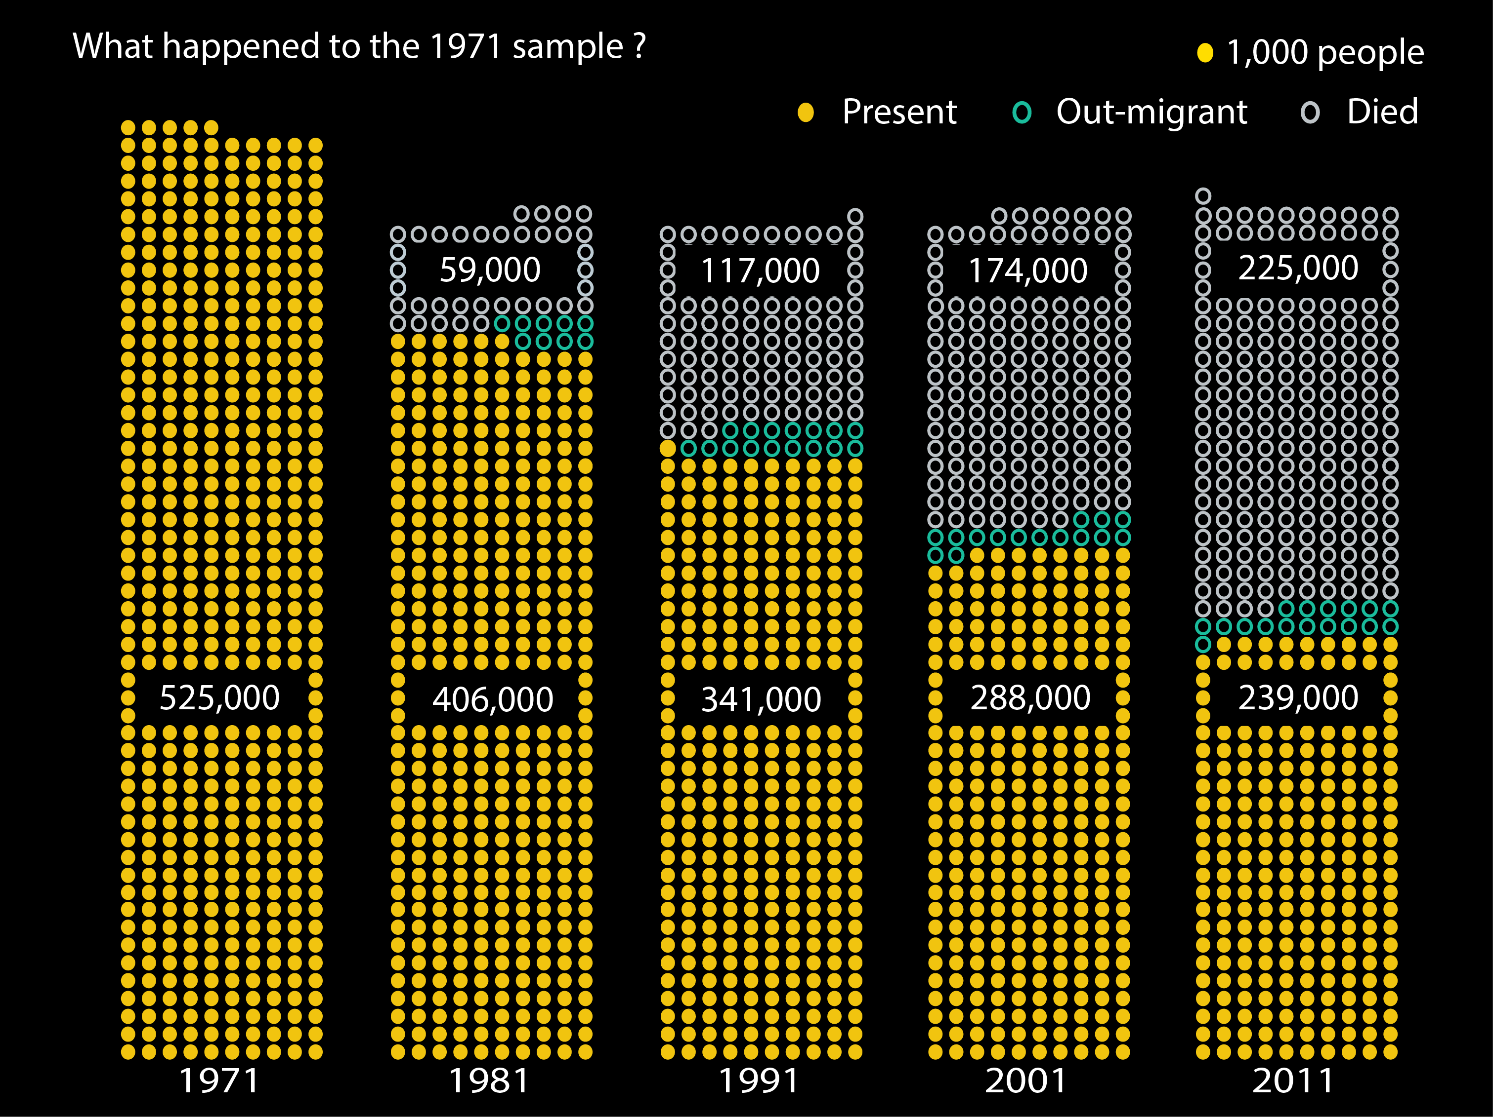
Following on from 1971…
Notes:
Note: 1971 – approx. 14k(m),26k(f),40k(p) persons aged 70+ therefore mostly born in c19th
Following 1971 forwards, we see exits from the sample: deaths and out-migration. This might be international migration, but in the context of the Lses might also be migration to Scotland or NI. Although the LS birth dates are a subset of the SLS and NILS dates, we can’t automatically track people moving across borders.
Deaths – to query: do we have place of death? I think so… Do we capture deaths in Scotland and NI in that case? DETH.CTRYRDE? DETH.CTRIRADE?
As well as deaths and out-migration we also have sample attrition, in the sense of people who do not complete a census (and are not identified in vital events data) and enlistment

Slide 6
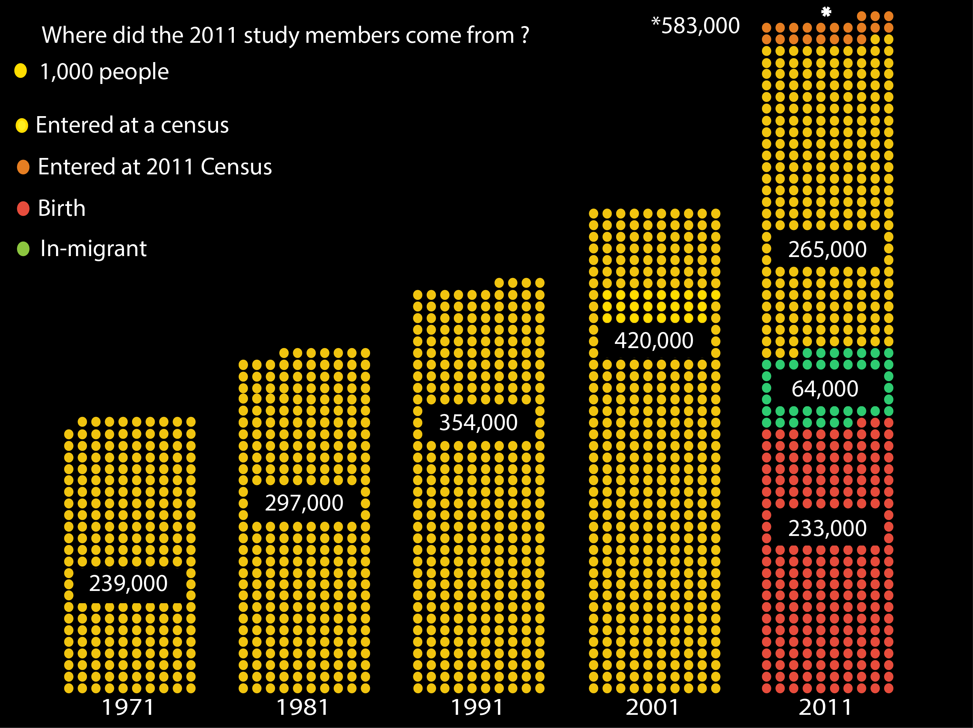
…leading up to 2011
Notes:
Looking at path to 2011, thinking about entries to the sample:
Birth
In-migration (international; from Scotland or Northern Ireland)
Re-entry

Slide 7
Developments since 2012
Beta test projects / 2011 linked data launch
User survey - matching users
Synthetic data
ONS consultations: 2021 Census, new approved researcher scheme & new VML
Training and Roadshows
Welsh linked data launch
Data dictionaries LS and UKLS

Slide 8
Beta tests supported by CeLSIUS
Health selective migration: Influences of geographical mobility & changes in socio-spatial contexts on health outcomes Norman, Leeds
Employment, family and caring responsibilities for women in the last decade: multiple jeopardy for some ethnic groups? Harding, Molaodi and Read MRC/CSO Social and Public Health Sciences Unit, Glasgow Rosato Queens University Belfast
Ethnic Migration and Mobility in England and Wales to 2011 Catney Liverpool, Kaufmann & Harris Birkbeck, Platt IOE, Zucotti EUI
Assessing the contributions of the workplace and employment history, the local area and individual health and social factors from childhood and adulthood to extended working life Shelton, Head & Stuchbury, UCL
Languages spoken and time since arrival, Duke-Williams UCL

Slide 9
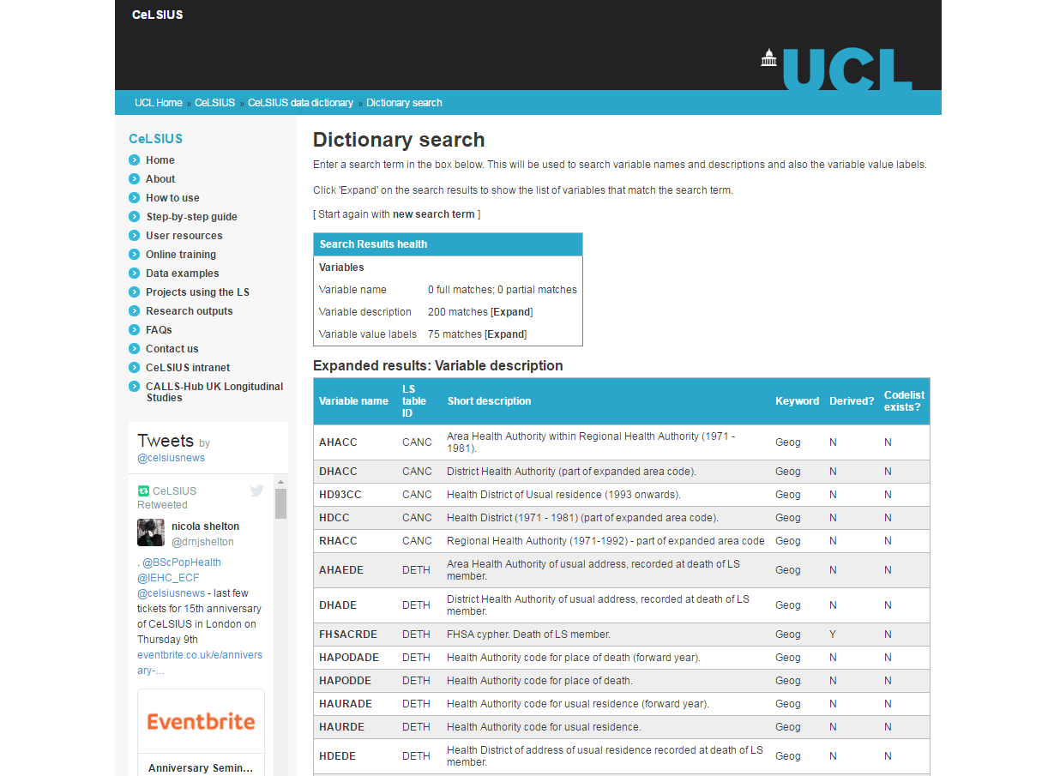
CeLSIUS Data Dictionary (all years)
Notes:
Developed by Oliver Duke-Williams

Slide 10
Dissemination
AAG
WISERD
Research Methods Festivals
PopFest
RGS
BSPS
RSS
SLLS
GSS
Government Office for Science
NISRA
Twitter
International Workshop on Multiple Cause-of-Death Analysis
EU data conference
UK Census Conference
ABS
DWP
ESRC meeting Brazil
IASSIST
Webinar
ESRC Doctoral Training
CLOSER
UCL

Slide 11
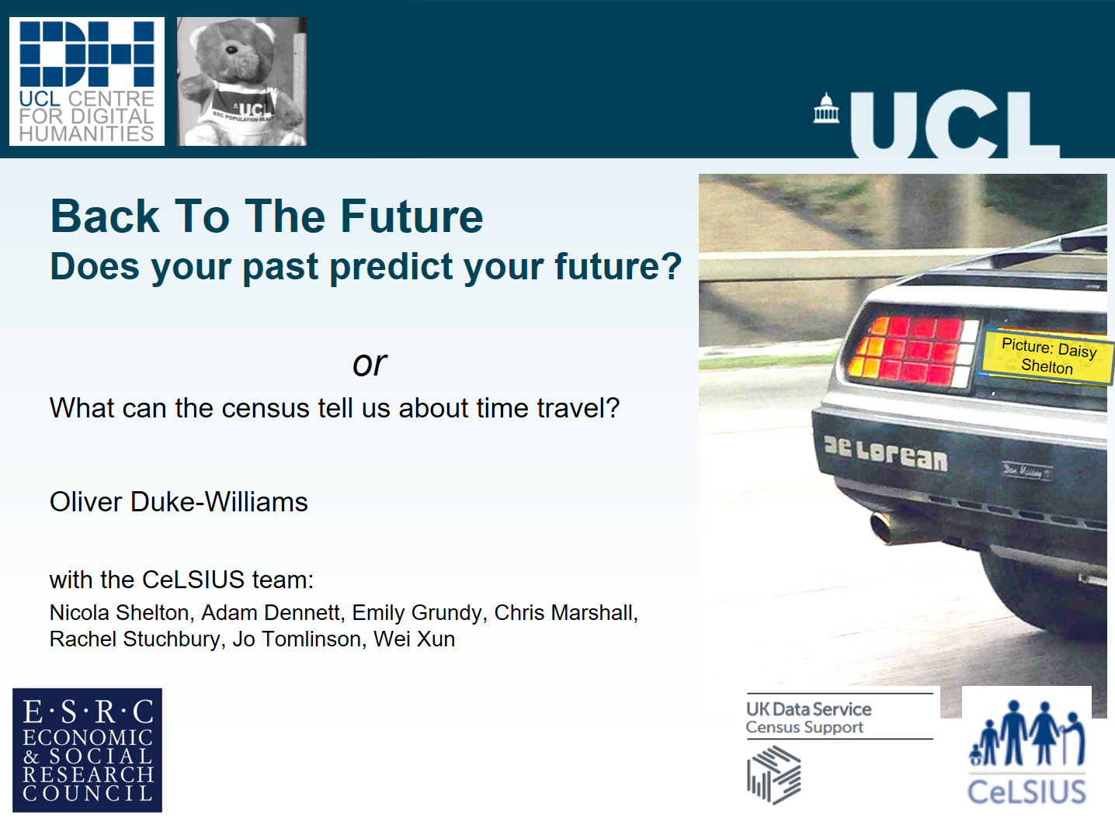

Slide 12
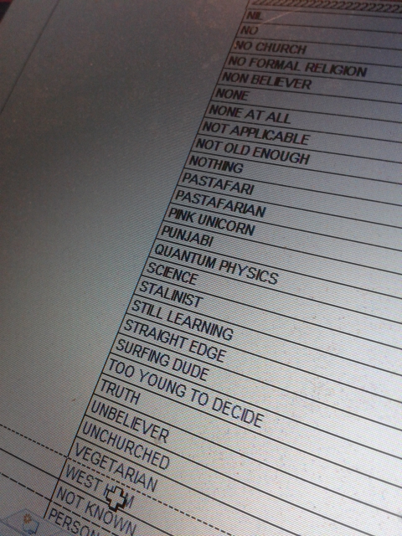
What can the census tell us about time travel?
We are all travelling in time, mostly in the same direction
  The census takes a look at time travellers every 10 years
  Longitudinal census data allow us to follow the same people, and see what happens to them

Slide 13
Longitudinal Study
Using longitudinal data, we can look at how individuals have changed over 30 years
  The same people seen as teenagers in the 1980s, and seen again in the 2010s
    Living with their parents in 1981
    Living with their children in 2011
Nearest dates to 1985 and 2015

Slide 14
Education
If your parents had educational qualifications, were you more likely to?
 |  | 1981 parental highest qualification
 |  | Degree / higher degree |  | Sub degree | None or unknown
2011 highest qualification
 | No academic or prof. quals |  | 1% | 3% | 13%
 | 1-4 O Levels / GCSE / equiv. |  | 6% | 12% | 24%
 | 5+ O Levels / GCSE / equiv. |  | 11% | 17% | 20%
 | Apprenticeship & Vocational |  | 1% | 3% | 5%
 | 2+ A Levels / equiv. |  | 10% | 14% | 13%
 | Degree inc. higher degrees |  | 72% | 52% | 25%
 | n |  | 1568 | 1376 | 16237
Age 15-17 in 1985 (Age 11-13 in 1981)
Source: ONS Longitudinal Study

Slide 15
Present in LS by age
% of persons within age group
All persons born in Wales, present in ONS LS (England and Wales) 2011

Slide 16
Future plans
Using the LS to identify missing data in the cohort studies
  and vice versa
Small area statistics over time
Missing data and internet response
Adding contextual data

Slide 17
Acknowledgment
The permission of the Office for National Statistics to use the Longitudinal Study is gratefully acknowledged, as is the help provided by staff of the Centre for Longitudinal Study Information & User Support (CeLSIUS). CeLSIUS is supported by the ESRC Census of Population Programme under project ES/K000365/1. The authors alone are responsible for the interpretation of the data.
This work contains statistical data from ONS which is Crown Copyright. The use of the ONS statistical data in this work does not imply the endorsement of the ONS in relation to the interpretation or analysis of the statistical data. This work uses research datasets which may not exactly reproduce National Statistics aggregates

