Slide 1
The mathematics gender jigsaw in Further Education
Assoc Professor Jennie Golding, UCL IOE
What do we know about gender and mathematics in FE, and how should we respond?
NANAMIC Keynote, 6 July 2022

Slide 2
About me
Gender and mathematics in mainstream education, including in FE
Approaches to addressing the identified issues, with a focus on PLAS
Questions

Slide 3
A note on terminology
Remember also that differential attainment and participation in mathematical and other qualifications by socioeconomic status, as well as for some ethnic and other groups, remains a significant issue for both personal and national thriving (e.g. Ofsted, 2014).

Slide 4
Who am I?
Mathematician turned teacher turned academic (‘maths ed junkie’)
35 years teaching 5 to 18 in schools, and working in teacher development/maths education policy, in England and internationally
‘Specialism’ in picking up year 10 or 11 low-attaining students and GCSE retake students
I now work in classroom-close curriculum enactment research, including with FE-based studies
Notes:
(using student and teacher voice to trying to understand why maths teaching and learning is as it is, and what changes in curriculum, assessment, teacher education would support better outcomes for our young people, so I know the evidence base reasonably well)

Slide 5
02
Gender and mathematics in mainstream education, including in FE

Slide 6
I’ll draw on
my recent research producing UK mathematics 14-19: the gender jigsaw. A report for the Joint Mathematical Council of the UK (2022). https://www.jmc.org.uk/output/ and Gender, self-perception, and mathematics: the 2020 England, Wales and Northern Ireland PISA Field Trial (2021). https://bsrlm.org.uk/publications/proceedings-of-day-conference/ip41-3/
my own teaching experience of mathematically low-attaining students,
the literature around these students, in a variety of contexts,
their reports when they return to school having transferred to FE College
the work of FE colleagues in colleges and UCL
Notes:
(using student and teacher voice to trying to understand why maths teaching and learning is as it is, and what changes in curriculum, assessment, teacher education would support better outcomes for our young people, so I know the evidence base reasonably well)

Slide 7
‘UK mathematics 14-19: the gender jigsaw’ for JMC concluded:
Broad structures in England, Wales and Northern Ireland have much in common, but curricula and assessments have diverged since 2016. Scotland’s provision supports greater local autonomy of enactment, and often a wider curriculum to at least age 17.
Across the UK, girls enter Mathematics GCSE/N5 and additional mathematics qualifications in comparable numbers with boys at age 16, and they perform at least as well as boys in those qualifications.
Approaches to assessment during the pandemic have resulted in the award of significantly enhanced grades, especially to girls.
Each year, around 180,000 older students retake GCSE, especially in England, but the ‘standard pass’ rate remains low and the mathematical benefit is often questionable.

Slide 8
Significant differential participation in favour of boys is evident in all main advanced school mathematics qualifications in the UK except Core Maths, including in FE colleges, though it is less marked in Northern Ireland. Total advance mathematics entries remaining fairly steady.
Key issues in 16+ UK education are therefore around provision for previously low-attaining students, gender bias within most advanced school mathematics pathways, and under-participation by previously moderate- or high-attaining students.
There is comparatively little national information about level 1 or Entry Level course participation and attainment, by gender.
(UK mathematics 14-19: the gender jigsaw Executive Summary)

Slide 9
In graphs:

Slide 11
For students over 16

Slide 12
Functional Skills qualifications
National pass rates for Entry Level qualifications are not easily available, as these are all internally assessed.
For Functional skills maths at L1,2, national statistics (entry and attainment) by gender are not available, but:
Assessment | First Time Pass Rate | Overall Pass Rate
Maths Level 1 | 40% (34.4% for FE) | 24.1% (20% for FE)
Maths Level 2 | 42.2% (33.6% for FE) | 29.3% (22.4% for FE)

Slide 13
Advanced school mathematics attainment

Slide 14
Advanced school mathematics participation

Slide 15
Scotland Higher and Advanced Higher Mathematical Studies participation

Slide 16
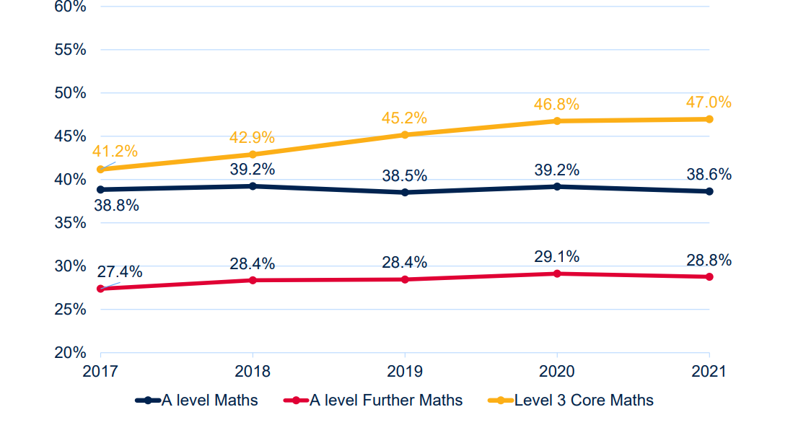
% of female entries for advanced school mathematics qualifications in England, Northern Ireland, Wales

Slide 17
In Scotland:

Slide 18
In summary: Mathematics participation and performance in the UK
F performance at least matches that of M at age 16
F then participate in GCSE resits in higher numbers. Their success rate is similarly low (except for in the last two years)
Success rates in entry level, L1 and L2 FS are also low, for both genders.
F participate in AL Mathematics in EWNI in much lower numbers than do M, but equally successfully.
The participation gap is less in Scotland, and F often outperform M in Scottish Highers.
Core Maths is currently achieving comparable participation and attainment from M and F.

Slide 19
Other international evidence: Are these gaps unique to the UK?
International studies show gendered gaps in academic and occupational mathematics participation are not inevitable, but they are widespread, and often related to comparatively poor mathematics-related affect or unhelpful stereotypes, especially among girls.
Girls are more likely to value, and be influenced by, pedagogic approaches and supportive interactions that are with a range of others. Participation at this level is enhanced by ambitious, connection-making teaching which embraces appropriate challenge and supports students through that. Importantly, we know that also supports long-term confident mathematical functioning across genders.

Slide 20
International large scale studies to 2022: PISA (mathematics literacy of 15 year olds) and TIMSS (curriculum mathematics at ages 9/10 and 13/14, in England)
England and Wales show an improving trend in ‘mathematics literacy’ across successive PISA cycles, while Scotland has declined and Northern Ireland has remained broadly stable. Boys have often, but not always, somewhat outperformed girls, but not to the extent they do across the OECD as a whole.
Accompanying surveys of mathematics-related beliefs and experiences show marked differences by gender, in ways known to be detrimental to girls’ future participation, and these differential reports are remarkably persistent across time and UK country.
In TIMSS at age 14 (England only, to 2019), students’ reported affect and experiences continue differentially detrimental to girls’ continuing participation.

Slide 21
PISA 2020 Field Trial in EWNI
‘We found that across performance levels on mathematics items, girls reported their mathematics attainment, enjoyment, interest in pursuing mathematics or encouragement to do so, and perceived competence in mathematics, as well as its perceived utility, significantly less positively than did boys. Irrespective of gender, students reported little exposure to authentic applications of the mathematics studied in school’.
(Abstract, ‘Mathematics and gender: lessons from the PISA 2020 Field Trial in England, Wales and Northern Ireland’)
International studies show that while such findings are not uncommon, they are also not inevitable

Slide 22
Why does it matter?
Relative, as well as absolute, participation and attainment matter because mathematics provides access to careers in the range of STEM and social science fields, and associated personal, economic and social benefits. Women are particularly underrepresented in jobs at the mathematics-intensive technical frontier: in the 20 leading economies, women workers account for 26 percent of workers in data and artificial intelligence, 15 percent of workers in engineering, and 12 percent of workers in cloud computing (WEF 2020). Such concerns underpin recent global focus on participation by gender (e.g. UNESCO 2017, World Bank 2020) but are experienced far from uniformly across the globe. Concerns are reflected in e.g. first year undergraduate numbers in England (Figure 1). However, it is becoming increasingly clear that there is a concern about ‘pipelines’ into not only the most mathematically demanding courses and careers, but across a much broader range of mathematical functioning, as mathematical demands increase across a wide spectrum of occupations as well as of personal thriving, especially with the proliferation of easily-accessible data
(UK mathematics 14-19: the gender jigsaw p6).

Slide 23
Particular (additional) issues for PLAS
Baggage 1: they have probably ‘failed’ maths multiple times, and have been in the lowest third of mathematics attainers from the start of school.
Baggage 2: they have probably been taught ‘to the test’ and believe GCSE/FS mathematics doesn’t make sense; they believe they ’can’t do maths’
Baggage 3: they probably believe they will look silly to peers if they make mistakes.
Baggage 4: they believe they are adults now
Baggage 5: they probably resent having maths lessons imposed on them

Slide 24
03
Approaches to addressing the identified issues

Slide 25
The evidence shows teaching mathematics for meaning-making and for connections, including to realistic uses of mathematics in across a wide range of contexts, supports the confident participation of all students, but especially girls. That teaching should also challenge, encourage, support and specifically affirm the mathematical identity and capabilities of all students. It should offer opportunity for working in a range of both collaborative and independent, discursive ways. Developing curricula and pedagogies should also build on gender-specific preferences and interests in harnessing digital tools for mathematical purposes. Other small-scale interventions should target the range of influences on young people’s pathways decisions: their peers, their parents and other influential figures, extra-curricular activities, the resources they use and images and roles they encounter, to promote gender-inclusive messaging. Teachers might also consider single-sex activities on occasion
(UK mathematics 14-19: the gender jigsaw Executive Summary).

Slide 26
Curriculum and Assessment
In EWNI, offer, and promote, (preferably two-year) Core Maths for non-specialist mathematicians who have already achieved a level 2 Ma qualification, unless they particularly enjoy pure mathematical ideas and/or want to pursue a maths-intensive area of study or work.
Revisit models of assessment to ensure they promote the mathematical behaviours we value most, including across genders

Slide 27
GCSE Mathematics
Our GCSE Mathematics curriculum and pedagogy in schools (or colleges) are not working well, for most young people. So we need to be more proactive in seeking curriculum and pedagogy models that engage young people and equip them for confident functioning in a world that is already making greater demands on mathematical, data, financial and digital literacies. That will benefit all students, but particularly girls.

Slide 28
Meanwhile, for young people coming into FE with low attainment in mathematics, we need to address their ‘baggage’:

Slide 29
Baggage 1: they have probably ‘failed’ maths multiple times, and have been in the lowest third of mathematics attainers from the start of school.
Explicit teaching
Student talk*: whole class, pairs, group activities such as Standards Unit Tasks ‘Improving Learning in Mathematics’ https://mrbartonmaths.com/teachers/rich-tasks/standards-units.html
Formative assessment* that emphasises effort and progress
Seek support for 18-month or two-year GCSE retake courses?
*Acknowledge and actively address exam worries
Notes:
(They may well have been out of school for a chunk of that time or have had additional significant stresses. (SES doesn’t add further to that). They might in theory recognise the ‘exchange’ value of GCSE grade 4+ but not believe it’s for them. They’ve failed so often, they worry about taking further maths exams (and not without reason, given the GCSE retake success rate: exchange vs use value)).

Slide 30
Baggage 2: they have probably been taught ‘to the test’ and believe GCSE/FS mathematics doesn’t make sense; they believe they ’can’t do maths’
Be selective and work in depth: it’s important the ideas you do work with make sense to students*
Draw from your classes what maths they use in their vocational or other courses*: Sam doesn’t need to be using ratios at present but will be convinced of their importance if Ali talks about using them. In large colleges you might be able to teach maths in vocational groups
Explicit teaching – for meaning, with manipulatives, representations, peer explanations* (‘who’s got a good way of going about this one?’). Perhaps brain-into-gear activity, focus on one area, build experience individually, in pairs or as a group, include GCSE paper questions and problem solving questions (e.g. https://www.resourceaholic.com/p/problem-solving.html)
Expose and affirm progress and specific successes*
Maths comes with a speed limit.
Notes:
(They may well have been out of school for a chunk of that time or have had additional significant stresses. (SES doesn’t add further to that). They might in theory recognise the ‘exchange’ value of GCSE grade 4+ but not believe it’s for them. They’ve failed so often, they worry about taking further maths exams (and not without reason, given the GCSE retake success rate: exchange vs use value)).

Slide 31
Baggage 3: they probably believe they will look silly to peers if they make mistakes.
Explicit teaching
It’s OK not to understand; it’s not OK to pretend to understand
Students write (and answer) their own questions, perhaps in pairs*
Games* are used for developing confidence and exposing challenges: Treasure Hunts, Murder Mysteries, board games, starters such as the 24-game*, Countdown*
Feedback has to be immediate, targeted, concrete, action oriented, and confidence building*.
Notes:
(They may well have been out of school for a chunk of that time or have had additional significant stresses. (SES doesn’t add further to that). They might in theory recognise the ‘exchange’ value of GCSE grade 4+ but not believe it’s for them. They’ve failed so often, they worry about taking further maths exams (and not without reason, given the GCSE retake success rate: exchange vs use value)).

Slide 32
Baggage 4: They believe they are adults now.
Make that work for you. ‘Now that you’re in college’: capitalise on that fresh start
Draw on their experience in their other courses, especially vocational courses*
Use examples that are quirky: are blonde men dumb?
Increase your expectations of their metacognition* (monitoring and controlling their thinking): what have you done? how far have you got? Why did you think of that?
Monitor resources you draw on for authenticity, e.g. https://www.map.mathshell.org/tasks.php, ‘Ponzi’ Pyramid Schemes.
Notes:
(They may well have been out of school for a chunk of that time or have had additional significant stresses. (SES doesn’t add further to that). They might in theory recognise the ‘exchange’ value of GCSE grade 4+ but not believe it’s for them. They’ve failed so often, they worry about taking further maths exams (and not without reason, given the GCSE retake success rate: exchange vs use value)).

Slide 33
Baggage 5: they probably resent having maths lessons imposed on them
Acknowledge the issue*
Relationships* are important, but…. Most low attaining pupils enjoy their mathematics lessons and value their mathematics teacher, even though they report finding mathematics difficult. However, learning to work through struggle and some failure is important.
Subtle messages about the usefulness of maths* – and talk with your colleagues across the curriculum. Contexts need to be authentic – or presented as puzzles.
https://www.transum.org/Software/sw/Starter_of_the_day/Starter_November25.asp
Notes:
(They may well have been out of school for a chunk of that time or have had additional significant stresses. (SES doesn’t add further to that). They might in theory recognise the ‘exchange’ value of GCSE grade 4+ but not believe it’s for them. They’ve failed so often, they worry about taking further maths exams (and not without reason, given the GCSE retake success rate: exchange vs use value)).

Slide 34
In summary, pedagogy at all levels should include
Explicit teaching for sense-making
Mathematical talk
Use of manipulatives and representations
Metacognition and self-regulation
Formative assessment
Feedback
And structures, including teacher professional development, that support those
Notes:
(They may well have been out of school for a chunk of that time or have had additional significant stresses. (SES doesn’t add further to that). They might in theory recognise the ‘exchange’ value of GCSE grade 4+ but not believe it’s for them. They’ve failed so often, they worry about taking further maths exams (and not without reason, given the GCSE retake success rate: exchange vs use value)).

Slide 35
04
Questions/discussion
j.golding@ucl.ac.uk

Slide 36
Key literature
Allen, T., Riley K., & Coates, M. (2020). Belonging, Behaviour and Inclusion: A Literature Review of What we know and What we don’t know. London: National Education Union.
ASCL (2019). The Forgotten Third: Report of the Commission of Inquiry chaired by Roy Blatchford. Oxford: OUP.
Ashcraft, M.H. and Kirk, E.P. (2001), ‘The relationships among working memory, math anxiety, and performance’, Journal of Experimental Psychology: General, 130, 224–237. Available at: http://dx.doi.org/10.1037/0096-3445.130.2.224
Dalby, D. and Noyes, A. (2016), ‘Locating mathematics within post-16 vocational education in England’, Journal of Vocational Education & Training, 68(1), 70–86. Available at: https://doi.org/10.1080/13636820.2015.1110828
Higton, J., Archer, R., Dalby, D., Robinson, S., Birkin, G., Stutz, A., Smith, R. and Duckworth, V. (2017), Effective Practice in the Delivery and Teaching of English and Mathematics to 16–18 year olds (Department for Education: London, UK). Available at: https://www.gov.uk/government/publications/english-and-maths-for-16-to-18-year-olds-effective-teaching
Hodgen, J., Coe, R., Foster, C., Brown, M., Higgins, S., & Küchemann, D. (2020). Low attainment in mathematics: An investigation focusing on Year 9 students in England. Final Report. London: UCL Institute of Education.
Maehr, M.L. and Meyer, H.A. (1997), ‘Understanding motivation and schooling: where we’ve been, where we are, and where we need to go’, Educational Psychology Review, 9, 371–409. Available at: https://www.jstor.org/stable/23359409
Riley K., Coates, M. &Allen, T. (2020) Place and belonging in school: why it matters today. London: National Education Union file:///D:/Low%20attainers/Other%20relevant%20literature/Belonging%20research%20booklet.pdf
Robbins, S.B., Lauver, K., Le, H., Davis, D., Langley, R. and Carlstrom, A. (2004), ‘Do psychosocial and study skill factors predict college outcomes? A meta-analysis’, Psychological Bulletin, 130, 261–288. Available at: https://doi.org/10.1037/0033-2909.130.2.261
The Research Base (2014), Effective Practices in Post-16 Vocational Maths (The Education and Training Foundation: London, UK). Available at: https://www.et-foundation.co.uk/research/effective-practices-post-16-vocational-maths/
Ramirez, G. and Beilock, S.L. (2011), ‘Writing about testing worries boosts exam performance in the classroom’, Science, 331(6014), 211–213. Available at: https://doi.org/10.1126/science.1199427

Slide 37
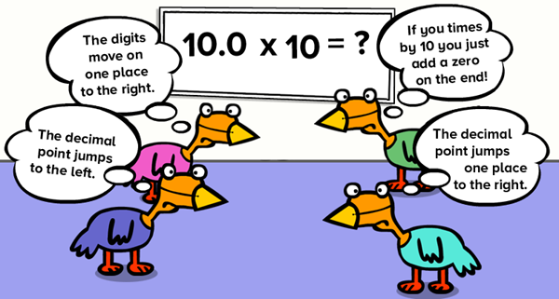

Slide 39
Bingo:
Answer the following questions, and cross out the answer on your grid. When you have a straight line of 5 in any direction, say ‘Bingo’: the winners are the first to say that (with correct answers!)
1 |  | 5% of 20
2 |  | 20% of 10
3 |  | 10% of 30
4 |  | 1/5 of 20
5 |  | 1/4 of 20
6 |  | 15% of 40
7 |  | 0.7 of 10
8 |  | 1/7 of 56
9 |  | 30% of 30
10 |  | 5% of 200
14 |  | 70% of 20
15 |  | 30% of 50
16 |  | 2/3 of 24
17 |  | 25% of 68
18 |  | 90% of 20
19 |  | 38% of 50
20 |  | 4/5 of 25
21 |  | 3/4 of 28
22 |  | 11% of 200
23 |  | 25% of 92
11 |  | 1/3 of 33
12 |  | 40% of 30
13 |  | 13% of 100
24 |  | 12% of 200
25 |  | 5/6 of 30

Slide 40
Building confidence with number
The 24-game
Using each number once and only once, can you combine the given four numbers using any of +, -, x, ÷?
9,6,6,2
7,8,5,3
3,3,8,8
Using all four numbers 4, 6, 6 and 8, but using each number only once, there are over 60 different ways of getting the answer 24 by adding, subtracting, multiplying and dividing. How many can you find?
Countdown:
Choose a ‘target number’ between 200 and 500
Choose two numbers between 1 and 10
Choose two numbers from 10 to 20
Choose one number from 20 to 30

