Slide 1


(A)
prediction
observation
DISCREPANCY
perception: change beliefs
action:
change world
(B)
variational free energy

Slide 2
GENERATIVE MODEL
GENERATIVE PROCESS
hidden state
hidden state
x
y
x*
inferred state
u
observation
action

Slide 3
(A)
(B)
(C)
x
x
x
y
y
y
Homeostat
Allostat

Slide 4
FIGURE 4 is on a separate file

Slide 5
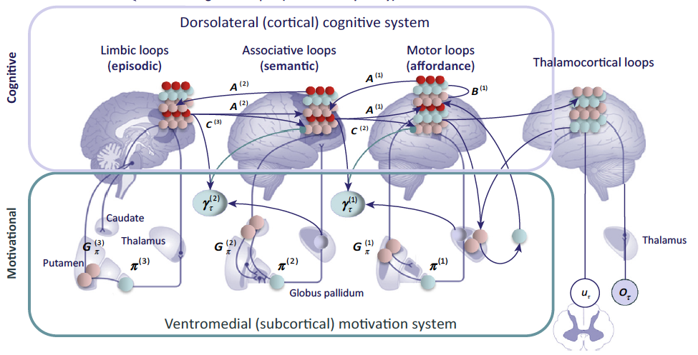
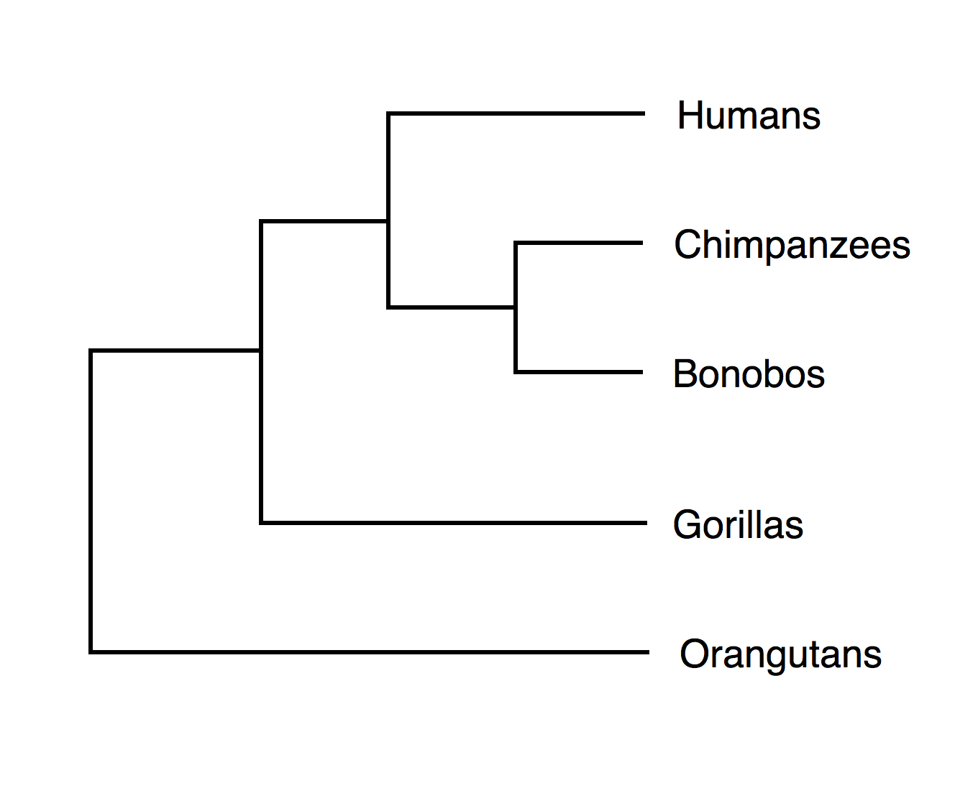
SCHEMATIC OF PRIMATE BRAIN
H
T
I
A
H
I
I+I
T
A
I
SCHEMATIC OF EARLY VERTEBRATE BRAIN
I
I
...
...

