Slide 1
Equality, Diversity and Inclusion Rima Chakrabarti Chair of Gender Equality Taskforce at UCLMS EDI
UCL Medical School

Slide 2
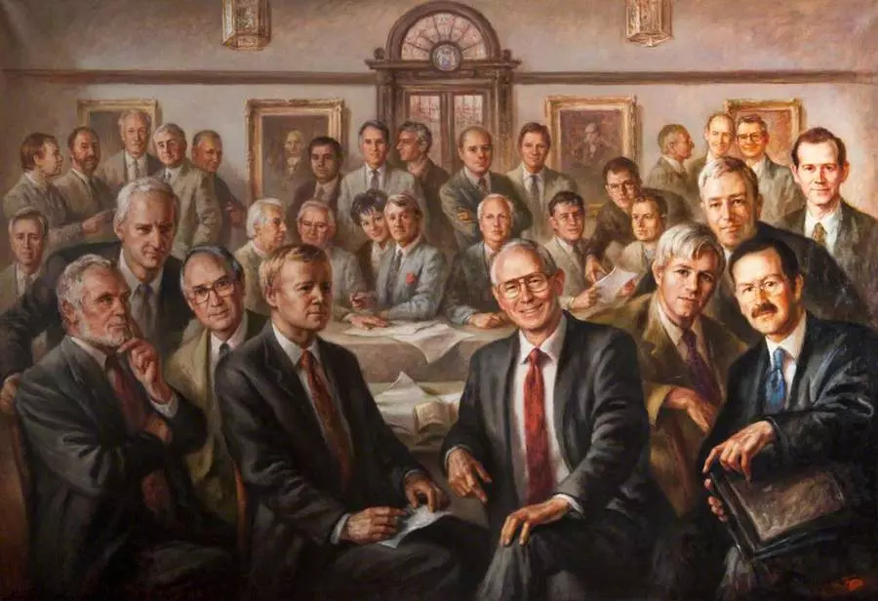
Representing a real cross section of society here
Group portrait by Alan Sutherland of Council members of Royal College of Physicians and Surgeons in Glasgow in 1999

Slide 3
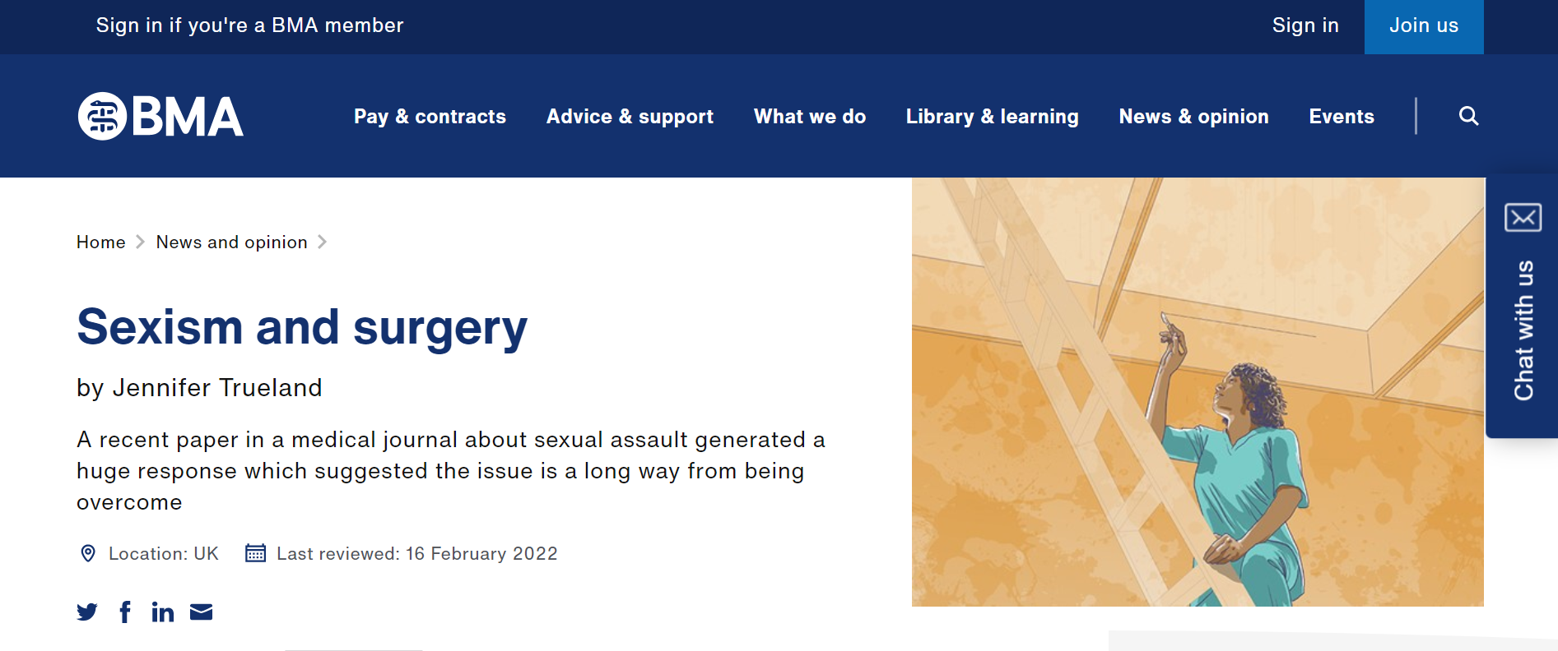
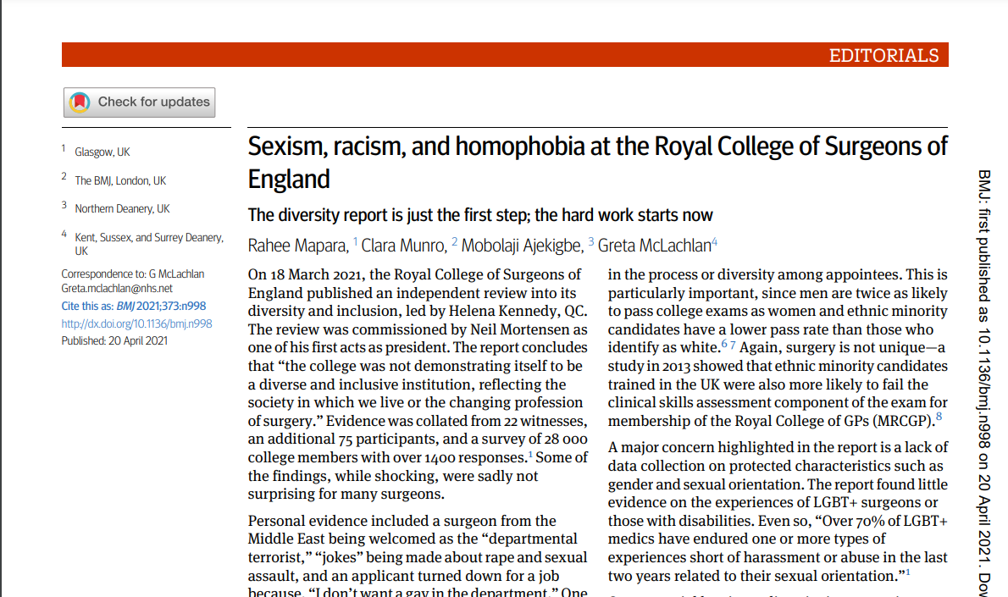
So how big is the problem in healthcare?

Slide 4
Policy documents to reflect creating safe and supportive culture
Policy documents to reflect creating safe and supportive culture
Equity of opportunities
e.g., Widening Participation Programmes
How do we promote EDI in Medical Education?
Purpose & Culture
Recruitment & Retention
Ongoing evaluation
Curriculum & Program structure
Challenging microaggressions
e.g., Active Bystander Training
Performance Assessments
Training Surveys
Challenging microaggressions
e.g., Active Bystander Training
Performance Assessments
Training Surveys
Adapted from Simpson D. 11 Framing equity, diversity & inclusion efforts across the continuum of medical education using IHI model for improvement. BMJ Open Quality 2020;9:doi: 10.1136/bmjoq-2020-IHI.11

Slide 5
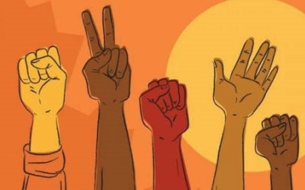
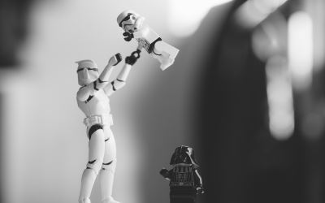
Ethnicity and Race
Disability, Health & Wellbeing
UCLMSEDI
Groups
Gender Equality
Faith
LGBTQ+ Equality
Parents and Carers

Slide 6
Email me at r.chakrabarti@ucl.ac.uk

