Slide 1
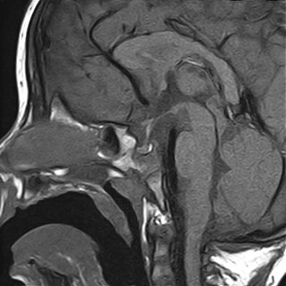
Patient 5
Patient 2
Patient 3
WML
CC
WML
CC
AP
PP
Patient 4
WML
CC

