Slide 1

OER and use of Open Data to Develop Transversal and Citizenship Skills
Leo Havemann @leohavemann | l.havemann@bbk.ac.uk | Birkbeck, University of London
Javiera Atenas @jatenas | javiera.atenas@idatosabiertos.org | Latin American Initiative for Open Data
2nd World OER Congress Satellite, Ljubljana, Slovenia | September 19, 2017
Image: Christoph Scholtz, 2017 (CC BY-SA 2.0)
Notes:
Photo Credit: <a href="https://www.flickr.com/photos/140988606@N08/36170629573/">Christoph Scholz</a> Flickr via <a href="http://compfight.com">Compfight</a> <a href="https://creativecommons.org/licenses/by-sa/2.0/">cc</a>

Slide 2


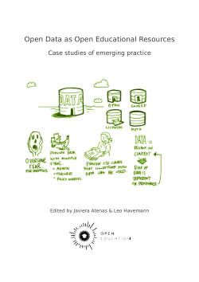
Introductions
Leo Havemann @leohavemann l.havemann@bbk.ac.uk
Open Education Researcher (OU UK)
Learning Technologist, Birkbeck, University of London
Advisory board, Open Education Working Group
Javiera Atenas @jatenas javiera.atenas@
idatosabiertos.org
Latin American Initiative for Open Data
Co-coordinator, Open Education Working Group
education.okfn.org/open-data-as-open-educational-resources-case-studies-of-emerging-practice

Slide 3
Why think about data?
“A recent White House report on ‘big data’ concludes, ‘The technological trajectory, however, is clear: more and more data will be generated about individuals and will persist under the control of others’ (White House, 2014: 9). Reading this statement brought to mind a 2009 interview with Google Chairperson Eric Schmidt …[who stated] , ‘If you have something that you don’t want anyone to know, maybe you shouldn’t be doing it in the first place, but if you really need that kind of privacy, the reality is that search engines including Google do retain this information for some time … It is possible that that information could be made available to the authorities’ (Newman, 2009). What these two statements share is the attribution of agency to ‘technology.’ ‘Big data’ is cast as the inevitable consequence of a technological juggernaut with a life of its own entirely outside the social. We are but bystanders.”
(Zuboff, 2015)
Notes:
Zuboff, S (2015) Big other: surveillance capitalism and the prospects of an information civilization. Journal of Information Technology, 30(1), pp 75–89, available: https://link.springer.com/article/10.1057%2Fjit.2015.5

Slide 4
Open Education/Open Data
Are these opening movements ‘in conversation’?
What can Open Data do for Open Education?
And what can Open Education do for Open Data?

Slide 5
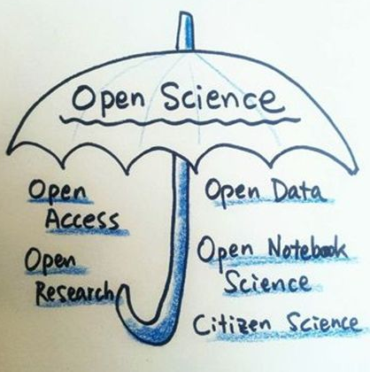
Opening movements … siloed conversations?
The idea of openness in
education has come to be closely
associated with technology-
enabled approaches, such as
Open Educational Resources
(OER), and Massive Open Online
Courses (MOOCs).
It has also been associated with
other related, parallel but ‘siloed’
opening movements for Open Data,
Open Access, Open Science etc.
More recently the term Open Educational Practices (OEP) has emerged via attempts to critique and reformulate the discourse around openness in education (Havemann, 2016).
© Julien Colomb, 2016:
https://www.meetup.com/Berlin-Open-Science-Meetup/photos/26645056/445567759/

Slide 6
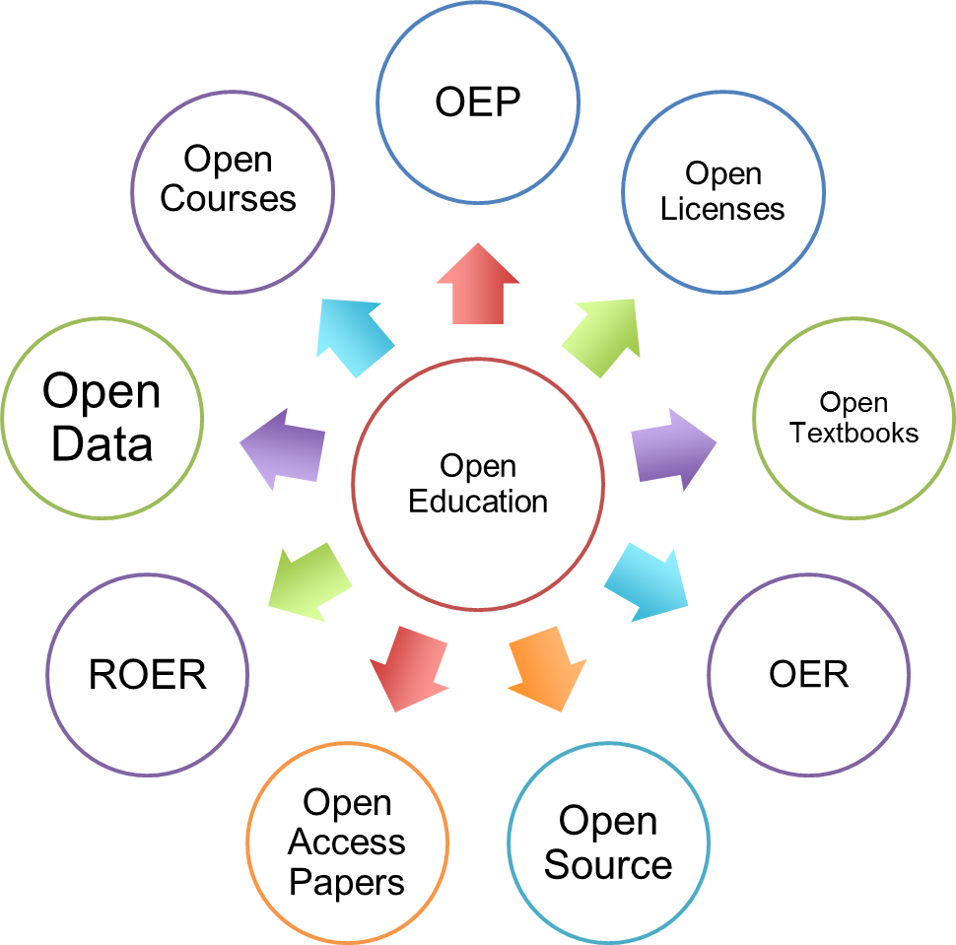
Open Educational Resources (OER)
A key strand of the drive to open education is the movement for Open Educational Resources (OER), which proposes
that the application of
open, permissive licenses to teaching and learning resources is a means of widening access to knowledge and enhancing teaching quality.

Slide 7
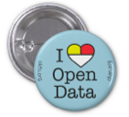
Open data
The Open Data Handbook defines Open Data as:
  “data that can be freely used, re-used and redistributed by anyone - subject only, at most, to the requirement to attribute and sharealike.”
  (Open Knowledge International, n.d.)
Availability and Access: the data must be available as a whole and at no more than a reasonable reproduction cost.
Re-use and Redistribution: the data must be provided under terms that permit re-use and redistribution, including the intermixing with other datasets.
Universal Participation: everyone must be able to use,
re-use and redistribute. There should be no discrimination against fields of endeavour or against persons or groups.

Slide 8
Digital and data divides
“The illusion of access promoted by computers
provokes a confusion between the presentation of information and the capacity to use, sort and interpret it.”
(Brabazon, 2001)
“as with the earlier discussion concerning the ‘digital divide’ there would, in this context, appear to be some confusion between movements to enhance citizen ‘access’ to data and the related issues concerning enhancing citizen ‘use’ of this data”
(Gurstein, 2011)

Slide 9
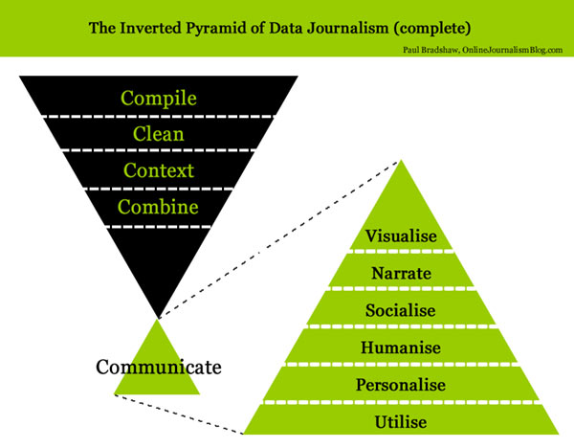
Using Open Data as OER
Many international
organisations,
governments, NGOs and
academic researchers
generate datasets, which are
often freely available
online and openly-licensed.
This data can be used in learning and teaching (therefore becoming OER) to give students authentic experiences of working with the same raw data used by researchers and policy-makers (Atenas, Havemann & Priego, 2015; Atenas, 2016).
(Bradshaw, n.d.)

Slide 10

Sources of Open Data
International agencies and organisations
  Word Bank ; United Nations ; EU
National Governments and their agencies
  UKOD; GermanyOD; USA
Local governments
  Sardinia ; London; Barcelona
Non-governmental organisations
  ODI; Monithon
Academic institutions
and research centres

Slide 11
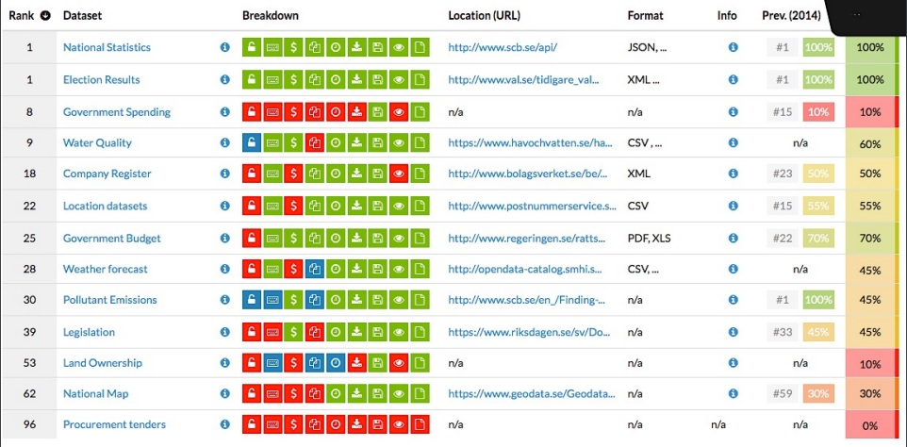
The practical value of Open Data
Open data is an invaluable resource for scientific communities
Supports scientific development and reproducibility
Encourages more transparent research practices
Can be used to model good practices in academia for research and teaching

Slide 12
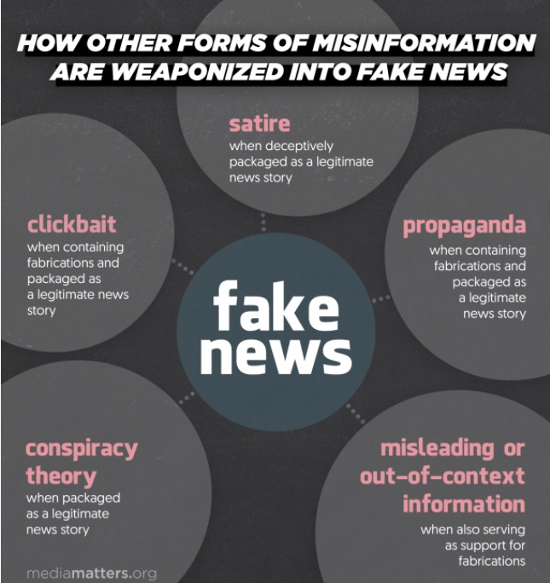
The civic value of Open Data
Students construct knowledge by critically analyzing information from various sources, including data.
We live in a “datafied” society, so being capable of analysing and interpreting data is becoming increasingly important.
Students need to become critical, skeptical, socially engaged, global citizens to avoid the influence of fake news, hate ads and broken democracy.
(Gertz, 2017)
When we are the consumers of free services,
we are the product.
Notes:
https://www.mediamatters.org/blog/2017/01/09/why-we-should-keep-using-term-fake-news/214957

Slide 13
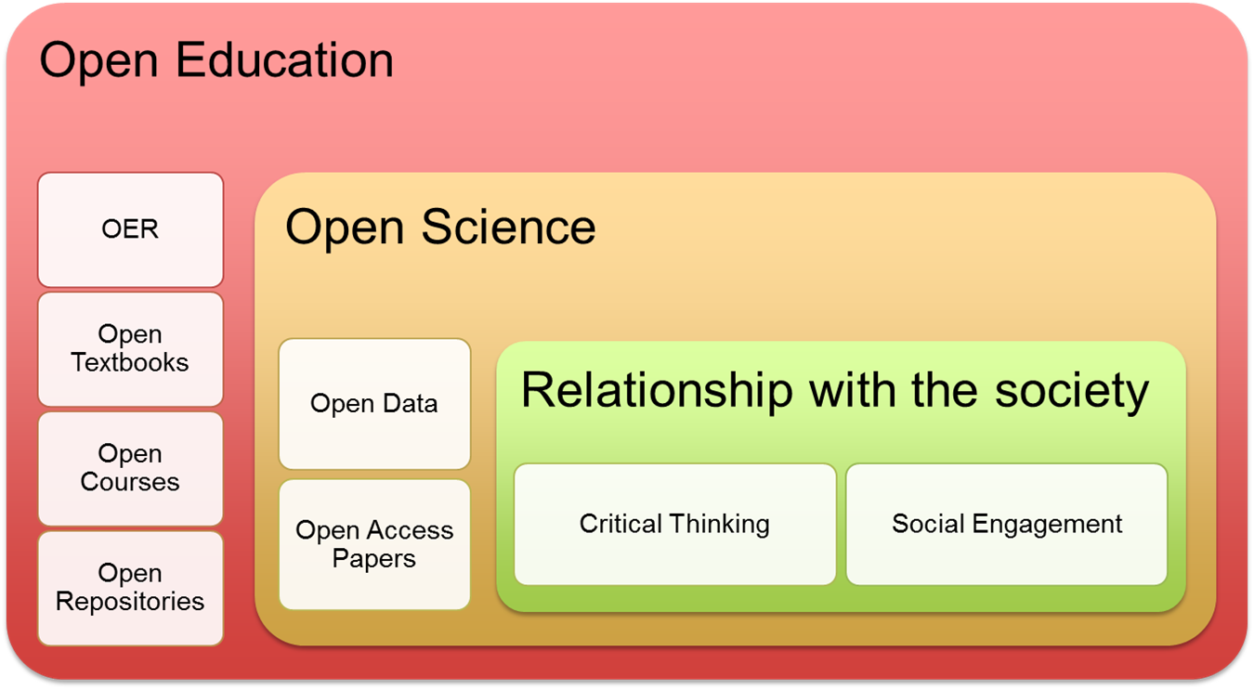
Open Data for social participation
“All citizens should have equal opportunities and multiple channels to access information, be consulted and participate. Every reasonable effort should be made to engage with as wide a variety of people as possible” (OECD, 2009, p.17).

Slide 14
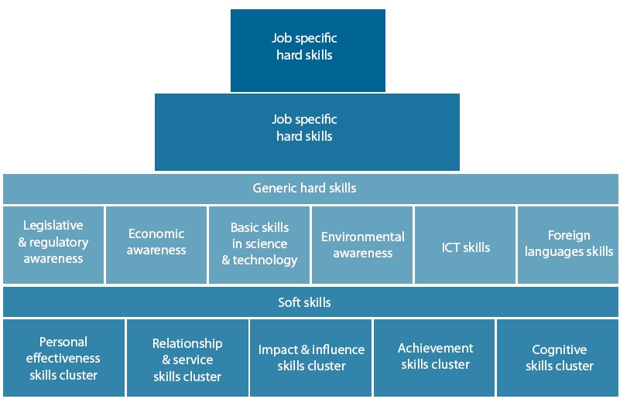
Transversal skills
Transversal skills are defined by UNESCO (2015) as:
“critical and innovative thinking, inter-personal skills; intra-personal skills, and global citizenship” (p. 4).
Lifelong and lifewide, not simply employability.
These include:
Language and communiation
Information, media
and data literacies
Critical thinking
Analytical skills
Research capabilities
Ethical practices
Teamwork
Citizenship
(European Union, 2011, p. 18)

Slide 15
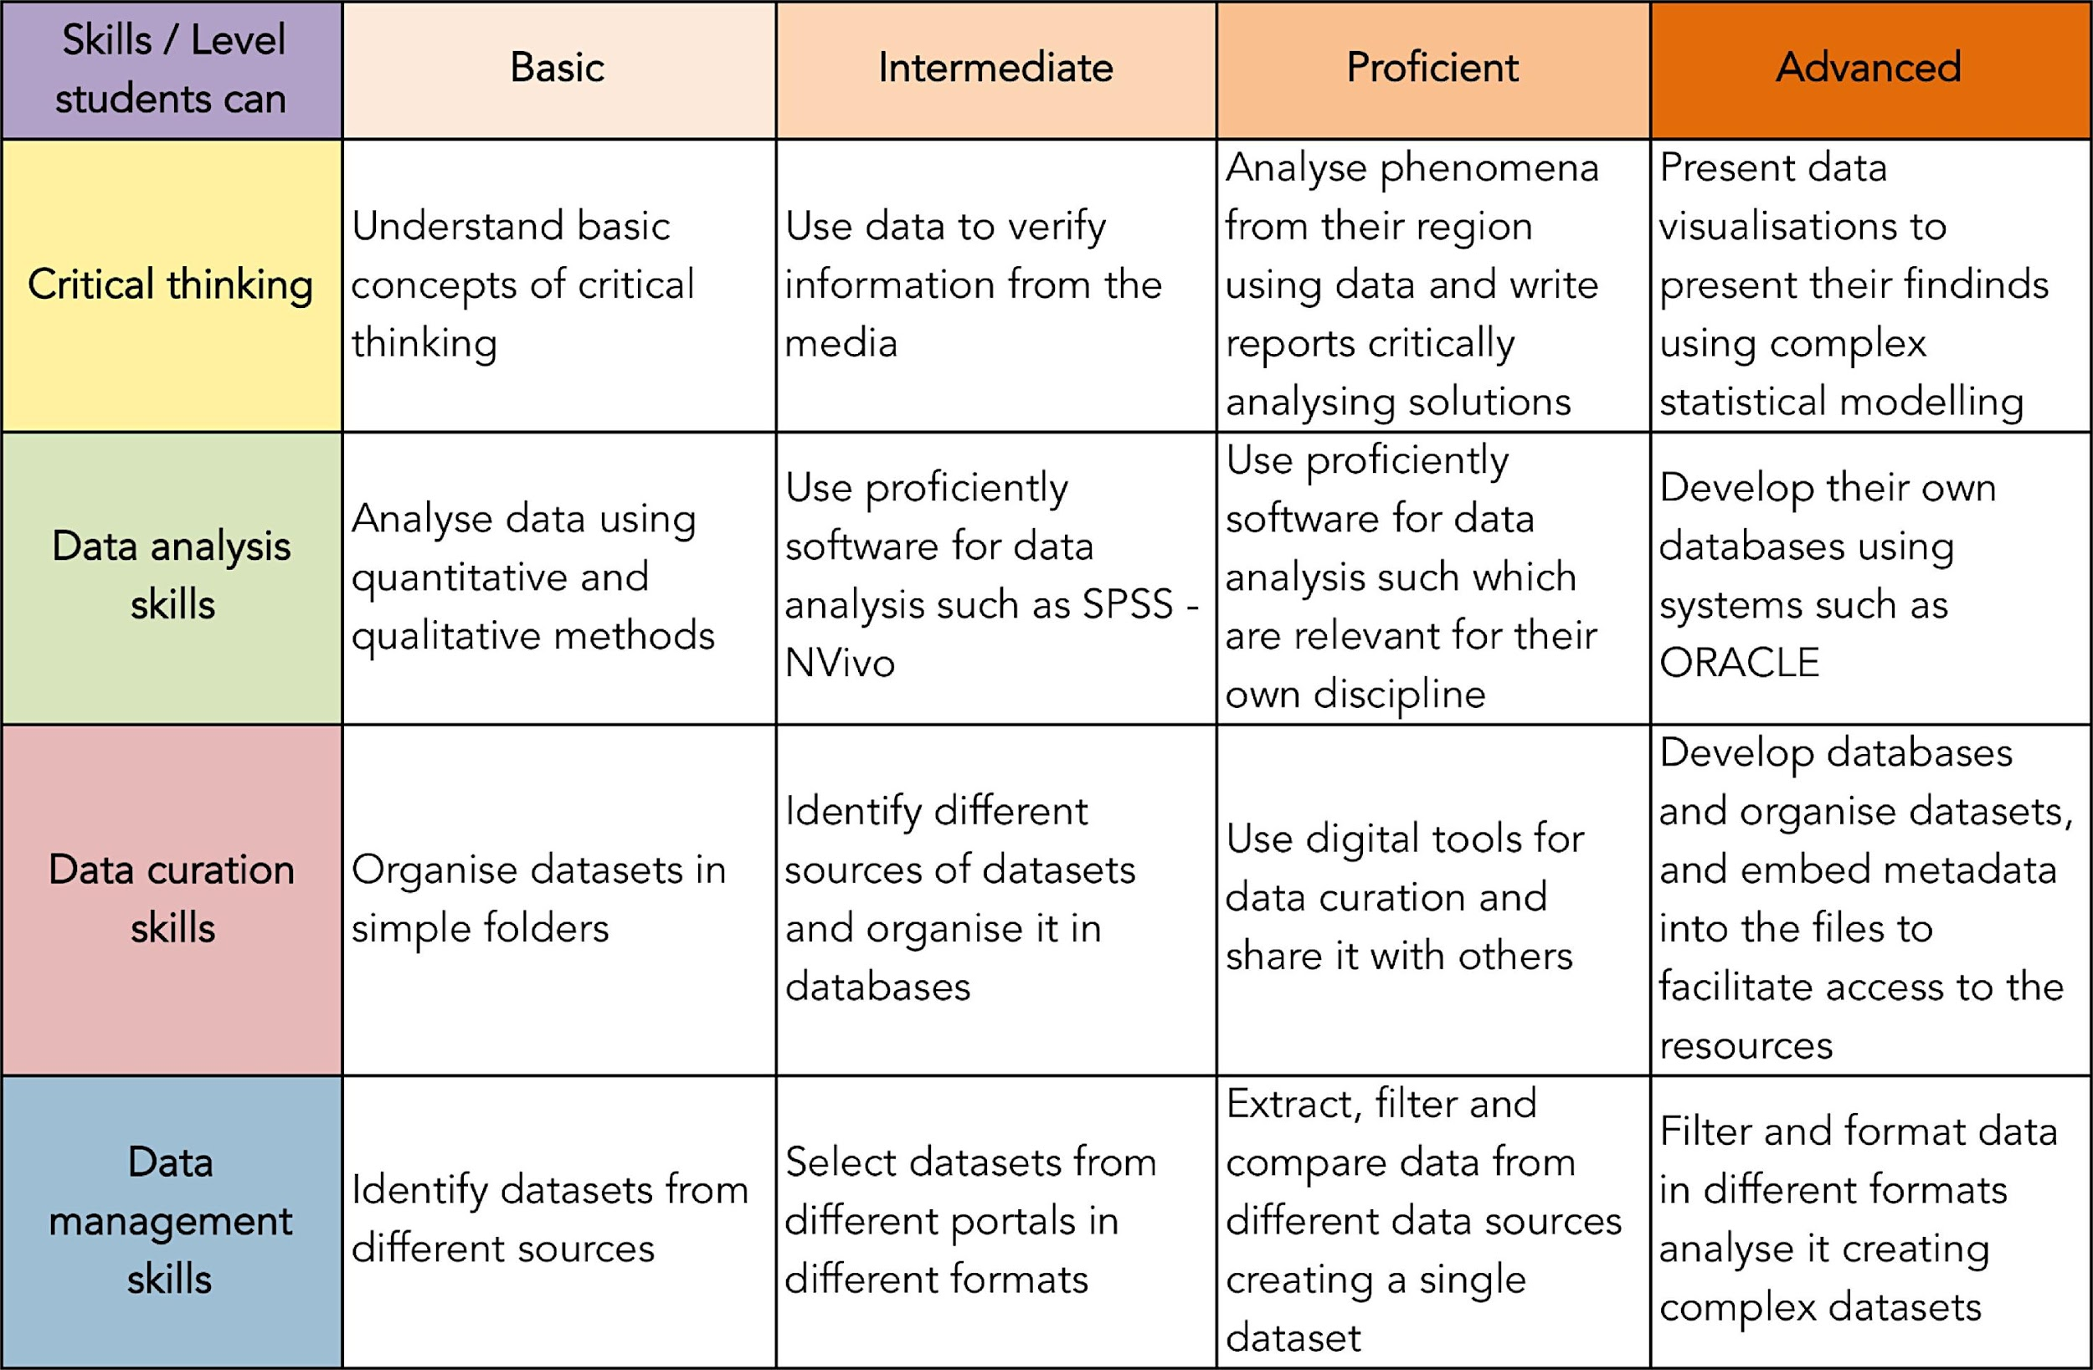
Open Data for developing transversal skills

Slide 16
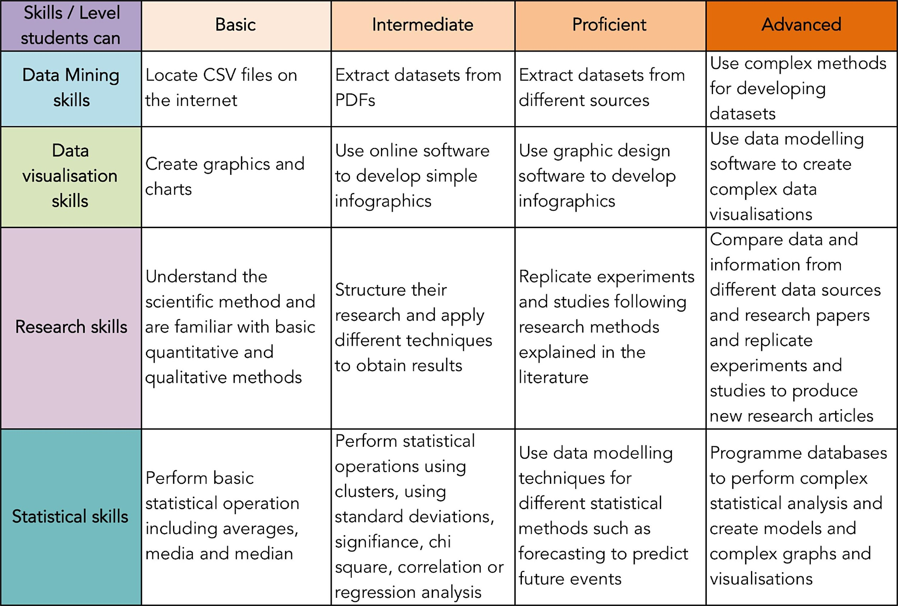
Open Data for developing transversal skills

Slide 17
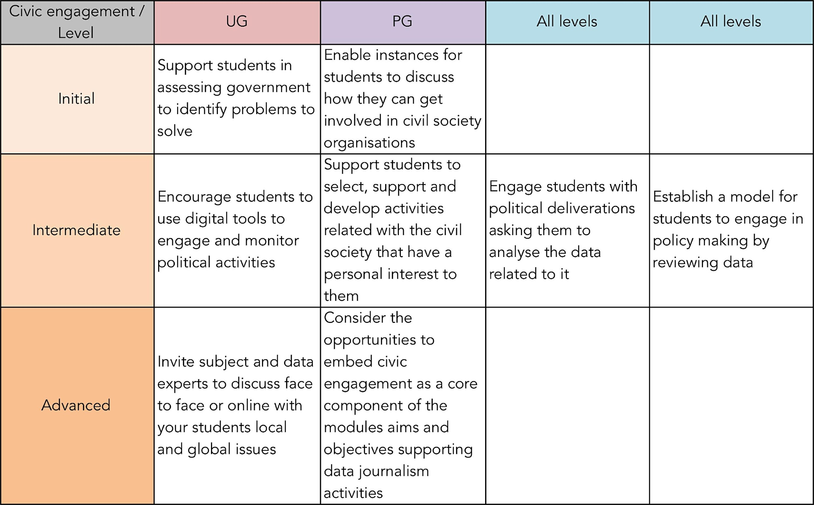
Open Data for civic engagement

Slide 18
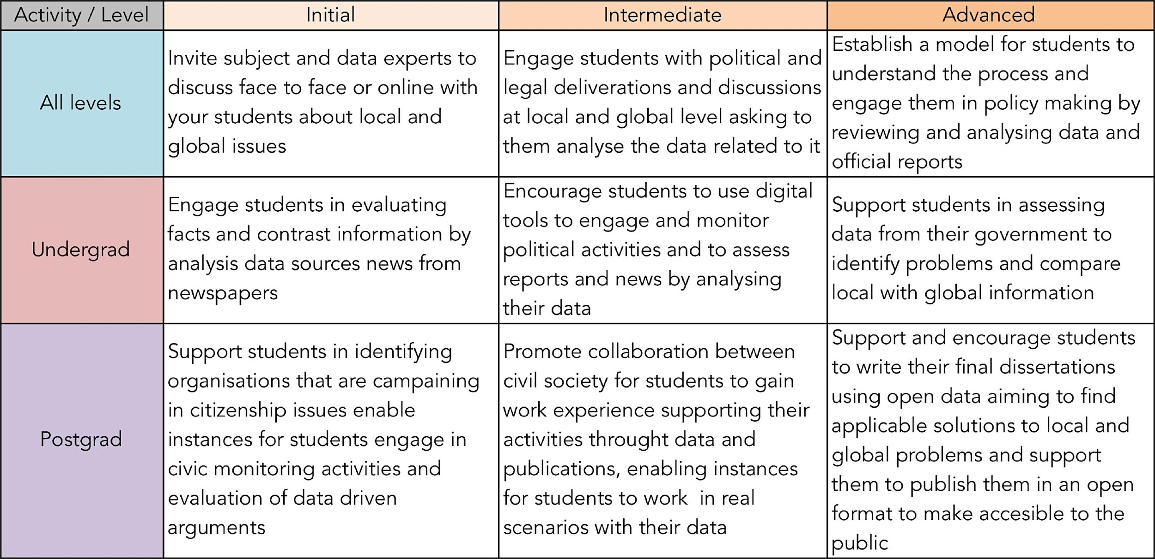
Open Data as OER at different levels

Slide 19
Open Data in learning and teaching
Focus: defining the research problems and their relation to the environment.
Practicality: matching technical applications and practices to expected solutions.
Expectations: setting realistic and achievable expectations for data analysis.
Direction: seeking data portals which contain appropriate information.
Training: providing training materials for the software students will need to use to analyse the data.

Slide 20
Open Data in learning and teaching
Location: using global, local and scientific data which is as granular as possible.
Modelling: developing model solutions to guide students during the challenges and activities.
Collaboration: supporting students to work collaboratively and at multidisciplinary level.
Communication: enabling students to communicate their findings to local or wider communities.
Criticality: encouraging students to consider how data are were collected and manipulated, by whom, and for what purposes.

Slide 21
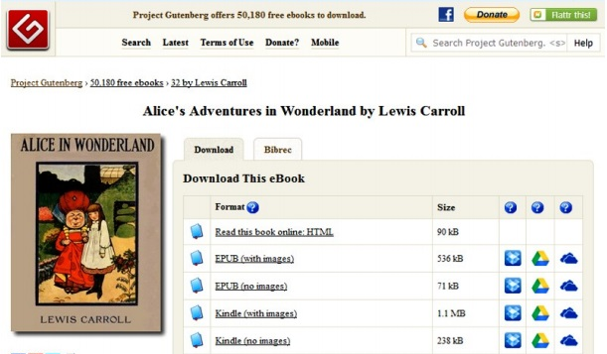
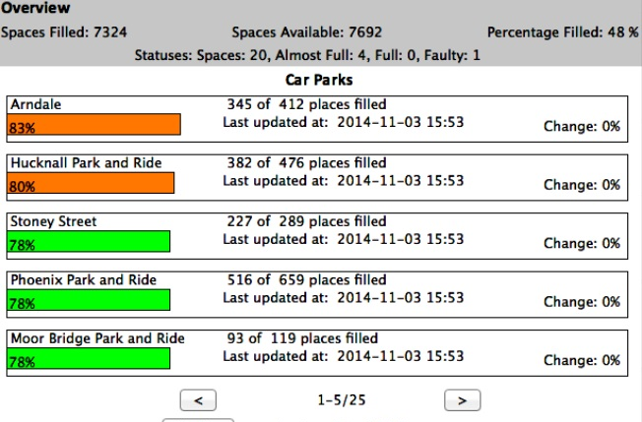

Open Data for introductory programming
The University of Nottingham used open data in a postgraduate computer science programming course to teach students to code with networks, files and data structures.
They used Python, which is a free
open source community-based programming language (Python Software Foundation, 2017).
Data were obtained from e-Book text files sourced from Project Gutenberg and City Council Carpark status data.
The assignment combined conceptual knowledge with authentic applications for public and educational use.
(Coughlan, 2015)

Slide 22

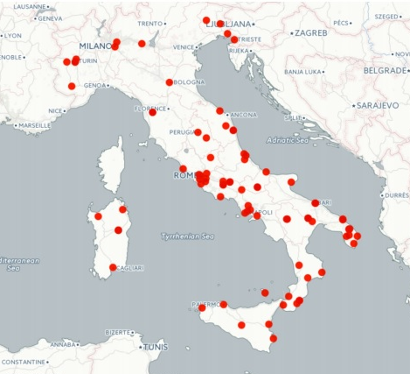
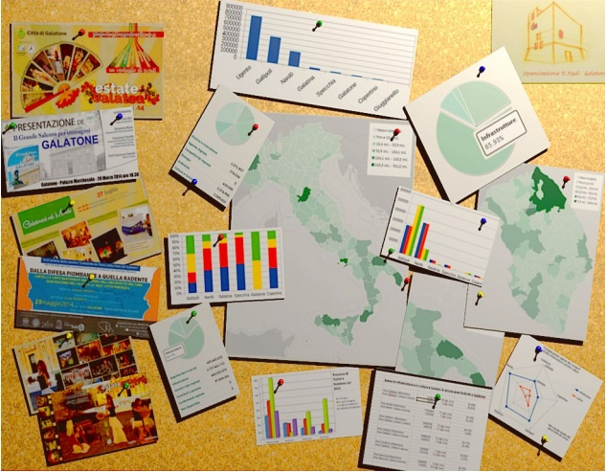
A Scuola di OpenCoesione
The Scuola di OpenCoesione is a MOOC designed for Italian High School students
to challenge them to:
  find out how public money is spent
  in a given area,
  assess the progress and challenges facing funded projects, and
  monitor public investment.
Data are obtained from the OpenCoesione portal, the Italian National Institute of Statistics and other public sources.
Participants collaborate in teams on projects involving open data analysis,
data journalism and creating infographics related to real-life civic issues.
(Ciociola & Reggi, 2015)

Slide 23
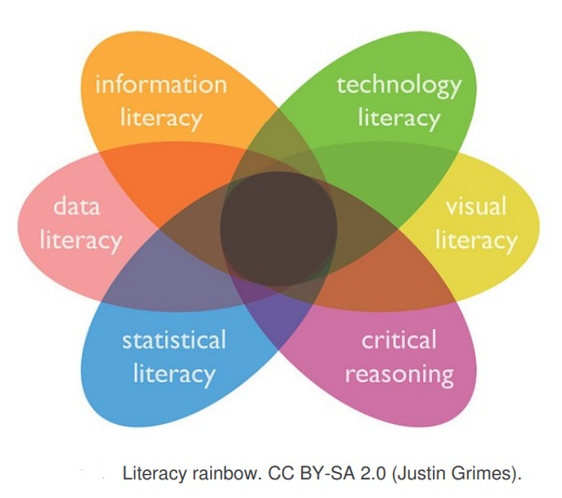
Open data and knowledge societies
MSc students studying towards Information
Management or Information Technology
qualifications at the University of Bristol
use open datasets and websites to consider
the benefits of being able to make sense of
data for individuals, organisations and society.
Website statistics and visualisation tools are used to help students consider the role of information and knowledge management and data literacy in knowledge societies and knowledge economies.
Students are asked to interrogate and analyse trends and developments using open data to deepen their understanding of how data is used to provide information and deepen knowledge, but also how it is produced, consumed and commodified.
This case study has been shared internally as an exemplar of practice at Sharing Approaches to Learning and Teaching (SALT) meetings and Faculty forums.
(Power, 2015)

Slide 24

Open Migration
Open Data can be used to support learners to understand
socio-political phenomena, such as the refugee crisis.
This Italian project used journalistic techniques, such as fact-checking (Annenberg Public Policy Center, 2017) in civic and
data-led research and data-expeditions (School of Data, n.d.).
Students engaged with migration data to challenge stereotypes
and influence public opinion and policy.
The project trained students, researchers
and citizens to understand the real numbers
and issues for refugees in Italy in order to
support their integration into the community.
Open Data was used in this project to create
a replicable pedagogical pathway to improve
media and data literacy.
(Atenas, Havemann, & Menapace, 2017).

Slide 25
Over to you
How can we make more datasets openly available for use as OER?
How can we raise awareness that Open Data can be used as OER?

Slide 26
References & resources
Atenas, J. (2016) Putting research into practice: Training academics to use Open Data as OER: An experience from Uruguay. Thoughts on Open Education. Retrieved from https://oerqualityproject.wordpress.com/2016/07/13/putting-research-into-practice-training-academics-to-use-open-data-as-oer-an-experience-from-uruguay/
Atenas, J., Havemann, L., & Menapace, A. (2017). Open Data and media literacies: Educating for democracy. In OER17: The Politics of Open, April 5-6, 2017. London. Retrieved from http://eprints.bbk.ac.uk/18959/
Atenas, J., Havemann, L., & Priego, E. (2015). Open data as open educational resources: Towards transversal skills and global citizenship. Open Praxis, 4, 377-389. Retrieved from https://www.openpraxis.org/index.php/OpenPraxis/article/view/233/180
Bradshaw, P. (n.d.). The inverted pyramid of data journalism (complete). Retrieved from https://onlinejournalismblog.com/2011/07/07/the-inverted-pyramid-of-data-journalism/
Brabazon, T. (2001). Internet teaching and the administration of knowledge. First Monday, 6(6). Retrieved from http://firstmonday.org/ojs/index.php/fm/rt/printerFriendly/867/776
Break Away. (n.d.). Active citizenship. Retrieved from http://alternativebreaks.org/
Ciociola, C., & Reggi, L. (2015). A Scuola di OpenCoesione: From open data to civic engagement. In J. Atenas, & L. Havemann (Eds.), Open data as open educational resources: Case studies of emerging practice (pp. 26-37). London, United Kingdom. Open Knowledge, Open Education Working Group. Retrieved from http://eprints.bbk.ac.uk/13346

Slide 27
Coughlan, T. (2015). Using open data as a material for introductory programming assignments. In J. Atenas, & L. Havemann (Eds.), Open data as open educational resources: Case studies of emerging practice (pp. 38-48). London, United Kingdom. Open Knowledge, Open Education Working Group. Retrieved from http://eprints.bbk.ac.uk/13346
European Union. (2011). Transferability of skills across economic sectors. http://dx.doi.org/10.2767/40404
Figshare. (n.d.). Store, share, discover research. Retrieved from https://figshare.com/
Gertz, M. (2017). Why we should keep using the term “fake news”. In Media Matters for America [Blog]. Retrieved from https://www.mediamatters.org/blog/2017/01/09/why-we-should-keep-using-term-fake-news/214957
Gurstein, M. B. (2011). Open data: Empowering the empowered or effective data use for everyone? First Monday, 16(2). Retrieved from http://dx.doi.org/10.5210/fm.v16i2.3316
Havemann, L. (2016). Open Educational Resources. In M. A. Peters (Ed.), Encyclopedia of Educational Philosophy and Theory. Singapore: Springer Singapore. Retrieved from http://eprints.bbk.ac.uk/17820/
Open Knowledge International. (n.d.). Open data handbook. Retrieved from http://opendatahandbook.org/guide/en/

Slide 28
Power, V. (2015). Open data for sustainable development: Knowledge society & knowledge economy. . In J. Atenas, & L. Havemann (Eds.), Open data as open educational resources: Case studies of emerging practice (pp. 67-77). London,
United Kingdom. Open Knowledge, Open Education Working Group. Retrieved from http://eprints.bbk.ac.uk/13346
School of Data. (n.d.). Data expeditions. Retrieved from https://schoolofdata.org/data-expeditions/
UNESCO. (2002). Forum on the Impact of Open Courseware for Higher Education in Developing Countries: Final Report. Retrieved from http://unesdoc.unesco.org/images/0012/001285/128515e.pdf
UNESCO. (2015). 2013 Asia-Pacific Education Research Institutes Network (ERI-Net) Regional Study on Transversal competencies in education policy and practice. Paris, France: Author. Retrieved from http://unesdoc.unesco.org/images/0023/002319/231907E.pdf
UNESCO. (2017). What are Open Educational Resources (OERs)? Retrieved from http://www.unesco.org/new/en/communication-and-information/access-to-knowledge/open-educational-resources/what-are-open-educational-resources-oers
Zuboff, S (2015) Big other: surveillance capitalism and the prospects of an information civilization. Journal of Information Technology, 30(1), pp 75–89, Retrieved from https://link.springer.com/article/10.1057%2Fjit.2015.5

