Slide 1
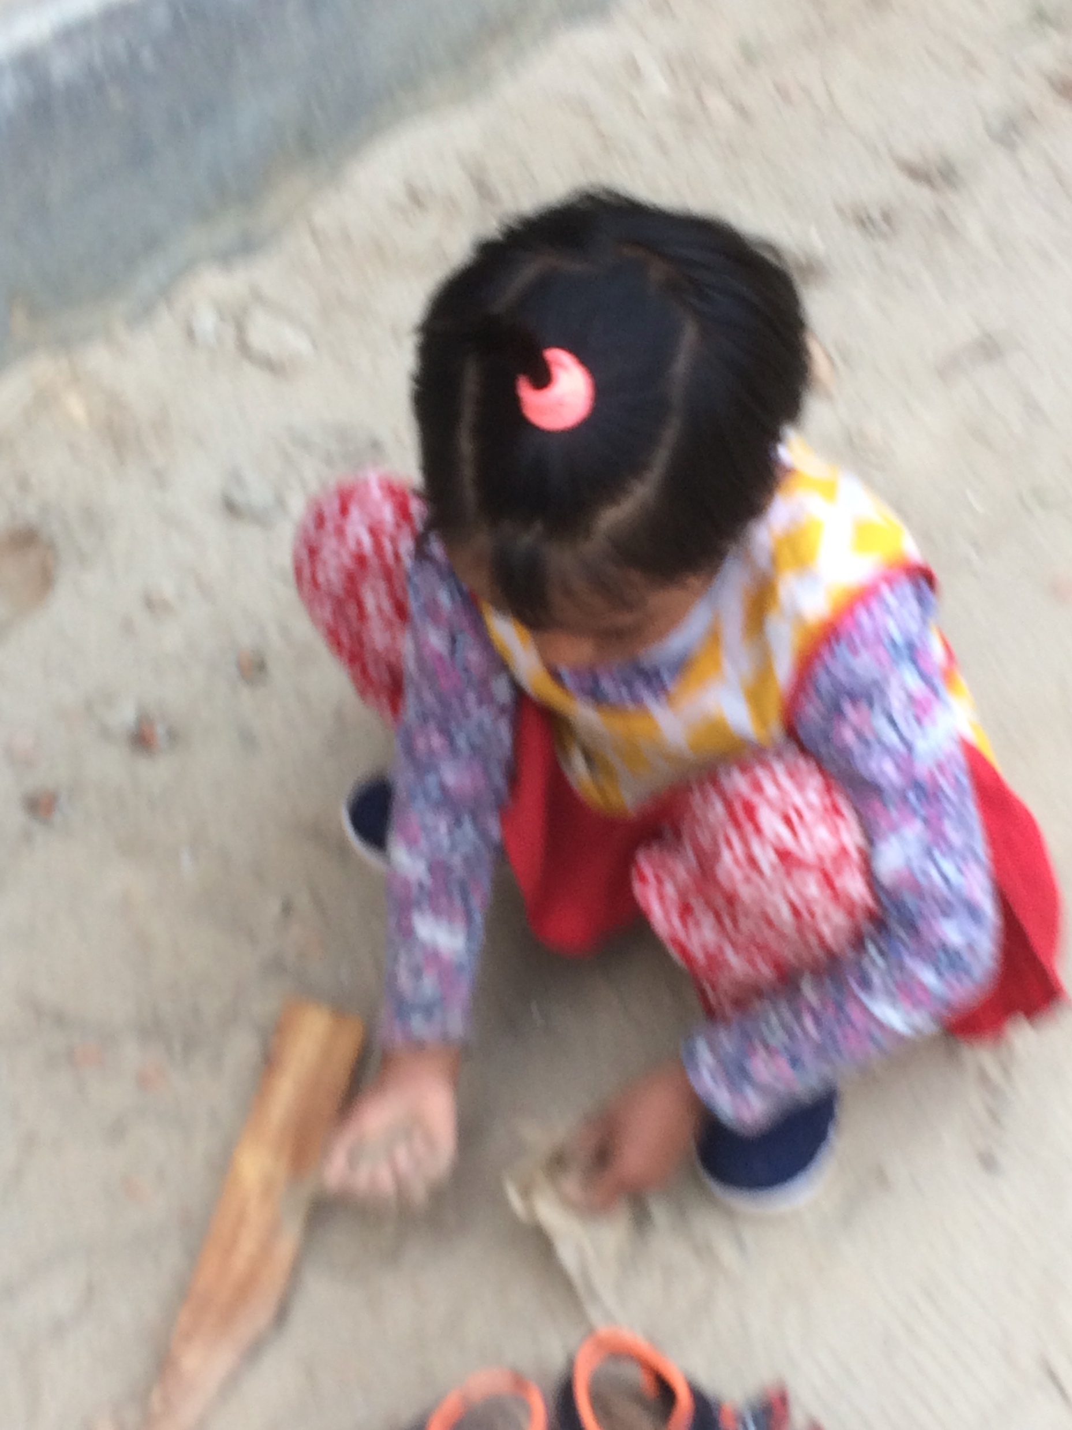
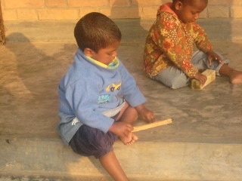
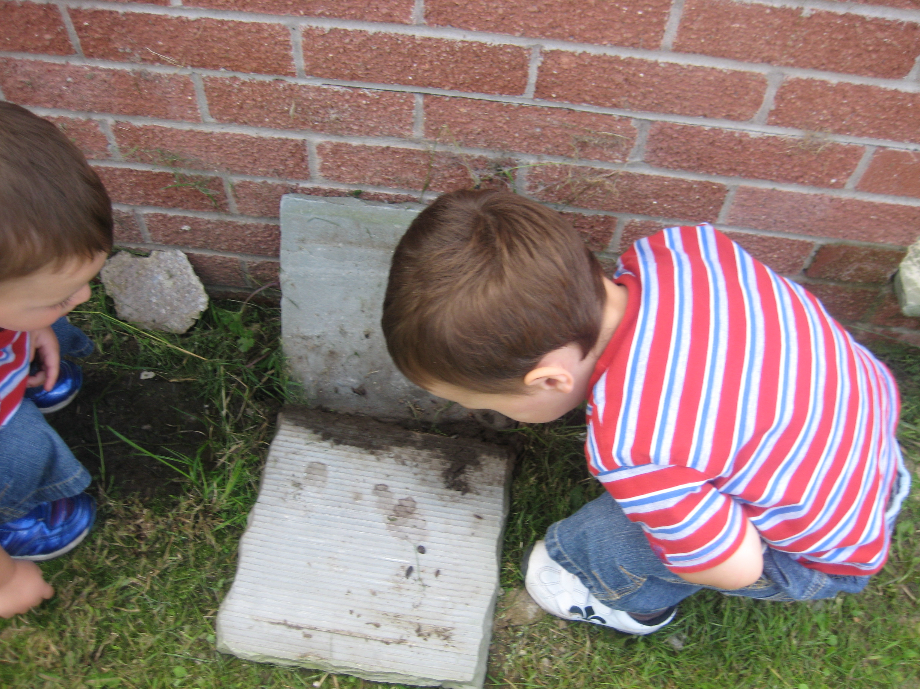
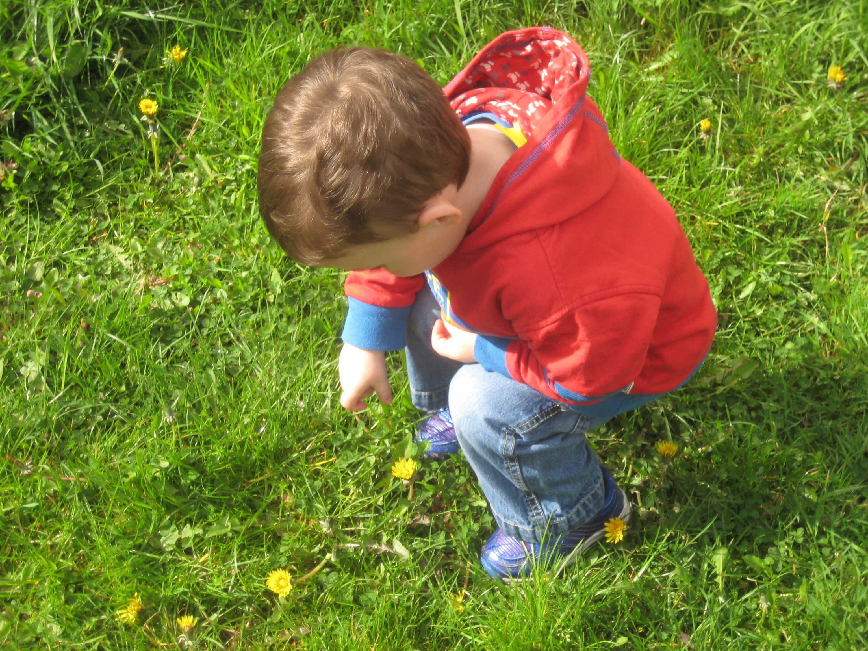
Experiencing science in free choice play pre school Dr Sue Dale Tunnicliffe, University College London Insitute of Education. s.tunnicliffe@ucl.ac.uk
I. Introduction
Early years, i.e. pre formal schooling children are intuitive scientists (Gopnik,2009) research in early years in formal school shows that young children can investigate, collect evidence and conclude( e.g. Monteira etc.al (2016), Piekeney et al. (2113).
Many adults consider play a waste of time( Moyles,(Ed) (1989)Roth et al.(2013) said “Play is children’s work`’
Some examples of free choice play activities
Activity | Scientific concepts | Science in action actions
Play in general | Nature of science | Observation, questions, plan to solve problem, choose items, recognizing outcome, repeating investigations, changing variables. Patterns over time
MATERIALS
Sand play | Forces, properties, feelings, mixtures, evaporation, friction, surfaces, | Filling, pouring, capacity, emptying, moulding, making tunnels, wet and dry sand.
Water Play | Mixing, currents, forces, gravity, ice- change of state, properties of water, absorption, | Using senses, hot, cold, tepid, Forces, gravity, buoyancy, measuring capacity, surface tension, light, colour, refraction,
Everyday Bricks, stones, soil, twigs Malleable materials | Properties, centre of mass, stability, strength, energy, purpose, design Twists, pushes, pulls | Construction. Making towers, bridges, homes for something, using levers.Wet, clay, mud, dough, modeling, throwing
VENUES
Outdoor Play | Light, shadows, weather, earth science living world biodiversity local plants, animals, | Soils, pebbles, stones, weather, rain, snow, hail, ice, appropriate clothing, sky, clouds, sun, recording weather, indicator species, variety of plants and particular habitats, clothes for weather. Flight, pets, how animals move, behave.
IV. Free choice Play
classroom.
II. Background
But these studies were about children in mediated situations, items provided, set up and supported encounters
PEaf
III Guiding Questions
What do young children choose to do in their own time which we call play?
What ‘science actions’ are used? These experiences form the foundation of their science and STEM capital
V. Authors’ bio:
`Dr Sue Dale Tunnicliife is a Reader in Science Education at University College London’s Institute of Education,
She is a zoologist specializing in education, particularly informal; She has published widely
She is a Life e member of NSTA

