Slide 1
New materialisms in science education
CHAIR: Dr Kerry Chappell, University of Exeter
DISCUSSANT: Prof Carol Taylor, University of Bath
Making the case for a Material-Dialogic theory for Science Education
Dr Lindsay Hetherington, Dr Mark Hardman, Prof Rupert Wegerif
2. Entangling Matter and Gender in the Teaching and Learning of Chemistry
Prof Kate Scantlebury, Dr Catherine Milne, Dr Anita Hussenius
3. The Lifeworld story of rocks in a New Zealand Primary Science classroom
Prof Kathrin Otrel-Cass

Slide 2
Making the case for a material-dialogic theory for practical science
Dr. Lindsay Hetherington, Dr. Mark Hardman & Prof. Rupert Wegerif
@Lindsayhether, @mahardman, @rupertwegerif
Notes:
Make clear that we are happy for people to tweet about content (as per ECER advice)

Slide 3
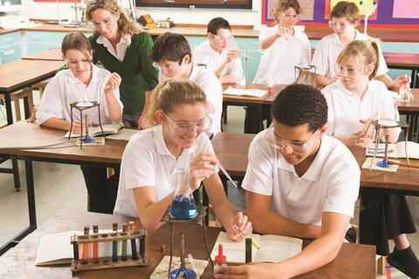
practical work in science education
Purposes for practical work typically relate to motivation or to disciplinary learning (knowledge or skills)
Studies exploring pupil learning through practical science have typically explored this through talk.
The material world, including practical, is passive, to be manipulated, investigated and understood
Notes:
Imagine a science lesson, and for most, an image of some pupils working together with some practical apparatus is likely to come to mind. Indeed, a quick search of ‘science lesson’ on google images yields many images like the shown here.
However, research into practical work in science education and how to make it as effective as possible in supporting pupils’ learning has tended to focus in on how the equipment is used to either demonstrate a phenomenon (with a pre-planned objective in mind), or on how the pupils might use the equipment to construct their own understanding of a scientific concept. In exploring these processes, the material nature of the practical (the observable world) takes second place to what is going on in the minds of the pupils, whose thinking is revealed, to teachers and researchers, by talk.
For example, in the influential work by Abrahams and Millar (2008), a pedagogical framework for effective practical science is proposed that is designed to encourage pupils to shift from describing their observations, to being able to explain and apply the underlying scientific concepts. This is useful, but does not focus on how the pupils are interacting with the materials.
We suggest that this means that the role of the material world in pupils’ learning in science more generally, and practical work specifically, is rendered passive, to be manipulated, investigated and understood by pupils and teachers, and that in failing to pay attention to the material in our understanding of how practical work plays a role in science learning, we could be missing something important that might make a difference to our pedagogical approaches.

Slide 4
(Re)focusing on the material
What happens if we think differently about the material world?
What would change in how we approach science education if the material is reframed as an active participant in the learning taking place?
We want to (re)focus on the materiality of school science, and how pupils learn with it (not from it/use it)
We need a theoretical framework to think with that helps us draw together the material nature of the science classroom and its embodied learners with the dialogue taking place. We have developed this using Barad’s ‘Agential Realism’ and a Bakhtin’s Dialogic.
Notes:
We therefore wished to refocus on role of the material in school science, and how pupils learn with it. This is not to say that pupils’ talk is not important: what we were looking for is a theoretical perspective that would help us foreground the material without losing insights from pupils’ dialogue.

Slide 5
BArad’s Agential realism
‘Neither discursive practices nor material phenomena are ontologically or epistemologically prior…Neither is articulated or articulable in the absence of the other; matter and meaning are mutually articulated’ (Barad 2007, p. 152).
KEY CONCEPTS
Phenomena
Intra-action
Agential cut
Diffraction
Entanglement
Notes:
Those of you in the presentations in the gender and subject didactics sessions yesterday will have heard Carol introduce Barad much more effectively than I am about to do, so bear with me…

Slide 6
DIALOGIC THEORY
KEY CONCEPTS:
Relational ontology – engaging in dialogue changes those engaged
Voice may be human or other-than-human, “I hear voices everywhere and in everything” (Bakhtin, 1978).
Dialogic Switching – seeing from the perspective of the ‘other’
Dialogic Space – where distinct voices are brought into relation

Slide 7
A material-dialogic FRAME
Both Agential Realism and Bakhtinian Dialogic have a relational ontological stance
KEY CONCEPTS:
Material-Dialogic Space
Diffractive Switch
Notes:
Relational Intra-action in a material-dialogic space
A dialogic space is a space of relation between different voices, where both meaning and subjectivities emerge in the relation. The term ‘voice’ gives primacy to the discursive element of those engaging in the relationship, but agential realism draws the material much more closely into the entangled relationships within a dialogic space. Using Barad’s language, phenomena, the temporarily bounded entities intra-acting relationally to produce those phenomena through agential cuts, and the meaning of material-discursive concepts relating to the phenomena, come into being in the intra-actions. Phenomena (including but not limited to scientific phenomena), ‘voices’, ‘bodies’, meaning and matter all continually come into being together within a relational space. However, this space is both material and discursive together; a ‘material-dialogic’ space in which there is potential meaning to be actualized, depending on the relations in that space. Where the phenomenon is learning, we could call this a material-dialogic educational space. In a science education setting, an example of a phenomenon might be pupils learning about the behavior of woodlice in a ‘choice chamber’, in which woodlice are seen to prefer dark and damp conditions. In any given educational setting, the learning taking place is effected by the voices and bodies of the pupils, teacher, environment, woodlice, choice chamber materials and disciplinary knowledge. The material-discursive concepts emerging through the performance of learning about woodlice behavior come into being in the intra-actions between all entangled components in the relational ‘material-dialogic’ space.
Diffractive Switching
Barad’s conceptualization of diffraction is about engaging with difference, with ‘other’ temporarily bounded entities for the production and performance of new phenomena. Diffraction (as opposed to reflection) is not about mirroring or sameness but about differences that come to matter (Barad, 2007). Dialogic switching between voices is the means by which dialogue can proceed – the ‘switch’, to seeing from a different perspective, is crucial in a continuing dialogue as it allows the relation, the intra-action, between different perspectives. Without a dialogic switch there can be no relation, but without different perspectives there can be no dialogue as there is only agreement (Bakhtin, 1986). Diffraction performs this switching move by intra-acting differences through one another, but once again draws in much more strongly the non-human ‘voices’ involved in the intra-action. In a practical science activity such as studying the rate of a chemical reaction, this highlights the voices of the materials in the creation of meaning: the bench, recording materials, glassware, reacting chemicals, chemicals produced, recording equipment, sounds, smells and so on as equally important in the dialogue as the pupils’ and teachers voicing their ideas and the disciplinary knowledge on which they draw in the material-dialogic space. That is not to say that the teachers and pupils must deliberatively ‘switch’ to consider the ‘point of view’ of the reacting chemicals. For students to be able to learn from practical work matter needs to move from being background context to being a voice in a dialogue, a voice that means something, that makes a difference. This tends to happens when it answers questions that the students have already posed both verbally and tacitly (Kazak et al., 2015). Diffractive switching is about drawing the voices of the material into the dialogic space (or how they push their way in, for example if a sudden colour change occurs), to explore how they relate to the dialogue as points of difference that material-discursively perform new phenomena (learning) with the pupils and teachers engaged in the dialogue.
Material-dialogic Pedagogy
This diffractive reading of Bakhtinian dialogic theory and Agential Realism raises questions of pedagogy. What does the new theoretical framework generated suggest one does differently with respect to teaching science? Specifically, what difference does it make to our use of practical activities in science education?
Firstly, this framework enables us to understand pedagogy in a particular way, as a material-dialogic practice in which planning, teaching, reading, talking with teacher and pupils, practical activity and so on all intra-act to enact agential cuts in material-dialogic space, producing phenomena, subjectivities and meaning. Thinking in this way, and encouraging teachers to do so (Hetherington & Wegerif, 2018), encourages science teachers to focus more closely on how the material (including but not limited to practical materials) plays in to pupils’ learning.
Initial analysis of study in which an experienced, skilled teacher taught three lessons on chromatography, and subsequently analysed the teaching and learning taking place with the researchers suggests that teachers continually engage with materials and implicitly recognize their importance (Hardman, Riordan, Cumbers, Hetherington, & Wegerif, In prep). However, they do not fully rationalize this role. Research suggests that planning for practical work appears to have a tendency to be primarily logistical or focused on a key misconception or skill, with less attention given to planning how to use the practical activity to foster learning (Abrahams & Millar, 2008). A material-dialogic pedagogy drives towards a focus on how materials, including practical activities, are in dialogue with teachers and pupils to produce new learning.

Slide 8
An empirical test-case
Analysis of 3 lessons on chromatography
London comprehensive school, 12-13 year olds, very experienced teacher (David).
Not appropriate to assume a ‘privileged’ position of the researcher and arrive at normative readings.
Taking seriously the material-dialogic position in design and analysis:
Diffraction of theory and material (Barad, 2007)
“A diffractive reading of data through multiple theoretical insights moves qualitative analysis away from habitual normative readings” (Mazzei, 2014, p. 742)
Notes:
The rest of this paper supports and develops the material-dialogic frame further, by exploring how it informed the analysis of a sequence of three science lessons, and subsequently what the frame can add to considerations of pedagogy. This provides a test-case for the application of a material-dialogic frame in better understanding pedagogy and learning in science classrooms. Three lessons on chromatography were taught by an experienced science teacher: David. The lessons took place in a large comprehensive school in London, and were taught to a group of high attaining Year 8 students (12-13 year olds). The lessons were part of a normal sequence of lessons determined by the science department teaching rota, and David was asked to plan and teach lessons as he would normally.
Given the theoretical basis of a material-dialogic frame it would be naïve and inappropriate to apply a conventional research design which takes the position of the researcher as privileged and divorced from the interpretation of data. The empirical study therefore takes seriously Barad’s (2007) claims that theory and material ‘diffract’ in producing our understanding of the world. To do so, the research design and analysis attempted to recognise the ‘intra-action’/dialogue of teacher, pupils, researchers and classroom material, each having agency. The analytical approach thus involves the accumulation of different theoretical lens (those of teacher, pupils and each researcher), and the use of each analysis as a date source in itself. The hope is that “A diffractive reading of data through multiple theoretical insights moves qualitative analysis away from habitual normative readings” (Mazzei, 2014, p. 742)

Slide 9
Design
a) Lesson video analysis (1 hr x 3)
b) Teacher verbal protocols (2 hrs x 3)
c) Pupil group verbal protocols (1 hr x 3)
d) Researcher group interviews (1 hr x 3)
1
p
t
r
r
1
2
t
r
r
1
3
r
r
t
4
t
r
r
Notes:
We will only describe the design briefly here (and intend to publish more detailed exploration of this very soon).
Three one-hour lessons were video recorded from three angles; the teacher had a lapel microphone and other microphones were position on desks in the centre of the room.
Two researchers observed the lessons and took field notes.
Following the lessons, and over a period of several weeks, the teacher was engaged in three sessions of verbal protocols, in which he watched the videos of the lessons and commented upon what was happening, without input from the researchers. This was also videoed.
Retrospective debriefing then allowed further discussion with the teacher, this was also videoed. The complementary use of video protocols and retrospective debriefing follows Taylor & Dionne (2000), and the project was framed as exploring the strategies that David uses to promote conceptual change.
Clips were selected which showed particular interest for the two researchers. These were then shown to a self-selecting group of 6 pupils, who undertook verbal protocols – commenting upon the videos with minimal input from the researchers. They were then asked questions to prompt further discussion. Three of these were conducted: one for each recorded lesson.
Following this, the two researchers coded the videos related to the first lesson separately, including the video of the lesson itself, of the verbal protocol with the teacher, the retrospective debrief with teacher and the protocols and debrief with students.
The researchers and teacher then met to discuss their initial coding once the first lesson had been coded (this was also videoed).
There was a further meeting once all of the coding had been done (which was of course also videoed!).

Slide 10
Analysis
a) Lesson video analysis (1 hr x 3)
b) Teacher verbal protocols (2 hrs x 3)
c) Pupil group verbal protocols (1 hr x 3)
d) Researcher group interviews (1 hr x 3)
Researchers present in lessons
1
p
t
r
r
Teacher agency in analysis
1
2
t
r
r
Pupil agency in analysis
1
3
Teacher & Researchers Code (grounded)
r
r
t
4
Re-coding from material-dialogic perspective
t
r
r
Notes:
The intention of this methodological approach was to see how the teacher, pupils and researchers understood the teaching and learning which was taking place, and allow ‘theoretical’ perspectives to intra-act. The project was framed as investigating how the teacher supports learning and, based upon the previous work of one of the researchers (Riordan, 2014), focused upon the instructional strategy used by the teacher to promote conceptual change. However, from the outset we recognised the material influences upon teacher, learners and classroom, and discussions throughout the project centred this. The analysis of material-dialogic practice thus emerged through layers of analysis. The researchers were present in the lessons, and made initial field notes around important phenomena. The teacher’s theoretical perspective intra-acted with the initial videos of the lessons within the verbal protocols, and furthermore as the teacher himself undertook coding. The sample group of six students also undertook verbal protocols, with the videos of these thus already encompassing an analytical intra-action between the lessons and pupils’ perspectives. Retrospective debrief interviews allowed a further layer, bringing in initial coding from the teacher and researchers which focused upon emergent meanings in the study. One of the researchers (Riordan) continued to code the strategic approaches of the teacher, then the other (Hardman) undertook a re-coding of this with the principles of material-dialogic teaching in mind. The study thus utilised established processes of data collection and analysis, but in allowing the layering, the diffraction of video, interpretation and coding, we sought to overcome the separation of each:
“in a diffractive process of data analysis, a reading of data with theoretical concepts (and/or multiple theoretical concepts) produces an emergent and unpredictable series of readings as data and theory make themselves intelligible to one another.” (Mazzei, 2014, p. 743)

Slide 11
Findings
Interactions with non-human materials
308 over 3 hours
Notes:
One emergent reading of relevance to supporting a material-dialogic interpretation is the number of interactions that David makes with what was coded as ‘non-human means’. This can be seen in the figure.
This reading primarily stems from the direct coding of the lessons, and thus approaches a more traditional analytical frame which categorises each ‘dialogue’ with a non-human resource. However, even in this we must recognise the intra-action of a theoretical lens and the video data. The quantification of incidents within each category, and indeed the categories themselves are not inert.
The teacher engages with classroom materials 308 times over the three lessons. The most frequent engagement with material was the Interactive Whiteboard (IWB), used to project images to the class, but also to make notes, show images of the experimental setup and to agree definitions of key terms. The interactive whiteboard and pen whiteboard next to it are important devices. Key phrases, ideas and models become crystallised, and are amplified by David. They take on agency in the room and in the thinking of the class – they become part of the dialogic space.
The mini-whiteboards were used by pupils to generate models of the process of chromatography, and the teacher continually refers to these within the teaching. The mini-whiteboards are also used in nonconventional ways – sometimes displaying a ‘covert message’ to another class member, but even at one point being bent by a pupil to demonstrate the curvature of the chromatograph.
Pupil exercise books also have agency, and again we might see that these contain ‘models’ and descriptions of the process of chromatography. The chromatographs themselves have agency (the papers on which ink flows upwards when dipped in a liquid). They shape pupils’ models, for example some pupils think that the dark colours travel further, and this takes on a narrative meaning in the room. There is also an issue that the chromatograph is bent, which has meaning for pupils. The experiments themselves took place before the lessons considered, and yet the experimental setup and results, down to the types of pens used, have influence on the dialogue, and are both referred to and used in the building of consensus around what is happening in the experiments being explored.
The above material influences take on meaning within the classroom (and are referred to within verbal protocols and debrief interviews). However, other materials have less of a lasting influence. As we move to items which are referred to less frequently within the figure above, we see that there are more ‘unintended’ influences on the classroom, for example the blinds blow in the wind, a mobile phone goes off, there is noise outside the classroom. Here the dialogic space is open to the broader world, but the teacher and class downplay their significance both through their intra-actions (or lack of them), and when describing what is happening during verbal protocols later.

Slide 12
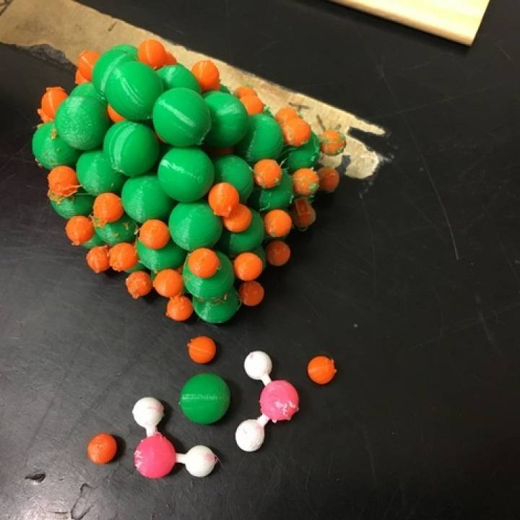
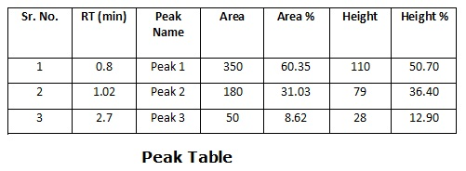
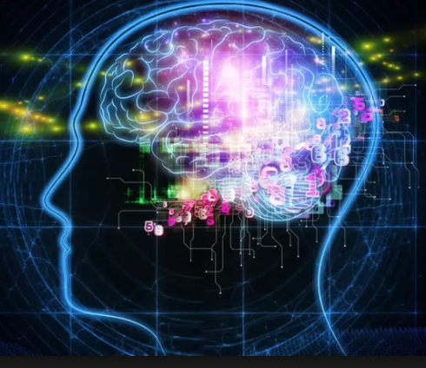
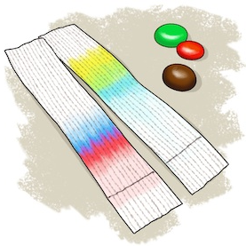
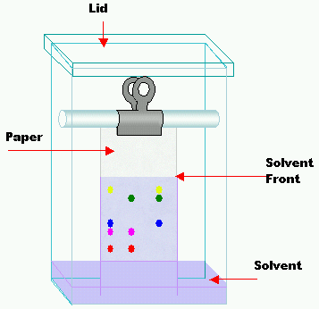
Findings
Models as Phenomena
Mathematical model
Gesture
Teacher is in dialogue with these models as a proxy for learning
Physical model
The experiment - chromatographs
Verbal &
“mental models”
Visual model
Notes:
Within teacher and pupil verbal protocols and interviews, the focus is on the understanding that pupils have, and the means by which these is developed. In line with discussion earlier in this paper, this stays very much on the level of ‘constructs’ or ‘mental models’ which are developed through social interaction, and ‘activities’. This does not mean that the teacher or pupils are not responsive to material influences in the classroom; our analysis suggests that they are continually responding and in dialogue with the material. However, retrospective discourse does not reflect this, and this reflects the arguably constructivist framing of the teacher and, interestingly, the pupils.
A material-dialogic frame allows us to see past this and ask questions of what it is that the teacher and pupil are actually intra-acting with, and how meaning emerges. To illustrate this, we share here one of the ‘readings’ which emerged from the diffracting of theory and data. In synthesising the material and the dialogic it becomes fruitful to see the models of chromatography present within the classroom as the key ‘phenomena’ in Barad’s (2007) terms. Throughout the lesson there are physical, mathematical and schematic models presented, developed and discussed. Indeed, the repeated dialogue with interactive and mini-whiteboards is in the teacher asking pupils to develop and explore models, and on occasions these individual models being ‘amplified’ as they are discussed with the whole class. There are also gestural models which have significance to the teacher and the pupils, and which are repeated several weeks after the original lessons – for example gestures around the movement of particles. As discussed above, the experimental results have meaning and are represented several times. Whilst not strictly ‘models’, they are representations of findings within the experiment.
The teacher and pupils implicitly, and sometimes explicitly, refer to ‘mental models’. Again, this fits the constructivist paradigm, and the teacher feels that he is crafting these mental models. The material-dialogic frame however suggests that in so doing what the teacher is actually in dialogue with are the physical manifestations – the models which have a physical presence in the classroom. These models are physical, mathematical and representational, but also manifest in gestures, verbal descriptions, written definitions, videos and animations. The dialogic space is inhabited not by amorphous ‘concepts’ but by these messy and entangled models, which are of course intra-acting with embodied brains. Focus on models has been a key discourse within science education for some time, and increasingly the focus is upon their physical or ‘artefactual’ nature (e.g. see Gilbert & Justi, 2016). However, a material-dialogic frame foregrounds not just the models deliberately introduced or developed, but those that emerge in intra-action in the complexity of classrooms. It also moves away from the representationalism inherent in the constructivist framing of models – that they are models of scientific concepts. Models have their own agency in classrooms, and we could go as far as arguing that it is these that pupils learn about, rather than scientific ‘concepts’. This will require greater exploration but demonstrates the potential of the material-dialogic frame to open up new avenues of enquiry.

Slide 13
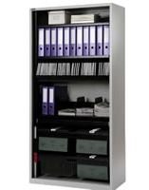
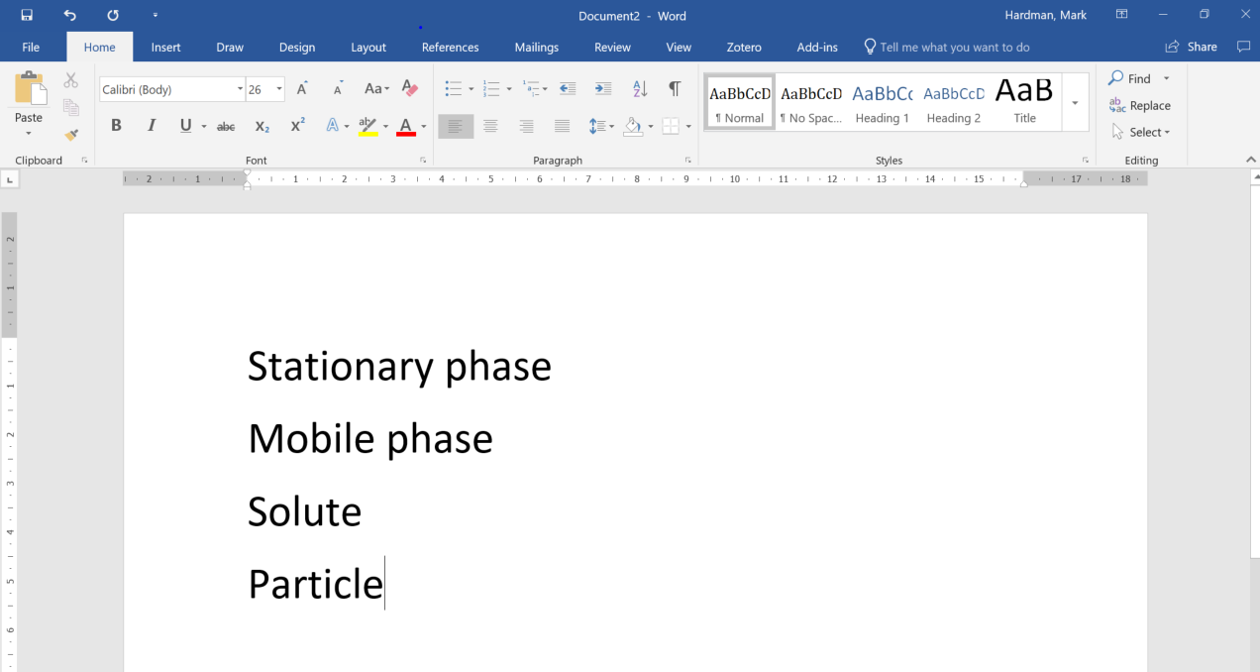
Findings
Jokes
Emergent Patterns of Dialogue
Stationary vs stationery
Emergent phrases, narratives and gestures take on meaning
Narrative explanations
“the ink lets go.”
Definitions and key terms
“cheating” = trying to guess.
“It’s not a thing”
Shared phrases
Notes:
[this slide can be skipped/reduced if time is short]
A further finding of potential interest is the importance of patterns of material-dialogue within the classroom, which become meaningful. There are particular phrases, gestures and actions which take on meaning as they are introduced and then repeated within the lessons.
In line with discussion of models above, the generation of narrative explanations emerge as verbal and representational models in classrooms, prompted by questions, activities and discussion. On occasions however, these models become entrenched within the dialogic space. For example, the notion that the ‘ink lets go’ at some point in the process was repeated within the lessons. Whilst this is a useful understanding, it is heavily anthropomorphised and may prevent a more nuance understanding later. There was also a naïve view presented by pupils that darker colours travel further than lighter coloured inks on the chromatography paper. This stemmed from the experimental findings, which took place before the three lessons analysed, but was a persistent narrative which took considerable effort to combat. Again, narrative explanations are well researched in the literature (e.g. see Bruner, 2000), but a material-dialogic frame recognises their significance within the dialogic space of a classroom, as well as their material manifestation and emergence.
An interesting feature of the lessons was a joke told by the teacher about a ‘stationary cupboard’. He suggested that within the school English department, they have a cupboard which is labelled as ‘stationary’, meaning ‘not moving’, however it should be a ‘stationery cupboard’: containing pens, paper etc. This joke was told within the first lesson, to little response from students. However, as it was retold in subsequent lessons, it firstly gained a begrudging laugh, and then a seemingly genuine one from the class. The joke has an epistemic quality in that it referred to the stationary phase within chromatography – essentially the paper which does not move. This took on meaning and indeed was repeated within the pupil verbal protocols. Similarly, the definitions which were co-developed within the classroom were reported and recalled by pupils. This suggests that the significance of these patterns is greater than them denoting ‘conceptual understanding’, they are in fact the basis of conceptual understanding.
A further class of shared dialogic patterns is of interest, that of phrases which take on meaning but are never explicitly defined. An example is the phrase ‘cheating’ which had varied uses over the lessons, but broadly referred to the desire of the teacher for pupils to arrive at descriptions themselves, rather than guessing the responses to questions or relying on terminology devoid of explanation. Both the teacher and pupils were able to recognise the epistemic basis of this phrase, that pupils should arrive at their own answers. Furthermore, there were shorthand phrases which developed to support pupils in responding to questions and developing their models. Phrase such as ‘it is not a thing’ and ‘it’s a what not a how’ guided pupils towards describing an item (such as the chromatograph), rather than a process, or vice versa. These phrases were used on multiple occasions and although initially unfamiliar, became helpful to pupils.
Patterns of dialogue, both verbal and with material, emerged within the lessons and became an integral part of the dialogic space. They took on meaning and we might suggest, albeit tentatively, that these constitute a considerable part of what pupils learn from within the classroom.

Slide 14
(Re)focusing on the material
What happens if we think differently about the material world?
What would change in how we approach science education if the material is reframed as an active participant in the learning taking place?
→ a new reading of ‘models’
→ Emergent dialogue comes to matter in learning
→ A need to further consider spatio-temporal nature of material dialogue: emergence, intention, patterns (c.f. Deleuze)
Notes:
We therefore wished to refocus on role of the material in school science, and how pupils learn with it. This is not to say that pupils’ talk is not important: what we were looking for is a theoretical perspective that would help us foreground the material without losing insights from pupils’ dialogue.

Slide 15
Where next?

Slide 16
References
Hetherington, L., & Wegerif, R. (2018). Developing a material-dialogic approach to pedagogy to guide science teacher education. Journal of Education for Teaching, 44(1), 27–43. https://doi.org/10.1080/02607476.2018.1422611
Hetherington, Wegerif & Hardman (under review) The case for a Material-Dialogic Approach to Science Teaching and Learning.
Barad, K. (2007). Meeting the Universe Halfway - Quantum Physics and The Entanglement of Matter and Meaning. London: Duke University Press.
Bruner, J. (2000). Acts of meaning (9. print). Cambridge, Mass.: Harvard Univ. Press.
Gilbert, J. K., & Justi, R. (2016). Approaches to Modelling-Based Teaching. In J. K. Gilbert & R. Justi, Modelling-based Teaching in Science Education (Vol. 9, pp. 57–80). Cham: Springer International Publishing. https://doi.org/10.1007/978-3-319-29039-3_4
Hein, S. F. (2016). The New Materialism in Qualitative Inquiry: How Compatible Are the Philosophies of Barad and Deleuze? Cultural Studies ↔ Critical Methodologies, 16(2), 132–140. https://doi.org/10.1177/1532708616634732
Mazzei, L. A. (2014). Beyond an Easy Sense: A Diffractive Analysis. Qualitative Inquiry, 20(6), 742–746. https://doi.org/10.1177/1077800414530257
Osberg, D. C., & Biesta, G. J. J. (2008). The Emrgent Curriculum: Navigating a Complex Course Between Unguided Learning and Planned Enculturation. Journal of Curriculum Studies, 40(3), 313–328.
Riordan, J.-P. (2014). Riordan J P 2014 Techniques, tactics and strategies for conceptual change in school science. PhD Thesis. Canterbury Christ Church University.
Taylor, K. L., & Dionne, J. P. (2000). Accessing problem-solving strategy knowledge: The complementary use of concurrent verbal protocols and retrospective debriefing. Journal of Educational Psychology, 92(3), 413–425.

Slide 17
Thank you for listening
Please do email us if you are interested in our work:
Lindsay Hetherington, University of Exeter, L.Hetherington@exeter.ac.uk
Mark Hardman, University College London, M.Hardman@ucl.ac.uk
Rupert Wegerif, University of Cambridge, rw583@cam.ac.uk

Slide 18
Discussion
Advantages
Evaluating a Material-Dialogic Position
Recognises that matter matters in classroom intra-actions.
Moves focus from acquisition of ‘concepts’ to the entangled phenomena that pupils actually learn from (e.g. models, narrative).
Recognises the potential of (critically) diffracting data and theory to produce new readings.
To Consider Further
Accounting for the spatio-temporal nature of dialogue: emergence, intention, patterns (c.f. Deleuze)
Notes:
Here we will briefly evaluate the advantages and some areas for further development in relation to the mater-dialogic position, based on the empirical test case.
The material-dialogic frame clearly recognises the importance of matter in a way that is not apparent in the constructivist frame that the teacher in the case study holds. However, this goes beyond making explicit something which is understood implicitly. In moving away from a focus on amorphous concepts (individual or social), which are acquired through activities, to a focus upon the entangled phenomena that pupils actually learn from, and as part of. We have above considered models and narrative patterns of dialogue as key aspects of this. The fact that it is these that were recalled directly in verbal protocols, suggests the importance of them in learning. This requires a greater body of research to support. The point here however is to suggest that a material-dialogic frame has the potential to provide a much more specific account of learning.
A further important advantage of a material-dialogic frame is that it’s theoretical basis encourages the diffraction of multiple perspectives, recognising the agency of the material (e.g. research data) and theoretical (including the ‘theoretical’ perspectives of pupils and teachers). This does not however provide a form of relativism where any lens or reading is appropriate. Barad’s (2007) work demonstrates that the ‘apparatus’ with which we view a situation produces the phenomena we see. As such we need to critically consider the apparatus we use within research, drawing upon a great deal of scholarship around research methods whilst simultaneously seeking to surpass simplistic interpretations of it.
The test case also throws up some areas for development in relation to material-dialogic theory. Karen Barad’s work draws from science studies, and specifically physics, in which replicability is important. However, in social setting such as classrooms, there can be no replicability: the phenomena in questions are complex and dynamic in a way that the ‘laws of nature’ are not. In this context, Barad’s frame alone does not account for the dynamic situation very well, nor the ‘purposeful’ nature of education (e.g. see Osberg & Biesta, 2008). Within the case study the teacher could be said to be continually attempting to modify the phenomena: the models of the pupils. Unlike phenomena in the physical sciences, the models and understandings of pupils cannot be probed by change as you interact with them. As well as a need to develop a temporal understanding, beyond Barad’s frame alone, material-dialogic theory must account for repetition – the jokes and phrases which take on meaning in the lesson have different meaning over time. Here Deleuze’s frame gives us a better sense of difference and repetition than Barad’s. As Hein (2016) points out, Barad still has a separation of discourse and matter, although they intra-act. The material-dialogic position inherits this as a relational ontology. Deluze’s ontology, in contrast, has no such separation.
However, material-dialogic theory draws on not just Barad but also on Bakhtin. Bakhtin is materialistically monistic, seeing signs as being both material and “ideological”. This materialism is Marxist in origin, and therefore differs from the ‘new materialism’ of Barad; we might however see it as less prone to a separation of ideas from matter (in line with Deleuze’s thought). As such, the relational ontology of a dialogic-space need not imply a dualism. Nevertheless, an areas for further consideration is how temporal aspects of dialogue are accounted for in the material dialogic space. We have considered how dialogue and patterns of intra-action emerge. This might be developed further in considering a spatio-temporal account of material-dialogue. This would allow further analysis of the emergence, repetition and evolution of patterns of dialogue, and the educative process which drive them.
Whilst there are areas for further consideration therefore, it is evident form the test-case that a material-dialogic frame allows the development of new, and more specific readings of pedagogy than the focus on concepts which currently dominates educational discourse.

