Slide 1
Research libraries – new approaches for library-based publishing
Dr Paul Ayris
Director of UCL Library Services, UCL Copyright Officer,
Chief Executive, UCL Press
Chair, LERU (League of European Research Universities) Chief Information Officer Community
Adviser to LIBER (Association of European Research Libraries) on EU issues and Horizon 2020
e-mail: p.ayris@ucl.ac.uk

Slide 2
Contents
Context
Open Access developments in the UK
Library in the research process
UCL Press model
Open Access Monographs
Open Access Textbooks
Conclusions

Slide 3
Contents
Context
Open Access developments in the UK
The Library in the research process
UCL Press model
Open Access Monographs
Open Access Textbooks
Conclusions

Slide 4
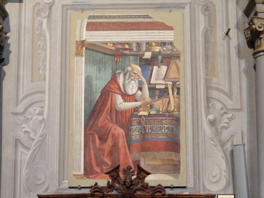
OA Policy developments
UK policy position defined by Finch Report and the RCUK policy
UK universities prefer Green OA dissemination via repositories
RCUK policy has a preference for Gold
HEFCE mandate for REF 2020 aims to secure near 100% OA compliance for journal articles and conference proceedings
Saint Jerome in his Study, fresco by Domenico Ghirlandaio, 1480.
Church of Ognissanti, Florence

Slide 5
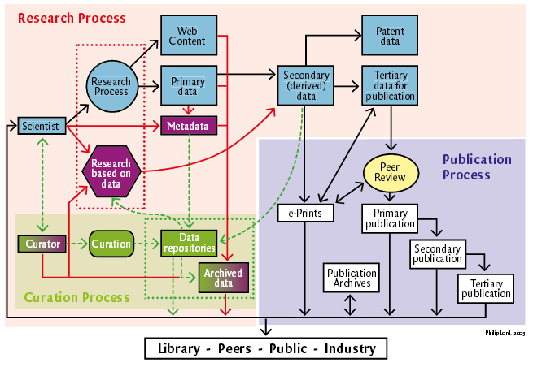
See http://www.ukoln.ac.uk/ukoln/staff/e.j.lyon/150.pdf

Slide 6
Contents
Context
Open Access developments in the UK
The Library in the research process
UCL Press model
Open Access Monographs
Open Access Textbooks
Conclusions

Slide 7
UCL Publishing model
Journal publishing platform
OJS (Open Journal Systems) overlaying UCL Discovery as storage layer
Peer-reviewed journals
Run by academic Editorial Committees
Research Monograph list being launched in 2014-15
10 titles in year 1
Using Open Monograph Press
Textbook infrastructure
Being constructed with JISC project monies
Open Access is an opportunity, not a threat
See http://www.ucl.ac.uk/library/ucl-press

Slide 8
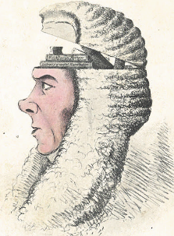
UCL Publishing model
Open Access business model
Sales via Print on Demand/enhanced e-models
Books will be peer reviewed before publication
Innovative technical solutions for Monographs and Textbooks
Open up publishing to new communities
Global impact for the University as an outcome
A Box of Useful Knowledge
(Brougham Papers, UCL Library Services)

Slide 9
Contents
Context
Open Access developments in the UK
The Library in the research process
UCL Press model
Open Access Monographs
Open Access Textbooks
Conclusions

Slide 10
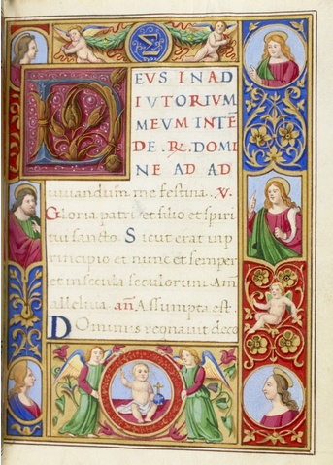
Monograph Publishing
Is Open Access a solution to broken Business Model?
University Press takes on role as monograph publisher
UK’s National Monograph Strategy sees a role for OA monographs
We need to be clear what the future of the scholarly monograph is in a digital world
UCL Special Collections, 15th century Book of Hours, with 19th century additions. MS. Lat. 25

Slide 11
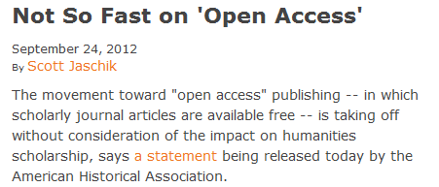
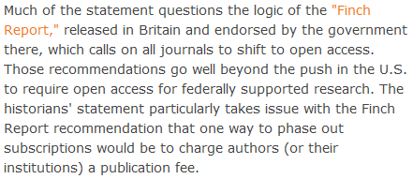
The view from Arts and Humanities?
http://blog.historians.org/2012/09/aha-statement-on-scholarly-journal-publishing/

Slide 12
Case Study – Shared European infrastructure for monographs?
19 European partners, led by UCL
European universities can become publishers themselves
Shared publishing infrastructure with Open Access business models
Research monographs in the Arts, Humanities and Social Sciences
OAPEN to provide much of the technical infrastructure
Launched at UCL in December 2013
UCL Special Collections. Pentateuch, 1666.
STRONG ROOM MOCATTA Q B 12 TAR

Slide 13
What could be achieved?
OUTPUTS
Shared publishing infrastructure Shared by 19 partners Scaleable to all European Universities
Advocacy for new solutions to solve monograph crisis
Marketing frameworks
Business Modelling activities
At least 180 OA monographs in 35 series

Slide 14
Indicative series in European collaboration
35 series titles proposed in total | Subject area
Media History and Film Theory | Media studies, Film theory
Spirituality Studies in Theology | Theology
World Oral Literature Series | Literary Studies
Iranian Studies | Middle Eastern Studies
Law, Governance and Development Research | Law, International Studies
Interdisciplinary Issues - Art, City, Society | Urban Studies
New Ideas in Human Interaction | Linguistics

Slide 15
Contents
Context
Open Access developments in the UK
The Library in the research process
UCL Press model
Open Access Monographs
Open Access Textbooks
Conclusions

Slide 16
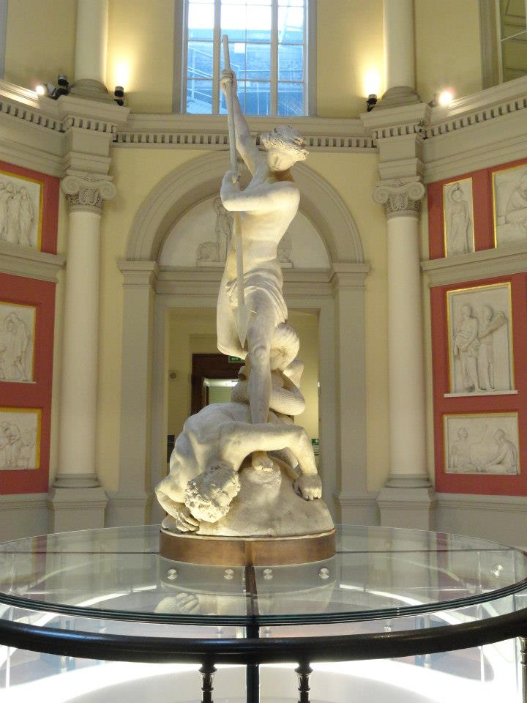
Challenges for Text Books
Students want remote access to core readings 24x7
In the US, just five textbook publishers control more than 80% of the $8.8 billion textbook market
E-book publishers are nervous about making course texts available as e-books (free at the point of use) as they do not want to cannibalize their print sales to students and lose revenue
St Michael, by John Flaxman, UCL

Slide 17
Opportunities for Text Books
UCL academics, particularly in Physical Sciences and Engineering, produce their own textbooks
Open Access is a core value of UCL Press
Open Access to resources will be part of UCL’s new Education Strategy
UCL’s International Strategy will also embrace Open Scholarship as an offering to the global community
COLLEGE COLLECTION PERS
The Centenary edition of the College Magazine, June 1927

Slide 18
JISC Call - Institution as E-Text Book publisher
£75,000 awarded to UCL
To create an Open Access E-Textbook publishing platform
To complement OJS for journals and OMP for monographs
2 textbooks being delivered as proof of concept
1 in Medical Sciences and 1 in Social Sciences

Slide 19
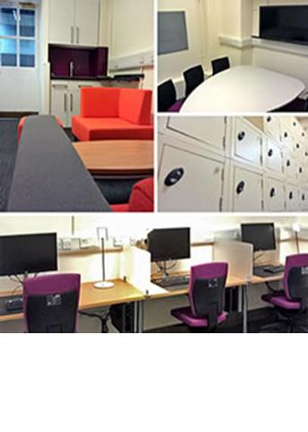
Public Archaeology
Course Book in Public Archaeology
Will give overview based on current undergraduate and postgraduate teaching
Will take account of global scholarship and practice
Target audience is undergraduates and postgraduates
Lecturers in countries where Public Archaeology is a growing field of practice

Slide 20
Plastic and Reconstructive surgery
Written by leading practitioner at Royal Free Hospital
Intended for MSc in Burns, Plastic and Reconstructive Surgery
Will provide overview for students coming from a variety of specialisms across the world
Course is only one of a handful to train medics not only in practice, but also in research and innovation in materials and techniques

Slide 21
Contents
Context
Open Access developments in the UK
The Library in the research process
UCL Press model
Open Access Monographs
Open Access Textbooks
Conclusions

Slide 22
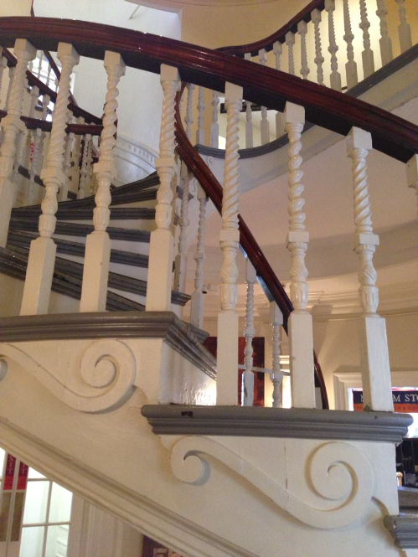
Next Steps
UCL is beginning to embrace the Open Scholarship agenda
University publishing supports this vision
Innovation
Formats
Business Models
Content types
Dissemination
New role for research libraries in the 21st century
Old State House, Boston, USA

