Slide 1
Implementing the Future: the LERU Roadmap for Research Data
Dr Paul Ayris
Director of UCL Library Services and UCL Copyright Officer
Chief Executive, UCL Press
Chair, LERU Chief Information Officer Community
Adviser to LIBER (Association of European Research Libraries) on EU matters and Horizon 2020
e-mail: p.ayris@ucl.ac.uk

Slide 2
Contents
The importance of Research Data
LERU Research Data Roadmap
Next Steps for LERU

Slide 3
Contents
The importance of Research Data
LERU Research Data Roadmap
Next Steps for LERU

Slide 4
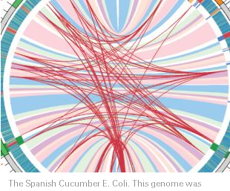
See Science as an open enterprise http://royalsociety.org/policy/projects/science-public-enterprise/report/

Slide 5
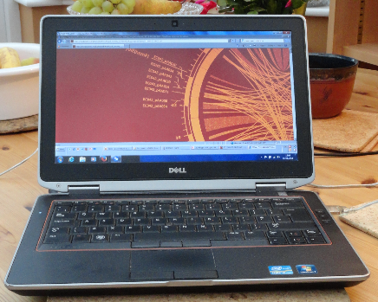
Technological change
Modern computers permit massive datasets to be assembled and explored in ways that reveal inherent but unsuspected relationships. This data-led science is a promising new source of knowledge (p. 7)
The emergence of linked data technologies creates new information through deeper integration of data across different datasets with the potential to greatly enhance automated approaches to data analysis (p. 7)

Slide 6
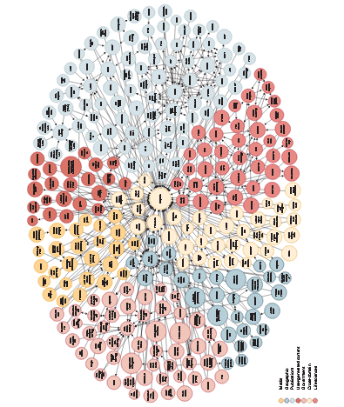
Map of Interlinked Data
W3C (2012). Available at: http://www.w3.org/wiki/SweoIG/TaskForces/CommunityProjects/LinkingOpenData

Slide 7
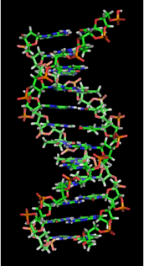
Open Data
Open data is the idea that certain data should be freely available to everyone to use and republish as they wish, without restrictions from copyright, patents or other mechanisms of control
Auer, S. R.; Bizer, C.; Kobilarov, G.; Lehmann, J.; Cyganiak, R.; Ives, Z. (2007). "DBpedia: A Nucleus for a Web of Open Data". The Semantic Web. Lecture Notes in Computer Science 4825. p. 722. doi:10.1007/978-3-540-76298-0_52. ISBN 978-3-540-76297-3.
http://en.wikipedia.org/wiki/File:DNA_orbit_animated.gif

Slide 8
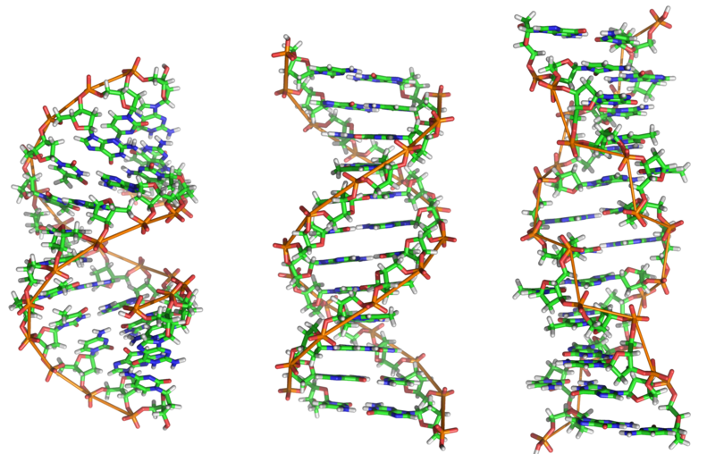
Human Genome Project
Aim: To determine the sequence of chemical base pairs which make up human DNA, and to identify and map the total genes of the human genome
See http://en.wikipedia.org/wiki/DNA
Benefits – felt from molecular medicine to human evolution
Better understanding of disease
Design of medication and prediction of their effects
Commercial development of genomics research

Slide 9
Contents
The importance of Research Data
LERU Research Data Roadmap
Next Steps for LERU

Slide 10
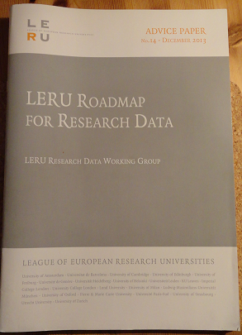
LERU Roadmap for Research Data
Overseen by Research Data Working Group
Pablo Achard (University of Geneva)
Paul Ayris (UCL, University College London)
Serge Fdida (UPMC, Paris)
Stefan Gradmann (University of Leuven)
Wolfram Horstmann (University of Oxford)
Ignasi Labastida (University of Barcelona)
Liz Lyon (University of Bath)
Katrien Maes (LERU)
Susan Reilly (LIBER)
Anja Smit (University of Utrecht)

Slide 11
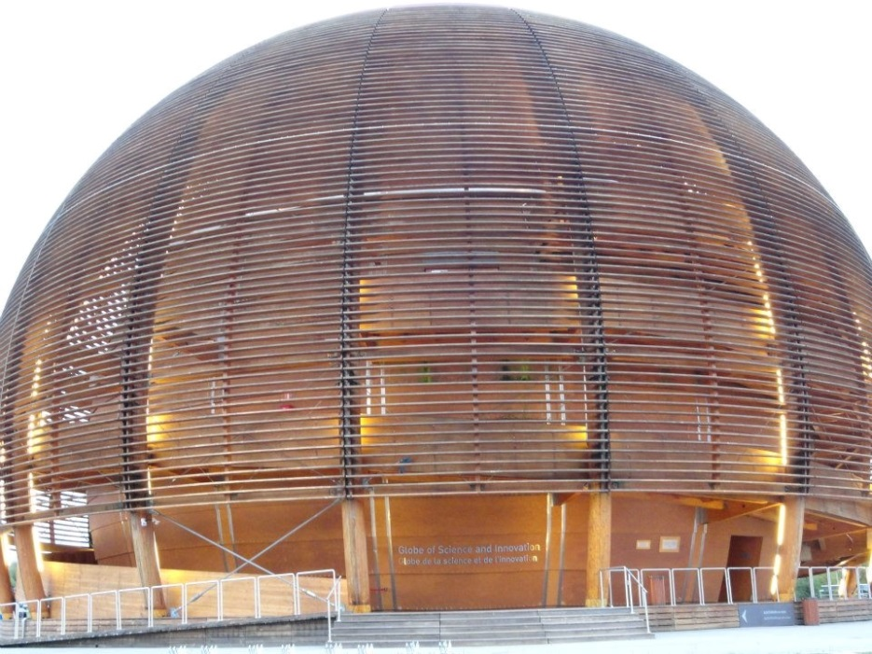
LERU Roadmap for Research Data
Policy and Leadership
Advocacy
Selection and Collection, Curation, Description, Citation, Legal Issues
Research Data Infrastructure
Costs
Roles, Responsibilities and Skills
Recommendations to different stakeholder groups
Cern, Geneva

Slide 12
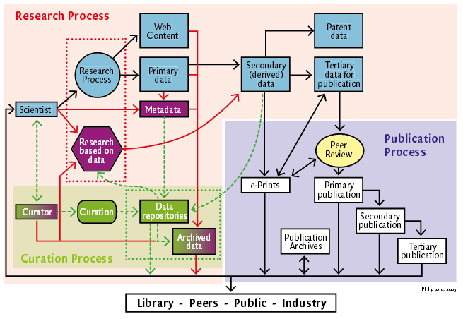
See http://www.ukoln.ac.uk/ukoln/staff/e.j.lyon/150.pdf

Slide 13
Key Messages
Each LERU university needs a Research Data Management Strategy
Researchers should have Research Data Management Plans
Benefits of ‘open data’ for sharing and re-use should be advocated and explored
Rewards and Incentives identified
King’s Cross, London

Slide 14
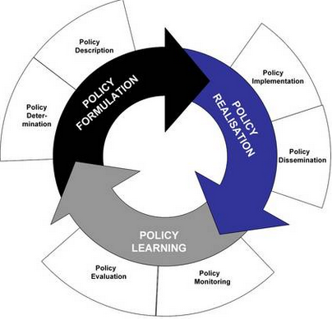
Policy Development
Case Study on Policy development from UCL
Drivers
External funders
Need to inform researchers
Raise awareness of issues facing UCL researchers
Identifies roles and responsibilities
Data to be made open in the most open manner appropriate
See www.lanecrothers.net/politicalprof/the-policy-cycle-and-our-frozen-politics/
Researchers should have Data Management Plans
LERU slams lack of data policies – Research Europe

Slide 15
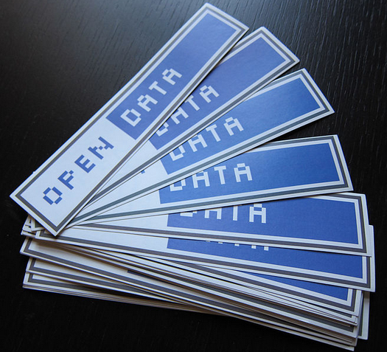
Open Data
Open Data allows research data to be shared and re-used
Avoids costly duplication of research activity
Provides greater transparency in research activity
Potential to speed discovery of solutions to societal Grand Challenges, such as health care & environmental science
Can all research data be open?
Certain categories probably cannot
National security
Data protection
Commercial Funder requirements
http://en.wikipedia.org/wiki/File:Open_Data_stickers.jpg

Slide 16
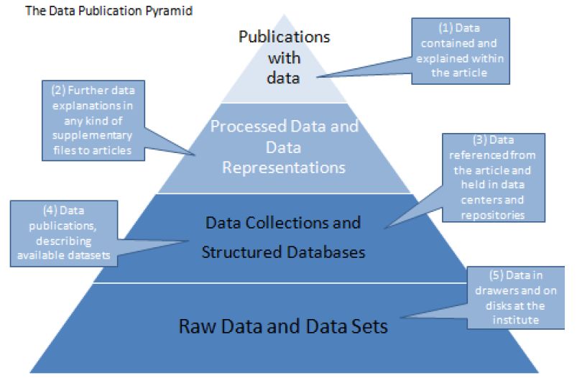
Data management
Which of these layers of research data need to be
curated for a fixed term?
preserved for the long term?
thrown away?
LERU Roadmap identifies this as an area for future study
The ODE Data Publication Pyramid at
http://www.alliancepermanentaccess.org/wp-content/uploads/downloads/2011/11/ODE-ReportOnIntegrationOfDataAndPublications-1_1.pdf

Slide 17
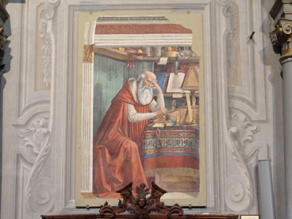
Rewards and Incentives for researchers
Driver: Individual Contributor Incentives
Preserving data for the contributor to access later - sharing with your future self;
Peer visibility and increased respect achieved through publications and citation;
Increased research funding;
Saint Jerome in his Study, fresco by Domenico Ghirlandaio, 1480. Church of Ognissanti, Florence

Slide 18
Driver: Individual Contributor Incentives
When more established in their careers through increased control of organisational resources;
The socio-economic impact of their research (e.g. spin-out companies, patent licenses, inspiring legislation);
Status, promotion and pay increase with career advancement;
Status conferring awards and honours.

Slide 19
Barrier: Individual Contributor Barriers
Journal articles do not describe available data as a publication;
Published data is not recognized by the community as a citable publication;
There is a lack of specific funding in grants to address pre-archive activities for data preservation;
There is a lack of mandates to deposit high quality data with appropriate metadata in preservation archives;
Journals do not require data to be deposited in a form where it can be re-used as a condition of publication;

Slide 20
Barrier: Individual Contributor Barriers
Data publication and data citation counts are not tracked and used as part of the performance evaluation for career advancement;
There is a lack of high status awards to individuals and institutions which contribute data that is re-used.
Thames Barrier, London

Slide 21
Enabler: Individual Contributor Enablers
Journal articles describing available data as a publication;
Citation of data itself, and articles describing it;
Specific funding in grants to address the pre-archive activities for data preservation;
Enforced funding regulation to ensure the depositing of high quality data with appropriate metadata in preservation archives;
Journals requiring data to be deposited in a form where it can be re-used as a condition of publication

Slide 22
Enabler: Individual Contributor Enablers
Tracking data publication and data usage and citation counts, and using them as part of the performance evaluation for career advancement
High status awards to individuals and institutions which contribute data that is re-used.
Dallmeier-Tiessen S, Darby R, Gitmans K, Lambert S, Suhonen J, Wilson M (2012). Compilation of Results on Drivers and Barriers and New Opportunities. Retrieved from
http://www.alliancepermanentaccess.org/wp-content/plugins/download-monitor/download.php?id=Compilation+of+Results+on+Drivers+and+Barriers+and+New+Opportunities

Slide 23
Contents
The importance of Research Data
LERU Research Data Roadmap
Next Steps for LERU

Slide 24
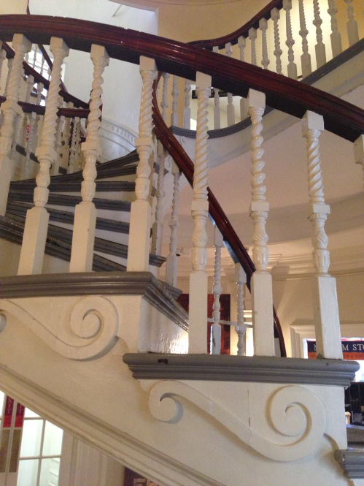
Next Steps
Changes advocated by Roadmap are far-reaching
LEARN will help embed LERU Roadmap in LERU universities and across national boundaries
LERU Rectors have suggested Data Pilot(s), with Horizon 2020 funding
Working Group to consider options
Old State House, Boston, USA

Slide 25
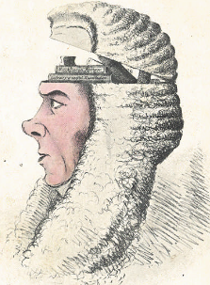
LEARN – Leaders Activating Research Networks
Project submitted for funding in Horizon 2020
UCL, Barcelona, Vienna, LIBER, UN (Chile)
Will advocate principles of LERU Roadmap for Research Data via
Model research data policy
Toolkit advocating best practice in research data management
Could be adopted by any research institution globally
A Box of Useful Knowledge
(Brougham Papers, UCL Library Services)

Slide 26
Finally
If you have been
Thanks for listening
Happy to hear questions

