Slide 1

Tropes of Academic Extractivism and Omissions in Urban Studies RGS-IBG Conference 2025
Vafa Dianati, Raktim Ray; DPU, UCL
Md Shajedur Rahman; University of Birmingham

Slide 2

Introduction
A1: A1’s paper from one of their doctoral chapters was rejected because the editor felt methodologically it was not ‘ethnographic enough’ and the fieldwork duration was not sufficient (fieldwork location was A1’s own home country and community, a site A1 is very familiar with)
A2: When a paper was submitted to a high-ranking journal for a special issue, after several rounds of revisions, at the end A2 was asked to cite an article (published after a year while the revision was going on) which was not directly relevant to their work but published by a leading academic, part of the editorial board.
A3: A paper was rejected and the ground for the rejection by the editor as the case study (non-western) is not well linked to specificities of the global knowledge (read western).
Source: The Book Seller Webpage
3 tropes: a) politics of citation
b) valorisation of certain knowledge at the expense of others
c) politics of qualification

Slide 3
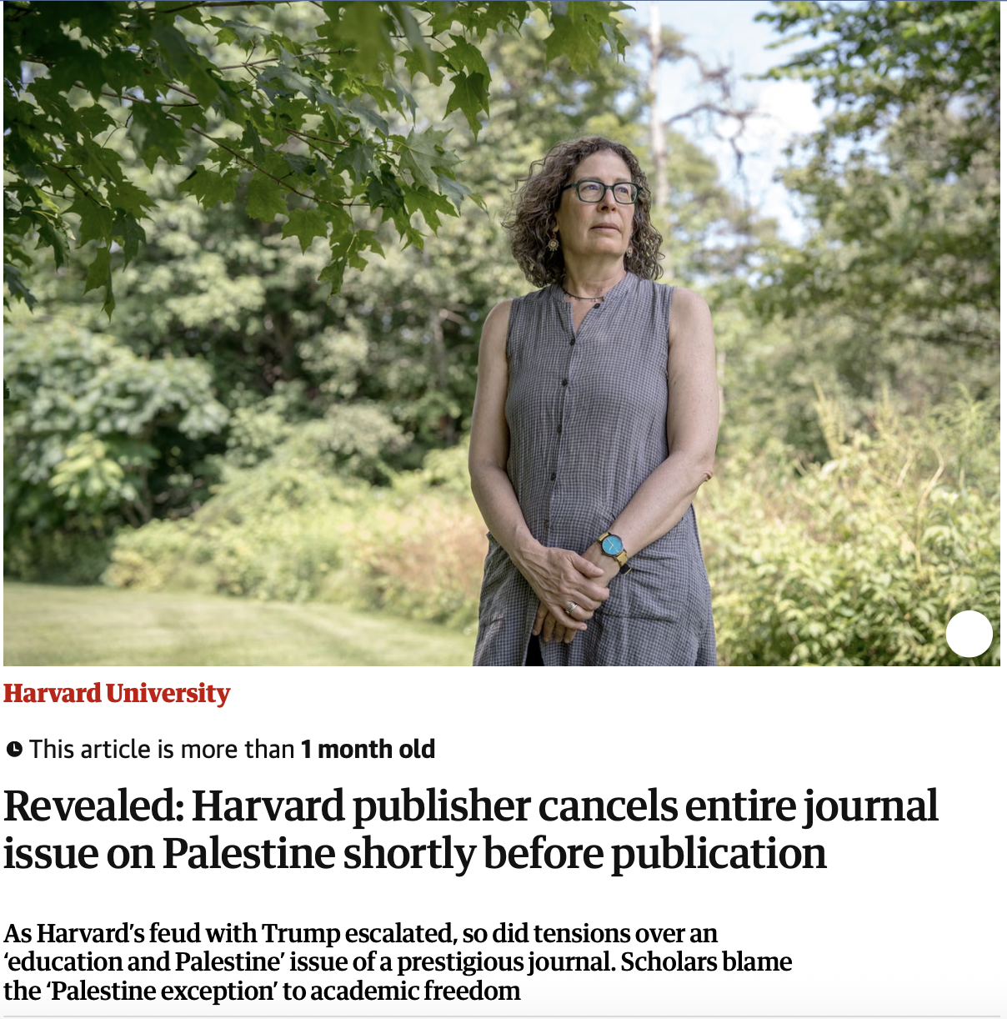
Logics of Omission/ Erasure/ Appropriation
Perpetuating the inequal power relations that exists between the north and the south which disproportionately benefits the north (Cruz and Luke, 2020)
Reinforces colonial authority over black/indigenous/ non-western knowledge systems or to fetishize knowledge designed to propel settler colonial logics (Simpson, 2014)
Creates ‘jargon’ or conceptual apparatus to isolate academia from engaging in dialogues with insurgent social forces (Cusicanqui, 2012)
Source: The Gurdian, July 2025
Following Grosfoguel, 2007, we collectively speak from the epistemic location of the south than the social location.

Slide 4
Academic Extractivism
Extraction is tied to the social reproduction of Whiteness- “a geometry of power that executed dispossession and displacement under the rubric of extraction”. (Yusoff, 2018)
“Through the game of who cites whom, hierarchies are structured, and we end up having to consume in a regurgitated form, the very ideas regarding decolonization that we Indigenous people and intellectuals of Bolivia, Peru and Ecuador have produced independently” (Cusicanqui, 2012: 103)
Colonialism and conquest lead to extraction (Madhok 2022)
Value-neutral subject in epistemology perpetuates epistemicide and produces universalised and abstract representation of colonial, white and European knowledge (Grosfoguel, 2013)
Theoretical support for racialised and exoticised multi- culturalism in the academia for conditional inclusion
South’s dependence on the north for ‘their development and growth’
Minimise south subjects as data harvesting points

Slide 5
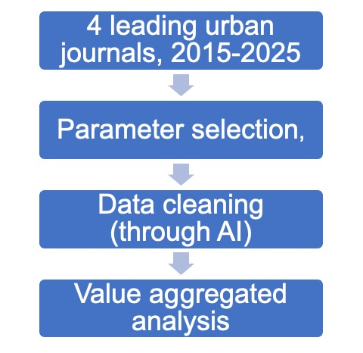
Debates in Urban Studies
42% of the journal articles and 17% of the handbook chapters were authored outside the north whereas 15% of the editor positions are outside the north (Muller et al., 2025)
Conceptual grammars of urban studies rely on handful cities like New York, Los Angeles and London
Theoretical metropoles within southern urbanism falls in the same trap (Narayanan 2021)
Existing citational canon upholds dominant epistemology even within decolonising urban discussions because of erosion and banalisation of the term (Ortiz et al, 2025)
Parameters: a) location of the study (UNM49 Classification)
b) Affiliation of the lead author
c) Nature of the work
d) Frequency of citation
e) Composition of editorial board
f) Nature of co-authorship

Slide 6
Provocations
“For the master's tools will never dismantle the master's house. They may allow us temporarily to beat him at his own game, but they will never enable us to bring about genuine change.” Audre Lorde, 1979
What do we do when majority of the funding is located in the north?
How do we grapple with complexities of ‘marginal native’ researchers located in the north?
How do ensure diverse editorial board beyond tick boxing exercise?
How do dismantle citational inequality?
How to go beyond theoretical metropoles?
Southern questions from the peripheries (Bhan, 2019)
Epistemic justice through unlearning and counteract academic extractivism (Ortiz et al., 2025)
Rasing ontological questions through doing ‘dirty research’ (Shafique, 2025)
Iteration of careful obstructions to disrupt categories with its discursive praxis and creating new categories (Sircar, Ray, Paiker, 2025)

Slide 7
Thank you
The Bartlett Development Planning Unit
34 Tavistock Square
London WC1H 9EZ www.bartlett.ucl.ac.uk/dpu

