Slide 1

Should we teach Rosa Parks before or after
The Great Fire of London?
Dr Helen Crawford
Lecturer in Early Childhood Education
UCL-IOE

Slide 2
Session Objectives
to enhance understanding of the importance of effective curriculum sequencing
to enhance understanding of strategies to support phase transition

Slide 3
Key Stage 1 programme of study
Changes within living memory. Where appropriate, these should be used to reveal aspects of change in national life.
Events beyond living memory that are significant nationally or globally.
The lives of significant individuals in the past who have contributed to national and international achievements. Some should be used to compare aspects of life in different periods.
Significant historical events, people and places in their own locality.
(DfE, 2013)

Slide 4
What does the National Curriculum say?
The current National Curriculum (DfE, 2013) does not provide guidance for content sequencing the Key Stage 1 programme of study.
However, previous iterations stated:
“[It is]..sensible for very young pupils to begin their study of history with the local and familiar, with stories about their own lives and about the times of older people well-known to them such as their parents or grandparents”
(HMI, 1988, p. 10; DfES, 1995)
Notes:
This recommendation was dropped from the 2000 revised version (DfEE/QCA, 1999)

Slide 5
What does Ofsted say?
‘School’s curriculum is coherently planned and sequenced’ Ofsted, 2024 current inspection framework
‘Subject/area curriculums are well designed to build pupils’ knowledge and skills sequentially and cumulatively’
Ofsted Toolkit, 2025

Slide 6
What did the model history curriculum say?
The model history curriculum will:
“set out a year-on-year programme of study from year 1 to year 9, following the National Curriculum as the framework for a chronological approach to history” (DfE, 2022, p. 2)

Slide 7
My Research Questions
What are history subject leaders’ perceptions of:
the factors that influence decision-making in relation to the content selection of the KS1 history curriculum?
the factors that influence decision-making in relation to content sequencing of the KS1 history curriculum?
their agency to determine the content and sequencing of the KS1 history curriculum?

Slide 8

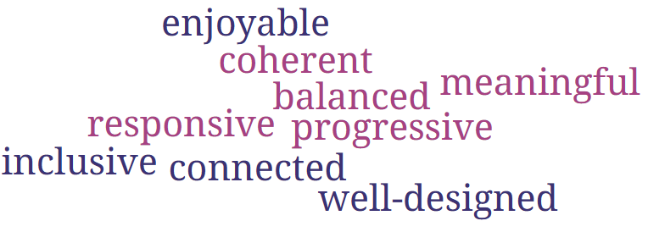
Research sample: finding the ‘best’ schools
Copyright: HA

Slide 9

Research methods
Alex | Beth | Emma | Freya | Max
Semi-structured interviews with five history subject leaders schools awarded a gold Quality Mark award

Slide 10

Let’s build a KS1 curriculum
On your table you have some popular curriculum topics/units.
Can you build a curriculum for Year 1 and Year 2 pupils?
Can you build a curriculum for a mixed Year 1/Year 2?

Slide 11
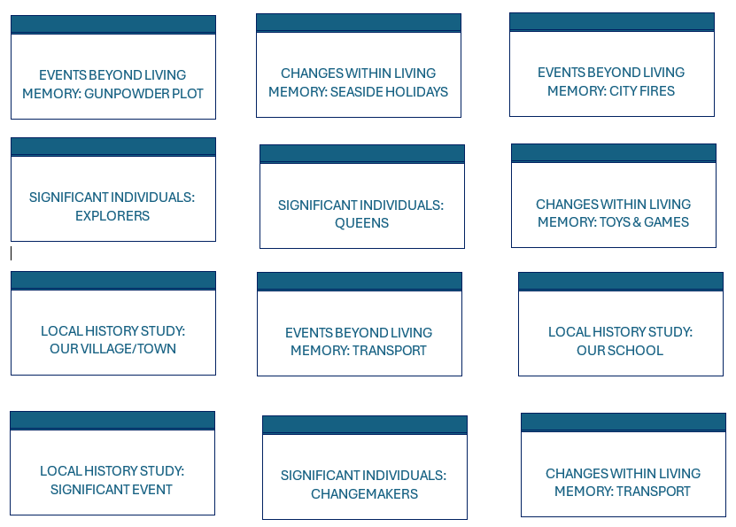

Slide 12
What does the National Curriculum say?
The current National Curriculum (DfE, 2013) does not provide guidance for content sequencing the Key Stage 1 programme of study.
However, previous iterations stated:
“[It is]..sensible for very young pupils to begin their study of history with the local and familiar, with stories about their own lives and about the times of older people well-known to them such as their parents or grandparents”
(HMI, 1988, p. 10; DfES, 1995)
Notes:
This recommendation was dropped from the 2000 revised version (DfEE/QCA, 1999)

Slide 13
Overall research findings
Range of scales
Phase transition
Progression in history
‘I think it's more difficult…Year 3 upwards to Year 6, the topics are in chronological order’

Slide 14
Range of scales
.
.
.
.

Slide 15
Starting from the known
‘We tried to start with units, you know, that we kind of almost, in living memory, possibly ones, you know, the children could relate to.’ Max
‘I think it's just something that they can really relate to, um, you know, in terms of it wasn't too far in the past.’ Alex
‘We did have the Great Fire of London before that [unit on local history], but we quickly realized that that's a very abstract concept to those children, London is s- so far away.’ Emma

Slide 16
Starting from the known
‘A lot of the first sort of units in Year 1, they start looking at their own history. So like my community is a, a unit that we do. So they look at, um, you know, the history of themselves and their grandparents.’ Freya
‘it's all within quite a relatively short space of time and we don't want to go further than that, at that stage, purely because we want the children to understand the immediate history before we go into further down the chronological periods.’ Beth

Slide 17
Why is ‘the known’ important?
‘it’s placing themself in the world. I think they need to know who they are, where they fit into society, where they fit into family and the school, and the wider context because if they can't grasp where they fit in and who their grandparents are, and who a sibling is, then they're not going to have empathy for different cultures, different traditions, different lines of enquiry.’ Beth
‘when they then go on to do, you know, topics that they've not got a personal connection to, they can still make that sort of relation.’ Freya

Slide 18
From known to unknown
‘We wanted one [unit] that kind of went further afield and kind of extended that timeline further back and we thought explorers was a good topic to do… just trying to look at lots of different people that we could kind of look at from different backgrounds.’ Max
‘Then in the summer term, we then move on to transport because that's gonna now take their understanding from the current, to events beyond that living memory. So that’s nationally and globally.’ Beth
‘So, we, we looked at how the child will experience that [the curriculum], and things like the Great Fire of London, making sure that it came after a local experience, so that they're able to understand it in a greater depth than they would be able to, uh, as a younger Year 1 child.’ Emma

Slide 19
Why are expanding scales important?
‘Actually if they've just looked at their community and their own history for two years, when they go on to Year 3 and they start looking at civilizations, I feel like they would be a little bit lost as to understanding, you know, where in the world that might be, who those characters are, the sort of concepts of like rebellion and you know, important documents that we look at.’ Freya

Slide 20
Learning outside the classroom
‘The seaside in the summer term was chosen obviously, because it's in the summer, so that we can hopefully have a longer, a, a trip that's a little bit further away, and take the children to the seaside, so they can experience that for themselves.’ Emma
I think that Local Heroes [Year 2 summer] we felt fitted nicely into the summer term because we could then, with the weather, go and explore our local area a bit more and be able to go and physically go to the museum. Beth

Slide 21

Phase transition

Slide 22
Content phase transition: EYFS to Year 1
‘I think we wanted to start with a topic that they could relate to… they look at toys in Early Years and again, that's almost like toys from the past. So I think we saw it as a good way of building on some [of that] as well. Max
“I [the child] would start with Victorian toys and games - which would already be familiar to me, because I've done it [toys] already in Early Years…I've got that experience of my own toys and games.’ Emma

Slide 23
Pedagogy phase transition: EYFS to Year 1
‘So the reason why we put it there [Year 1- autumn] is it fits in quite nicely to their role play area.’ Beth
‘in Year 1, the first, uh, topic that they do, first unit, is called stories from history… um, the importance of that is because obviously children at that age are so familiar with stories. They hear stories all the time.’ Freya

Slide 24
Content phase transition Year 2 to Year 3
The end of Year 2, we start looking at, we do the Stone Age and then we do two terms on Ancient Egypt. Um, and obviously that then is giving them that sort of beginning of understanding of looking at civilizations because then for the whole of Year 3 and 4 is every unit is a different civilization. Freya

Slide 25

Progression in history

Slide 26
Progression in enquiry
‘As you get further up the school, the more challenging [enquiry questions] that they become, the more sort of like historical, uh, you know, disciplinary knowledge, they need to answer those questions… so you can see kind of how those questions evolve from Year 1, looking at how has your community changed [Year 1 autumn/spring], right to Year 2, looking at like, you know, impact and things like that.’ Freya
‘Our plan is by the end of Year 1, they've got that understanding of themselves, that enquiry. So now when you're Year 2, we can really build upon some of those more deeper enquiry questions.’ Beth
Notes:
Seemed to associated consequence/impact with difficulty and change as easier

Slide 27
Progression in substantive/disciplinary knowledge
‘I think the main reason we decided to do a lot of them, the way we did, we looked… like how complex the topic was. Um, so the idea of like ‘Rags to Riches’ is even though it's, there's still some challenges in there, it's not as complex as the idea of, um, you know, ‘Invaders and Explorers’ gets a little bit harder each unit that they do.’ Freya
‘When you kind of look at where they've gone from quite, being quite simple with the Transport [Year 1 autumn], to then really looking at some of the themes in the Castles unit [Year 2 summer], it's quite, um, you can kind of see that progress, um, that castles wouldn't really work at the beginning of Year 1. You know, you couldn't put it there, it would just be too, too heavy.’ Alex

Slide 28
Interchangeability of content
‘It was kind of like, well, it can work anywhere, so, um, as long as the, kind of the skills and the things that are being taught are developed. Um, so, yeah, so there's no particular reason.’ Alex
‘The reason why we do Rebellion before Important Women? That one I'm not sure is why we do, which I dunno if it would make any difference if we switch those two round.’ Freya

Slide 29
Conclusion
Sequencing the KS1 curriculum should draw on knowledge of the child, knowledge of educational contexts and knowledge of the subject.
Decision-making is therefore present-focused and future-focused.
Knowledge of the child particularly informs decision-making at the beginning of Key Stage 1.
Notes:
A form of pedagogical content knowledge (PCK) as this, in part, involves knowledge of how to represent the subject in ways that make content most understandable to learners (Shulman, 2013).

Slide 30

Questions for discussion
Do the research findings surprise you? If so, in what way?
Or do they confirm your existing thoughts? If so, in what way?
What implications, if any, might the findings have for navigating curriculum decision-making in KS1?

Slide 31
Reference list
Department for Education. (2013). The National Curriculum in England: Key Stages 1 and 2 framework document.
Department for Education. (2022). Model history curriculum terms of reference. Retrieved from https://assets.publishing.service.gov.uk/government/uploads/system/uploads/attachment_data/file/1087804/Model_history_curriculum_terms_of_reference.pdf
DfES. (1995). History in the National Curriculum: England. HMSO.
HMI. (1985). History in the Primary and Secondary years - an HMI view. London. HMSO: 1.
Ofsted (2024) https://www.gov.uk/government/publications/school-inspection-handbook-eif/school-inspection-handbook-for-september-2023
Ofsted (2025) School Inspection Toolkit; draft for consultation https://assets.publishing.service.gov.uk/media/67927f1ebcd53eb4d9fad612/school_inspection_toolkit_draft_for_consultation.pdf

Slide 32
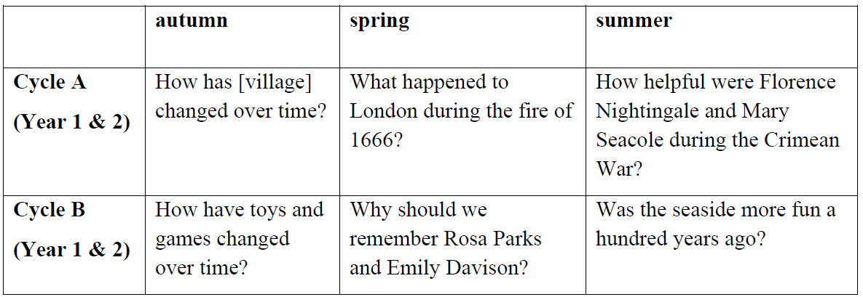
Emma
Notes:
47% primary schools in England have some mixed-aged classes (DfE, 2023c) which inhibits a chronological approach to teaching the subject year by year (HA, 2023).

Slide 33
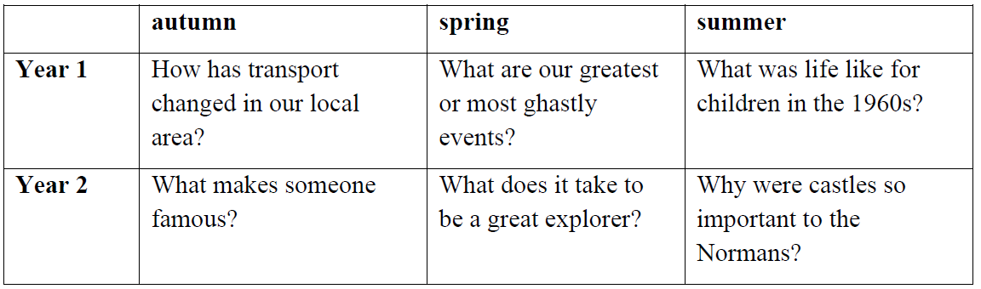
Alex

Slide 34
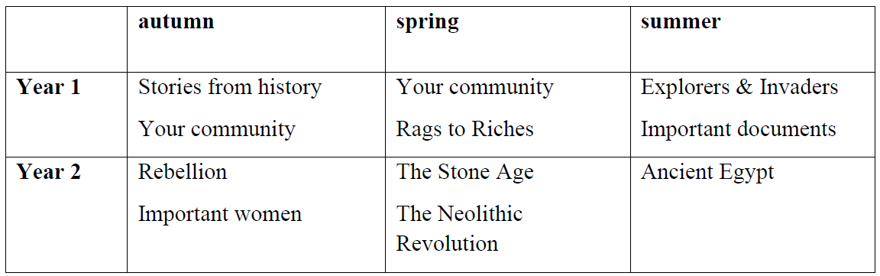
Freya

Slide 35
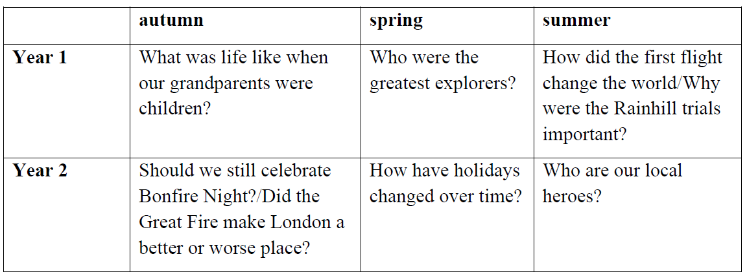
Max & Beth

