Slide 1


WHOLE CLASS SINGING STRATEGIES IN ENGLAND – A REVIEW
Dr Motje Wolf,
Voice Study Centre and
De Montfort University, Leicester, UK
Jenna Brown, MSc,
Voice Study Centre and
Bristol Beacon, UK

Slide 2
PLAN FOR THE TALK
The State of Singing in Schools in England – pre/during Covid
The 3 Tier Model of Music Education
The Model applied to whole class singing today

Slide 3
THE STATE OF SINGING IN SCHOOLS IN ENGLAND
Often looked at very critically (Finney 2000, Ashley 2013, Schaumberger et al 2020)
Previous evaluations on Sing Up (Welch et al 2011), and Case Studies of whole class singing (Lamont et al 2012) suggest that good work is going on that essentially benefits children not only in music making but also in wider skills (Welch et al 2020).
During the Covid-19 Lockdowns: singing was affected strongly:

Slide 4
2020/21 STUDY (WITH SAM WHELAN)
What happened during Covid in schools (singing & instrumental music making)
42 primary music teachers
Mainly from state-funded schools (27)
Majority confident in music teaching (27)
Wolf et al (in preparation)

Slide 5
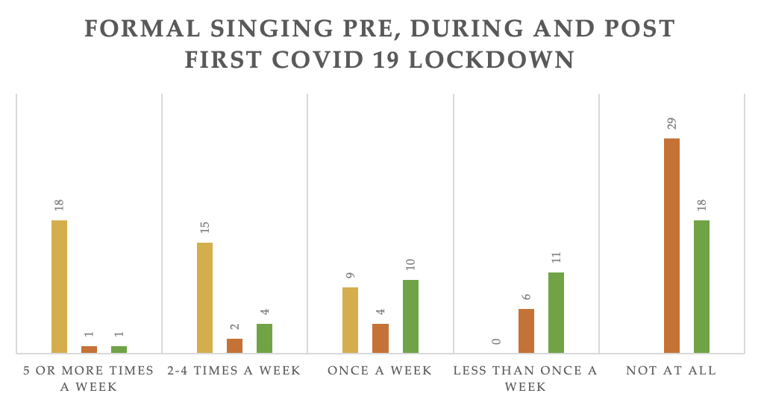

Slide 6
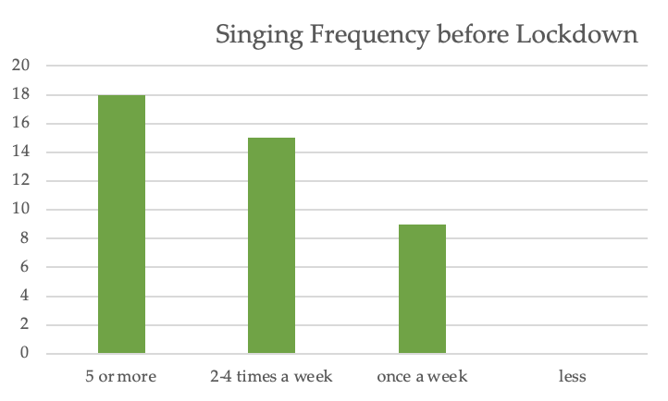

Slide 7
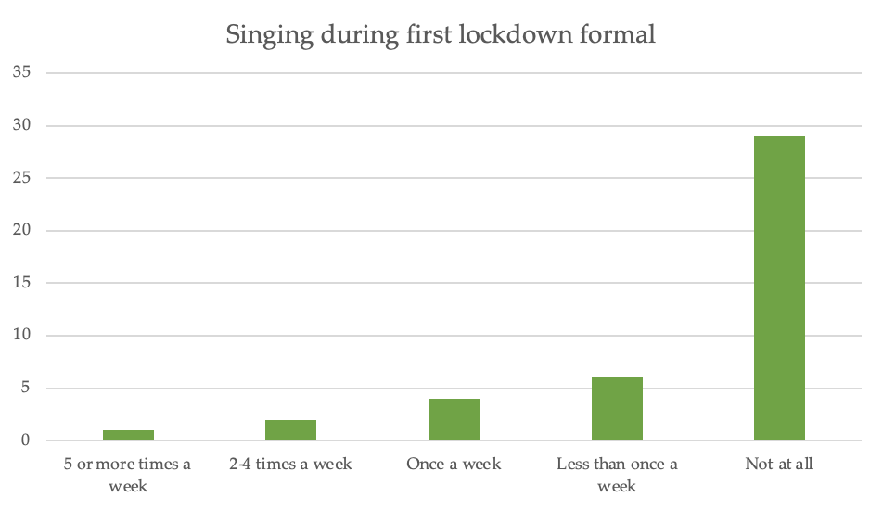

Slide 8
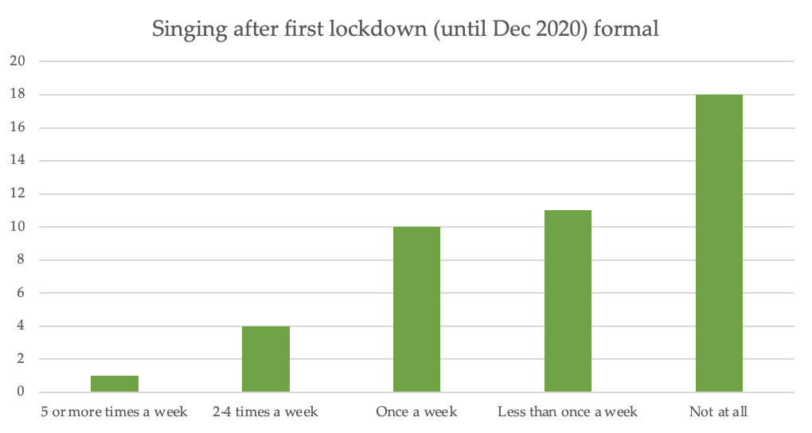

Slide 9
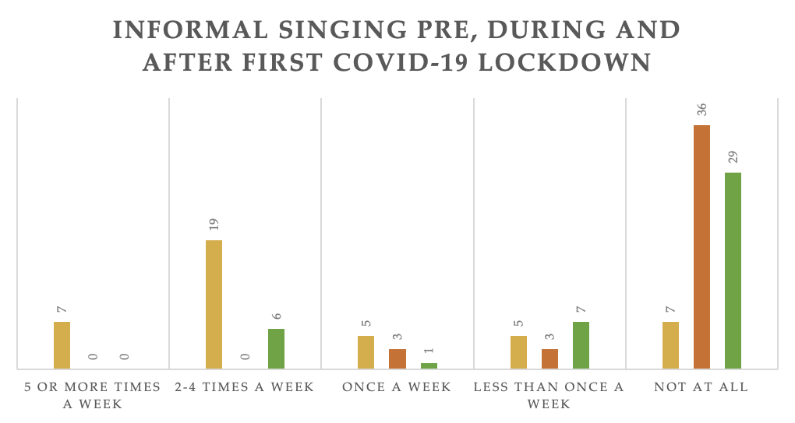

Slide 10
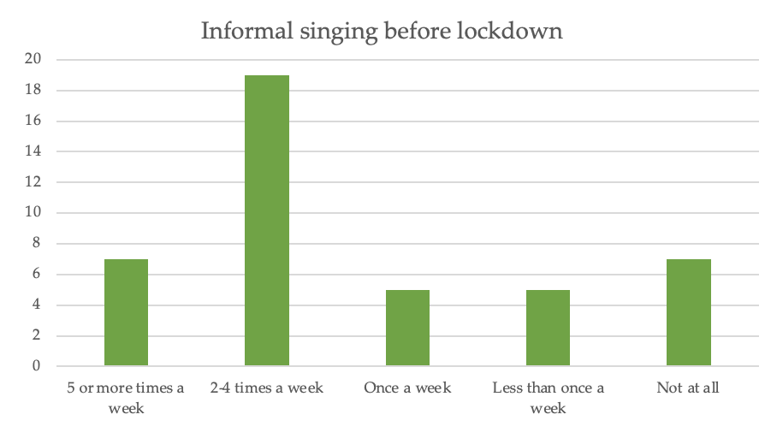

Slide 11
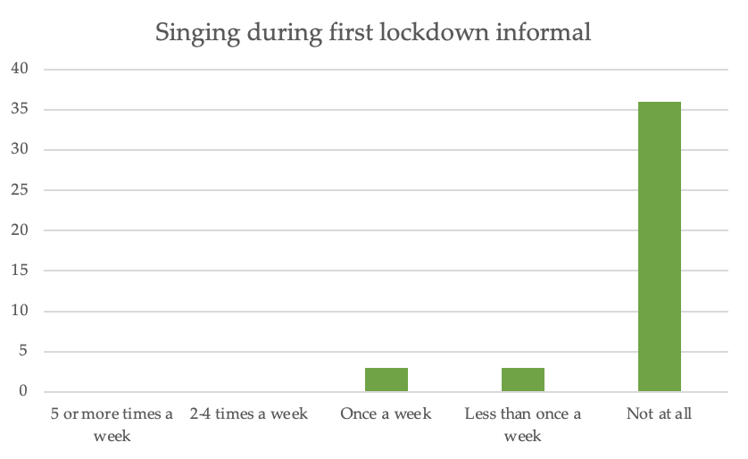

Slide 12
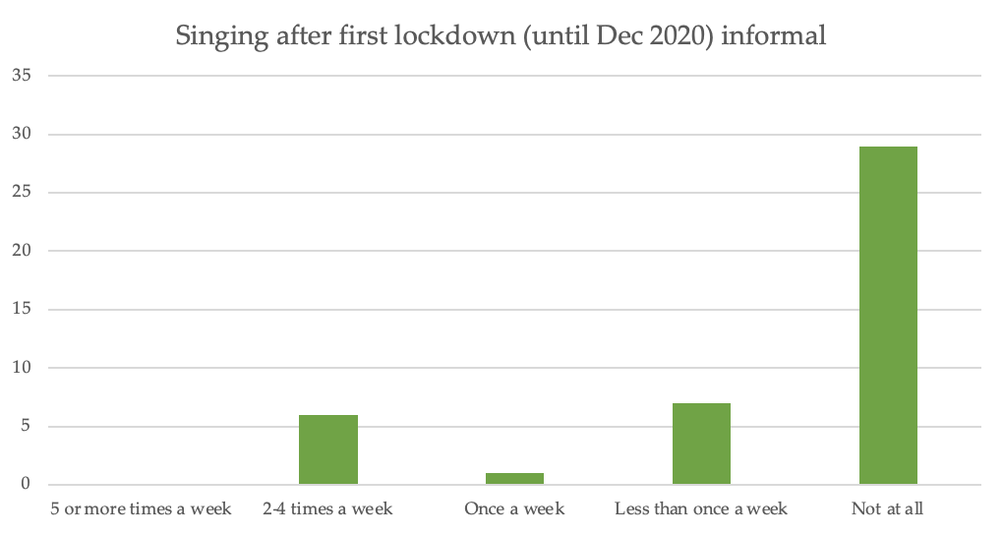

Slide 13
WHERE ARE WE AT NOW?
Lots of singing is happening again – no more government restrictions,
  but regional cautious of aerosol emissions and singing
Needed a way of looking at this in more detail:
3 Tier Model of Vocal Education:
  Capturing the different sets of knowledge that are required for singing teaching (in any context).

Slide 14
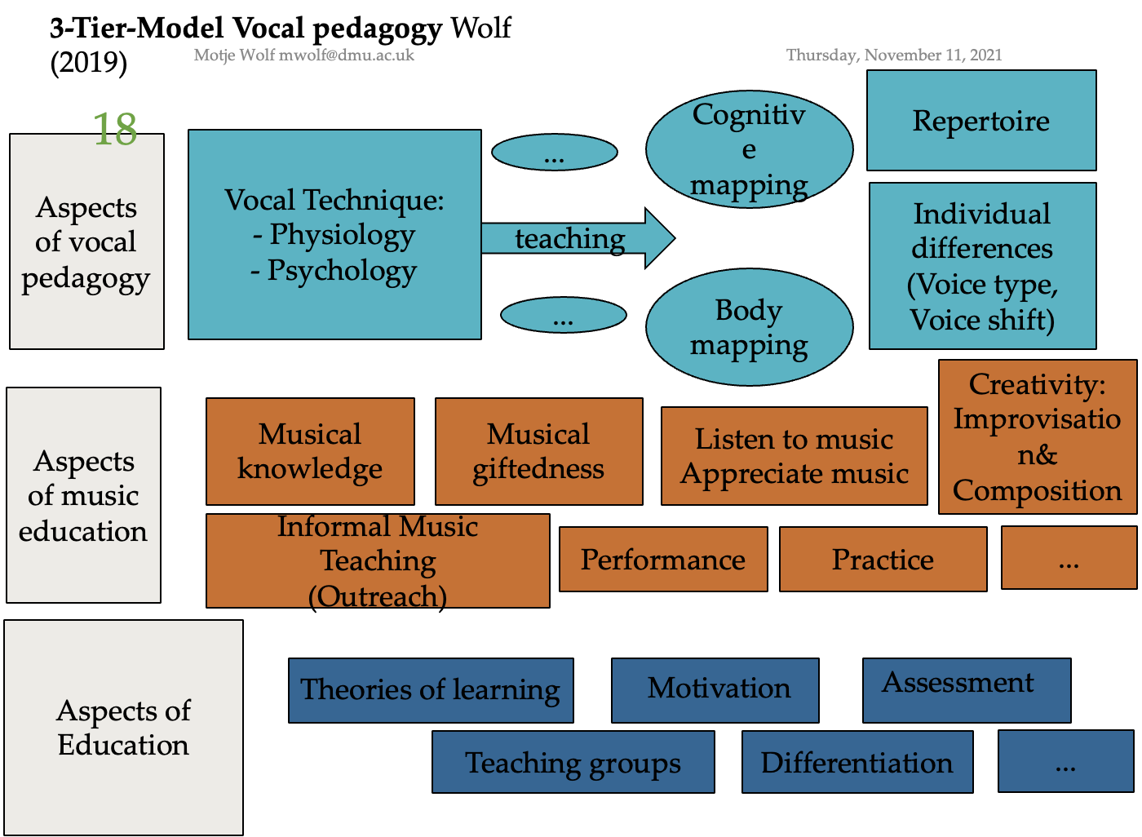
3
2
1
Notes:
Good singing needs to have all of these aspects

Slide 15



REVIEW OF CURRENT PRACTICE
Case Study: Earthsong Foundation, Start with Singing Programme
A first access programme of singing classes and instrumental learning in primary schools
Project Aims:
To increase rates of continued musical learning following Whole Class Ensemble Teaching (WCET)
To demonstrate the value of a year of funded musical activity at KS1 as a core role for Music Education Hubs (MEH)
Notes:
More info to sketch out the project

Slide 16
REVIEW OF CURRENT PRACTICE
630 pupils, 12 Bristol Primary Schools
Visiting Music Teachers (VMT) deliver weekly 45min singing and musicianship lessons
Supporting pupils to ‘find their voice’ and grow in singing & musical confidence
Initial 5 year funded programme, including pilot and full evaluation by Sound Connections
Notes:
More info to sketch out the project: Example of kinds of songs and activities – Standing Tall, Don’t Clap This One Back, Tinglayo (all are link to core music competencies/elements of music to improve musical literacy)

Slide 17


Slide 18
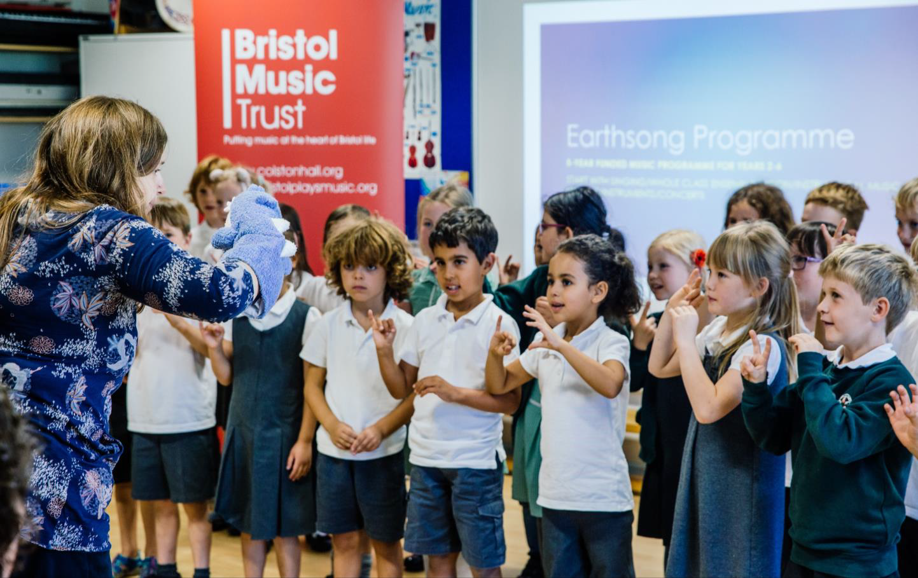
REVIEW OF CURRENT PRACTICE - Tier 1, Aspects of Education
Current Strengths
Experienced teachers and music educators
Motivation - play, variety & fun
Inclusive Practice - SEND, Social & Cultural
Differentiation - clear & structured for support & challenge
Assessment for Learning: formative & summative
Notes:
What can we learn from this for future projects?

Slide 19
What can we learn from this for future projects?
Best practice joins all areas of teaching and learning pedagogy
Experienced, confident and enthusiastic teachers motivate and inspire learners
Participation in music activities can contribute to inclusive educational practices

Slide 20
REVIEW OF CURRENT PRACTICE - Tier 2, Aspects of Music Education
Current Strengths:
Outreach and Curriculum: progression & inspiration
Musical Knowledge: breadth & depth
Musical Giftedness: identifies & nurtures
Performance: modelling & opportunity
Improvisation & Composition: play & creativity
Future Developments
From ‘what’ to ‘how & why’
Sustainability & knowledge transfer
Communities of practice
Notes:
What can we learn from this for future projects?
Clearly thought about this aspect by the project. E.g., progression routes, methods etc

Slide 21
What can we learn from this for future projects?
Thinking about the end before planning the start
Be ambitious with musical expectations for students
Why develop Tier 2 needed:
Don’t assume class teacher knowledge of music pedagogy
Tandem projects need clear teacher training for a sustainable legacy
Notes:
1. Plan your progression routes for learners before you design the content
2. Consider the whole range of musical skills, pedagogical approaches – don’t limit students through lack of breadth and depth – they can and do surprise you with their abilities if you give them a chance to
3. An excellent teacher may not have the skills and confidence related to music specific pedagogy
4. Otherwise it is reliant on the skill of the VMT for bringing the teacher into the tandem teaching and nurturing their skills in music education. Not every teacher has this experience or confidence to do this. They need structure and support.

Slide 22
REVIEW OF CURRENT PRACTICE - Tier 3, Aspects of Voice Pedagogy
Current Strengths:
Repertoire: stylistic variation, performance opportunities
Introduces basic, age appropriate techniques to children
Supports and develops individual solo voices
Future Developments
Voice pedagogy for non-singing VMTs
Voice lessons for unconfident class teachers
Lesson structures more clearly linked to best practice in voice pedagogy
Notes:
What can we learn from this for future projects?
Creating awareness of how songs develop voice technique - not an optional extra
All 3 levels build together good singing education

Slide 23
What can we learn from this for future projects?
Why develop Tier 3:
Vocal Health: sustainable practices
Strategic intervention & skills development
Teacher confidence: modelling & enjoyment
Programme reach & legacy
Notes:
1 & 2Creating awareness of how songs develop voice technique - not an optional extra. For healthy voice production and sustainable, lifelong enjoyment of singing the teachers need to be skilled in knowing what a healthy voice looks and sounds like, and also what to do when one does not sound healthy.
3. If teachers have a level of vocal training they can accurately model (a key teaching strategy in the call and response/echo sructure of many songs in these programmes), and as we have seen in Tier 1 teacher confidence and enjoyment leads to better motivation and overall outcomes for students.
4. Teachers need these skills for the programme to have meaningful impact across multiple cohorts and years

Slide 24
Conclusion
Singing programmes are happening, but need further development
Tier 1: well represented
Tier 2: some development needed
Tier 3: lots of development needed
Teacher training needed
Model offers differentiated ways of understanding development need for project
It would be interesting to see how this is in other countries.

Slide 25
CONTACT
Dr Motje Wolf: mwolf@dmu.ac.uk or motje.wolf@voicestudycentre.com
Jenna Brown: hello@jennabrownmusic.com or jenna.brown@bristolbeacon.org

Slide 26
Acknowledgements
With thanks to The Earthsong Foundation, Bristol Beacon: Laurie Stewart, Kirsten Cunningham, Nonny Tabbush (start with singing syllabus author), Sound Connections (Start with singing Evaluators)

Slide 27
REFERENCES
Ashley, M. R. (2013). Broken voices or a broken curriculum? The impact of research on UK school choral practice with boys. British Journal of Music Education, 30(3), 311–327.
Finney, J. (2000). Curriculum Stagnation: The case of singing in the English National Curriculum. Music Education Research, 2(2), 203–211.
Lamont, A., Daubney, A., & Spruce, G. (2012). Singing in primary schools: Case studies of good practice in whole class vocal tuition. British Journal of Music Education, 29(2), 251–268.
Welch, G., Himonides, E., Saunders, J., Papageorgi, I., Rinta, T., Preti, C., Stewart, C., Lani, J., & Hill, J. (n.d.). Researching the first year of the National Singing Programme in England: an initial impact evaluation.
Welch, G. F., Purves, R., Saunders, J., Mason, K., Bowmer, A., & Wright, A. (2020). ‘ Sing Every Day ’: The wider benefits of a school-based singing project with disadvantaged children. Proceedings of the ISME Pre Conference Research Commission Online Seminar, July, 1–13.
Wolf, M. (2020) Concepts, Models and Methods in Vocal Pedagogy with Children, in: van der Sandt, J. (2020) Singing with Children. Series Ars Musicalis. Lucca, Italy: LIM, p.51-66.

