Slide 1
2022 GTE Conference University of Worcester 28th January 17.20 – 17.55
Why Recontextualise Geography in Education?
‘Processes of recontextualization can be interpreted as the ways in which knowledge is selected from the fields in which it is produced , and informed into school curricula, textbooks, lessons, and ultimately into what students learn (Firth, 2017) p.1.
The idea of recontextualisation originates in the work of Basil Bernstein (2000) who coined the term with regards to his theoretical model of the ‘pedagogic device’ through which he considered how disciplinary knowledge (most usually associated with universities) is transformed into forms of subject knowledge (most usually associated with schools)’ p.2.
‘In the case of geography…recontextualisation is a particularly tricky idea and should be treated with caution.’ (Lambert, 2019, p.260).
‘In transforming knowledge from the discipline to the subject geography is exceptional in having the conceptual tools to draw together and make sense of the physical and human elements of our planet (Matthews & Herbert, 2008).
‘The study of geography in schools remains vital…we believe it is timely to publish…on the opportunities and challenges of recontextualising geography in education’ p.2.
‘Geography teachers as key agents of change in recontextualising’ p.2.
‘The power of geography’ p.2.
‘In this epoch-making time of a largely unforeseen global pandemic, socio-economic uncertainty and as we tread deeper into the Anthropocene, equipping young people with a strong, evidence- based and dynamic geography education has never seemed more needed.’ p.3.

Slide 2
Why Recontextualise Geography in Education? Mary Fargher, David Mitchell and Emma Till
The Challenge of ‘Recontextualisation’ and Future 3 Curriculum Scenarios: An Overview
David Lambert, Tine Béneker, Gabriel Bladh
Recontextualisation: Selecting and Expressing Geography’s ‘Big Ideas’
Alaric Maude
Questioning Recontextualisation: Considering Recontextualisation’s Geographies
Matt Finn
Reflecting on Knowledge and Primary Geography
Simon Catling
A Call to View Disciplinary Knowledge Through the Lens of Geography Teachers’ Professional Practice
Grace Healy
The Role of Students in the Recontextualisation and Transformation of Powerful Knowledge: A Study of Sixth Form Geography Students
Daniel Whittall
Practising Powerful Geographical Knowledge to Understand Interdependence
Osvaldo Muñiz Solari
Recontextualisation Continued: Designing and Evaluating Conceptual Learning in Geography Classes
Pola Serwene
Teaching About Space and Place: Everyday Geographies of Young People Living in the Slums of Nairobi, Kenya
Andreas Eberth
From Fast Fashion to Slow Fashion – Raising Awareness of Young People for Sustainable Production and Consumption
Christiane Meyer, Christine Höbermann
Reflecting on Recontextualising Geography in Education
Mary Fargher, David Mitchell, Emma Till

Slide 3
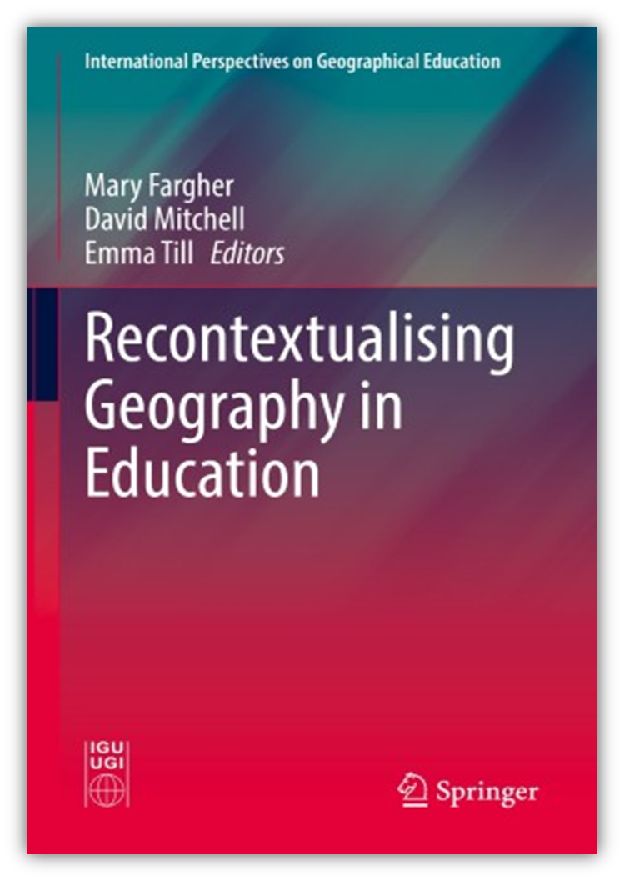
Contributions from Chapter Authors
1. Prof David Lambert ( University College London) builds on his Ch (2) written with Prof Tine Beneker (University of Utrecht) and Prof Gabriel Bladh (Karlstad University) with his contribution Recontextualisation and Social Justice.
2. Prof Osvaldo Muñiz Solari, (Texas State University) on his Ch 8 Practising Powerful Geographical Knowledge to Understanding Interdependence.

Slide 4
1.Recontextualisation and Social Justice Prof David Lambert (UCL)
Prof David Lambert (building on Ch 2 with Prof Tine Beneker and Prof Gabriel Bladh

Slide 5
2. Practising Powerful Geographical Knowledge to Understanding Interdependence. Prof Osvaldo Muñiz Solari, Texas State University
https://mediaflo.txstate.edu/Watch/z2P4Ena8

Slide 6
Questions
Questions

Slide 7
References
Bernstein, B. (2000). Pedagogy, symbolic control, and identity: Theory, research, critique (Vol.5). Rowman & Littlefield Publishers.
Fargher, M, Mitchell, D. and Till, E. (eds). Recontextualising Geography in Education. Springer: Switzerland.
Firth, R.(2017). ‘Recontextualising’ geography. International Research in Geographical and Environmental Education, 28(4), 257-261.
Lambert, D. (2019). On the knotty question of ‘Recontextualising’ geography. International Research in Geographical and Environmental Education, 28(4), 257-261.
Matthews, J.A; & Herbert, D.T. (2008). Geography: A very short introduction. Oxford University Press.

