Slide 1

Droughts, floods and within household resource allocation towards schooling
Rozana Himaz and Mohammad Shamsudduha
UCL Institute for Risk and Disaster Reduction
Presentation for Development Studies Association Conference
June 2023

Slide 2
Motivation
Severe droughts and floods have increased in intensity and frequency in recent times, and African nations are no exception.
What has been the impact of such extreme weather events on schooling and education spending within a household?
Focus of this presentation on school enrolment and education spending among 5-18 year olds in Malawi from 2010-2019.
Notes:
Severe droughts and floods have increased in intensity and frequency in recent times, and African nations are no exception. Such extreme weather events can worsen existing inequalities and there are discussions around this area often based on aggregate data at the country level for example.
But in order to address aggregate inequalities we need to look at the roots that start within a household- the relative bargain power of members, how household decisions are made, conflict and cooperation between household members and implicit and explicit rules of the game and how these can result in resource distribution within the household and subsequent outcomes.
There is very little empirical evidence about how education resources are allocated within a household between boys and girls, and even less on resource allocation in times of droughts and floods.
This paper contributes to this literature by looking at school enrolment and education spending among 5-18 year olds in Malawi from 2010 to 2019. A household’s school enrolment decision is essentially a reflection of choices and decisions about time-use. Spending on schooling once enrolled, is about allocating money, the household budget.

Slide 3
What we know about within household biases in allocation of education resources
Not easy to estimate within-household differences in spending as individual-level information is not available. So differences measured indirectly using household level data.
‘Engle curve approach’ with ‘Hurdle models’ separating the enrolment and spending once enrolled decisions.
Much of the literature focuses on Asia
- pro-male: Azam & Kingdon (2013) for India, Aslam & Kingdon (2006) Pakistan
- Pro-female: Himaz 2010 (Sri Lanka); Wogamonta & Glewwe 2017(Thailand);
Kaul 2018 (matrilineal communities in India)
- Mixed: Xu et. al (2022) for Bangladesh-pro-female enrolment. pro-male
spending
Africa: very little empirical work done in this regard. Available evidence not conclusive: no differences Deaton (1989), Pro-boy/pro-girl Idrisu et. al (2018) for Ghana; Delelegh (2012) for Ethiopia
Notes:
So what do we know so far from the economics literature about education resource allocation within a household? I shall only focus on the empirical evidence based on publications in peer reviewed journals.
First, its hard to estimate how resources are allocated within a household. Part of the reason is because of the lack of individual information on how much is spent on whom. Most work is based therefore on household level data, with within household differences measured indirectly, looking at how the budget share on education for a household as a whole changes when you add an extra girl in a particuar age category, say age 5-10 versus a boy. There are modelling challenges that arise because spending on education depends on whether a child is enrolled at school in the first place, and these are addressed by hurdle models.
Most of the available evidence is for Asia. Pro-male biases in enrolment and/or education spending is often noted in India and Pakistan. But this isn’t always the case- In Sri Lanka the bias is reversed, with housheolds spending more on girls in rural areas in the run up to important public examinations. This type of pro-female bias has been noted in Thailand as well. Recent work for Bangladesh shows that the bias is pro-female in term of enrolment but pro-male in terms of spending.
What is more interested perhaps is why such biases arise. It isn’t always discrimination or favouritism within a household. Sometimes cultureal norms are such that parents choose to invest in different assets for boys versus girls, such as gold and jeweelery for women but education for boys. In some cases the hosuehod allocation choice is a response to what happens in the labour market. Sometimes it is linked to norms about who will support them financially in their old age.
There is very little empirical economic work on within household resource allocation difference in Africa and available work is not conclusive. Ranging from no biases to some evidence of pro boy or pro girl bias. So overall, the existing literature shows that the bias, if it exists, is context specific.

Slide 4
What we don’t know: How do droughts/floods change within household education resource allocation?
Droughts/floods can affect education inputs via the following channels exacerbating existing inequalities or creating new ones
Household income
Health
School buildings and infrastructure (damaged/inaccessible/used as temporary shelters)
Local economy (can reduce/increase opportunity cost of schooling)
Some mixed evidence of average impacts by sex
Drier weather correlated with lower school enrolment for girls (Uganda Bjorkman-Nyqvist 2013), increases school enrolment, effects stronger for girls (India, Zimmerman (2020)
- Floods/cyclones/positive deviations from average rainfall reduce school enrolment for boys (Bangladesh Mottaleb et. al. 2015); reduces school enrolment, effects stronger for girls (India, Zimmerman 2020)
Notes:
The literature on intrhousehold allocations during times of droughts and floods is very thin. We would expects droughts and fllods to affect education inputs via challenging household income, health, school and road infrastructure and the local economy. These can exacerbate, reduce or create new inequalities within households.
The few papers that looks at drought and schooling show mixed impacts. Drier weather seems correlated with lower school enrolment for girls in Uganda but higher enrolment for girls in India. Floods, cyclones and high rainfall can reduce school enrolment for boys in one paper but both boys and girls in another.

Slide 5
Data
Malawi Integrated Household Panel Survey (IHPS)
2010, 2013, 2016, 2019
education spending data at the individual level available
Climatology Lab’s TerraClimate products
Household location data from Malawi IHPS used to extract the high-spatial resolution (~4 km) monthly Palmer Drought Severity Index (PDI) to construct the annual average relative dryness for survey year t, t-1 and t-2, for each household
https://www.climatologylab.org/terraclimate.html
Notes:
So this paper asks What the impact of such extreme weather events such as droughts and floods has been on school enrolment and spending decisions within a household in Malawi, a country that is highly vulnerable to weather events and climate change, with high poverty rates. The data for the study comes from the Malawi Integrated household panel survey, with data collected in 2010, 2013, 2016 and 2019. We use data for 5-18 year olds and information for around 8200 individuals. What is really unique in this data set, useful for our estimation, is that education spending data is available at the individual level. So we can get a more accurate understanding of within household allocation than if we had only household level data.
Several housheolds migrated in between survey rounds but the dataset has information on the exact household location at every location the household was at, at the time of interview. This helps us derive an objective measure of the relative dryness of the location using the Climatology lab’s terra climate products.

Slide 6
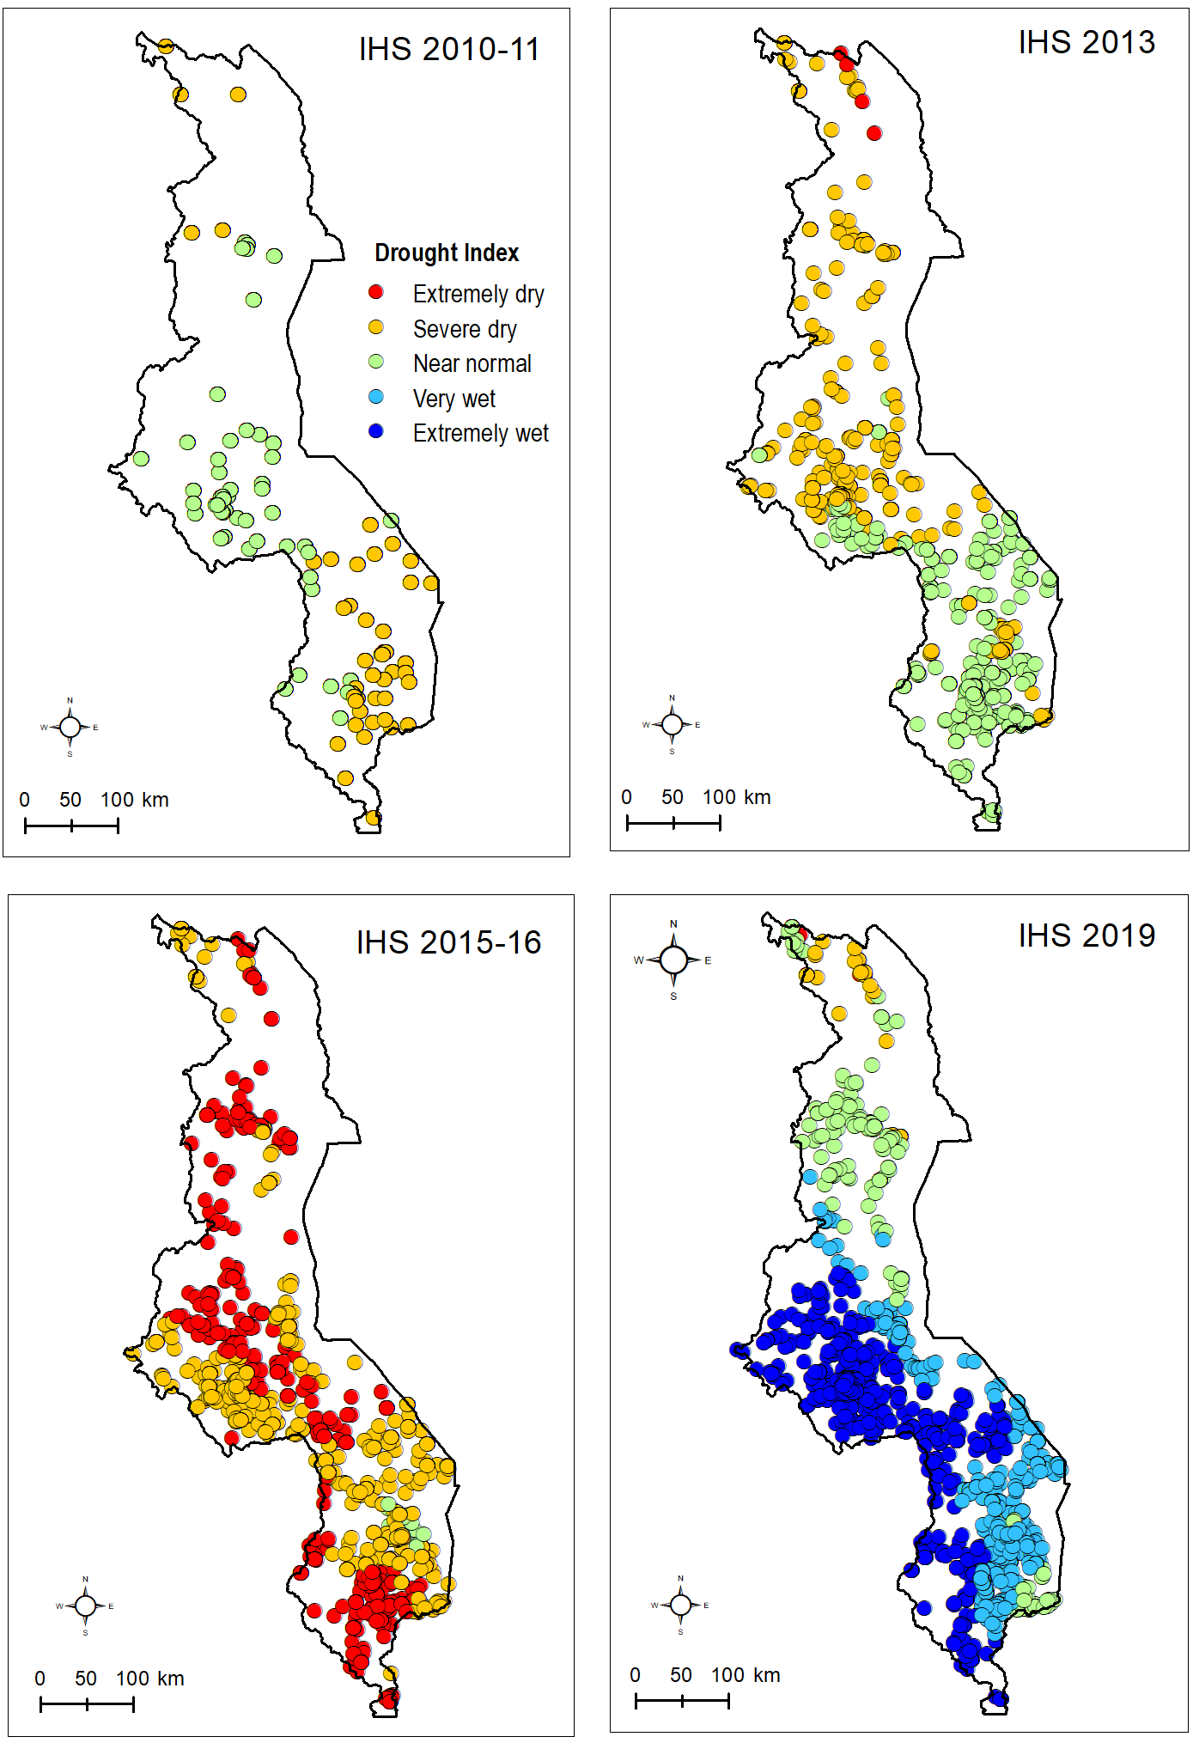
Palmer Drought Index
- PDI uses temperature and precipitation
data to estimate relative dryness.
- Index ranges from -10 (dry) to +10 (wet).
Extremely dry:-7 < PDI ≤ -4
Severe dry: -4<PDI ≤ -2
Near normal: -2<PDI ≤ 2
Very wet: 2<PDI≤ 4
Extremely wet: 4< PDI ≤ 7
Drought and flooding randomly allocated
(cross-checked by regressing outcomes in time
t against PDI scores during next survey round- t+3)
Notes:
We use the PDSI (Palmer Drought Severity Index) that is based on water balance theory considering precipitation, soil moisture, runoff and potential evapotranspiration.
The PDSI is a relative measure that represents how soil moisture availability differs from that expected for a given place and time of year. In climatology, long-term mean generally means 30 years average climate conditions. In the empirical estimations to follow, ‘extreme dry’ is termed ‘drought’ and extremely wet is termed ‘flood’
Important for our empirical methodology described later on it is important that the timing and severity of drought a child was exposed to was unpredictable and therefore uncorrelated with other time varying determinants of the utcomes we consider. We argue that it is BASED on the figures here and other techniques. In the figure here for example, the very locations that had droughts in 2016 are very wet and with some experiencing flooding in 2019.

Slide 7
Malawi schooling system and summary statistics
Schooling starts around age 5 and has a 6-2-2 structure. Primary school finishes around age 14, and legal age for starting work is over 14.
Delayed enrolment is common
Compulsory schooling fee-free since 1994.
Education spending includes tuition, books, clothes, transport, PTA and other fees
Education spending on 5-18 year olds around 1.5% of the households budget
Bias in enrolment favouring boys aged 15-18 compared to girls significant at the 1% level
Bias in education spending favouring girls aged 5-14 compared to boys significant at the 1% level in 2010, 2016 and 2019. Same for 15-18 in 2016.
Notes:
Moving on to Malawi’s School system, it starts around age 5 and has a a 6-2-2 model: 6 years of primary school finishing around age 14, and this is compulsory. This is followed by 4 years of secondary school. Although delayed enrolment is common, If a child starts at age 5 or 6, they should technically finish primary school at age 14. The legal age to start working is 14. The figure on the left shows that school enrolment is almost equal between boys and girlms aged 5-14, in our dataset. But as the children get older, girls seem to be dropping out of school more. Compulsory schooling is fee free but households still incur costs towards extra tuition, books, clothes. The graph on the right shows that on average, more is spent on girls than boys within households.
Bias favouriong boys in terms of enrolment in all years. Further disaggregation shows that this is not for those in the age 5-14 category. Its for those over 14, and about 10-14% more boys are at school than girls.
Boias favourin girls in education spending once enrolled, notable in 2016. This was the year with sever drought. Girls education spending significantly higher than that of boys age 5-14.
Migration not uncommon, especially in years of severe of extreme dryness where about 50% of the children had moved location since the previous survey year.
Averahe age was about 11 in all 4 surveys.

Slide 8
Empirical model
Notes:
To capture impact of the effect of drought and flood exposure on education spending for boys versus girls we use a fixed effects panel model. The parameter gamma against the interaction term is the parameter of interest. In the estimations, we include 2 dummy variables that caoture drought exposure. One dummy equals 1 if the palmer drought index was less than -4, that’s extreme dryness. The other equals 1 if extreme dryness was experienced in the two years before the survey. We also add a dummy to indicate whether the child was exposed to extreme wellness.

Slide 9
Results
Notes:
Enrolment results are estimated using a fixed effects logit model. This means that the model retains only observations where the dependent variable enrolment shows variance over the 4 survey rounds.
The way droughts and floods affect boys’ relative investments in education is different to that of girls, and the impacts are driven by what happens to children in the 5-14 year category. These are the years Malawian children engage in primary school education that is compulsory. For this agegroup, experiencing a drought in the survey year – that is current drought has a significant positive effect on school enrolment. Possibly as opportunities outside school dwindle for both paid work and and agriculture.
,however Past droughts– those experienced in the two years prior to the survey year seem to- have a significant negative impact on boys copared to girls on reducing both enrolment and the budget share of spending on conditional on being enrolled.
With floods, again most of the gender-based impacts are found in the age group 5-14, and here again the interaction term between flood and male is significant and negative.
xtlogit fe drops all observations where the dependent variable showed no variance. also keeps only those in all 4 rounds.

Slide 10
Conclusion
Droughts and floods seem to cause significant changes to how households allocate education and health spending between boys and girls, especially in the 5-14 age group that usually engage in compulsory schooling.
Persistent negative effects of drought on school enrolment and spending on school once enrolled affecting boys in the 5-14 year category relatively more than it does girls.
More work needs to be done, testing for robustness and in terms of interpreting findings.
Notes:
The results subject to robustness checks and further investigation as to pathways in which these effects occur. It could be related to household coping strategies, the income effect, health, local environment and other reasons.

Slide 11
References
Azam, M. and Kingdon, G.G., 2013. Are girls the fairer sex in India? Revisiting intra-household allocation of education expenditure. World Development, 42, pp.143-164.
Mottaleb, K.A., Mohanty, S. and Mishra, A.K., 2015. Intra-household resource allocation under negative income shock: A natural experiment. World Development, 66, pp.557-571.
La Mattina, G., 2017. Civil conflict, domestic violence and intra-household bargaining in post-genocide Rwanda. Journal of Development Economics, 124, pp.168-198.
Wongmonta, S. and Glewwe, P., 2017. An analysis of gender differences in household education expenditure: the case of Thailand. Education Economics, 25(2), pp.183-204.
Notes:
ki

Slide 12
Appendix

