Slide 1
Accounting for Oneself in Teaching: Trust, Parrhesia, and Bad Faith
Dr. Alison M. Brady
UCL Institute of Education
alison.brady.14@ucl.ac.uk

Slide 2
Educational Context
Measurement culture in schools - related to the ‘accountability’ agenda
Focus here: the ways in which teachers ‘account’ for themselves using a technicist language – e.g. narrow conception of evidence and effectiveness of practices
This emphasis on measurement signals a lack of trust in the ability of teacher’s to account for their practices on their own terms
But also, frames what is considered to be trustworthy in the first place:
i.e. based on a narrow conception of ‘accuracy’ in accounts – where accuracy is defined as the extent to which the account captures or articulates a static form of ‘objective truth’

Slide 3
Educational Context
In this paper:
Explore how one might account for practices and for themselves on their own terms – ‘autobiographical writing’
In this context, the measure of this trust is sincerity, therefore, rather than accuracy – explored through the concept of parrhesia
Implications:
For teachers to account for their practices on their own terms – including the concrete, lived complexities of their experiences, so much of which is ambiguous, paradoxical and confusing – might there be a value in encouraging a sincere (rather than simply ‘accurate’) account of their practices? How would this be achieved, and what would it mean?

Slide 4
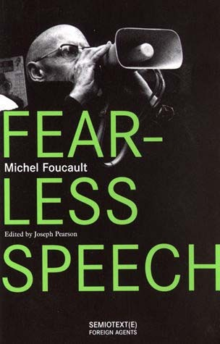
Parrhesiastic Practices
For Foucault (2001), parrhesia consists in:
‘Frankness’ - where one ‘says everything’ and ‘opens his heart and mind completely to other people through his discourse, [giving] a complete and exact account of what he has in his mind so that the audience is able to comprehend exactly what the speaker thinks’ (Foucault, 2001, p. 22)
Truth-telling in an ethical sense
Duty towards oneself and others, freely undertaken
Courage – to engage in criticism of oneself and others
Risk – to one’s social standing, their lives, to self-certainty and self-understanding, possible (mis)recognition from others
In some sense, parrhesia concerns how sincere I am about what I say to myself and to others

Slide 5
Parrhesia, Risk and Sincerity
But how do we ‘measure’ sincerity?
For Foucault (2001): the extent to which one is courageous enough to accept ‘risk’ in their accounts:
A willingness to elicit anger from others, or to accept ambiguity in self-understanding, or to address the potential disharmony between one’s commitments (how they wish to be) are manifested in one’s actions
For Foucault (2001, p. 17): the purpose of parrhesia is ‘not to demonstrate the truth to someone else, but [it] has the function of criticism: criticism of one’s interlocutor or of the speaker himself’
Hence, being open to potential (self-)criticism and the risk this involves in relation to one’s own self-understanding is a ‘measure’ of sincerity

Slide 6
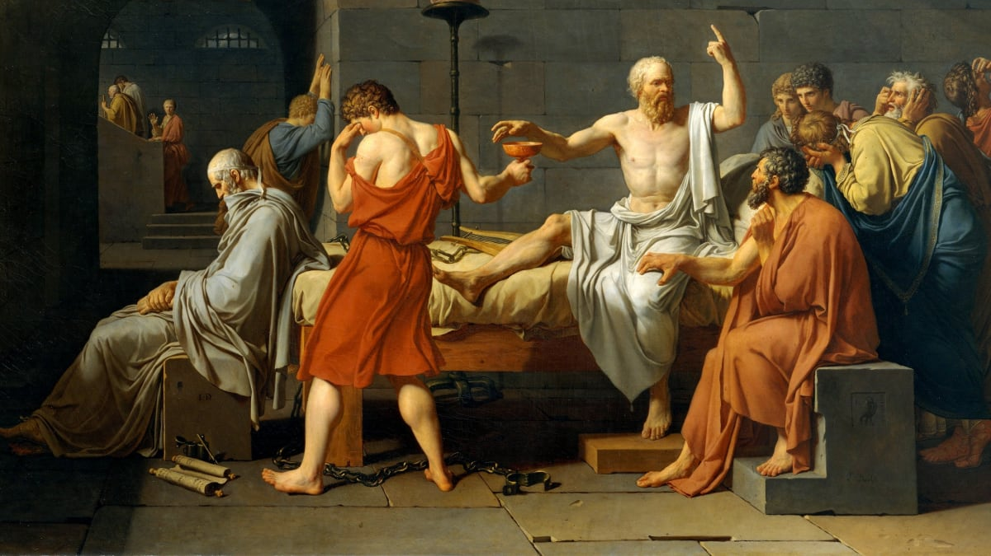
Socrates, the Parrhesiastes
For Foucault, Socrates represents the ultimate form of parrhesia
Socratic dialogues represent ‘parrhesiastic games’ – where Socrates’ interlocutors are not only ‘shown’ the truth but are actively encouraged to situate themselves in relation to what they say
Socrates in ‘frank’ in what he says in order to encourage a parrhesiastic relations in his interlocutors
He does so courageously, and he also puts himself at risk – both in terms of the annoyance he causes others, as well as in relation to his own life
Socrates is also open to self-criticism e.g. in his repeated admissions of ignorance
He sees this as a duty towards himself as well as wider society – and is willing to accept the consequences that this duty entails

Slide 7
Autobiographical Writing: Parrhesiastic Practice
Importantly, autobiographies – not a mere reporting of ‘things that have happened’ (i.e. valuable only in relation to their ‘accurate’ depiction of events)
Rather, autobiographical writing inevitably involves the re-interpretation of events, where we continually (re)situate ourselves in relation to the ‘truth’ of what has happened
In a way, they are ‘confessional’ – understood by Butler (2009) as a means of ‘publishing’ oneself, of making oneself intelligible, of allowing for a ‘critical opening’ in which the process of self-(re)formation can take place
Autobiographical forms of account-giving concerns both a vulnerability towards the other, as well as confessionalism, where one lays one’s commitments bears, and where one ‘tests’ the accounts that they give – i.e. where parrhesiastic relations with oneself is therefore possible

Slide 8
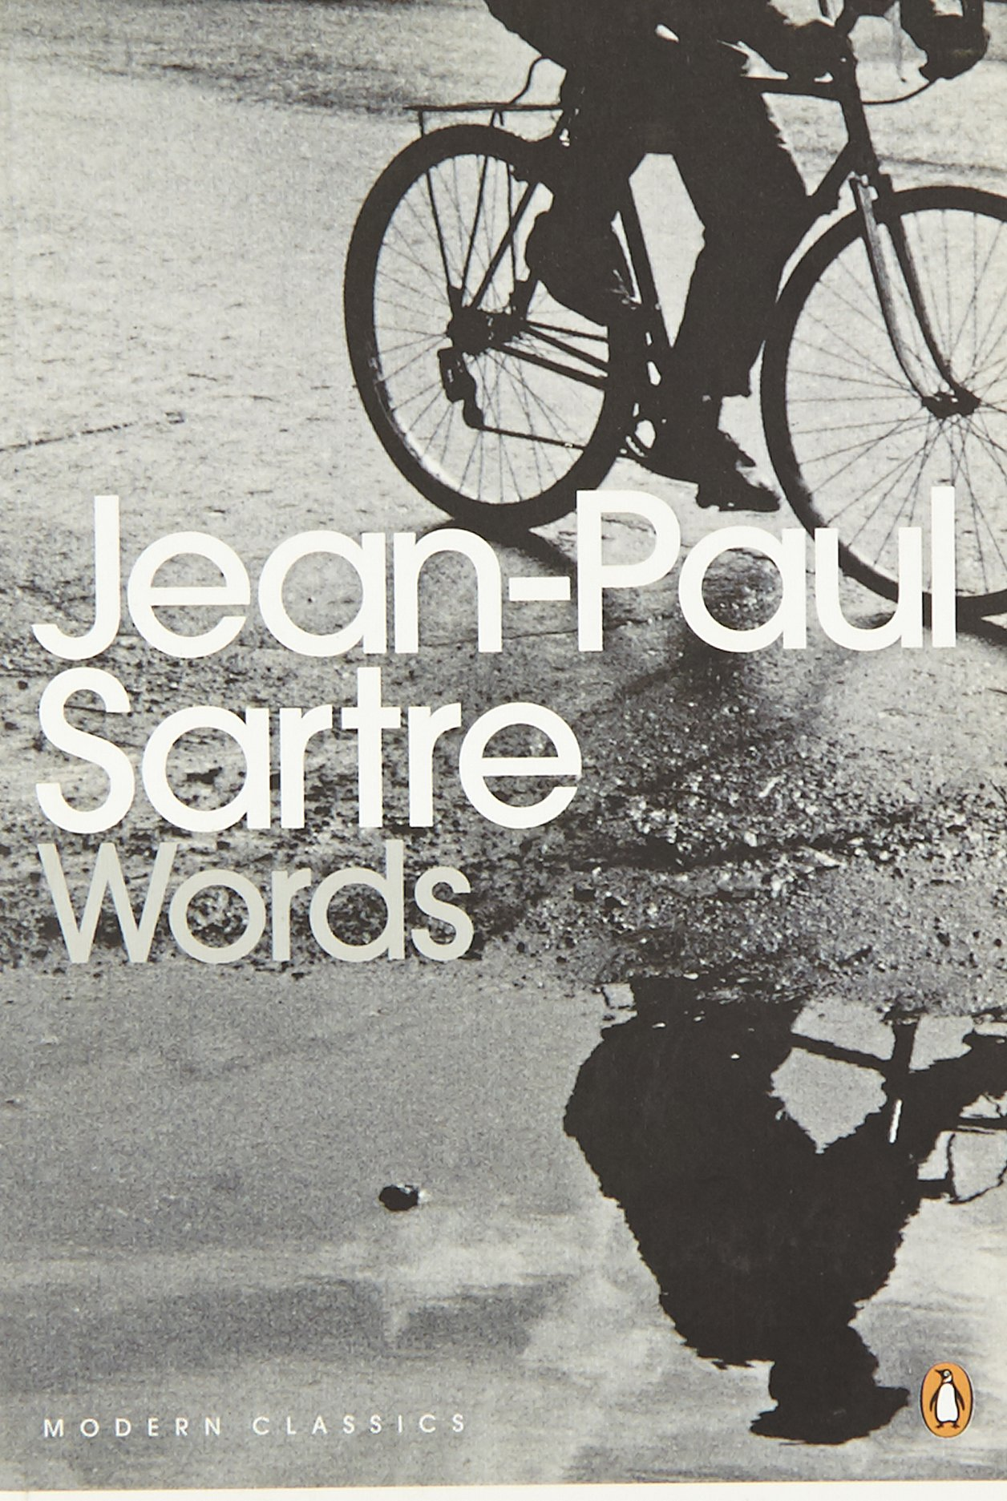
Sartre’s Words
Written in 1964 – when Sartre was 59 years old
Poignant and often comical notes on his formative years, as well as offering a commentary on the ‘bourgeois’ values that underpinned much of what he understood about the world at that time
The autobiography itself was first drafted in 1954, and then redrafted about 10 years later
Represents an important ‘junction’ in Sartre’s thought – from his more ‘individualistic’ earlier writing (concerning the radical freedom in making who we are) and his later Marxist-inspired thought (where ‘who we are’ is in part determined by our material circumstances and social upbringing)
Words is often seen as a ‘pampliest’ of sorts – thus reveals the tensions between these two ideologies, not only in terms of Sartre’s intellectual legacy, but also in terms of his own self-understanding

Slide 9
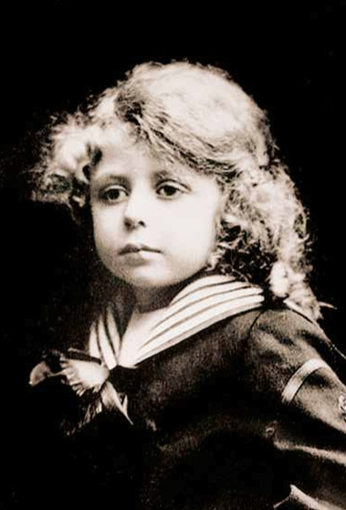
Words as Parrhesia
Sartre (2000) navigates these two opposing thoughts with a form of frankness
refers to himself as ‘coddled’ and ‘precocious’, a ‘cultural possession’, marked by ‘arrogant hypocrisy’ who ‘knew [his] worth’
admits to the bourgeois values that he had then uncritically held as a child and that nevertheless influenced – or perhaps even determined - his decision to become a writer – ‘by birth and forever’ (p. 108)
Speaks of how his ‘most recently acquired knowledge’ [Marxism] ‘gnaws at [his] old established facts without entirely dispelling them’ (Sartre, 2000, p. 150) – i.e. accepts the risk to his position and his self-understanding
Thus, he admits that the ideas which made him ‘famous’ were in some ways over-stated, that there is a disharmony between his early life and his thought today – and in doing so, he opens himself up to (self)-criticism
He doesn’t shy away from this potential criticism, and in recognising his own hypocrisy, he is also encourages his readers to do the same
The point here is not so much to think about the inconsistencies in Sartre’s earlier and later thoughts, but to explore how one might navigate these inconsistencies, and how they might be rendered in our accounts

Slide 10
Words as Sincere?
Autobiographies are fictionalised accounts of our past
e.g. we are often selective about which events we remember, we write in terms of how we wish to portray ourselves to others:
“But here was the poison: without ever mentioning the name Rousseau, Bach, or Molière, the author deployed his skill in planting allusions everywhere to their future greatness, recalling casually, by some detail, their most famous works or actions, and arranging his narrative so that you could not grasp the most trivial incident without relating it to subsequent events; into the tumult of daily life, he brought a vast, fabulous silence which transfigured everything: the future.” (Sartre, 2000, p. 127).

Slide 11
Words as Sincere?
And can we ever be sure of how sincere we acted in the past?
‘How could [one] pinpoint – especially after so many years – the intangible, shifting frontier that divides possession from play-acting?’ (Sartre, 2000, p. 46)
How then do we situate ourselves in relation to truth, when the ‘truth’ of our past is always suspect, ambiguous, unclear - or where the extent to which we are being sincere about ourselves is uncertain?

Slide 12
Words: Sincerity vs. Accuracy
This issue stems from a conflation of ‘sincerity’ with ‘absolute accuracy’
Autobiographies are not necessarily concerned with being ‘accurate’ in terms of a direct correspondence between ‘what has really happened’ and ‘what I think happened’, between objectivity and subjectivity etc.
However, they can represent a sincere engagement with the past, where sincerity does not exclude the fact that our accounts of the past will always be subject to (re)interpretation or (re)evaluation
In parrhesiastic practices, the measure of this sincerity is the extent to which we open ourselves up to (self)-criticism and to risk – including in our engagement with ‘who we were’ in the past

Slide 13
Parrhesia, Sincerity and ‘Good Faith’
Is parrhesia a form of ‘good faith’?
Bad faith = ‘self-denial’ i.e. a denial in the idea that individuals are ‘condemned to be free’, and thus ultimately and fundamentally responsible for ‘who they are’, and for the ways in which we engage with our past (selves)
Sartre recognises that each of us is ‘situated’ within the world with others (towards whom we also have to make ourselves intelligible)
Often, we convince ourselves that we are fully determined by these circumstances, or we come to ‘define’ ourselves purely in terms of how we are recognised by others (in order to avoid the anxiety of responsibility)
However, are always respond to or negotiate our existence in the world with others, and the ways in which we account for ourselves within
It is in this response towards the situation in which we find ourselves that Sartre’s conception of freedom can be understood – and this includes the ways in which we respond to our past selves

Slide 14
Parrhesia, Sincerity and ‘Good Faith’
In autobiographical writing – the danger of bad faith is persistent:
“I have set down the facts as accurately as memory permits. But how far did I believe in my frenzy? That is the basic question and I cannot make up my mind about it. I realised afterwards that it is possible to know everything about our affections except their strength; that is to say, their sincerity. Actions themselves will not serve as a standard unless it has proven that they are not gestures, which is not always easy.”

Slide 15
Parrhesia, Sincerity and ‘Good Faith’
Importantly, sincerity does not necessarily exclude bad faith:
Waiter example
If a person refers to themselves as ‘sincere’, we may be tempted to think that they will always be sincere, and if they think of sincerity as a fixed quality in this way, they may be avoiding the responsibility to ‘test’ themselves, or to open themselves up to (self-)criticism – i.e. it radically reduces our freedom to be insincere, to go against what is in our so-called ‘nature’
Good faith (and sincerity) is akin to the ‘critical attitude’ of parrhesia as care for the self
i.e. it is something we are continually responsible for putting into practice – a persistent and ongoing attempt to be ‘authentic’ and sincere in our actions and in our self-understanding, knowing that we are much more susceptible to bad faith than to good faith, to inauthenticity rather than authenticity
In other words, accounting for oneself through something like autobiographical writing must be continually engaged with, (re)evaluated and (re)interpreted – in that sense, it will never be conducive to something like ‘accuracy’ (narrowly defined)

Slide 16
To sum…
Autobiographical account-giving as parrhesiastic practice:
A form of frankness in terms of how we relate to ourselves in the past
Not measured or understood purely in terms of the ‘accuracy’ of our accounts but instead, in terms of our ongoing attempts to relate ourselves to the ‘truth’ of what has happened
Involves risk – self-criticism, criticism from others, but also the possibility of being (mis)recognised in ways over which we have no control, and of falling into bad faith with ourselves
Thus – requires a willingness to expose oneself to oneself and others, to the uncertainty and instability this may involve (e.g. in relation to our self-understanding, to the (dis)harmonies between our commitments and our actions)
This willingness, however, is a measure of sincerity – understood here good faith – ongoing in nature

Slide 17
Accounting for Oneself in Teaching
Often understood in terms of accountability – tied to a narrow conception of ‘accuracy’
Also related to an inherent mistrust of teachers in accounting for themselves outside of these ‘evidence-based discourses’ which, as Biesta (2014) remarks, have come to ‘monopolise thinking and talking’ about education in an effort to ‘generate increased uniformity [and a] reduction in diversity’
But all of this has reduced our capacities to take stock of what has happened, of what ultimate values are made manifest in our practices – it ‘narrows’ our view to only consider that which is explicit or measurable
It relies on the idea that some sense of certainty is always possible in accounts, and that anything that is uncertain is to be mistrusted
It also assumes that through the cultivation of certain types of expertise (e.g. data collection, evidence-informed decision making), teachers can always be trusted in their accounts, since they are trained to identify, measure and account for their practices in robust ways

Slide 18
Accounting for Oneself in Teaching
And yet, isn’t there something insincere about these claims to absolute certainty?
Or would we want teachers to account for their practices on the basis of sincerity, one that accepts that uncertainty is very much part of what we do and what we experience as teachers?
What would ‘trust’ look like in this context?
Trust – entails risk
For Sartre, the paradox of good faith relates to the paradox of faith itself
i.e. that to be in faith, one both believes and not believes
In trusting someone or something, one both knows that they are to be trusted, but they also know that they cannot know this for certain -> this is the very nature of trust
It can be ‘measured’ in terms of sincerity (risk, courage, a willingness towards (self-)criticism) but not a form of accuracy or measurement that relies to readily on ‘certainty’
Might look something more like ‘autobiographical’ accounts than the technicist accounts we see today

Slide 19
Aesthetic Practices of the Self
How to encourage parrhesia in the accounts of teaching?
At the end of the lecture series, Foucault refers to three aesthetic practices of the self in which parrhesiastic relations with oneself is made possible:
Self-Examination
Self-Exposure
Self-Testing
These techniques may be usurped by the discourses I wish to call into question
Thus, they will need to be ‘reimagined’ with more existential sensitivity to the practices of being a teacher

Slide 20
Self-Examination
Not to be confused with ‘self-reflection’ in current educational (technicist) discourses
Rather, it is more akin to how one might posit an ‘inner judge’ – to open up the space in which one can ‘take stock’ of one’s commitments and behaviour, not on the basis of guilt and shame but in order to habituate changes in one’s ‘practice’ thereafter
In teaching, self-examination might come about through a range of catalysts
i.e. moments in which you can begin to examine your role and the commitments you make manifest more intensely
In other words, self-examination requires a rigorous form of introspection as well as a willingness to be ‘exposed’ to oneself and others.
It can be harrowing and uncomfortable, but revealing
This, of course, is risky – and it thus requires courage – to undergo introspection and to confront the ways in which we have acted, and the extent to which we are willing to take responsibility for this or to habituate change

Slide 21
Self-Exposure
Foucault refers to Seneca’s ‘seasickness’ metaphor here – that although the ‘journey’ is uncomfortable (or perhaps even ‘nauseating’), it is a necessary element to arrive at one’s destination (self-governance or self-mastery)
For Sartre (1938), this ‘nauseating’ experience is also necessary in order to recognise that we are not ‘ready-made’, but are ultimately responsible for who we are (unlike rocks and trees and other inanimate objects)
In teaching, self-exposure is an intimate part
But rather than being ‘neutralised’ (through certainty discourses), it must be lived with well if one is to teach
Self-exposure itself is testament to something more fundamental about teaching – that rather than being constrained by current discourses, one is always free to respond to the situation in which they find themselves, and it is in this response that one’s responsibility as a teacher comes to light

Slide 22
Self-Testing
For Foucault – self-testing is an ongoing endeavour, one that leads to a form of ‘self-mastery’
For Sartre – self-mastery is not and end to be ‘attained’, however
And yet, it may relate to what Sartre (2018) calls the ‘fundamental project’ – i.e. ‘a choice of myself in the world’, which provides the context and meaning for our actions, and the person we ‘are’ by virtue of these
Self-testing, therefore, can be a way to ‘check in’ with or take stock of these commitments, through which we can then attain self-mastery over our choices, rather than lapsing into bad faith
In teaching, this may mean being more closely attuned to the reasons for our actions and behaviours, and for the responses that have underpinned our interpretation of situations in the classroom, and the values that have been made manifest in these

Slide 23
References
Biesta, G. J. J. (2014). The beautiful risk of education, London and New York: Routledge.
Brady, A. M. (2019) Anxiety of performativity and anxiety of performance: self-evaluation as bad faith, Oxford Review of Education 45 (5), pp. 605-618
Brady, A. M. (2016) The regime of self-evaluation: self-conception for teachers and schools, British Journal of Educaitonal Studies, 64 (4), pp. 523-541.
Butler, J. (2009) Giving an account of oneself. New York: Fordham University Press
Foucault, M. (2001) Fearless Speech, J. Pearson (ed.) Boston, MS: MIT Press.
Sartre, J. P. (2000) Les mots, or “words”. I. Clephane (trans.) Middlesex, England: Penguin Classics.
Sartre, J.P. (1943) Being and nothingness: an essay on phenomenological ontology. (H. E. Barnes, trans.), London and New York: Routledge Classics.
Sartre, J. P. (1938) Nausea. London: Penguin Books Ltd

