Slide 1
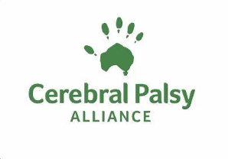
Insert title of the presentation
Determinants of Infants’ Readiness Transitioning To Eating Solids: A Systematic Review
Dr. Michelle McInerney
Dr. Amanda Khamis
Dr. Katherine Sanchez
Ms. Lisa Gielis

Slide 2
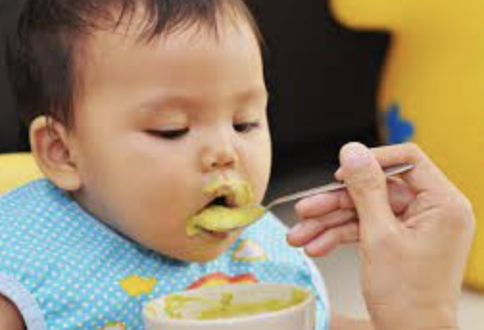
Background
Variability in what is recommended to parents in practice regarding optimal transitioning to eating solids from Paediatricians, Allied Health Clinicians, Nursing etc.
Leads to sub-optimal infant care +
Reduced health outcomes
Parents experience stress and frustration with mixed messages regarding guidelines and recommendations.
Minimal empirical research on behaviours that are thought to indicate readiness.
Notes:
Variability in infant guidelines world wide and stronger emphasis on breast feeding e.g. in Australian guidelines- 2/ 13 guidelines only focused on transition to solids
Also issue of secondary consequences of introducing solids too early or too late.
To help address this gap in the literature, we conducted a systematic review.

Slide 3
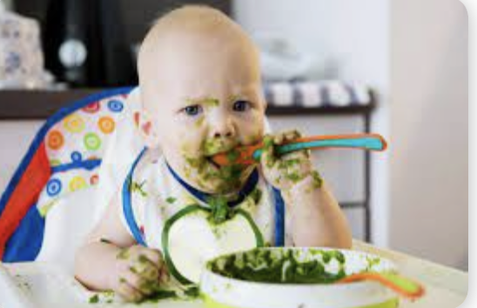
What are the developmental behaviours that indicate readiness of an infant to transition to eating solids?
Are developmental behaviors that indicate readiness aimed at a body functions and structures (BFS)-level, activity- level, or participation-level of health?
What is the level of evidence to support each?
What are external influences on transitioning period?
Research questions
Picture

Slide 4
PRISMA Statement
Identify + Evaluate Developmental Behaviour
ICF CY
(WHO, 2007)
5 Databases:
CINAHL, Medline, Embase, APA Psych INFO, Scopus
Cho & Bero Appraisal Tool
Peer Reviewed
Empirical Research
Human Studies
English, Full text
METHODS

Slide 5
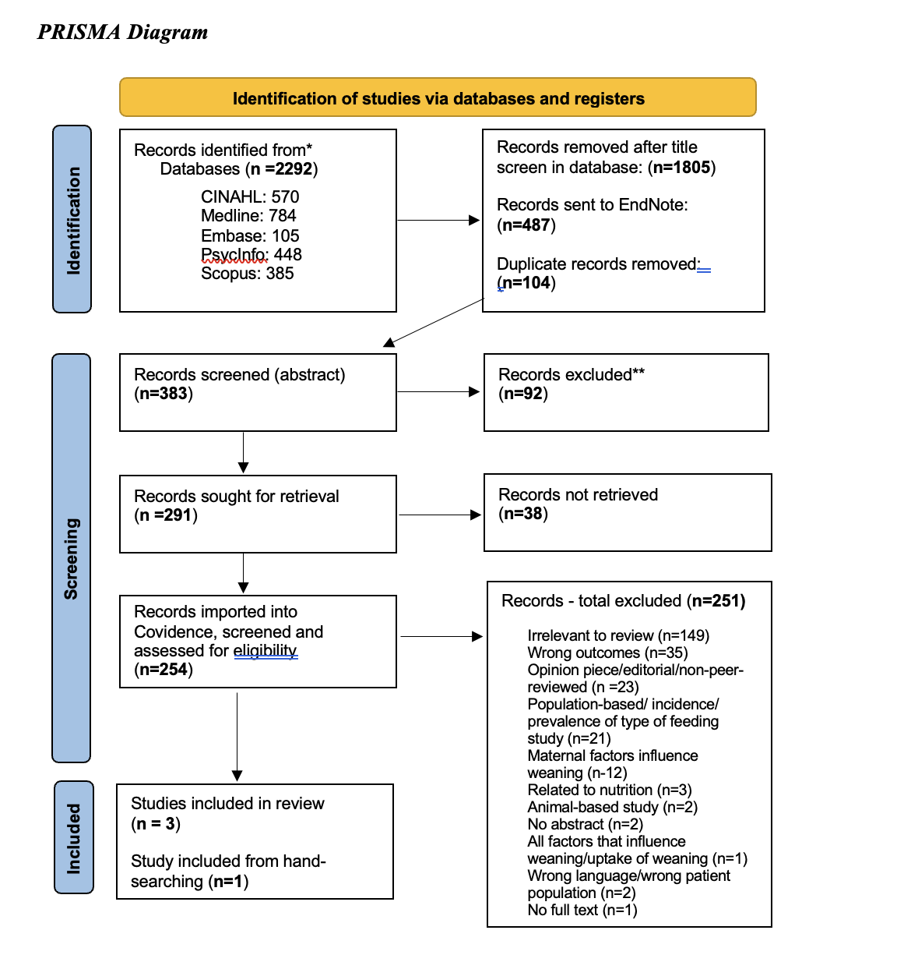
Picture
SUMMARY OF FINDINGS
1,805 TITLES 252 FULL TEXTS
N=4
17 developmental behaviours:
Gagging, choking to self-feeding
Targeted mostly a BFS-level of health
+ Range of external influences
Cross-sectional survey design
Risk of bias high (3/4 studies)
Notes:
From four studies, 17 developmental behaviours were identified as being a sign and/or associated with the infant’s readiness to transition to solids.
Inconsistent terminology used to describe over-lapping behaviours across studies.
All four studies were cross-sectional survey designs.
Developmental behaviours targeted mostly a BFS-level of health (n=15) and two behaviours targeted activity- level.
Wide range of external influences on the infants’ transitioning to eating solids.
Risk of bias high in 3/ 4 studies.
ext

Slide 6
Conclusion
Few heterogenous studies with high risk of bias and less than optimal design
None of readiness behaviours identified = adequately evaluated
Very low-level of evidence
Further research is needed
FEW STUDIES
Heterogenous & lack of definitions
Cross-sectional survey designs
High-level of bias.
READINESS SIGNS
17 developmental behavioural indictors of readiness in four studies = complex developmental process!
None of readiness behaviours have been adequately evaluated and are therefore not well-supported by evidence!
VERY- LOW LEVEL EVIDENCE
Over-reliance on these developmental behaviours as indicators may:
Delay transition to solids

Slide 7
REFERENCES
Centre for Disease Control and Prevention. (2021). When, what, and how to introduce solid foods. https://www.cdc.gov/nutrition/infantandtoddlernutrition/foods-and-drinks/when-to-introduce-solid-foods.html.
Koletzko B, Hirsch NL, Jewell JM, Dos Santos Q, Breda J, Fewtrell M, We ber MW. National Recommendations for Infant and Young Child Feeding in the World Health Organization European Region. J Pediatr Gastroenterol Nutr. 2020 Nov;71(5):672-678. doi: 10.1097/MPG.0000000000002912. PMID: 33093377; PMCID: PMC7575031.
National Health & Medical Research Council. (2013). Eat for health: Infant feeding guidelines information for health workers summary: A summary. https://www.nhmrc.gov.au/about-us/publications/infant-feeding-guidelines- information-health-workers.
Schwartz, C., Madrelle, J., Vereijken, C. M. J. L., Weenen, H., Nicklaus, S., & Hetherington, M. M. (2013). Complementary feeding and “donner les bases du goût” (providing the foundation of taste). A qualitative approach to understand weaning practices, attitudes and experiences by French mothers. Appetite, 71, 321–331. https://doi.org/10.1016/j.appet.2013.08.022
Scientific Advisory Committee on Nutrition (SACN).(2018). Feeding in the first year of life. https://www.gov.uk/government/publications/feeding-in-the-first-year-of-life-sacn- report.
World Health Organization. (2021). Infant and young child feeding. https://www.who.int/news-room/fact-sheets/detail/infant-and-young-child-feeding.
World Health Organization. (‎2007)‎. International classification of functioning, disability and health: childrenand youth version: ICF-CY. World Health organization. https://apps.who.int/iris/handle/10665/43737

Slide 8
THANK YOU FOR LISTENING ☺

