Slide 1





Supporting mental health professionals in decisions about sharing their own mental health difficulties: The HOP-MHP project
Julie Evans, Harriet Mills, Anna Hildebrand, Henry Clements & Katrina Scior
Research Dept of Clinical Educational & Health Psychology

Slide 2
Barriers to openness among MH Professionals
Pressure to achieve and be evaluated as ‘competent’ at course and NHS level
Key message: Extent and depth to which trainees discuss lived experience is a personal choice, very much dependent on need and context
Fears about damage to professional standing, fitness to practise procedures, and workplace discrimination
Emphasis on ‘resilience’ at (pre-)training level – often clashes with unspoken belief that disclosing lived experience may result in discrimination
Limited consideration and evidence regarding the impact and potential value of lived experience

Slide 3
Aims of HOP-MHP
To support mental health professionals in carefully considering disclosure related decisions
To reduce self-stigma, stigma stress and disclosure related distress associated with mental health problems and ‘dual status’, and promote sense of empowerment
To challenge stigma within the mental health professions and contribute to challenging stigma within society

Slide 4

Guided self-help intervention for mental health professionals with lived experience designed to support decisions and actions regarding disclosure
Adapted from Corrigan et al.’s manualised peer group programme Honest, Open, Proud (HOP)
What is HOP-MHP?
Delivered alongside online peer support forum and info re: support, resources and rights
Stage 1 of HOP-MHP: Clinical Psychologists and other Psychological Professionals

Slide 5

HOP-MHP Self-Help Guide
1.
Considering the Pros and Cons of Disclosing
Three sessions:
2.
Different ways to Disclose
3.
Sharing Your Experiences (if decided to do so)
Follow-up (review) session

Slide 6
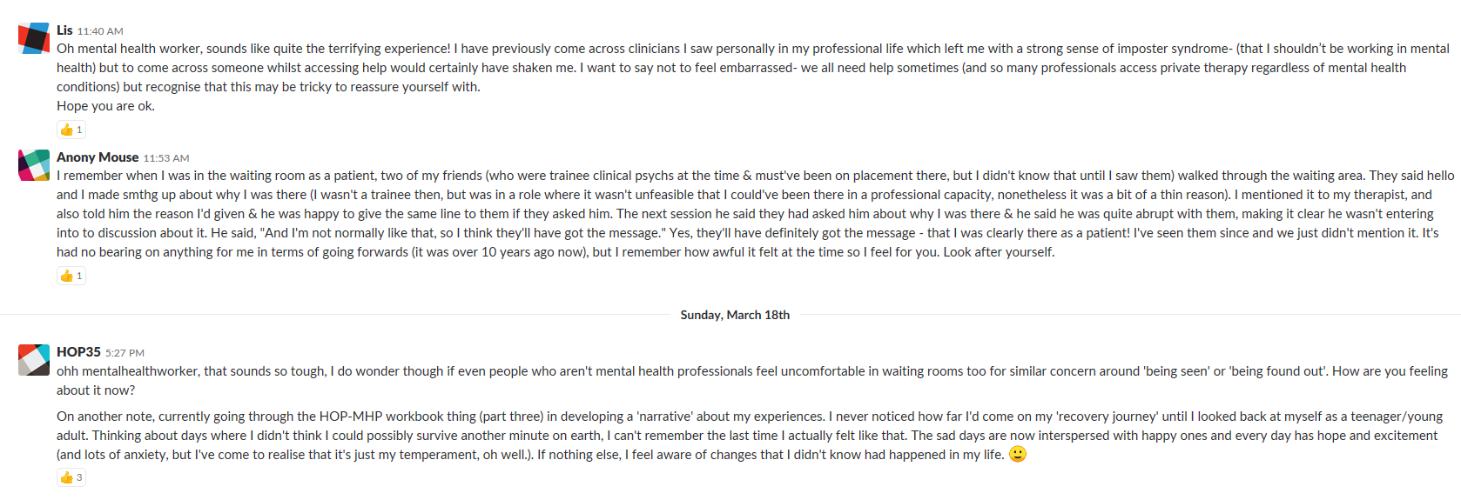
HOP-MHP Web Peer Forum (anonymous sign-up and postings)

Slide 7
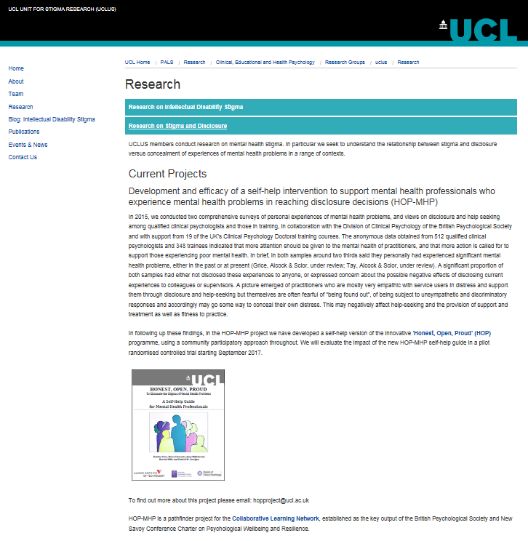
Full project information on website of UCL Unit for Stigma Research (UCLUS):
https://www.ucl.ac.uk/pals/research-stigma-and-disclosure

Slide 8
Timeframe
Development of
HOP-MHP Guide
Mini-pilot
Revisions
Feasibility study and Pilot RCT
Oct ‘16 to
June ‘17
June ’17 to August ‘17
August ‘17
Sept ’17 to Feb ’19
(Closed to recruitment 16 Nov ‘18)

Slide 9

HOP-MHP Guide
CBPR Model:
Stake-holder Group
Development
Outcome Measures
Peer Support

Slide 10
Baseline
N=61
Randomised
HOP-MHP
n=30
Control
n=31
T1
(after 3 core sessions)
n=16
T1
(3 – 4 wks post-randomisation)
n= 23
T2
(after booster)
n=10
T2
(6-8 wks post randomisation
n=21

Slide 11
Feasibility study and Pilot RCT
Research Questions:
Is HOP-MHP feasible and acceptable for use with mental health professionals (MHPs)?
Are the outcome measures feasible and acceptable to participants?
Is it feasible to evaluate HOP-MHP in an RCT?
Does HOP-MHP appear to have positive effects on chosen outcomes?

Slide 12
Feasibility and acceptability measures

Slide 13
Outcome Measures
Stigma Stress
Secrecy
Internalised Stigma
Likelihood of Disclosure
Disclosure related distress
Perceived benefits and experiences of disclosure
Depression
Anxiety
Full outcome data to be analysed following end of pilot RCT

Slide 14
Acceptability & Feasibility: Preliminary Findings
Intervention
92% found the intervention easy to access, 77% found it easy to complete
Useful in helping participants consider new ways of disclosing
At T1, 85% were either ‘satisfied’ or ‘very satisfied’ with the overall intervention
Comprehensive and validating
Reduced isolation and perceived need for concealment
54% were happy with recommended time frame
Increased confidence in making disclosure-related decisions
92% would recommend it to others and rated it as either ‘helpful’ or ‘very helpful’

Slide 15
Acceptability & Feasibility: Preliminary Findings
Peer Forum
72.2% rated peer forum as ‘very useful’ or ‘useful’ as a separate resource to the guide
54.5% thought peer forum in combination with self-help guide was either ‘very useful’ or ‘useful
Peer forum seen as of particular value
A space to discuss HOP-MHP worksheets and anonymously share experiences as dual status professionals
Validating and de-shaming

Slide 16
Acceptability & Feasibility: Preliminary Findings
Outcome Measures
Described as clear, user friendly and thoughtfully selected
71% of respondents found measures easy to complete
74% were happy to complete the outcome measures at the three time points
71% happy with the time taken to complete the measures
At points repetitive, too long and sometimes too ambiguously worded

Slide 17

Participant feedback: HOP-MHP self-help guide
“I thought it gave me the means to reflect on my choices in terms of disclosure and how I communicate (or sometimes not) my mental health difficulties to others.”
“It made me feel a little bit less isolated as a dual status professional.”
“I had a bit of a relapse of my difficulties during the intervention and I found the tools and workbooks helpful to navigate that while at work.”
“I think I feel much more confident, especially with the choice to not necessarily disclose, I think it’s just sort of validated that a little bit for me.”

Slide 18
Participant feedback: Peer Forum
“Just being in a space where other people talked really openly about their own experiences and the impact on them now (…) I mean for me, I sort of never really had these conversations with people… and I think I actually took more from that than the rest of it (…).”
“I am glad this forum exists so after all these years holding a conversation becomes possible.”
“I liked hearing others' experiences in the peer forum, it was comforting to hear others having similar thoughts/doubts/worries etc.”

Slide 19
Participant feedback: Outcome Measures
“Super easy software to use - I could easily complete them on my phone
which was a massive benefit”
“Clearly worded, no double negatives enabled clarity. Was very sensitive.”
“Time taken to do it each time, it felt like a challenge but I signed up for
this and understand the importance of measures!”

Slide 20
Participant feedback: Feasibility and preliminary impact
“I found it useful to be prompted to reflect on what disclosure would mean, and where disclosure is ’safe’… but it felt to me that, whilst a self-help booklet has great value on a practical level, it can’t address the underlying systemic problem of there being something of a false binary set up within services: ‘I am well, you are not’. In a way, it feels to me that a booklet on ‘disclosure’ can almost reinforce this binary on some (implicit) level.”
“I think over the course from the start of the project to the end I think I did feel like the likelihood of me disclosing had reduced… I wouldn't necessarily obviously wholly attribute that to the manual cos at the same time… I think unfortunately I probably was being exposed at least occasionally to these stigmatised views at work, which probably would have been a factor as well. I think what the manual really did was made me really grapple with what the consequences would be.”
“Since doing this study I have disclosed to a couple of colleagues… who I would consider friends as well and not necessarily in the work environment, and I told them things about myself and it actually sort of felt quite nice. I feel like it sort of deepened our friendship and our working relationship.”

Slide 21
Adverse effects
No participants raised concerns that the intervention was harmful when asked about this directly
One participant shared that the intervention elicited some feelings of guilt as they wanted to disclose more openly to tackle public stigma but did not feel ready to take that step
Another participant commented that after an initial positive disclosure experience, they started to feel a bit uncontained and less in control of what they might inadvertently disclose – attributed this to a mixture of the stressful situation they were in and completing the self-help guide
Some participants commented in the SAT questionnaire that the outcome measures brought up negative emotions for them
Two participants commented on periods of low level of activity in the peer forum during which some posts were left without acknowledgment or response which may have negatively impacted upon the original poster

Slide 22
Participant: I found it useful reading other people's experiences. They... but at the same time they made me feel a bit uncomfortable.
Researcher: Okay, in what kind of way?
Participant: I think because some people were so much more open about their experiences…. But at the same time it was good to see that difference, and to read about how other people do manage it, and what's that like for them. And then I think I posted and then, I don't know if I ever looked at it again? I want to say maybe I did once and then nobody had really responded. So I felt... rejected is too strong, but it's something, that's the word that is in my head.

Slide 23
Participant: There were times when I was completing the manual and I was really like thinking about whether I thought it was... would be beneficial for me to disclose more about my mental health to supervisors or tutors or things like that. And then I was thinking. I don't know, there was kind of well, a little bit of a sense of then feeling a bit pushed to do that, which I then was thinking 'I'm not sure I'm ready for this' and whether this is what I want to do, but just in the, through the act of signing up for the study and its kind of name then I was thinking well, 'Is it bad if I then don't do that? Or decide not to disclose more at this point?'

Slide 24
Preliminary outcomes

Slide 25
Problems identified
Intervention
Huge variability in completion time of self-help guide (20 to 123 days)
Raises question whether feasible in current format
Some participants felt that it was difficult to complete the intervention due to its length and detail
Suggested 3 week time frame for completing guide placing unrealistic demands on participants

Slide 26
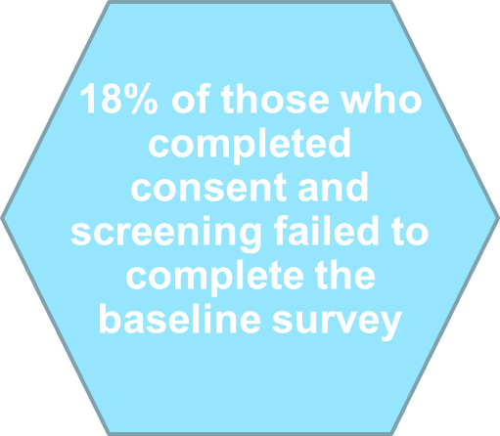
Problems identified
Recruitment and retention
Attrition from baseline to T1 survey: 47% in intervention arm compared to 29% in control arm (but some more surveys due for completion)
Small sample size

Slide 27
Problems identified
Outcome Measures
Limited qualitative feedback at Time 2 (after follow-up)
Feedback at T1 and T2 indicated that in current format, measures too long and repetitive
Preliminary analysis indicates that measures appear to only partly capture participants’ perceived benefits of the intervention

Slide 28
Conclusions
Go back to research questions

Slide 29
Acceptability & Feasibility: Summary
Opportunity for anonymous peer support seen as particularly helpful
Participant feedback → amendments to the intervention, peer forum and outcome measures
Outcome data to be analysed following end
of pilot RCT

Slide 30
Going forward
How to increase engagement with HOP-MHP and retention in trial?
Stepped care approach?
How to provide peer support?
Future Plans:
Work in partnership with other mental health professions (Royal College of Psychiatrists, Royal College of Nursing, IAPT Programme) and 3rd sector organisations

Slide 31

A warm thank you
to all HOP-MHP Stakeholders & Participants
Get in touch:
k.scior@ucl.ac.uk
henry.clements@ucl.ac.uk

