Slide 1
A novel self-practice/self-reflection programme for CBT therapists from minoritised ethnic backgrounds: A multiple baselines single case experimental study
Sakshi Shetty Chowdhury
Trainee Clinical Psychologist, UCL

Slide 2


What brought me to this project?
Experience of working in a staff support team
Personal experience of migrating and navigating my own changing ethnic identity

Slide 3
Background
Existing service context
(Baker & Kirk-Wade, 2023; Harwood et al., 2021; Lawton et al., 2021)
Significant cultural competence training gap
(Faheem, 2023; Hakim et al., 2019; Naz et al., 2019)
Focus on experiences of white therapists working with service users from minoritised ethnic backgrounds
(Beck, 2019; Kadaba et al., 2022; Sue & Sue, 2015)
Insufficient support for therapists from minoritised ethnic backgrounds
(Beck et al., 2019; Naz, 2021; Paulraj, 2016; Williams et al., 2022)

Slide 4
Impacts of SP/SR
Traditional SP/SR
SP/SR for therapists from minoritised ethnic backgrounds
SP/SR
Therapist
Skills
CT Specific Skills
Interpersonal Skills
Skills in working with ethnicity in
clinical practice
Enhanced therapist self-reflection
Therapist flexibility
Beliefs about the self
‘Person of the self’ beliefs
Ethnic identity development
‘Self as therapist’’ beliefs
Wellbeing
Personal wellbeing
Personal wellbeing
Professional wellbeing
Professional wellbeing

Slide 5

Aims:
Novel adaptation of SP/SR – need to evaluate
Lack of quantitative research around SP/SR.
Primary aim to explore the impact of the programme on:
Therapists’ self-rated skill in working with ethnicity within their clinical practice
The ethnic identity development of therapists themselves
The wellbeing of therapists in relation to their professional and personal selves
Secondary aim to consider if any impacts were maintained at follow up

Slide 6
Method: Participants
Therapists who self-identified as being from minoritised ethnic backgrounds.
Nine therapists started programme. Two dropped out and one did not complete due to health reasons.
Six therapists completed programme and provided sufficient data points for analysis.
Five female and one male therapist from different ethnic backgrounds.
Range of experience (Two months to 12 years).
All therapists reported experiences of discrimination within current workplaces and in therapeutic work.

Slide 7
Method: Design and Analysis
Multiple-baselines single case experimental design (repeated measurement across baseline, SP/SR and follow-up phases).
Visual analysis (What Works Clearing House, Kratochwill et al., 2010) and statistical analysis (Tau-U, Parker et al., 2011).

Slide 8
Method: Outcome Measures
Outcomes
Skills in working with ethnicity within clinical practice
Ethnic identity Development
Wellbeing
Lack of standardized and validated measures appropriate for use
Need for simple measures, to be administered over 37 weeks
→ Development and adaptation of measures

Slide 9
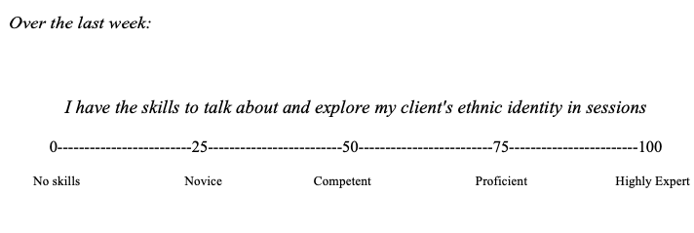
Skills in working with ethnicity
No suitable measure of skills in working ethnicity.
Informed by ideas from Beck (2016) in transcultural CBT and DPR model of therapist skill development (2006).
10 questions.
Technical skills, reflective skills and supervision.

Slide 10
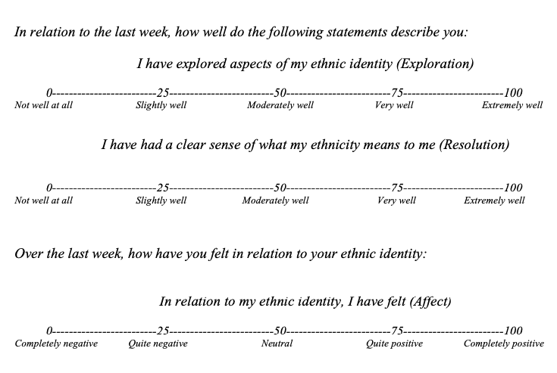
Ethnic Identity Development
Protective nature of positive ethnic identity (Williams et al., 2020; 2022),
Adaptation of Ethnic Identity Scale (Umana-Taylor et al., 2004).
Three questions related to three dimensions of EID.

Slide 11
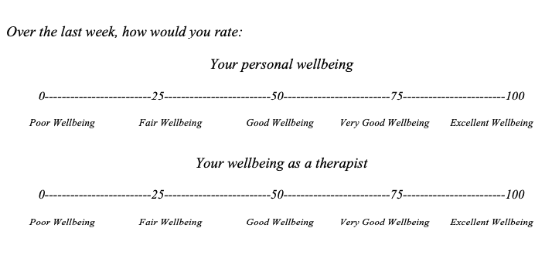
Wellbeing
Recent research around the impact of SP/SR on wellbeing (Pakenham, 2015; Scott et al., 2020)
Adaptation of Outcome Rating Scale (Miller et al., 2003).
Differentiation between personal and professional wellbeing.
Two questions.

Slide 12
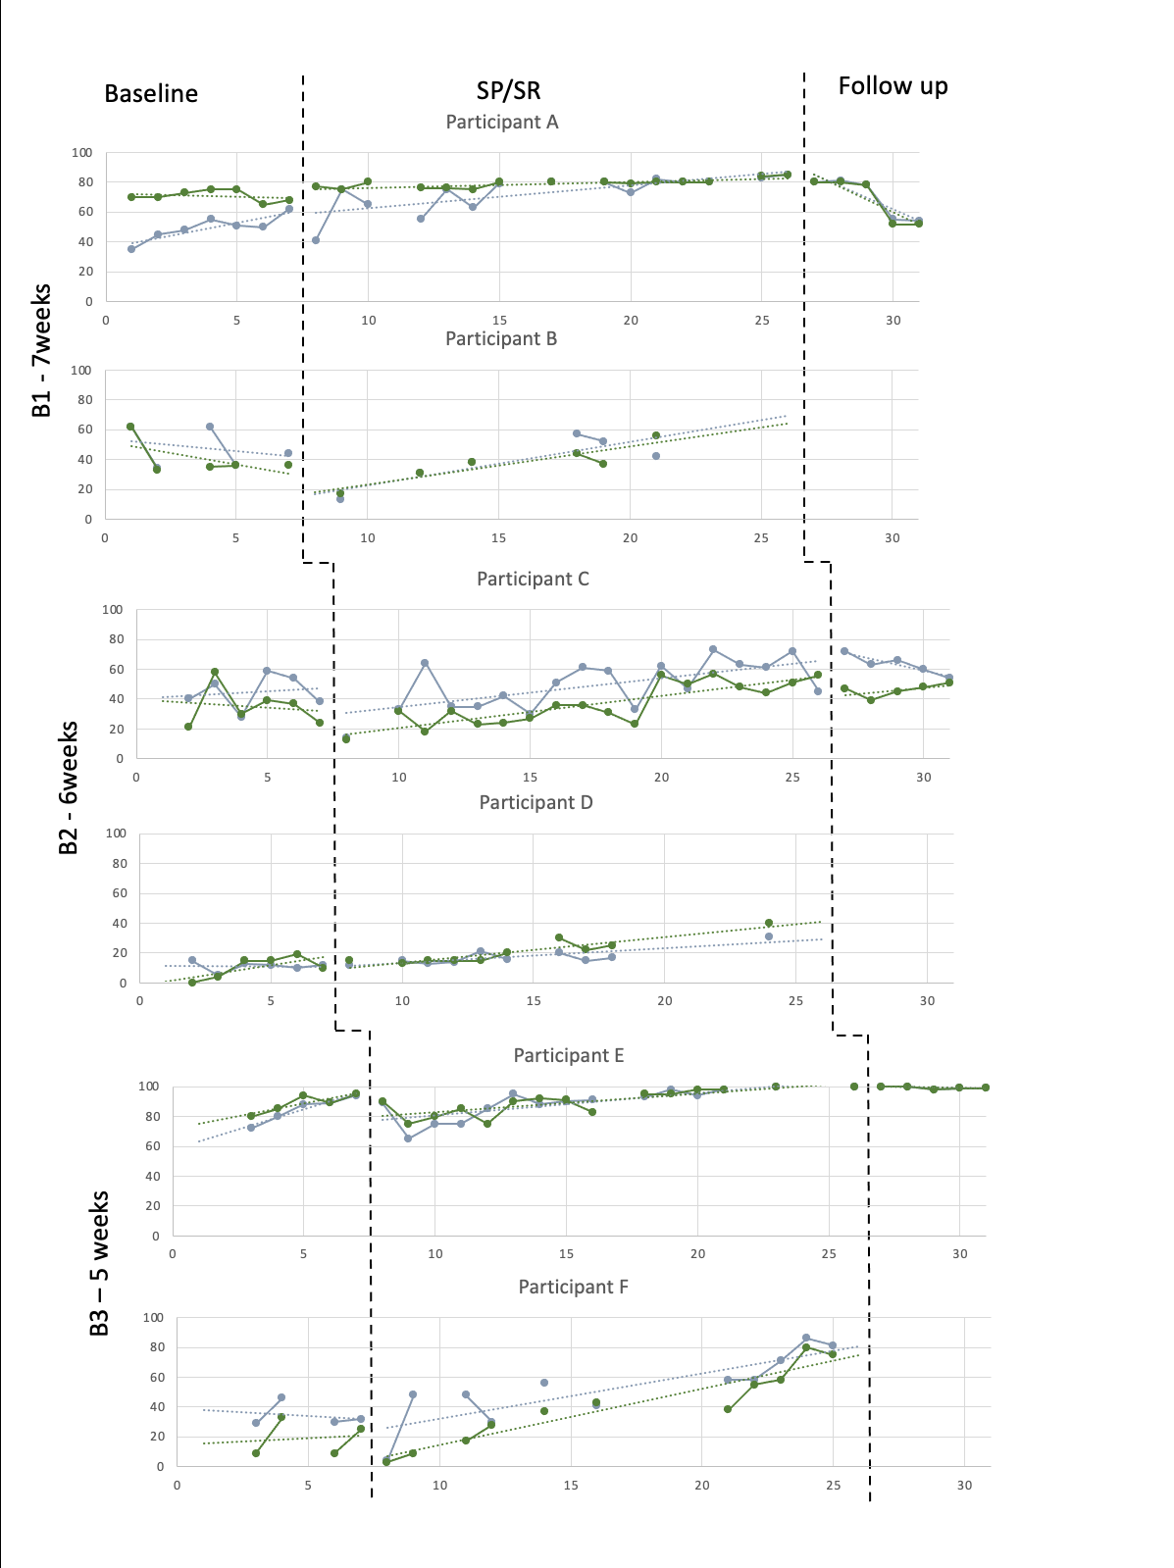
Results
Example of graphing of data and visual analysis.
I have the skills to elicit and integrate my client’s strengths that are related to their ethnic identity
Significant improvements for Participants A and D
I have the skills to identify and address my own ethnic differences and/or similarities with my client in sessions
Significant improvement for participants A, D and F → improvement across three baseline conditions
Overall, increase in mean ratings and an improving trend during intervention.
Mixed pattern at follow-up.

Slide 13
Overall Findings
Significant improvement in skills related to exploring and addressing similarities and differences in ethnicity with service users
Overall increases in mean scores and upward trends during SP/SR
Differential impacts and levels of benefit for different people
Level of experience
Mixed findings during follow up

Slide 14

Strengths and Limitations
Strengths
1. Novel adaptation
2. Design
3. Co-production
Limitations
1. Un-validated outcome measures
2. Lack of context within quantitative information
3. Hard to know the mechanisms of change
4. Intervention at the individual level and need for systemic change
Notes:
Cross-

Slide 15

Implications
Initial support for the use of SP/SR as a methodology for developing therapist skill in working with ethnicity
Extends existing initiatives that support the personal and professional development of therapists from minoritised ethnic backgrounds
Further support for individual impacts of SP/SR, including differences based on level of experience
Research methods adapted for future quantitative research on SP/SR
Co-production

Slide 16

Reflections on process
Undertaking research which has personal resonances
Feeling connected/disconnected from stories
Reducing experiences into numbers and the lack of nuance in quantitative research
The importance of reflexivity even in quantitative research
The benefit of having a reflective space

Slide 17
A final thought…
In ‘Why therapists should walk the talk’, Bennett-Levy (2019) writes:
“In regard to Personal Practices (PP), we have two choices:
1. Either to hide behind the cloak of scientism and suggest that in the absence of gold standard research that demonstrates an impact of PPs on therapist skills and client outcomes, there is no basis for including PPs in therapist training and professional development.
2. Or we can acknowledge the difficulty of research in this domain; recognise the consistencies and growing convergent validity in therapists' reports, and the level of correspondence between the reported impacts of PPs and the key attributes and skills of the most effective therapists. This would enable us to move on from asking whether or not PPs are effective to researching the value of different PPs in different contexts and at the same time developing progressively sophisticated measures to assess their impact.”

Slide 18
References
Baker, C & Kir-Wade, E. (2023). Mental health statistics: prevalence, services and funding in England. UK Parliament. https://commonslibrary.parliament.uk/research- briefings/sn06988/.
Beck, A. (2016). Transcultural cognitive behaviour therapy for anxiety and depression: A practical guide. Routledge.
Beck, A., Naz, S., Brooks, M. and Jankowska, M. (2019). Black, Asian and Minority Ethnic Service User Positive Practice Guide.
Bennett-Levy, J. (2019). Why therapists should walk the talk: The theoretical and empirical case for personal practice in therapist training and professional development. Journal of Behavior Therapy and Experimental Psychiatry, 62, 133–145. https://doi.org/10.1016/j.jbtep.2018.08.004
Faheem, A. (2023a). ‘It’s been quite a poor show’ – exploring whether practitioners working for Improving Access to Psychological Therapies (IAPT) services are culturally competent to deal with the needs of Black, Asian and Minority Ethnic (BAME) communities. The Cognitive Behaviour Therapist, 16, e6. https://doi.org/10.1017/S1754470X22000642
Kratochwill T. R., Hitchcock J., Horner R. H., Levin J. R., Odom S. L., Rindskopf D., Shadish W. R. M. (2010). Single case designs technical documentation Retrieved from http://ies.ed.gov/ncee/wwc/pdf/wwc_scd.pdf
Naz, S. (2021). Where am I really from? CBT Today, 49 (1), p28.
Pakenham, K. I. (2015). Effects of Acceptance and Commitment Therapy (ACT) Training on Clinical Psychology Trainee Stress, Therapist Skills and Attributes, and ACT Processes. Clinical Psychology & Psychotherapy, 22(6), 647–655. https://doi.org/10.1002/cpp.1924
Parker RI, Vannest KJ, Davis JL, Sauber SB (2011). Combining nonoverlap and trend for single-case research: Tau-U. Behavior Therapy 42, 284–299.

Slide 19
References
Paulraj, P. S. (2016). How do black trainees make sense of their identities in the context of clinical psychology training? [Doctoral dissertation, University of East London]. https://doi.org/10.15123/PUB.5401
Scott, J., Yap, K., Bunch, K., Haarhoff, B., Perry, H., & Bennett-Levy, J. (2020). Should personal practice be part of cognitive behaviour therapy training? Results from two self-practice/self-reflection cohort control pilot studies. Clinical Psychology & Psychotherapy, 28(1), 150–158. https://doi.org/10.1002/cpp.2497
Sue, & Sue, D. (2015). Counseling the culturally diverse: theory and practice (7th ed). Wiley.
Umaña-Taylor, A. J. (2011). Ethnic identity. In S. J. Schwartz, K. Luyckx, & V. L. Vignoles (Eds.), Handbook of identity theory and research (pp. 791–801). Springer Science + Business Media. https://doi-org.libproxy.ucl.ac.uk/10.1007/978-1-4419-7988-9_33
Vannest, K.J., Parker, R.I., Gonen, O., & Adiguzel, T. (2016). Single Case Research: web based calculators for SCR analysis. (Version 2.0) [Web-based application]. College Station, TX: Texas A&M University. Retrieved Saturday 10th June 2023. Available from singlecaseresearch.org
Williams, M. T., Faber, S. C., & Duniya, C. (2022). Being an anti-racist clinician. The Cognitive Behaviour Therapist, 15, e19. https://doi.org/10.1017/S1754470X22000162
Williams, M. T., Holmes, S., Zare, M., Haeny, A., & Faber, S. (2022). An Evidence-Based Approach for Treating Stress and Trauma due to Racism. Cognitive and Behavioral Practice. https://doi.org/10.1016/j.cbpra.2022.07.001
Williams, M. T., Rouleau, T. M., La Torre, J. T., & Sharif, N. (2020). Cultural competency in the treatment of obsessive-compulsive disorder: Practitioner guidelines. The Cognitive Behaviour Therapist, 13, e48. https://doi.org/10.1017/S1754470X20000501

