Slide 1
Gender and paid work in the pandemic: do women pay for working from home?
Bożena Wielgoszewska, Alex Bryson, Heather Joshi, David Wilkinson
QSS Away day
7 November 2023

Slide 2
Motivation:
The covid-19 pandemic affected women’s employment more adversely than men’s through job loss and furlough (Wielgoszewska et.al., 2023)
Those who continued working experienced increased working from home, but the implications of this shift for gender equality are less clear
Historically women with more flexible working arrangements, such as part-time work, are reimbursed at lower pay rates per hour than their male counterparts

Slide 3
Aims and objectives:
Aim: to investigate gender differences in gross hourly pay as well as mental health and well-being by work location a year into covid-19 pandemic
RQ1: Who works from home?
RQ2: How is working from home related to gender differences in hourly pay?
RQ3: How is working from home related to gender differences in mental health and well-being?

Slide 4
Data:
Covid survey (https://cls.ucl.ac.uk/covid-19-survey/) utilising information collected at wave 1 (May 2020) and wave 3 (February – March 2021)
Linked information from previous sweeps
Cohorts:
National Child Development Study (aged 63),
British Cohort Study (aged 51)
Next Steps (aged 31)
Millenium Cohort Study (aged 20)

Slide 5
Analytical sample
Continuous employees employed and currently working at wave 3 (February and March 2021) and before the Coronavirus outbreak in March 2020 (N = 9,244)
Cohorts NCDS (Age 63), BCS (Age 51) and Next Steps (age 31); MCS excluded (N = 8,705)
Pay can derive gross hourly pay after top and bottom coding (N = 7,712)
Work location reports work location information own home, employer’s premises or some days at home and some at employer’s premises i.e. hybrid (N = 7,348)
Great Britian lives in England Scotland or Wales at wave 3 (N = 7,154)
Has job satisfaction and mental health measures can derive anxiety depression as well as life and job satisfaction (N = 7,040)

Slide 6
Who works from home?

Slide 7
Methods :
Outcome: working from home measured by two binary indicators:
Broad definition - any work from home, which includes those who work some days at home and some days at employer's premises)
Narrow definition – those working only from own home
Exposure: female dummy
Pooled sample
Logit models
Missing values on covariates replaced with missing dummy if categorical or sample mean if continuous

Slide 8
Stages of adjustment:
M1: Raw gaps by gender
M2: + Basic controls Cohort (NCDS, BCS, Next Steps) Country (England, Scotland, Wales), London, Education (none, NVQ1-5), parental social class (manual, non-manual), mode of survey (CAWI, CATI), number of rooms
M3: + Family characteristics Family (single, partnered, partner and 0-5 kids, partner and 6-11 kids, partner and 12+ kids, lone parent, other ), number of kids in the household
M4: + SOC current SOC (2-digit classification with occupation with high prevalence of one gender aggregated to 1-digit),
M5: + Part time PT (based on current hours worked, with cut-off of 30),
M6: + key worker (based on pre-pandemic occupation),
M7: + home working propensities (Pre-pandemic home working probabilities by 3 digit occupation, age-group, and sex derived from the 2019 Annual Population Survey)

Slide 9
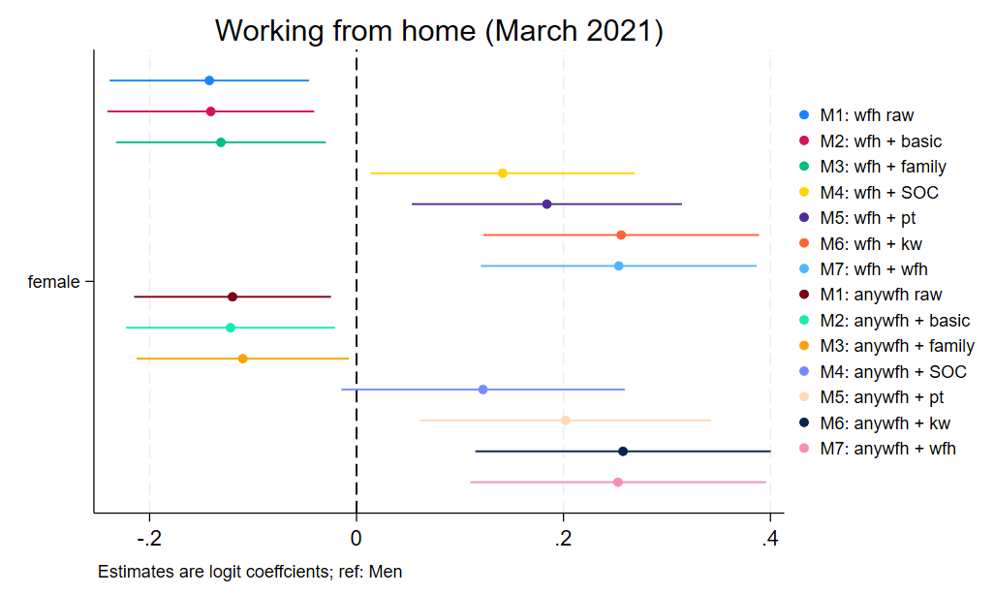
Results - gender

Slide 10
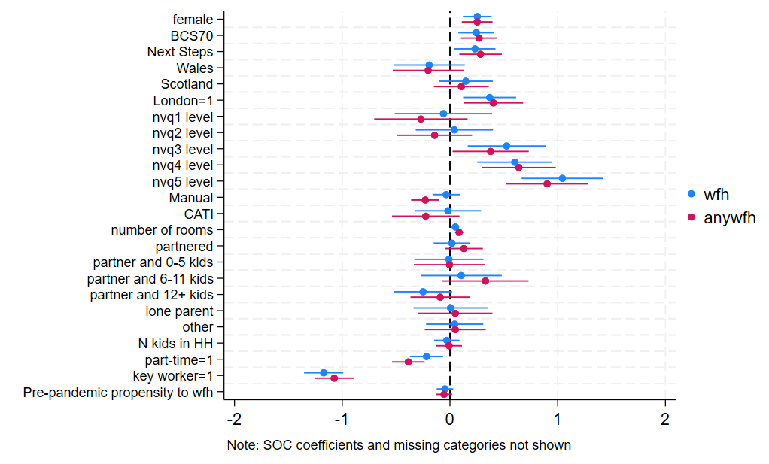
Results – other characteristics (M7)

Slide 11
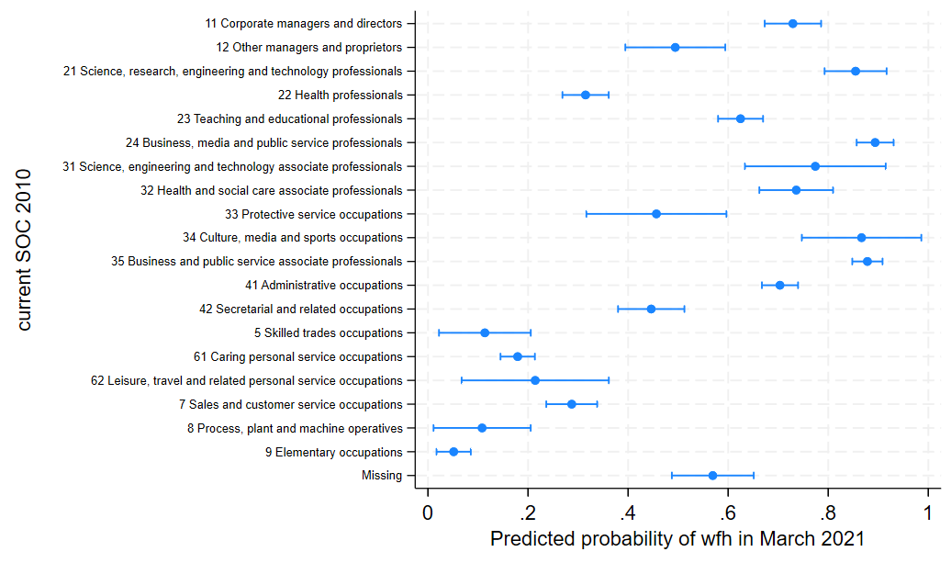
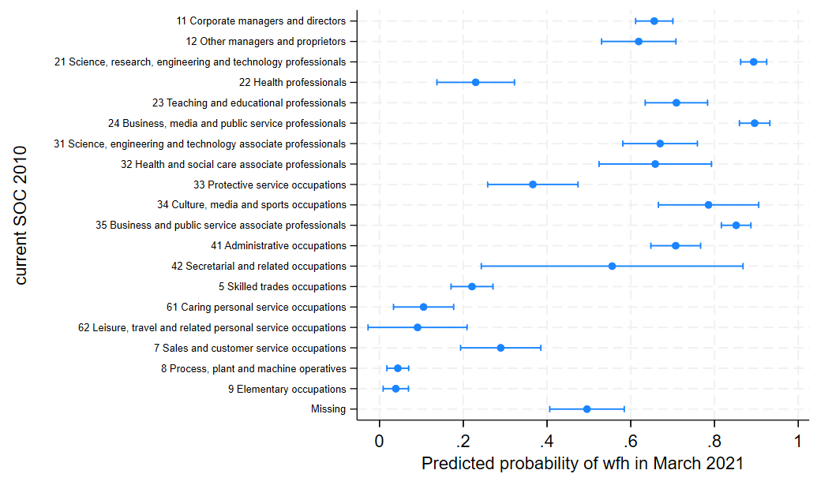
Results – occupation (M7) by gender
Women
Men

Slide 12
Gender Pay Gap
Notes:
Ok so what about the gender pay gap?

Slide 13
Methods :
Outcome: Log gross hourly pay top and bottom coded per cohort
Exposure: working from home gender interaction
men working from employers' premises – ref.
men hybrid
men working from home
women working from employers’ premises
women hybrid
women working from home
Pooled sample
Linear regression models + quantile regression at 20th and 80th percentile
Missing values on covariates replaced with missing dummy if categorical or sample mean if continuous

Slide 14
Stages of adjustment:
M1: Raw gaps by gender and work location
M2: + Basic controls Cohort (NCDS, BCS, Next Steps) Country (England, Scotland, Wales), London, Education (none, NVQ1-5), parental social class (manual, non-manual), mode of survey (CAWI, CATI), number of rooms
M3: + Family characteristics Family (single, partnered, partner and 0-5 kids, partner and 6-11 kids, partner and 12+ kids, lone parent, other ), number of kids in the household
M4: + Pre-pandemic pay Gross hourly pay in March 2020
M5: + Pre-pandemic job characteristics pre-pandemic SOC (2-digit classification with occupation with high prevenance of one gender aggregated to 1-digit), PT (based on current hours worked, with cut-off of 30), key worker (based on pre-pandemic occupation)
M6: + Home working propensities Pre-pandemic home working probabilities by occupation, age-group, and sex derived from the 2019 Annual Population Survey
M7: + Job change whether CM has changed job (binary directly asked), change in hours worked (decrease, the same, increase)

Slide 15
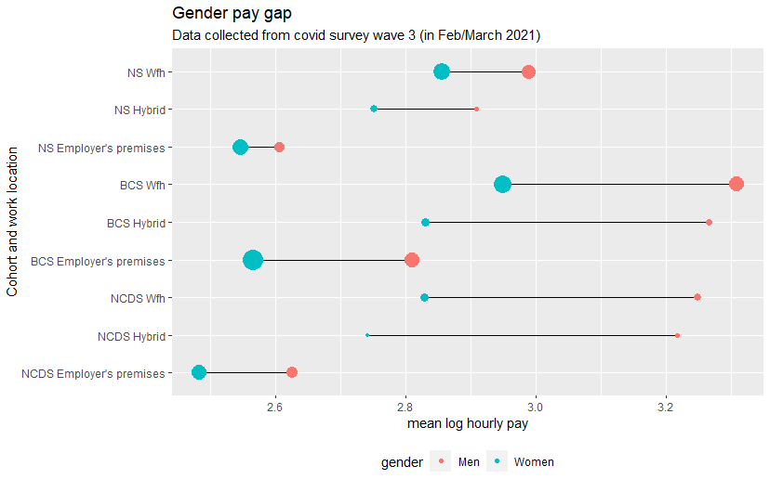
Results – descriptive statistics

Slide 16
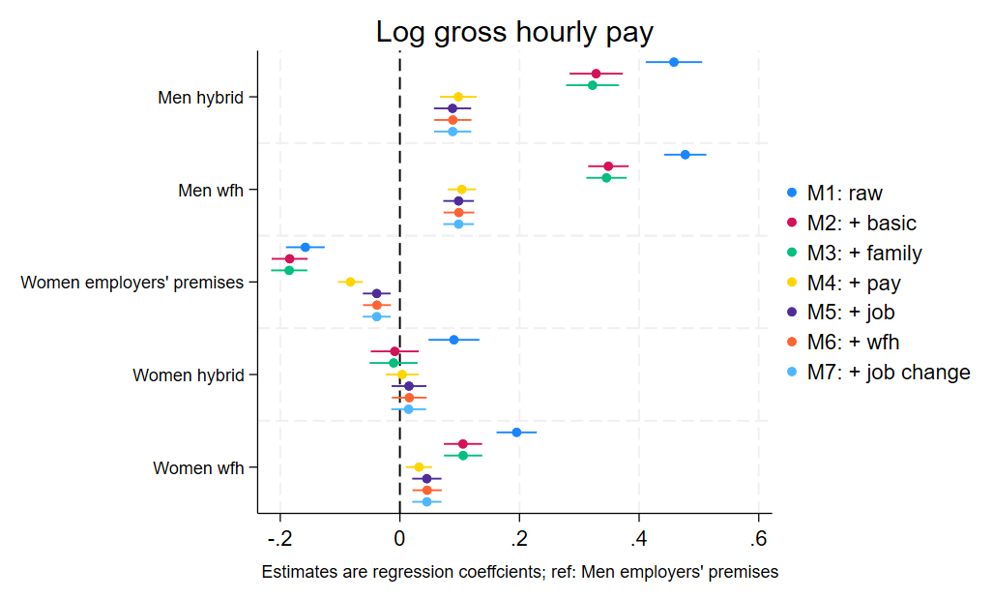
Results – gender and working from home

Slide 17
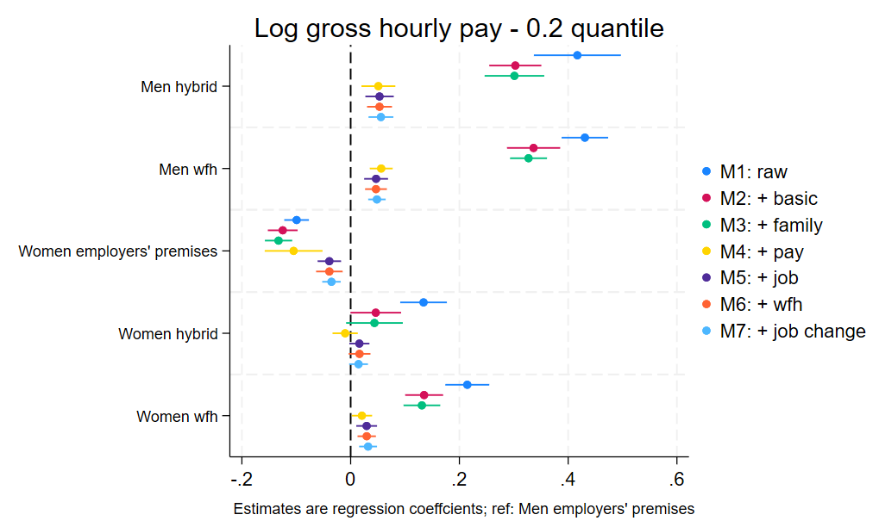
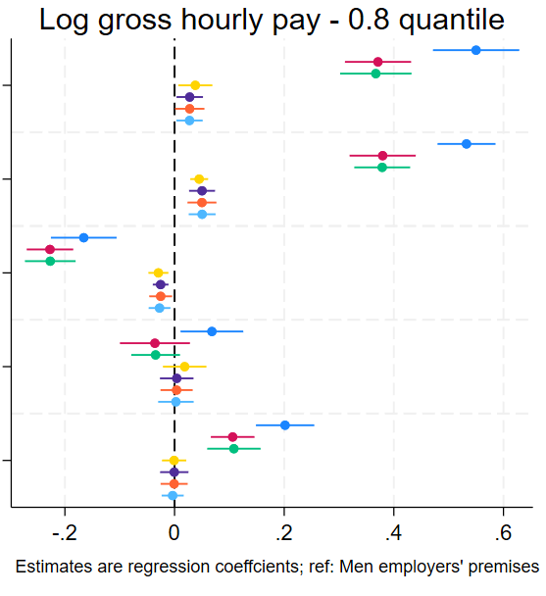
Results – across distribution

Slide 18
Gender Gap in Mental Health and Well-being

Slide 19
Methods :
Outcomes:
Life satisfaction (0 very dissatisfied -10 very satisfied)
Anxiety (sum of 2-item general anxiety disorder (GAD-2), 0 - don’t experience either symptom – 6 experience both symptoms nearly every day)
Feeling nervous, anxious or on edge
Not being able to stop or control worrying
Depression (sum of 2-item Patient Health Questionnaire (PHQ-2)
Little interest or pleasure in doing things
Feeling down, depressed or hopeless
Job satisfaction (5-point scale from very dissatisfied to very satisfied)
Exposure: working from home gender interaction (as before)
Linear regression models

Slide 20
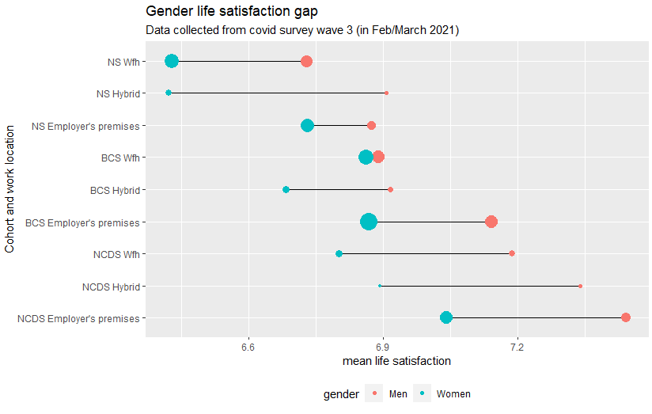
Results – life satisfaction

Slide 21
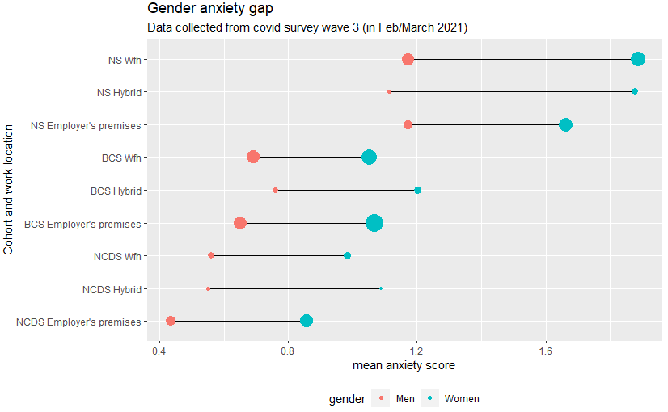
Results – anxiety

Slide 22
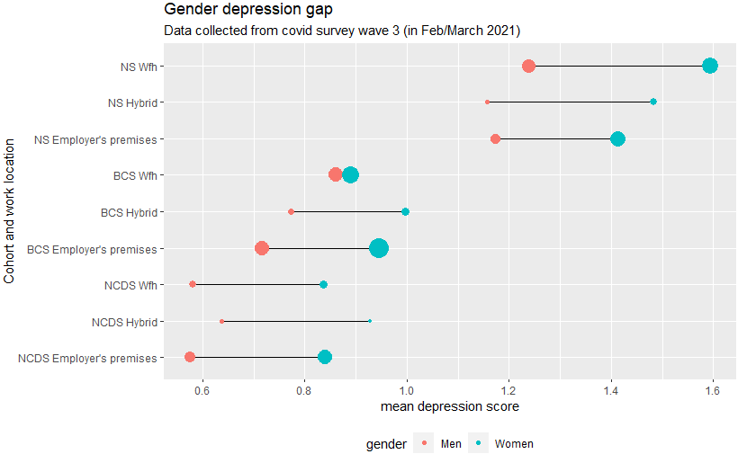
Results – depression

Slide 23
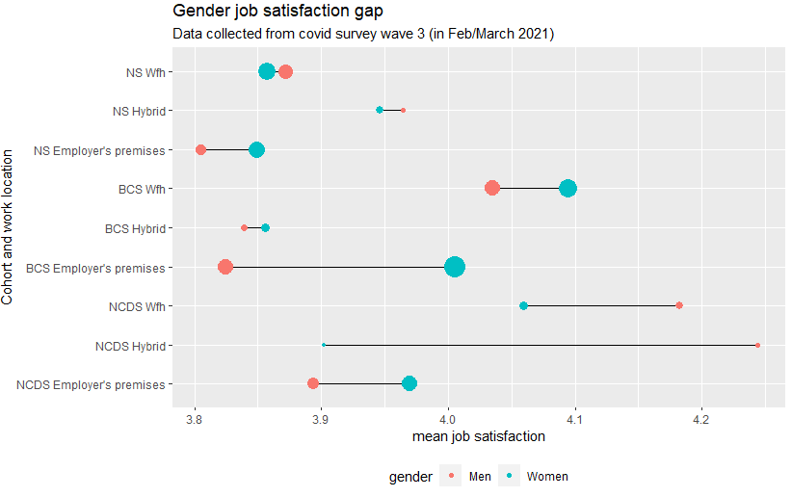
Results – job satisfaction

Slide 24
Stages of adjustment:
M1: Raw gaps by gender and work location
M2: + Basic controls Cohort (NCDS, BCS, Next Steps) Country (England, Scotland, Wales), London, Education (none, NVQ1-5), parental social class (manual, non-manual), mode of survey (CAWI, CATI), number of rooms
M3: + Family characteristics Family (single, partnered, partner and 0-5 kids, partner and 6-11 kids, partner and 12+ kids, lone parent, other ), number of kids in the household
M4: + Pre-pandemic life satisfaction standardised life satisfaction from pre-pandemic surveys (NCDS 2008, BCS 2016, NS 2015)
M5: + Pre-pandemic job characteristics pre-pandemic SOC (2-digit classification with occupation with high prevenance of one gender aggregated to 1-digit), PT (based on current hours worked, with cut-off of 30), key worker (based on pre-pandemic occupation)
M6: + Home working propensities Pre-pandemic home working probabilities by occupation, age-group, and sex derived from the 2019 Annual Population Survey
M7: + Job change whether CM has changed job (binary directly asked), change in hours worked (decrease, the same, increase)

Slide 25
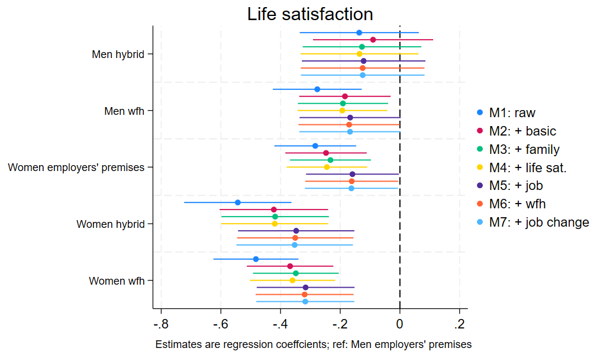
Results: adjustment (life satisfaction)

Slide 26
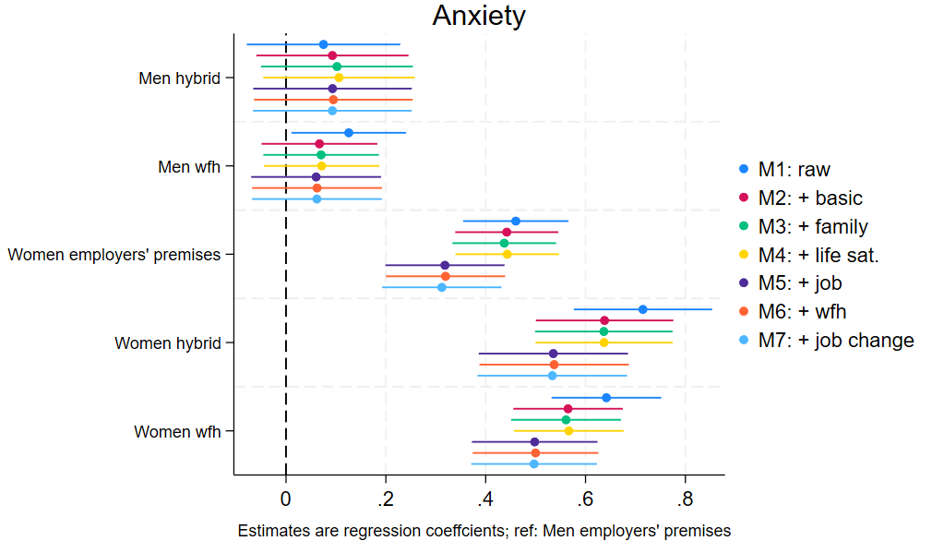
Results: adjustment (anxiety)

Slide 27
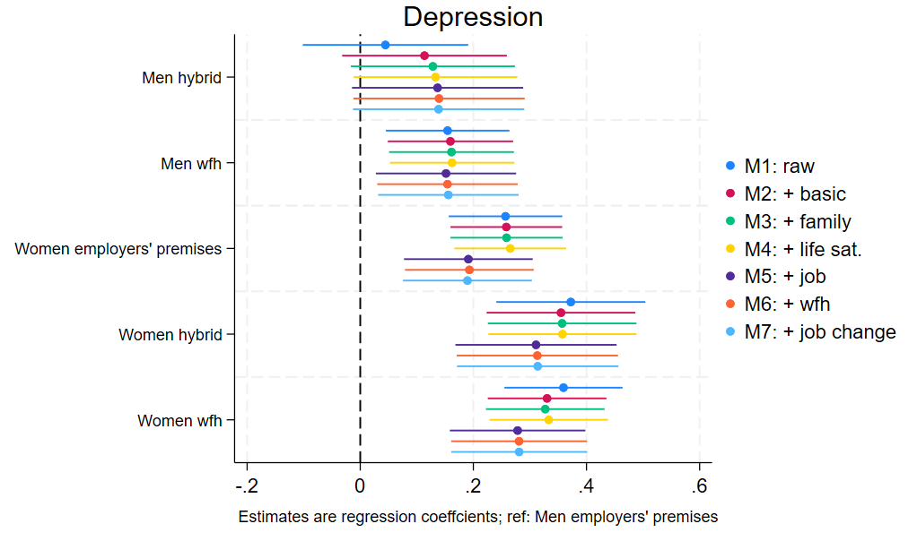
Results: adjustment (depression)

Slide 28
Summary and Conclusions

Slide 29
Summary :
Who works from home?
Raw estimates indicate that women are less likely than men to work from home, but after adjusting for their job characteristics they appear to be more likely
Those who are more educated (and earn more) are more likely to work from home, while part-timers and key workers are less likely to do so
Large variability within and across occupations
How is working from home related to gender differences in gross hourly pay?
Women earn less than men across all work locations, with gaps the widest amongst those who work from home
This is largely, but not fully, accounted for by pre-pandemic pay, implying that cohort members’ work location reflects the pre-existing line of gender inequalities (i.e. women underrepresented in the “top jobs”, which are more likely to be done from home)
How is working from home related to gender differences in mental health and well-being?
Job satisfaction appears relatively high amongst the sample of continuing workers, but there is not clear gendered pattern, with men working from employers’ premises less satisfied than everyone else
Mental health measures indicate that working from home might not be “the blessing” for women and may be related to “double burden”

Slide 30
Limitations :
Selective analytical sample with implications for missing data
Sample skewed towards high earners and those who didn’t go for the conditions offered under furlough scheme, so not necessarily representative of all workers
Pandemic context may not be translatable into the post-pandemic world, especially as we don’t know who did and who didn’t work from home by choice
Longer term impact on career progression is not yet observed, and we don’t see who continues to work from home or hybrid post covid

Slide 31
Next steps :
Test interactions by gender and other characteristics
Sensitivity analyses (including those working in other locations)
Figure out what is happening with the job satisfaction
Policy implications ?

Slide 32
Thank you! Questions? Comments?
Project website: https://www.ucl.ac.uk/ioe/departments-and-centres/centres/quantitative-social-science/gender-wage-gap-evidence-cohort-studies
Funding: ESRC grant ES/S012583/1
Email: b.wielgoszewska@ucl.ac.uk
Twitter: @MeBozena
QSS Away day
7 November 2023

