Slide 1
The Gender Wage Gap at 42 Evidence from two British Birth Cohort Studies
David Wilkinson, Alex Bryson, Francesca Foliano, Heather Joshi, Bożena Wielgoszewska
SRI Gender Equality Workshop
20th June 2023

Slide 2
Secular trend in gender pay gap: various series and some policy landmarks
Notes:
Can anyone find a NES series for all workers 1974- 2001? I know NES had low coverages of very pt workers

Slide 3
Falling for all age groups over time
Notes:
Similar patterns reported by Goldin et al 2014 in USA

Slide 4
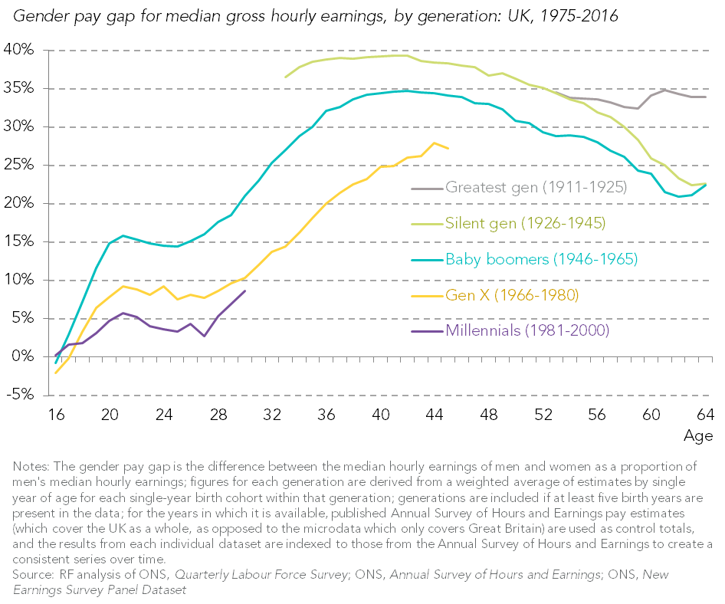
Falling trend with time: age pattern within cohorts
Quasi cohorts, Gardiner 2017
Notes:
Similar patterns reported by Goldin et al 2014 in USA

Slide 5
Convergence in Educational Attainment

Slide 6
Findings for covariate-adjusted (human capital) GWG
NCDS
Life-course pattern of GWG similar to that for raw gap, but gap begins to close in 30s not 40s
Gap is less pronounced than raw gap due to human capital differences in 30s and 40s
Accounting for attrition gap is larger later in life
Selection-adjustment means gap is larger until 40s
BCS
GWG much flatter between 20s and 40s when covariate adjust due to human capital differences
GWG always smaller than in case of NCDS
GWG smaller with selection-adjustment

Slide 7
Notional components of the Gender Pay Gap
EXPLAINED
Productivity/ human capital characteristics
Education
Skills
Age
Experience
Family responsibilities
Job characteristics ***
Full/part-time
Occupation
vertical or horizontal segregation
Extent of part-time work
Employer characteristics
Sector, contract, bargaining, size, institutional structure
UNEXPLAINED
RESIDUAL/ ‘adjusted’ ‘standardized’ component
Unequal rewards to a given characteristic for men and women
Some arguably discriminatory arising from:
Employer/ee preference against hiring, promoting, training or retaining women, institutional culture
Women’s preference for flexibility or female workmates
lower bargaining power and travel range
Asymmetric social expectations of men’s and women’s family roles.
Omitted explanatory factors ( eg data without work histories)
*** Job characteristic can also be seen contributing to unequal treatment rather than the EXPLAINED component

Slide 8
What does the GWG look like in mid-life?

Slide 9
Method
An accounting exercise not an exploration of causality
Estimating gender difference in all treatment parameters
Taking each sweep separately
Decomposition - Kitagawa, Oaxaca, Blinder
Explained gap, parameter gap,
Pooled estimates
Exploring the inclusion of different sets of explanatory variables with and without job characteristics,
Notes:
Different treatment of interaction in other decompositions
Not showing estimates of selection bias – pay gap is understated for some younger samples. Selection bias cannot be estimated if job characteristics are included.

Slide 10
Dependent and Explanatory Variables
Dependent Variable
Log of hourly wages at time of interview, all employees (RPI deflated)
Human capital controls
Highest qualification at time of interview, test score aged 10/11, months in full and part-time jobs since school leaving (plus squared terms), months in current job, region at interview (London +Southeast v rest of GB)
Family composition
Presence of dependent children by age, presence of a partner, ever been a parent of co-resident child
Occupation
One digit SOC dummies, dummies for whether two digit SOC had 30-70% or 70% or more female employees
Hours
Whether worked 16-30 hours, 30-45 hours or 45 or more hours; whether two digit SOC has 10-30% or 30% or more part-time (less than 30 hours) employees

Slide 11
Which characteristics explain the gap at age 42

Slide 12
Working hours by cohort and gender
 | % working less than 30 hours | % working 30-45 hours | % working 45 or more hours
NCDS men | 2.0 | 59.5 | 38.5
BCS men | 2.7 | 65.2 | 32.1
NCDS women | 39.8 | 52.7 | 7.6
BCS women | 41.0 | 52.0 | 6.9

Slide 13
Does it change if we include hours worked and the extent of part-time occupations

Slide 14
Comparison across the pay distribution Pay gap explained by gaps between male and female characteristics is smaller at higher wages, but not much changed across cohorts (controlling for education and experience)
Notes:
Black line shows how the gap varies over the distribution
Increases for NCDS. More stable for BCS.
Mean very similar to Median
Both cohorts – more of the gap is explained (related to differences in characteristics) at the bottom of the distribution than at the top
HJ: Don’t follow why ‘didin’t do a decomposition’
Units on RH y axis are proportions of male wage, not logs
Whay are we so keen on the share of the gap rather than the absolute size of the gender premium?

Slide 15
Elements of Explanation
The main source of the explained pay gap in both cohorts at 42 is human capital, particularly full-time work experience. Very little contribution of education -or family responsibilities.
The vertical hierarchy of occupations in broad SOCs accounts for a lot of variation in wages, but not so much of the pay gap
Occupational segregation, horizontal, particularly in part-time work, absorbs some of the effects of human capital, and accounts for some more of the pay gap.
Changing patterns between cohorts require further investigation

