Slide 1
Optic Neuritis Case
25-Year-old female nurse
Past ocular history
  Nil
Past medical history
  Nil
Medications
  oral contraceptive pill
No known drug allergies

Slide 2
PRESENTATION
1 week history of left eye pain, worse on eye movement
Pain worse at night
Mild photophobia
No systemic symptoms

Slide 3
exam
Right |  | Left
6/6 | VA | 6/15
12 | IOP | 14
 | RAPD | Yes

Slide 4
REPRESENTATION
Right |  | Left
 | Red sats | Decreased
 | Bright sats | Decreased
Full | Ishihara | TP+3

Slide 5
EXAMINATION
Right |  | Left
Normal | Lids | Normal
White | Conj | White
Clear | Cornea | Clear
Deep and quiet | AC | Deep and quiet
Normal | Iris | Normal
Phakic | Lens | Phakic
Normal | Ant. vit | Normal

Slide 6
EXAMINATION
Right |  | Left
CDR 0.4, no swelling | Disc | CDR 0.4, no swelling
Normal | Macula | Normal
Normal | Retina | Normal

Slide 7
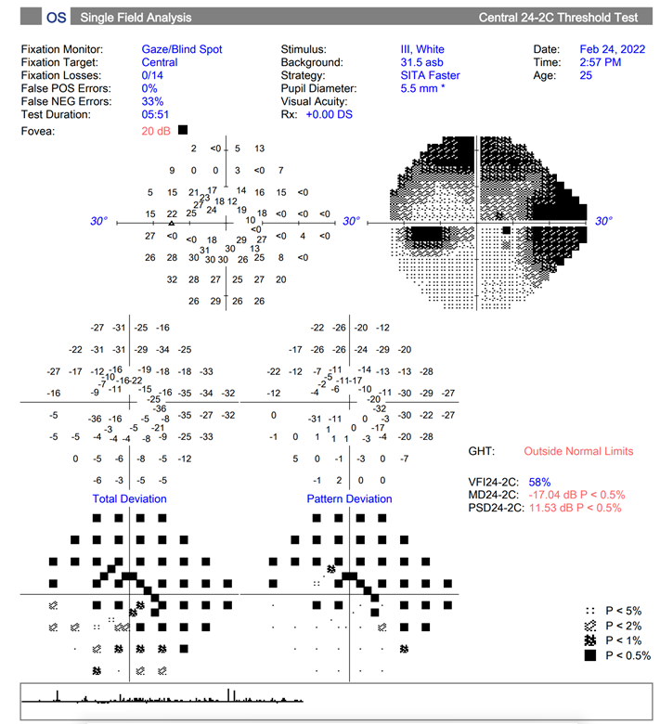
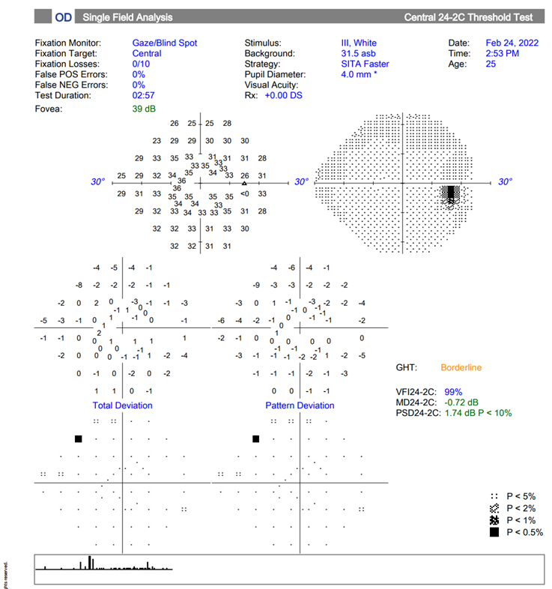
HVF

Slide 8
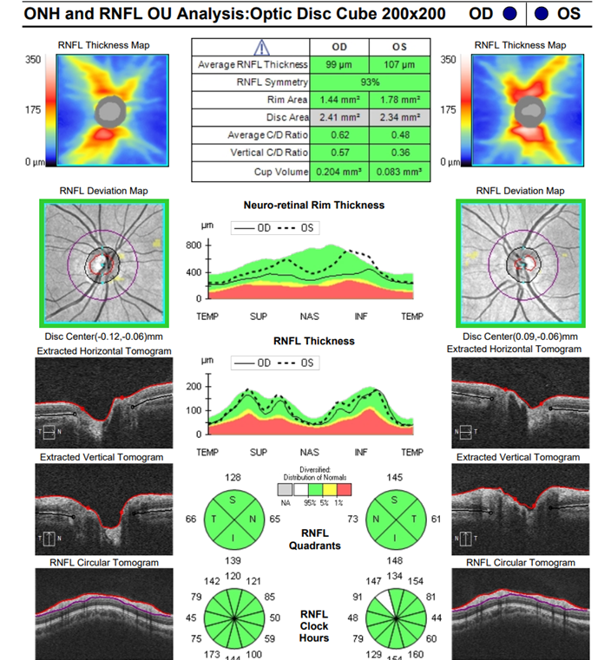
OCT disc

Slide 9
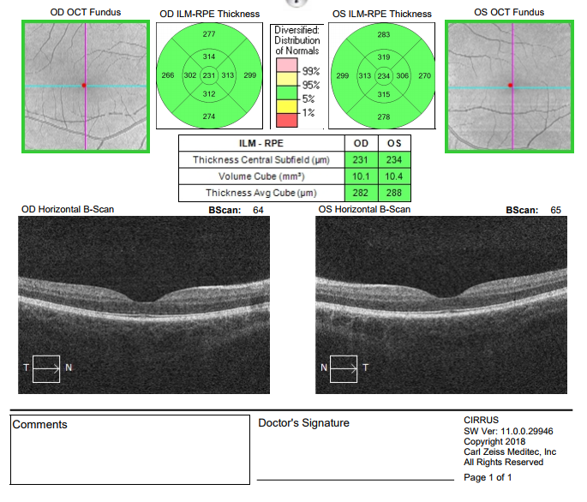
OCT MAC

Slide 10
basic emergency dept work-up
FBC Normal
EUC Normal
CRP < 1
ANA Negative
ANCA negative
ENA negative
ACE normal
CXR - normal

Slide 11
further history
Has a new kitten at home
Recently travelled overseas and did a nursing job in Fiji for one month
  – which included patients with TB and Dengue

Slide 12
IS this infective optic neuritis?

Slide 13
EXTRA Bloods
HIV negative
Syphilis negative
TB Negative
Bartonella negative
CXR normal

Slide 14
is this
MS optic neuritis?
Axel petzold

Slide 15
Review in clinic
Vision now dropped to count fingers
Pain continues 2 weeks after first noticed and 1 week after first presentation

Slide 16
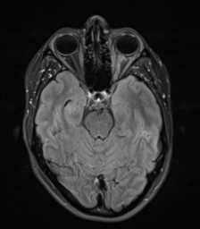
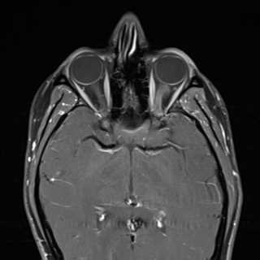
MRI

Slide 17
MRI
Left optic nerve swelling with high T2 signal
GAD enhancement from optic discs to orbital apex

Slide 18
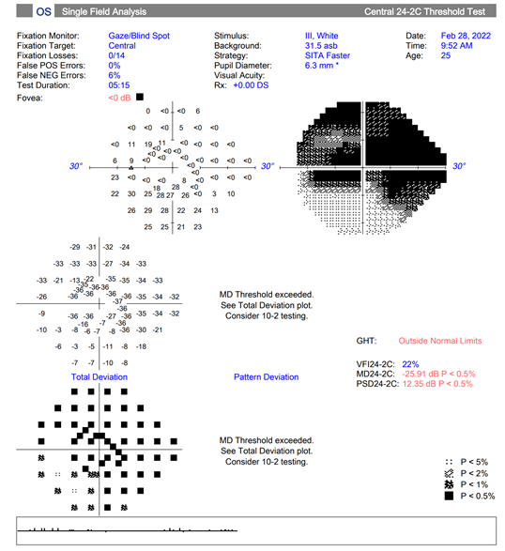
Management
Received IV Methylprednisolone 1g daily for
3 doses
On review after three doses
  Pain improved
  LE VA 6/60
  Ongoing left RAPD, colour vision and
  bright sats decreased

Slide 19
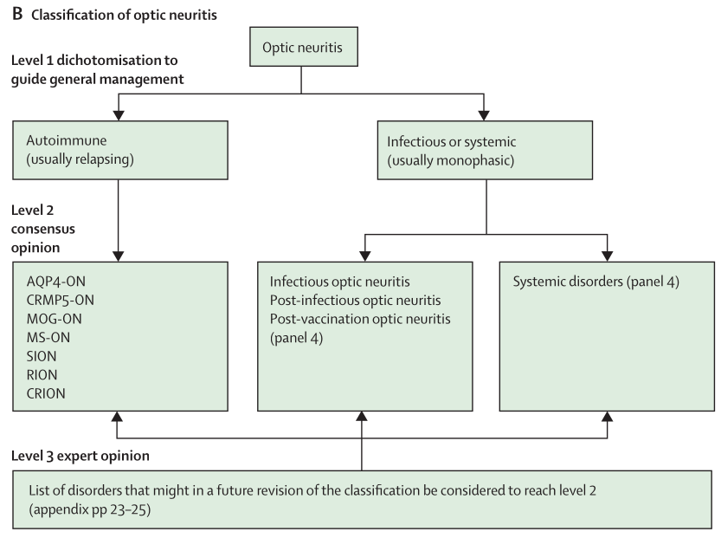
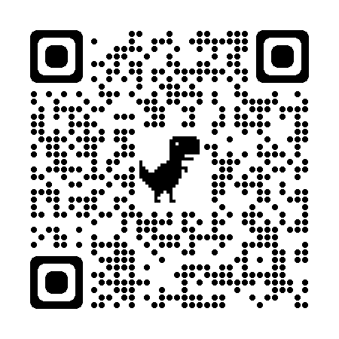
The Lancet Neurology 2022;21:1120-1134

Slide 20
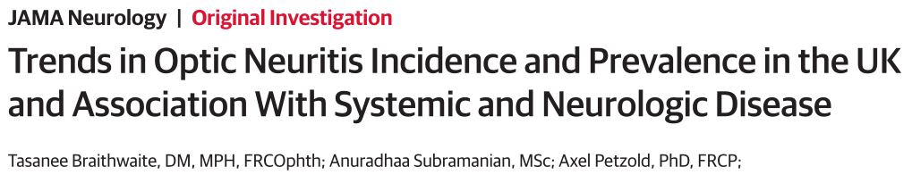
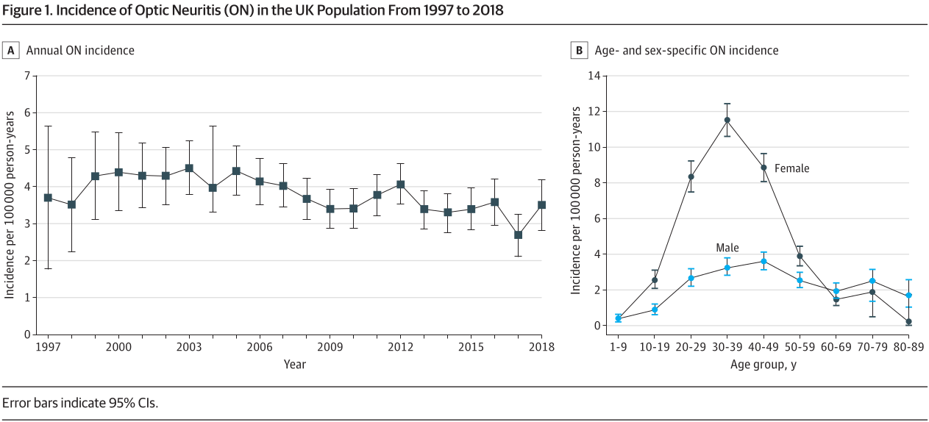
Epidemiology

Slide 21
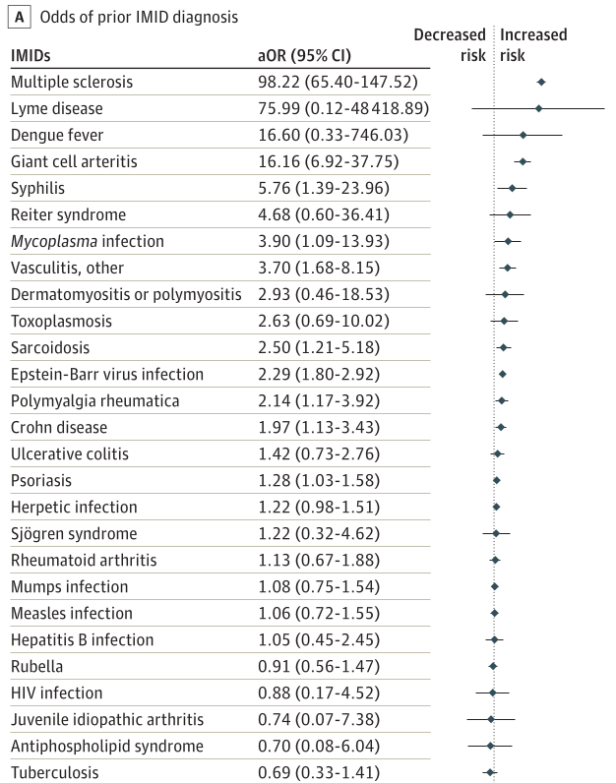
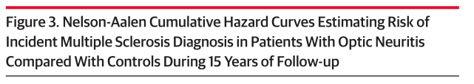
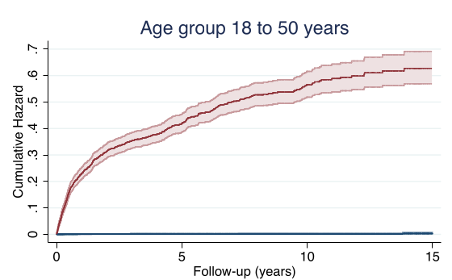
How likely is ms-ON?
JAMA Neurology 2020;1:1514-1523

Slide 22
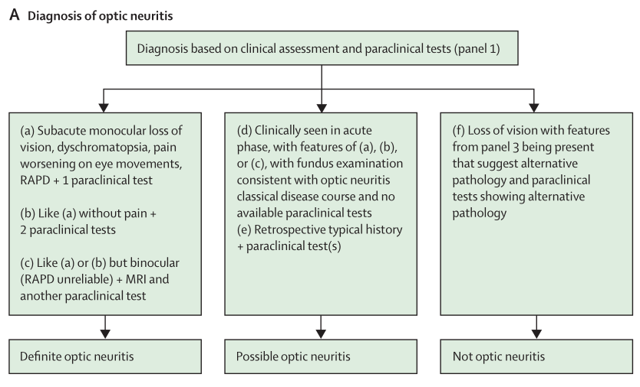
Does it meet Diagnostic criteria?
The Lancet Neurology 2022;21:1120-1134

Slide 23
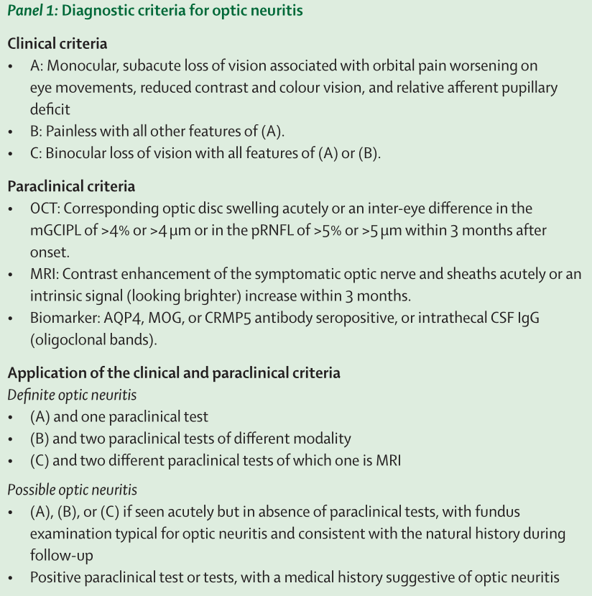
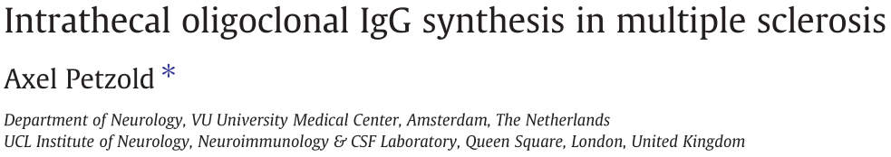
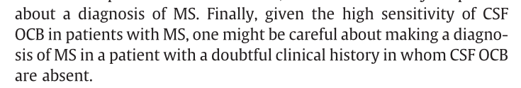
The Lancet Neurology 2022;21:1120-1134
J Neuroimmunology 2013;262:1-10

Slide 24
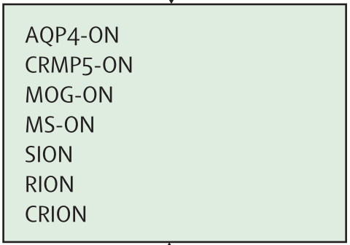
Is this MS-ON ?
Meets diagnostic criteria
  Clinical: Scenario A
  Paraclinical: OCT & MRI
Classification
  Presently: SION
  Most likely: MS-ON
  Not yet excluded: AQP4-ON,
  CRMP5-ON, MOG-ON
The Lancet Neurology 2022;21:1120-1134

Slide 25
is this
NMO optic neuritis?

Slide 26
Bloods
Anti NMO negative (2x)
Serum IEPG normal
IgG and subclasses normal

Slide 27
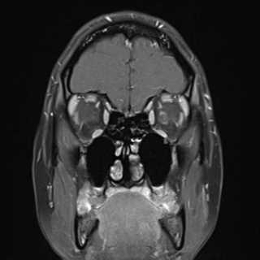
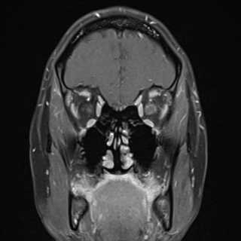
Progress
Anti-MOG negative (3x)
On review MRI shows perineural enhancement

Slide 28
this must be MOG optic neuritis?

Slide 29
Further management
Continues for 5 days IVMP
LP performed, opening pressure 10mmHg
-> normal chemistry, no oligoclonal bands
After 5 days of IVMP and one day of oral steroids
-> LE VA 6/60 PH 6/36
Initiated 3 days IVIG in conjunction with neurology
  Day 0 – LE VA 6/60
  Day 1 – LE VA 6/21
Discharged on slow steroid taper

Slide 30
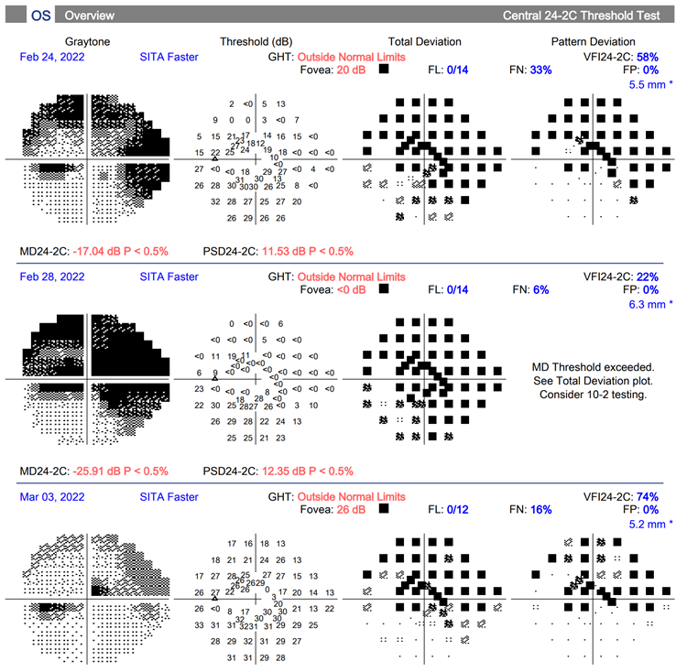
Follow Up
3 days post IVIG
  LE VA 6/15 + 2
  No pain
  0.9 RAPD
17 days post IVIG
  Finished steroid taper
  LE VA 6/7.5 + 2
  0.6 RAPD

Slide 31
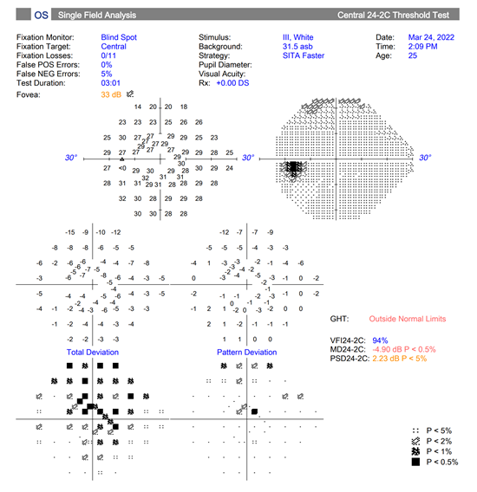
Follow Up
6 weeks post IVIG
  VA LE 6/5 – 3
    RE N4, LE N6
  Faint residual colour difference
(80% red saturations)
  No RAPD
Maybe it was neuro-sarcoid?

