Slide 1
Comics as a tool for reflection in the research process
Helen Jones

Slide 2
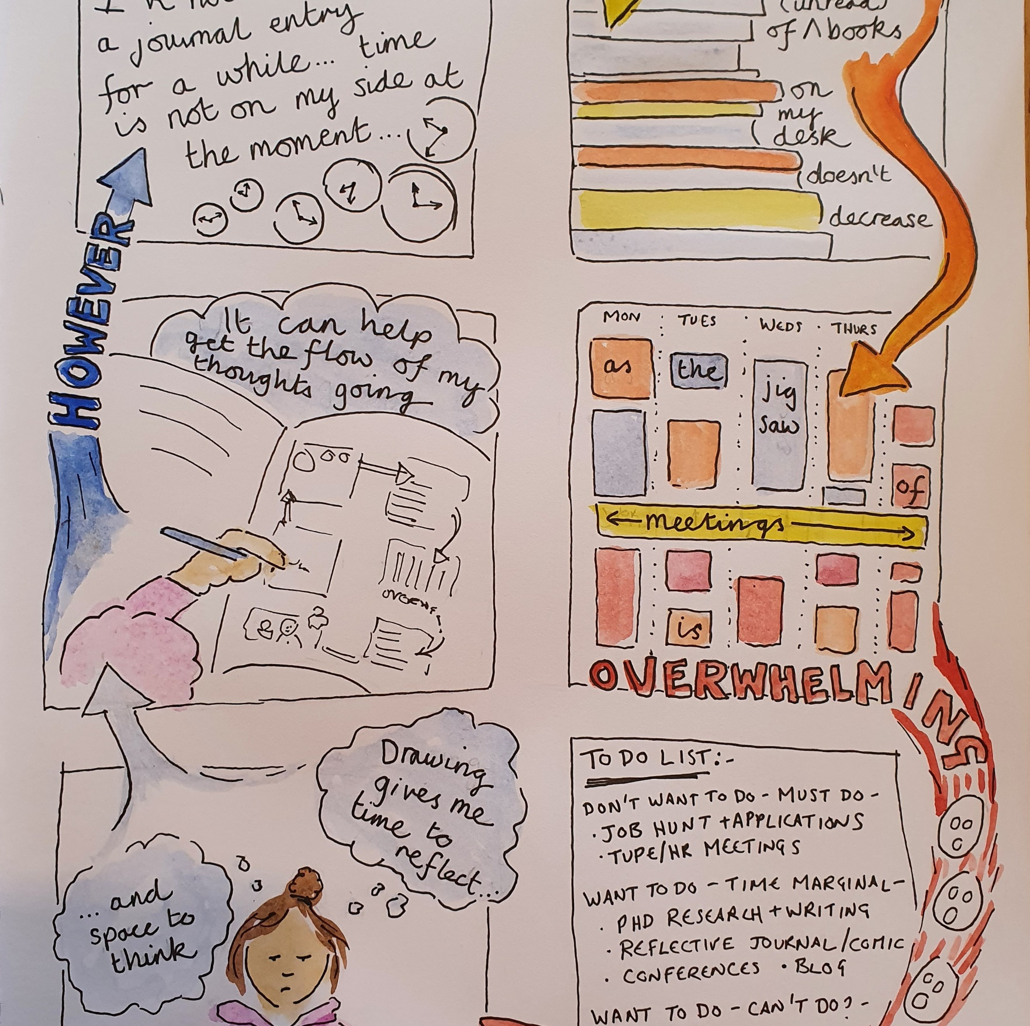
Overview of workshop
Why use comics as a tool for reflection?
Getting hands on – playing with comics.
Making a mini-zine and reflecting on your research.

Slide 3
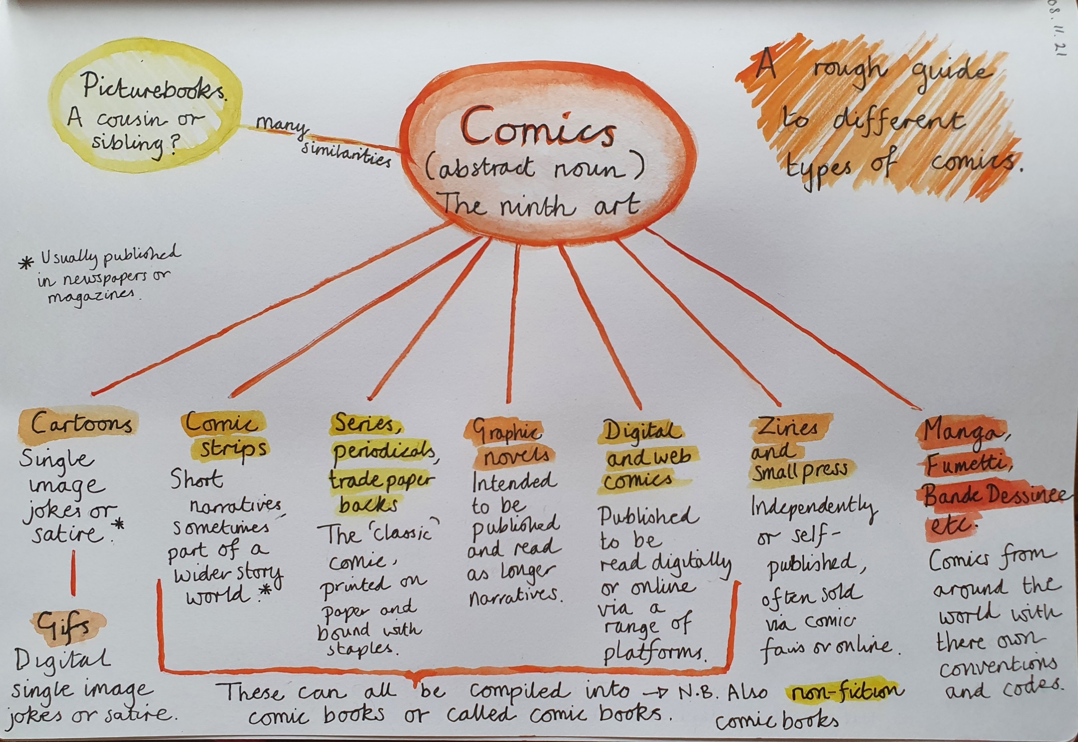
What are comics?
“It’s like learning a new syntax, a new way of ordering ideas.”
- Alison Bechdal
“a narrative in the form of a sequence of pictures with or without text” (Sabin,1993, p.5)
“juxtaposed pictorial and other images in a deliberate sequence, intended to convey information and/or produce an aesthetic response in the viewer” (McCloud,1994, p.9).
The reader is invited to “join in a pulsing and ever shifting movement in to and out of numerous possibilities of illustrative connections which both organise and complicate time” (Nodelman, 2013, p.439)
Notes:
Wordless, abstract

Slide 4
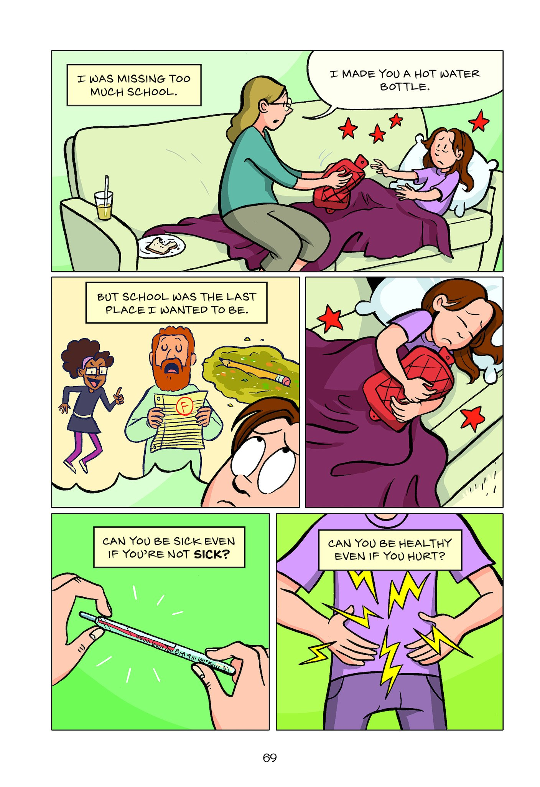
The Language of Comics
Panel
Gutter
Speech bubbles, thought bubbles
Captions
Movement lines, emenata
Telgemeier, R. (2019) Guts
Notes:
5 minutes –identify how the features of comics are working across these three panels – practice at the same time
Panel = regular sizes, not straight edges (hand drawn, child like?), breaking of border by movement lines and characters – indicating force of sandwich hitting Monkey.
Gutter = see border breaking note above. White space – could be another colour – how would that change the mood?
Flow = Characters talking to each other panel to panel, use of reverse ‘shot’ – make links here to film – similar use of terminology for angles and framing (e.g. close up, birds eye) – needs to work to understand flow of narrative from one moment to the next. Again, flow is drawn into this comic strip through the use of the movement lines.
Speech bubble = identify use of different text sizes, shapes, font
Caption = No captions used – why? What do captions add? (voice over, narrative, movement of time and space)
Movement lines and emanata = Emanata – anger lines, pig’s munching indicated by circles (crumbs?), show off triangles, being hit stars; movement lines of impact, throwing
Sound effects = BLAT!!, eugh, rrrghh! – comics as a ‘noisy’ art form

Slide 5
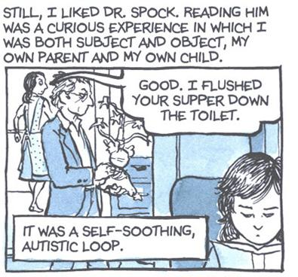
Comics as autobiography
“the authorial self in autobiographical comics can thus be characterized as tacitly— or sometimes quite blatantly— plural” (Refaie, 2012, p.52)
“narrative of the self” (Hall, 1992, p.277)
“multi-voiced dialogic self that is involved in internal and external interchanges that never reach a final destination” (Hermans and DiMaggio, 2007, p.35)
Bechdel, A. (2006) Fun Home

Slide 6
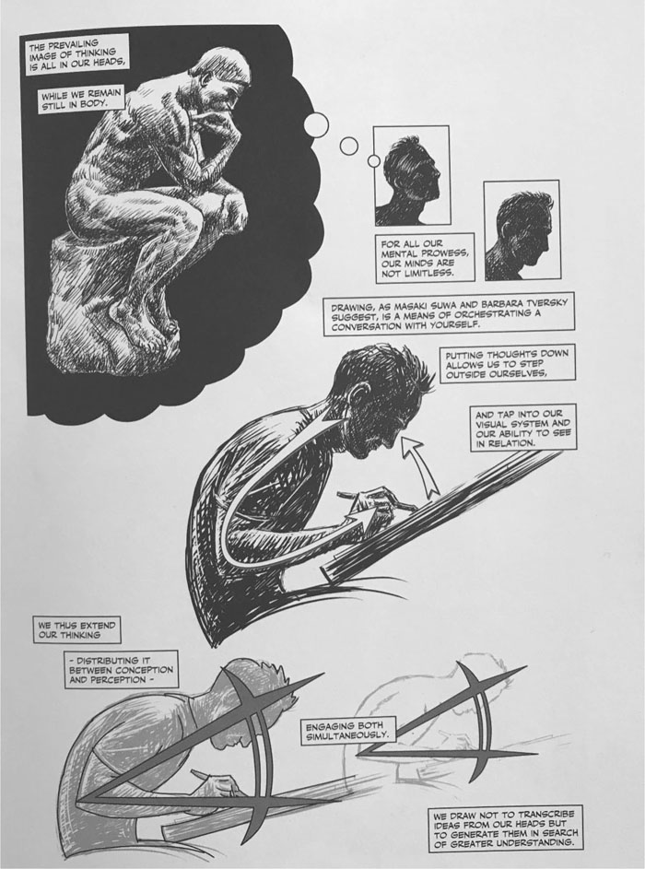
Comics as a way of thinking
“The medium we think in defines what we can see” (Sousanis, 2015, p.52)
“drawing…is a means of orchestrating a conversation with yourself…we draw not to transcribe ideas from our heads but to generate them in search of greater understanding” (Sousanis, 2015, p.79)

Slide 7
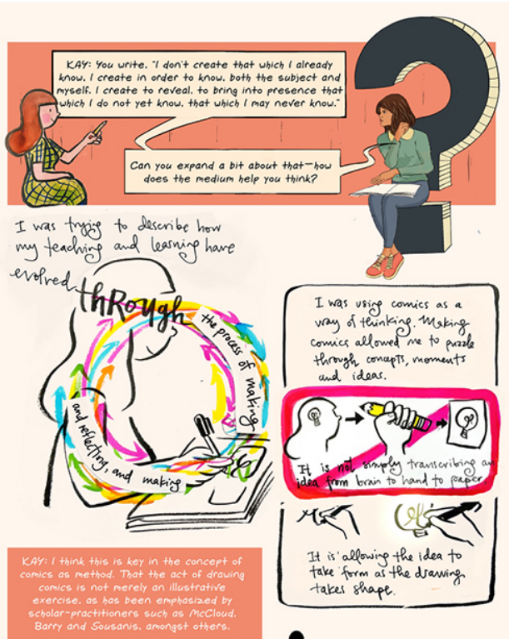
Comics as a way of thinking
“comics as a way of thinking…allowing the idea to form as the drawing takes place” (Sohini, 2022, p.76)
“engaging the embodied process underlying thinking” (Parker, 2021, p.81)

Slide 8
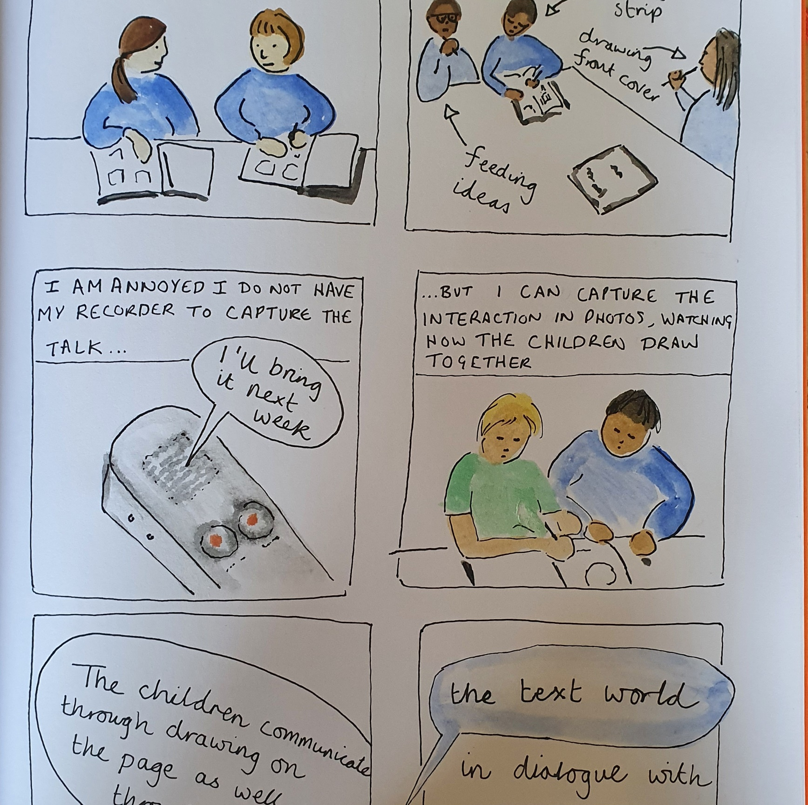
Comics as a way of thinking
Comics ping pong…
Fold a piece of A4 paper into four…
You will draw the first panel and then you will swap with the person next to you…
You will have one minute for each panel – keep it simple!!

Slide 9
Comics as reflection
“You must think slowly, organise your mind and select the most relevant events of your life, those that have left a mark”
- Student on making a reflective comic (McGarr et al., 2021, p.4)
Identify critical incidents and key moments
Bring to light tacit knowledge
Call attention to the everyday through ‘estrangement’
Consider the temporal order
Reflect multiple perspectives
Revaluate beliefs, perspectives and assumed knowledge
(McGarr et al., 2021; Whiting 2019)

Slide 10
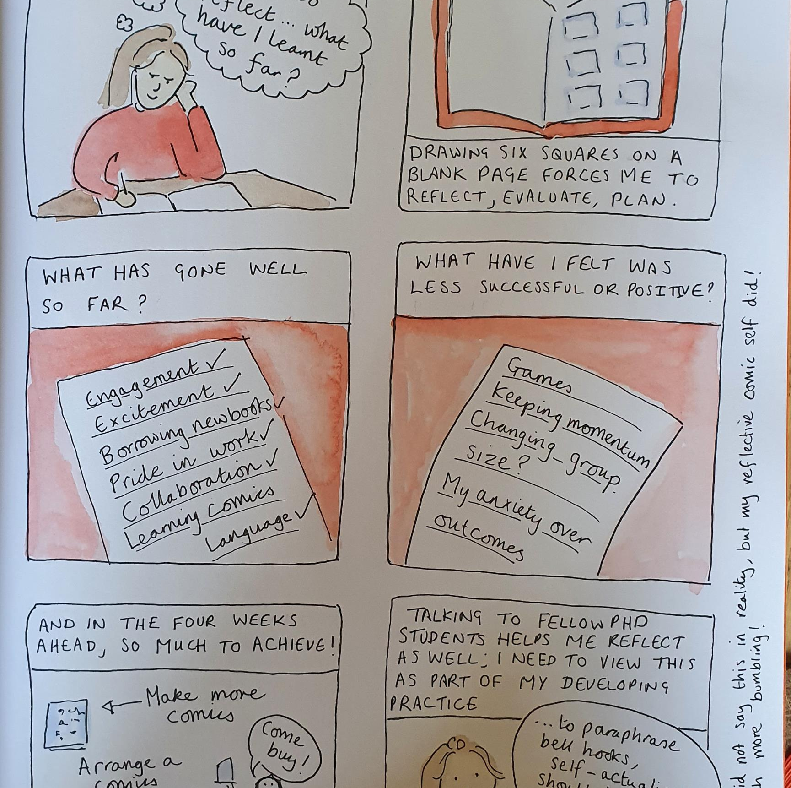
Making your own mini-zine comic
Make a mini-zine
Consider what aspect of your research you want to reflect upon
You might want to draw panels, or use each page as a panel of your comic
Consider how you position yourself in the comic…
…but don’t overthink it – let the pencil or pen do the thinking!

Slide 11
References
Emmert, L. (2007) The Alison Bechdel Interview, The Comics Journal 282, p.34-52
Hall, S. (1992). The question of cultural identity in Hall, S., Held, D., McGrew, T., & Open University. (1992). Modernity and its futures (Understanding modern societies: an introduction ; Book 4). Cambridge: Polity Press in association with The Open University.
Hermans, H., Dimaggio, G. (2007). Self, Identity, and Globalization in Times of Uncertainty: A Dialogical Analysis. Review of General Psychology, 11(1), 31-61.
McCloud, S. (1994). Understanding comics : The invisible art. New York: HarperPerennial by arrangement with Kitchen Sink Press.
McGarr, O. et al. (2021) Using comics as a tool to facilitate critical reflective practice in professional education, SANE journal: Sequential Art Narrative in Education: Vol. 2 : Iss. 6 , Article 1.
Nodelman, P. (2012). Picture Book Guy Looks at comics: Structural Differences in Two Kinds of Visual Narrative. Children's Literature Association Quarterly, 37(4), 436-444.
Refaie, E. E., (2012). Autobiographical comics : Life writing in pictures. University Press of Mississippi.
Sohini, K. (2022) On Teaching Artfully : A Graphic Interview with Meghan Parker, Inks: The Journal of the Comics Studies Society, Volume 6, Issue 1, Spring 2022, pp. 69-84
Whiting, J. (2020) Comics as Reflection: In Opposition to Formulaic Recipes for Reflective Processes. Permanente journal. [Online] 24.

