Slide 1
Explanatory factors for variations in multimorbidity among ethnic groups: findings from the Health Survey for England 2011-2018
Dr Linda Ng Fat, Dr Shaun Scholes, Dr Logan Manikam, Professor Jenny Mindell
Research Department of Epidemiology and Public Health
University College London (UCL)
Society of Social Medicine (SSM) – Exeter, 8th September 2022
j.mindell@ucl.ac.uk @j_mindell
Notes:
10 minutes

Slide 2
Background
Multimorbidity is increasing, given an ageing population
Variations in risk of multimorbidity among ethnic groups exist
Compared with the white population, non-white ethnicities with multimorbidity had almost triple the risk of having COVID-19 (McQueenie et al., 2020)
McQueenie R, Foster HME, Jani BD, et al. Multimorbidity, polypharmacy, and COVID-19 infection within the UK Biobank cohort.
PLOS ONE. 2020;15:e0238091.

Slide 3
Research Gaps
The Black and South Asian populations have higher rates of cardiovascular multimorbidity (Mathur R et al., 2011)
Studies in England have not explored what could be explaining variations including:
Deprivation / lower socio-economic position
Health status & behaviours e.g. smoking, obesity
Mathur R, Hull SA, Badrick E, Robson J. Cardiovascular multimorbidity: the effect of ethnicity on prevalence and risk factor management.
Br J Gen Pract. 2011;61:e262-270.

Slide 4
Research Gaps – ‘ethnic groups’
Ethnic groups such as ‘Asian’ and ‘Black’ often grouped together
Considerable heterogeneity exists within these ethnic groups, e.g.
Indian cf Pakistani / Bangladeshi
Black African cf Black Caribbean groups (Mindell et al., 2014)
Mindell JS, Knott CS, Ng Fat LS, et al. Explanatory factors for health inequalities across different ethnic and gender groups: data from a national survey in England.
J Epidemiol Community Health. 2014;68:1133.

Slide 5
Study Aims
How do levels of multimorbidity vary among distinct ethnic groups in a nationally representative sample?
Can this relationship be explained by differences in socio-economic position or health behaviours, namely smoking and obesity?

Slide 6
Methods
Data: The Health Survey for England 2011-2018
Ethnic groups: White British (reference category), White Irish, Other White, Indian, Pakistani, Bangladeshi, Chinese, African, Caribbean, White Mixed, Other mixed, Other

Slide 7
Multimorbidity
General multimorbidity
Cardiovascular multimorbidity
Multiple biological cardiovascular risk factors

Slide 8
General Multimorbidity (N= 54,447 adults 16+)
Participants who reported Longstanding conditions, were asked to list the conditions that affected them (up to six)
Participants with two or more conditions were defined as having multimorbidity.

Slide 9
Cardiovascular multimorbidity (N=37,148 adults 40+)
Self-reported doctor-diagnosed cardiovascular multimorbidity: 2+ of the following
Direct questions:
Self-reported doctor-diagnosed diabetes
Self-reported doctor-diagnosed hypertension
Derived from follow-up questions on longstanding conditions
Self-reported stroke
Self-reported heart disease

Slide 10
Multiple Cardiovascular Risk Biomarkers (N=24,203 16+)
Biological data from the nurse visit
Two or more of the following:
Raised glycated haemoglobin (hbA1c levels) (≥6.5%);
Raised blood pressure (systolic blood pressure ≥140mmHg &/or diastolic blood pressure ≥90mmHg);
Raised total cholesterol level (≥5mmol/L),
Notes:
Regardless whether on medication or not which suggests not meeting targets – mismanagement or undiagnosed.

Slide 11
Method
Multivariable logistic regression – ethnic group risk of having multimorbidity (vs. no multimorbidity)
Complex survey design and non-response weighting (interview or blood weight) applied
Model Building
Model 1: Sex + Age
Model 2: Model 1 + Area Deprivation
Model 3: Model 1 + Educational qualifications
Model 4: Model 1 + Smoking status
Model 5: Model 1 + BMI
Model 6: Fully-adjusted: All covariates + survey year

Slide 12
Results - Descriptives – Multimorbidity
20% of adults aged 16+ had general multimorbidity
General multimorbidity was higher by:
survey year,
lower education,
higher area deprivation,
larger BMI and
current / former smokers; and
varied by ethnicity (p<0.001)
7% of adults aged 40+ had cardiovascular multimorbidity
7% of adults aged 16+ had multiple cardiovascular risk biomarkers

Slide 13
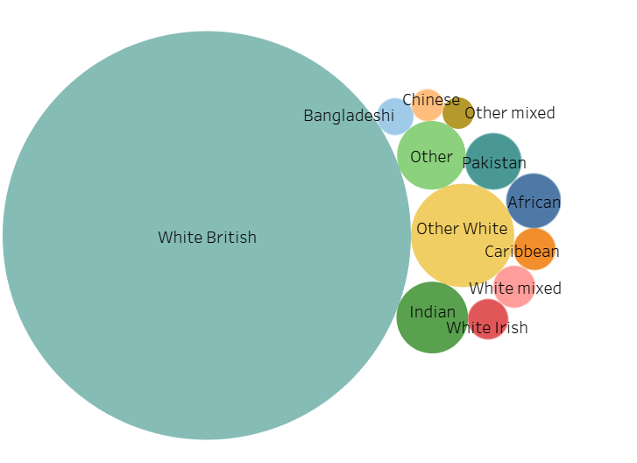
Ethnic groups
N=268
N=44,928
N=44,928
N=54,447

Slide 14
D – Diabetes,
H - Hypertension
S - Stroke
HA - Heart Attack

Slide 15
BP: Raised BP:
SBP ≥140mmHg &/or DBP ≥90mmHg
C: Raised total cholesterol level (≥5mmol/L)
HG: Hyperglycaemia: Raised HbA_{1c} levels ≥6.5%

Slide 16
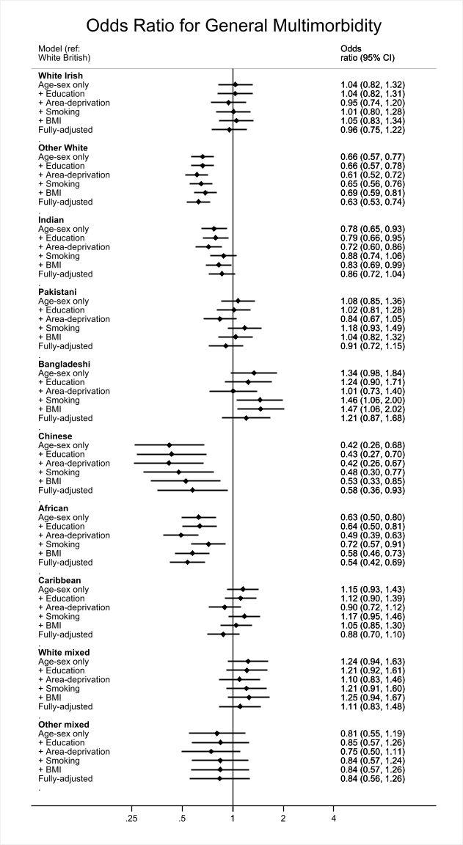

Slide 17
General MM - results
Lower odds:
Indian (less difference; NS adjusted smoking or full model)
Lower OR among <40yr Indian & Pakistani
Aged 40+, OR sl higher than all ages for Other white, I, P, B
Higher odds:
Bangladeshi (Signif if adjusted smoking, BMI)
Lower odds:
Other white, Chinese, African – no diff by age

Slide 18
Odds ratio for general multimorbidity continued…

Slide 19
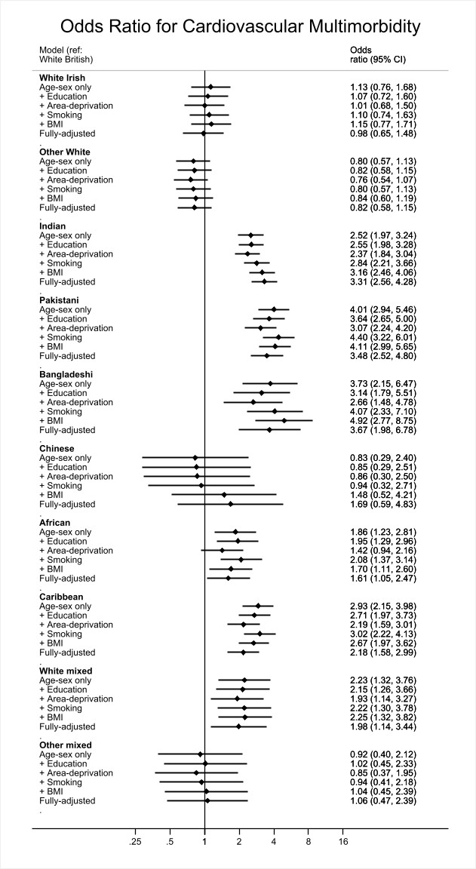

Slide 20
Odds ratio for cardiovascular multimorbidity continued…

Slide 21
CV MM - results
Higher odds:
Indian, Pakistani, Bangladeshi
Caribbean, White mixed, [African]
Minimal fx of adjustment

Slide 22
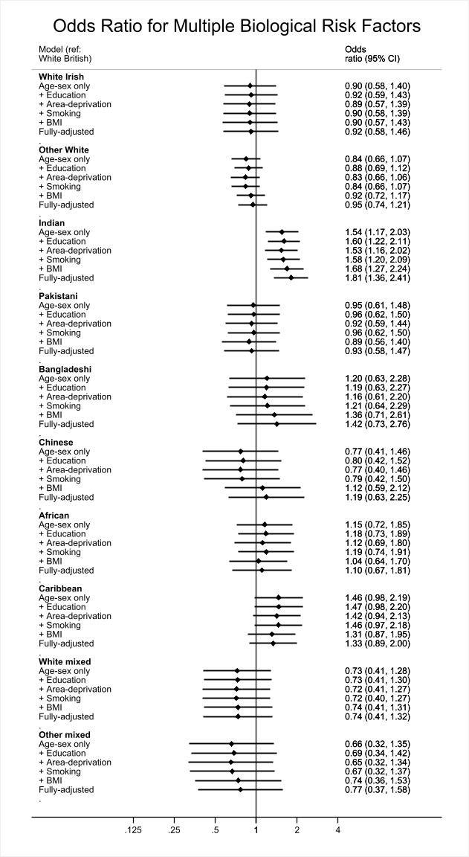

Slide 23
Odds ratio for multiple biological cvd risk factors continued…

Slide 24
Multiple biological risk factors - Results
Higher odds:
Indian
Sample sizes much smaller, so wide CIs

Slide 25
Limitations
Cross-sectional
Small sample size of some ethnic groups
Inability to look at other factors

Slide 26
Summary & Conclusion
Risk of multimorbidity varies among distinct ethnic groups independent of social factors, smoking and obesity.
Variations in differences in general multimorbidity by ethnic group exist by age
Ethnic minority groups are particularly at risk of cardiovascular multimorbidity.
Non-diagnosis or poorer management of cardiometabolic biological risk factors may play a role, particularly for Indian adults
Notes:
Ethnic inequalities in multimorbidity varies between older and younger adults, distinct ethnic groups, and is independent of social–economic status and some health behaviours. Ethnic minority groups are particularly at risk of cardiovascular multimorbidity, which may be exacerbated by underdiagnosis and/or poorer management of cardiometabolic risk factors.

Slide 27
Acknowledgements
HSE participants, interviewers and field staff
NatCen Colleagues
NHS digital for supporting the HSE
L.ngfat@ucl.ac.uk
Thanks for listening!

Slide 28
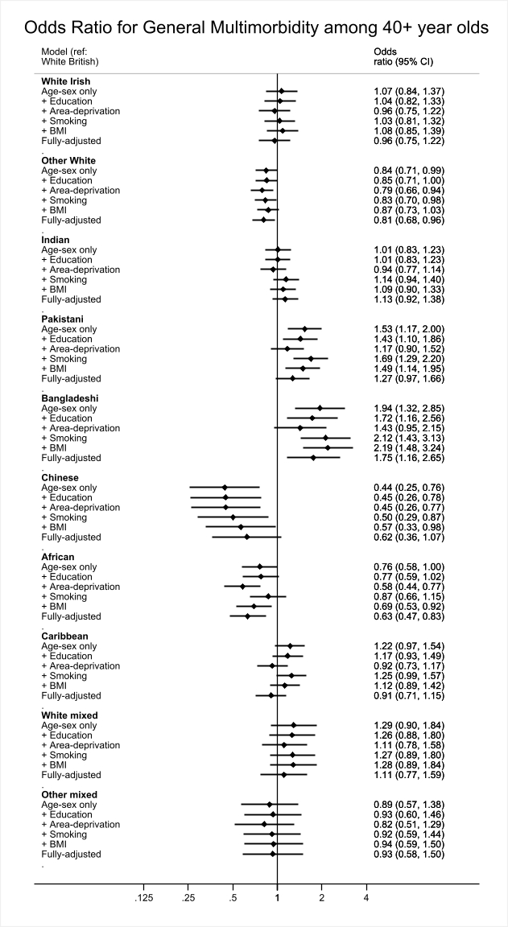

Slide 29
