Slide 1
What does sustainability education look like at UCL East?
Anne Preston, Elena Dimova and Rehan Shah

Slide 2
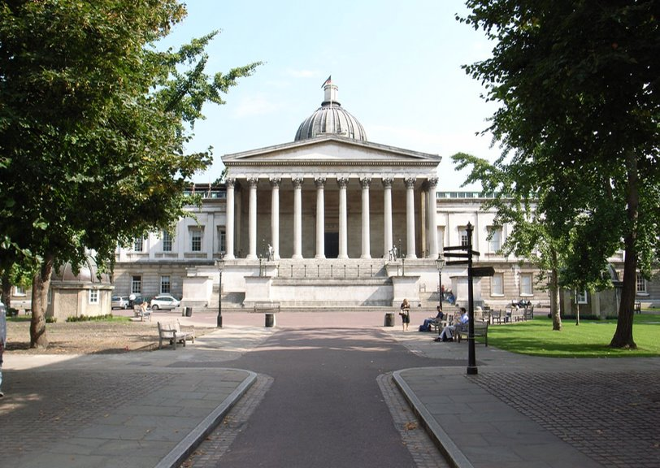
Sustainability and Universities
Current activities: ​
sustainability in all relevant academic disciplines​
research on sustainable development issues,​
‘greening’ campus operations​
Co-curricula activities​
infusing environmental education
Higher education plays a key role as a means​ to achieving Sustainable Development Goal 4 on education: inclusive, equitable and quality​ education for all.

Slide 3
Sustainability and UCL East
universities must focus on fully developing all three educational missions – teaching and learning, scientific research, and community service.​
investing public money in research and development and building up new coordinating partnerships​

Slide 4
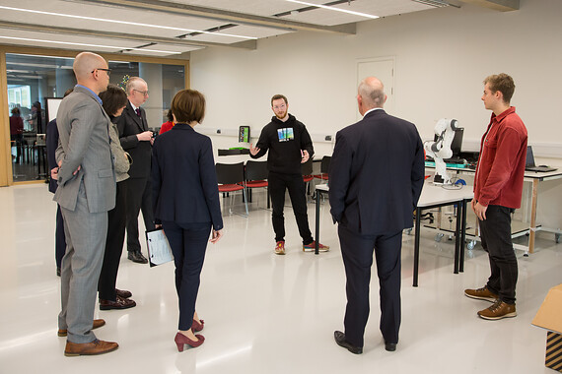
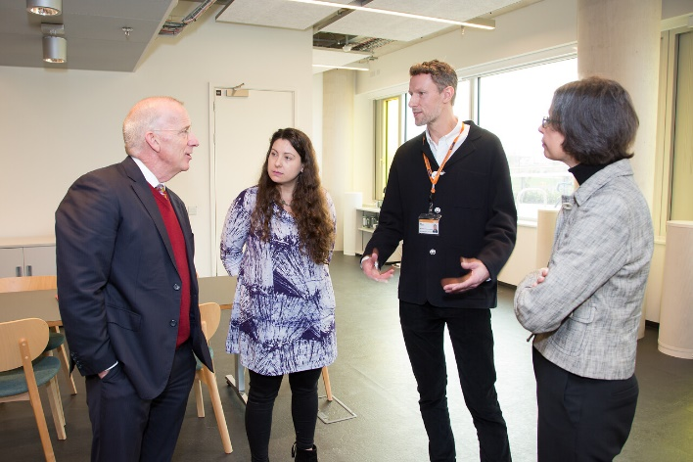
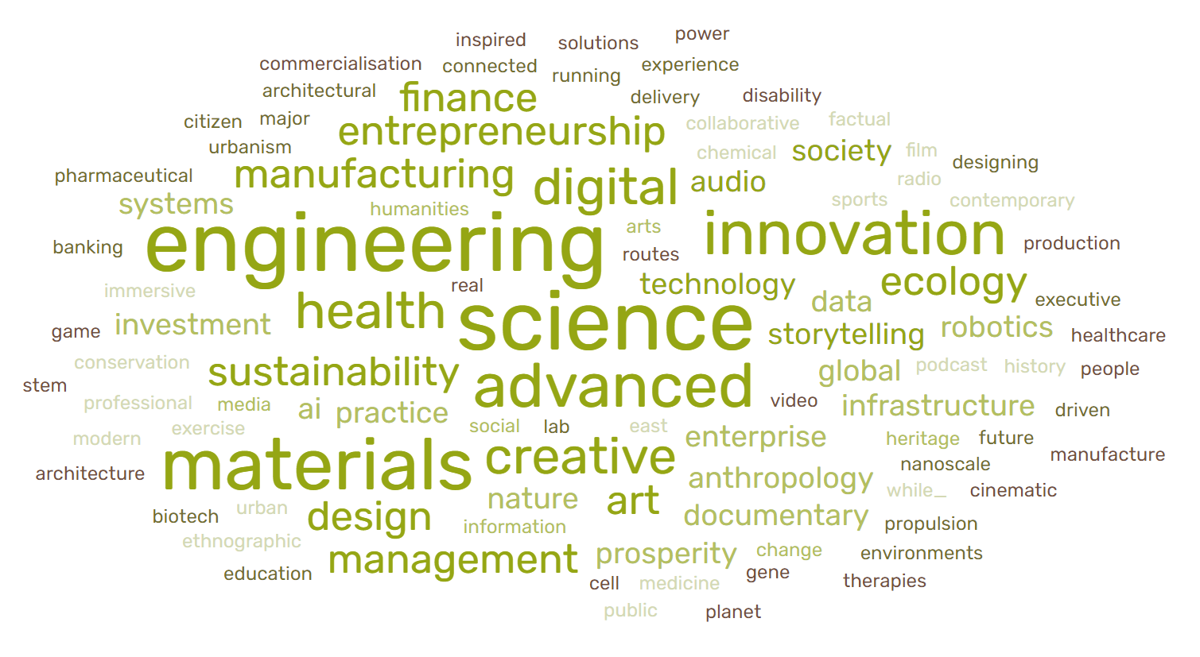
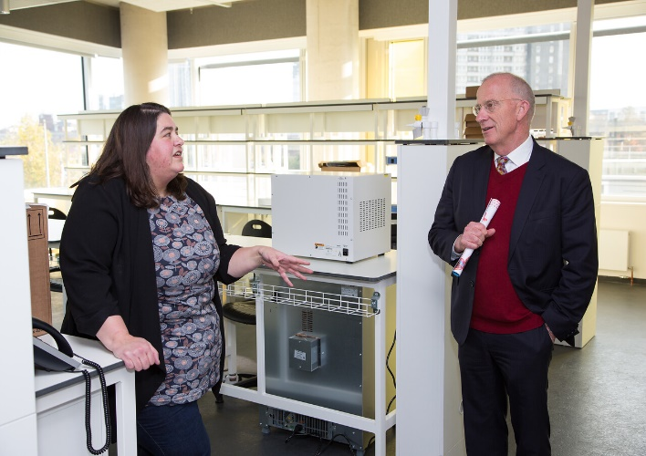

Slide 5
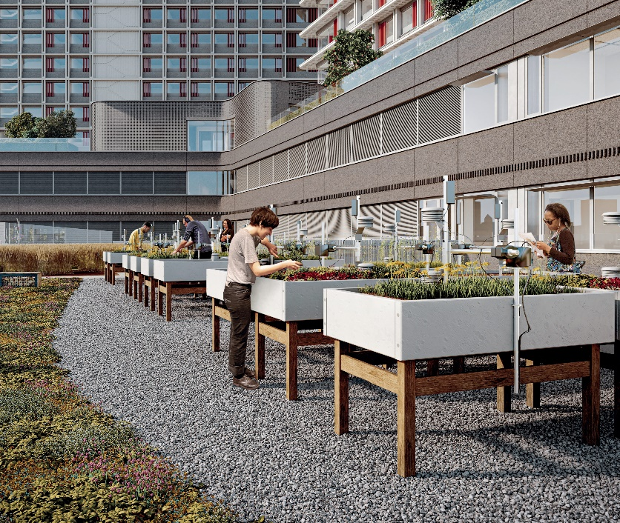
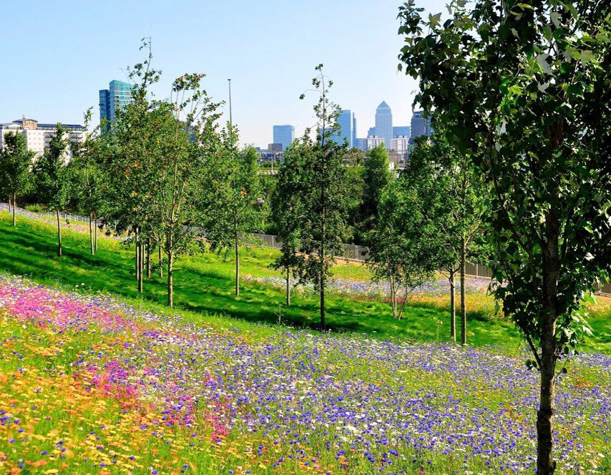
A Sustainable Living Lab Campus in the Park
UCL East: Living Landscape Strategy
Our campus will be created and managed as a ‘Living Landscape’ – we will create a biodiverse landscape in line with the Biodiversity Action Plan and the Park Management Plan
Addresses sustainability and nature conservation goals, brings health and wellbeing benefits to both people and wildlife and maximises opportunities for teaching, research and outreach
A sensored
biodiversity
terrace for research and education
Marshgate site
Fantasticology
Meadow

Slide 6
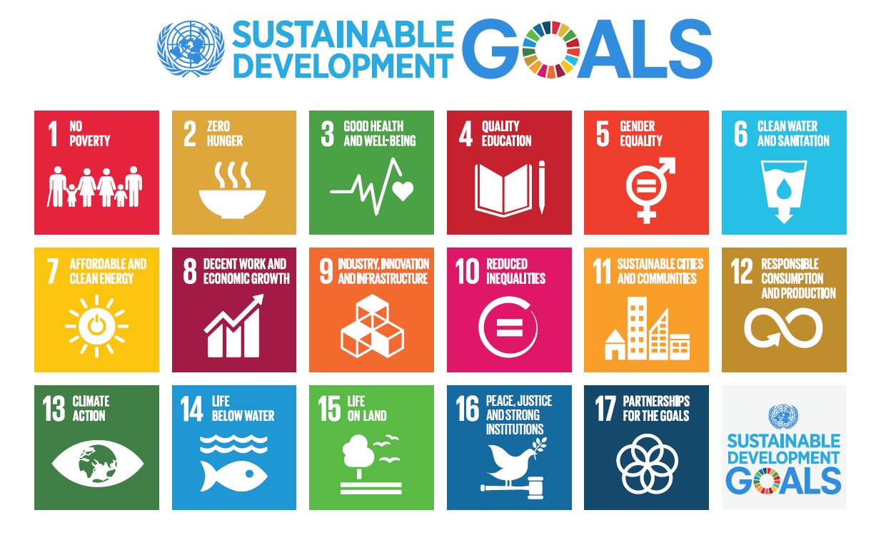
What are the Sustainable Development Goals?
The sustainable development goals are a ‘to do list for the planet that will transform the world’. Ban Ki-Moon, Secretary-General of the United Nations
Notes:
max 2 mins (explain briefly what SDGs are (most people know nowadays)

Slide 7
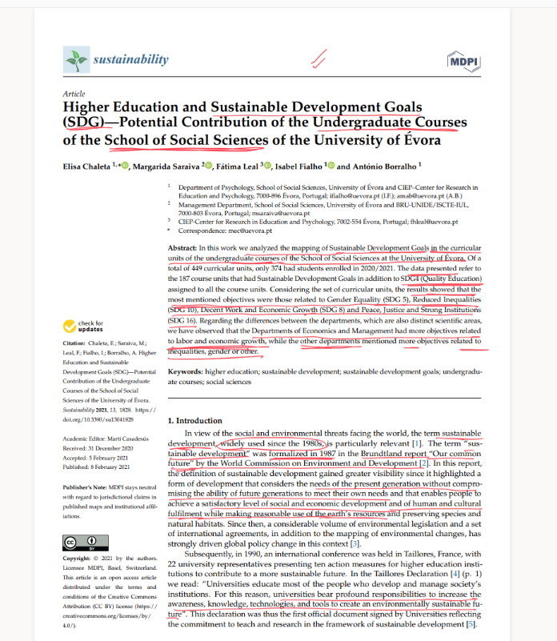
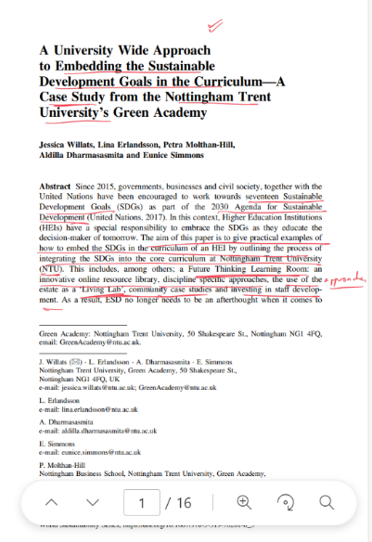
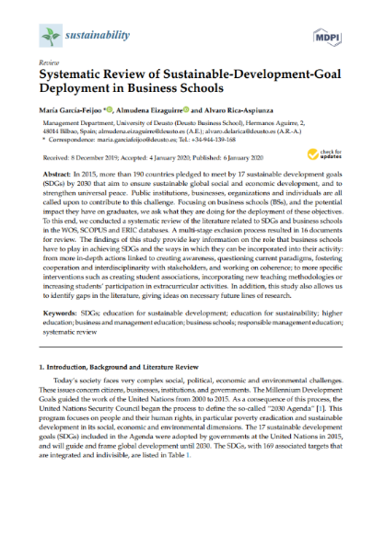
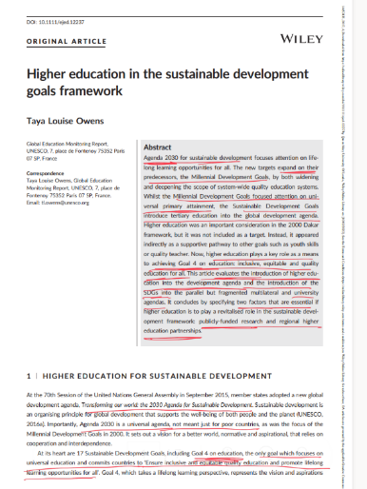
Trends in Higher Education to measure education for sustainable development using the SDGs
Notes:
what the research papers do in general - the ones you read and found in our folder - general higher education)

