Slide 1
IOE Impact Meetup – March 24 2023
Reflections on creating impact
Lorraine Dearden
UCL

Slide 2
My Background
I have been at IOE since September 2005
I am an applied Economist/Social Statistician who uses large-scale data to evaluate and design public polices and interventions to hopefully improve the life of the most vulnerable
My whole research agenda is driven by a motivation to improve public policy making and to improve the lives of the most vulnerable in society
My academic expertise is in using data and statistical techniques to demonstrate reforms that can achieve better outcomes for individuals and society

Slide 3
My approach to research questions
I always approach a problem with an open mind and some of my best research ideas have come from being told by practitioners or other researchers “that we all know that this policy is bad/good for children”
I always ask – what is the evidence for this?
Sometimes there is strong evidence behind the statement but often it is simply one person’s “feeling” and I think – could I use quantitative methods/data to look at this question?
Example: Evaluation of wrap-around care pilot for DfE started my research agenda on the impact of month of birth on children’s outcomes

Slide 4
However things don’t always go to plan….
Despite me and my collaborators on the project having many meetings with key policy holders (including Minister Michael Gove) the policy response of the government to our findings was the opposite of what we recommended
Likely made the problem worse – we said age standardize tests in primary school
The gave parents freedom to choose when their summer born children started school – makes the problem worse

Slide 5
My work on HE funding
I started working on this issue during my PhD in the early 1990s
Over a period of 20 years developed huge expertise in how to simulate the impact of HE funding reforms for students, taxpayers and graduates across the earnings distribution
Showed then department of BIS how it was getting it estimates wrong by not properly modelling transitions in the labour market for HE graduates (paper in Economic Journal in 2008)
BIS changed its model as a result of this interaction and us showing how they were getting projections wrong
Developed a working relationship whereby BIS would approach me to independently model implications of different HE Funding Models to check their modelling
Part of my impact case study for 2014 REF involved letter form David Willets saying how important my work was
Though I thought there was still huge problems with 2012 reforms I think I successfully stopped them doing some really crazy policy changes but hard to prove this

Slide 6
International Work
My work on international HE funding started in 2015 when I got funding to work with Bruce Chapman at ANU as part of the IOE’s Centre for Global Higher Education
In 2016 we were both invited by Susan Dynarski to the US in the run-up to the 2016 Presidential election to talk to politicians (both Democrats and Republicans) including a visit to the White House
Also a public conference for key stakeholders in Washington
Realised that policy-makers were making the same modelling mistakes that BIS had been making and this was leading to bad loan design not only in US but rest of the world

Slide 7
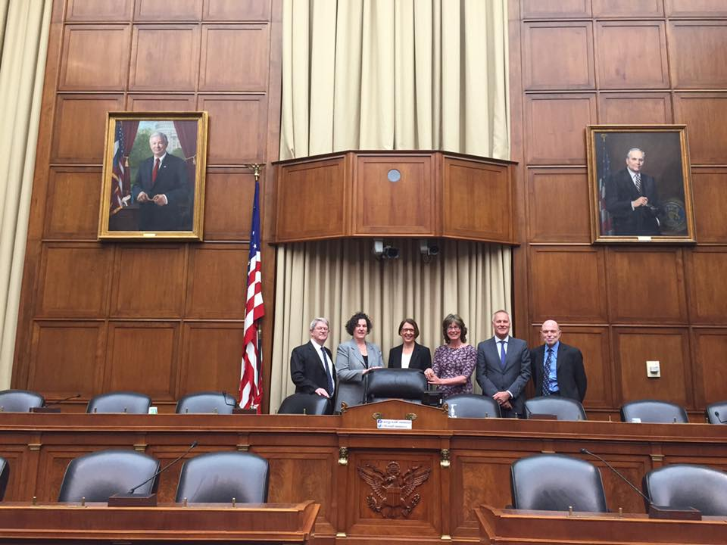

Slide 8
US Collaboration
As a result of that I collaborated with Bruce, Susan and Nick Barr (from LSE) and we wrote an academic paper about how you could reform the US loan system (published in 2019 in the Economics of Education Review)
Showed way of correctly modelling distribution of lifetime earnings of graduates (separate paper by me in the same issue of Economics of Education Review)
Showed how you could design an Income Contingent Loan that avoided the huge problems with the current US student loan system and that in the long-run was cheaper for the taxpayer and meant that no student could default on their student loan or face financial hardship from their student loan
But 2016 election result stopped the momentum we had going so our short-run impact was minimal
BUT in 2023 income-based repayments are now back on the table and we used our earlier work to submit a comment on a consultation of the proposed reforms in February this year AND 4 days ago

Slide 9
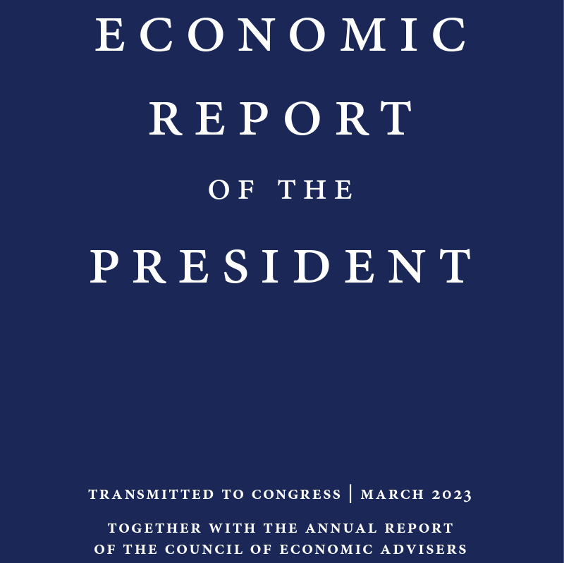

Slide 10
Our research cited (alongside Gill Wyness of IOE UCL)

Slide 11
More countries followed…
This work was the springboard to work in a number of other countries including Japan, Chile, Malaysia, Brazil and, most importantly, Colombia where an ICL has just been introduced
Conference in Shanghai in October 2016 followed the 2016 Washington event where a lot of our collaborations began

Slide 12
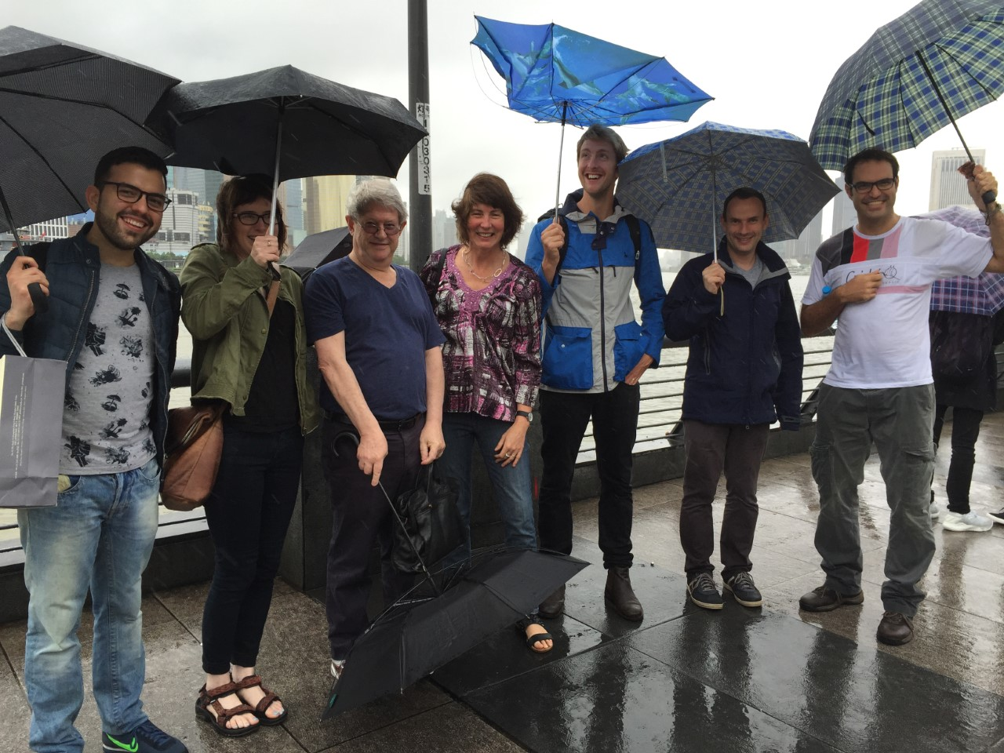
More countries followed…

Slide 13
Conference in Brazil in 2019
After Shanghai I worked with local analysts in Japan, Malaysia and Brazil who were interested in reforming their student loans
My collaborator in Brazil was Paulo Nascimento who I first met as a student at IOE when he took my Program Evaluation course
Paulo invited international experts on student loans to discuss ways of helping reform higher education financing in Latin America and this included individuals running student loan systems in Latin American Countries including:
Manuel Acevedo, President of ICETEX, the Colombian Student Loan Company

Slide 14
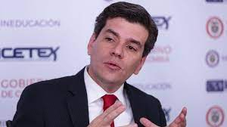
Paulo and Manuel

Slide 15
Why did our collaboration work?
Leader of the student loan company actively asked us to work with his colleagues to come up with possible ways of reforming their student loan system
I worked with a fantastic colleague, Bruce Chapman who designed the first ICL in Australia and our skills complemented each other
Bruce had the more big picture policy experience and knew what information and institutional factors were needed for an ICL design to work in a country
Bruce can spot in 5 minutes whether the desire for reform is real (e.g. we went to Malaysia and there was no interest in reform at the top of the student loan company because of vested interests – they had invited us to stifle reform)
What I had done in the UK with colleagues over 15 years, which I bought to our joint work, was to use relatively cutting edge statistical methods that could use country specific data to show how different loan designs work and why their current loan systems were not working

Slide 16
What we bought to the table
We bought to the table huge experience in student loan design and we were willing to share our expertise
Our strategy was always to use local data to show this in order to convince local policy makers to avoid the usual first response “it might work in the UK and Australia but it will never work in [Colombia/Japan/Brazil…..]”
We ALWAYS involved local analysts either in government and/or academia so that we could develop country-specific models. This meant that domestic experts took ownership of the analysis drawing on our methods and extensive international experience

Slide 17
International reform
Not obvious, but with good country data you can show this and sometimes get progressive, equitable and affordable change using ICLs (e.g. Colombia)
And sometimes you can’t (e.g. Chile, Malaysia, …) – the politics wins out over the data/modelling (e.g. Chile) or keeping the status quo (bad mortgage style loans) because of vested interests (e.g. Malaysia)

Slide 18
Colombian reform
Bruce first visited Colombia in 2010 and has visited the country on numerous occasions
Conference in Brazil in 2019 started the latest collaboration and a visit in November 2019 saw us get access to fantastic Colombian data
Helped local analysts build a HE model showing the implications of different loan designs
Had monthly earnings data for all loan holders since early 2000s as well as linked education data and their history of loan (non) repayment
Showed that students, their families and taxpayers would all be better off with a well designed ICL and showed convincingly why the current loan system was not working
High default rates (>50%) and high taxpayer subsidies
With great data you could show why the current system is failing

Slide 19
The killer pictures for Colombia
Using local data and modelling we produced some amazing simulations and illustrations of why the current system was going wrong and how much better a reformed system would be
Still quite a bit of skepticism before we produced evidence using local data
It might not be local data, but local qualitative and/or quantitative research as often the biggest task with international work is convincing locals that something that works elsewhere which is not well known might also work in their country

Slide 20
Monthly Repayment Burdens – 2019 active loan holders ICETEX
Notes:
Note: Undergraduate ICETEX loan holders in the active portfolio, in the repayment period. The cut-off date is January 2020. For the calculations, the median of the income range is used.
In 2019, on average, 62.95% of ICETEX loan holders made a monthly payment, but only 22.29% made all the payments during a year.
In terms of money, 50% paid the total amount they had to during 2019.
The figure shows the repayment burden, per month, for those who made the payment and the hypothetical repayment burden that the non-payers would have had had they done so.
On average, for those who made the payment, 50% percent of the loan holders have a repayment burden below 20%, but 32% have RB above 90%. This percentage increases in January and December and reaches 43%.
For non-payers, if they had made it, they would have had higher RB. On average, 40% of the loan holders would have a RB above 90%.

Slide 21
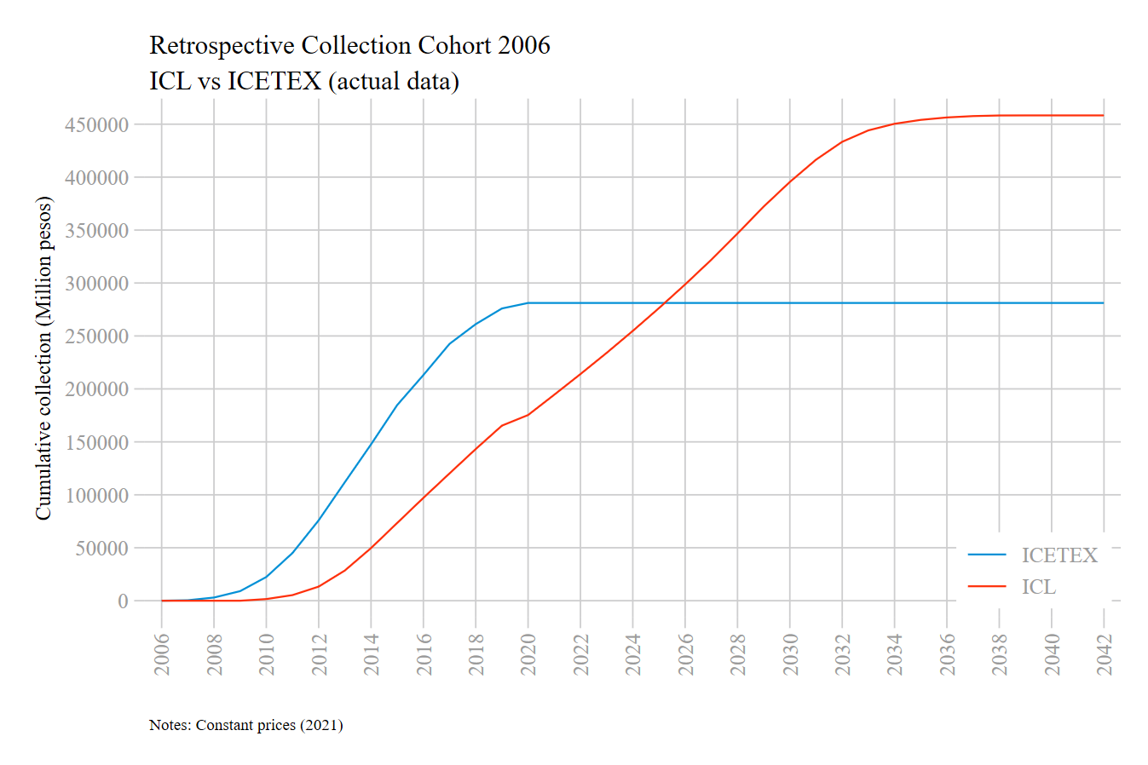
We could show with data (and some simulations) how an ICL would have operated for earlier cohorts….
Comparing ICL loans with ICETEX (discounted and in 2021 prices): 2006 Cohort

Slide 22
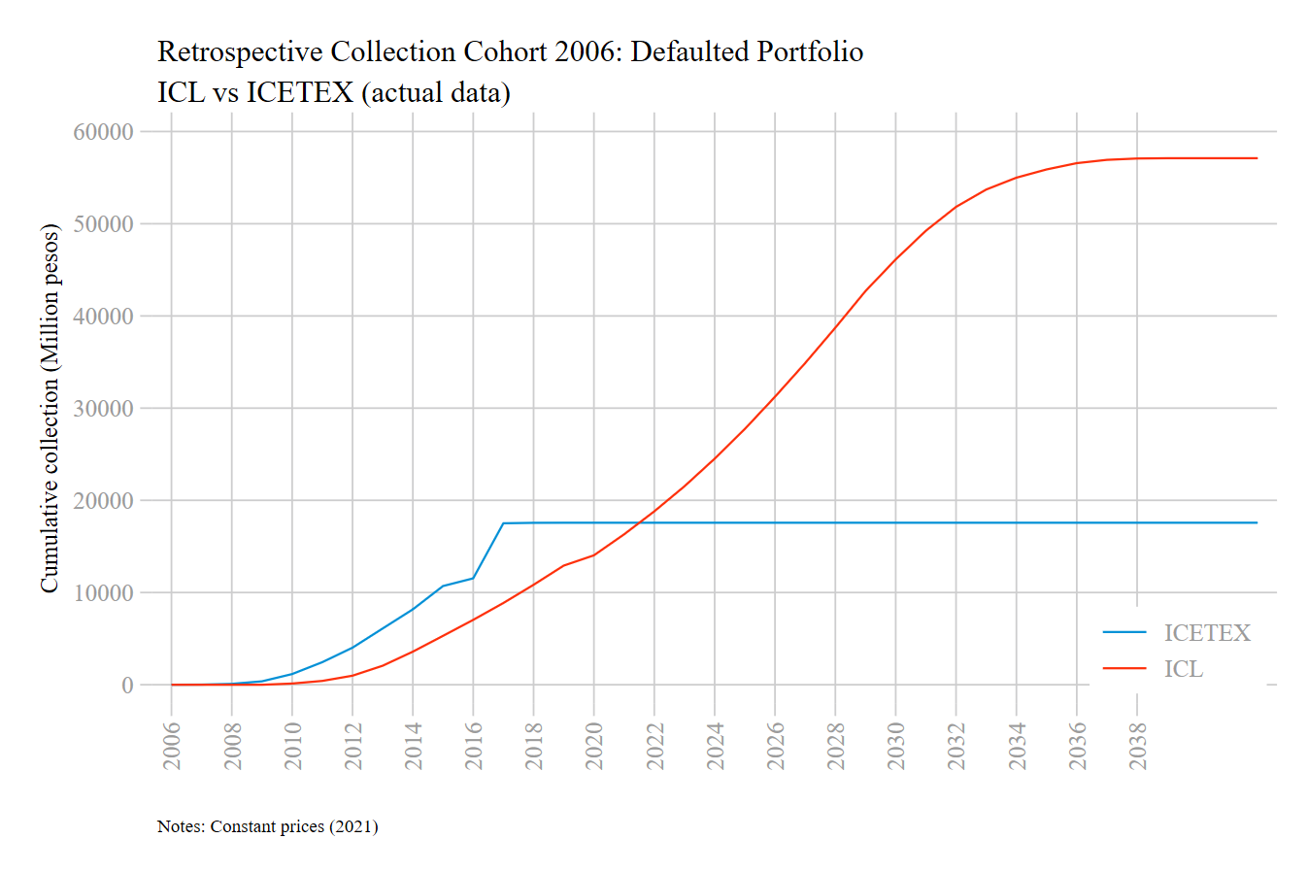
Could show how it would have operated for those who defaulted in the 2006 cohort

Slide 23
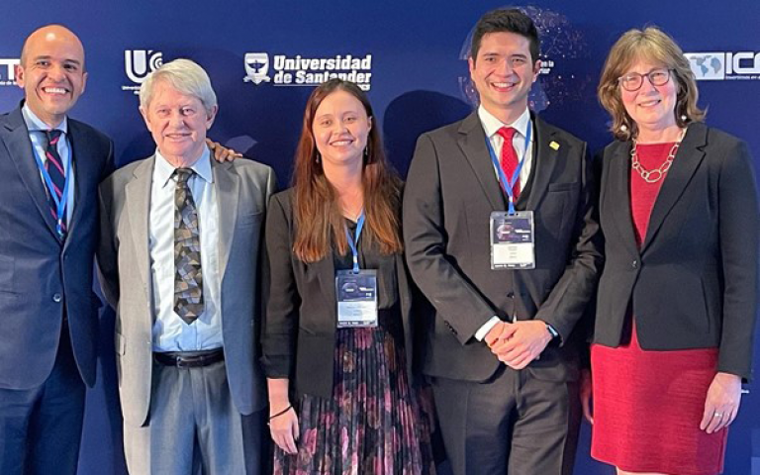
ICL introduced in Colombia
As a result of our collaborative work with Colombia an ICL was introduced in Colombia in April 2022 and is now available for new students from January 2023 (though not yet for all students)

Slide 24
Lessons for getting impact
You never know when your research may have impact so keep plugging away
Make sure you publish your impactful research – often temptation with policy relevant research to write a report for the funder or a accessible policy briefing but also important to produce peer reviewed publications
You make policy-makers lives easier if they can cite a peer reviewed journal article
Just look at the Economic Report of the President
We have been invited to the US in May this year to discuss potential reforms

Slide 25
Lessons
To have impact give stakeholders/locals ownership of the policy reforms – doesn’t always go right but it won’t work if you tell somebody what they should do
Your role is to share expertise but if you want reform, policy-makers have to be in charge of the reform
In Colombia we helped the local analysts build a model to look at the implications of different loan designs but they designed the final system without our input
They knew the players, the politics, the laws and regulations and had all the tools needed to get the design right
We simply gave them these tools drawing on our 50 year plus experience in the area and our peer reviewed academic research

Slide 26
Lessons
Impact takes many forms – make sure you document this when it happens
One of the things I am proudest of is that German Pulido who was involved in this research received a UCL scholarship to undertake the MSc in Data Science and Public Policy this year (2022/23) and has just been awarded a UCL RES to undertake a PhD at UCL starting this September
His colleague and fellow collaborator, Juliana Aragon, is applying to UCL to follow the same path this year

Slide 27
Lessons
Even though you be having significant impact it is quite often hard to prove
Remember to document this as it occurs – much more difficult going back after the event (as I did with David Willetts) when REF submission is being written

Slide 28
Thank you
Happy to answer any questions

