Slide 1
The ONS Longitudinal Study
Presented as part of: Introducing longitudinal population studies: The ONS Longitudinal Study and the Longitudinal Study of Young People in England 2
A CLOSER webinar; Nov 10th 2022
Jim Newman¹, Oliver Duke-Williams²
(thanks Rebecca Jathoonia^{1,} Nicola Shelton²)
  Office for National Statistics
  UCL
Contacts for more info:
celsius@ucl.ac.uk
twitter @celsiusnews
o.duke-williams@ucl.ac.uk
@oliver_dw

Slide 2
Contents
Examples of LS research
How to access the data
The 2021 beta test programme

Slide 3
Examples of LS research

Slide 4

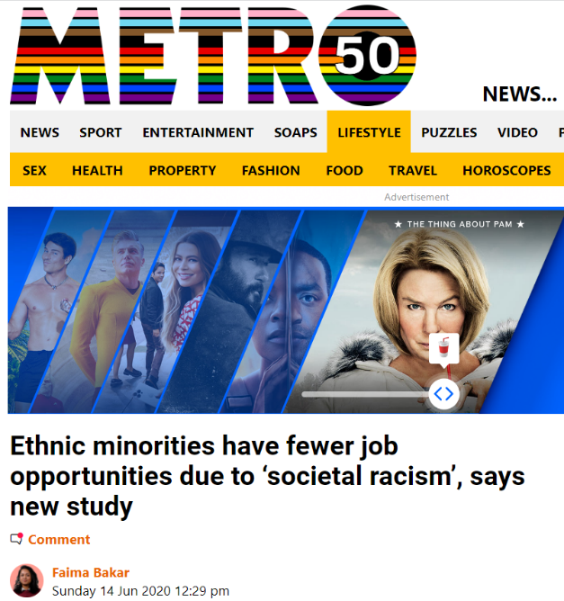
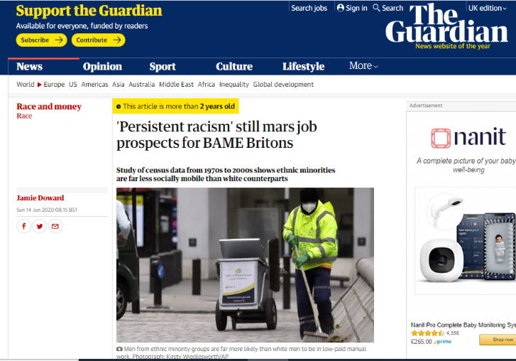
Being a Muslim in Europe: attitudes and experiences Karlsen et al

Slide 5
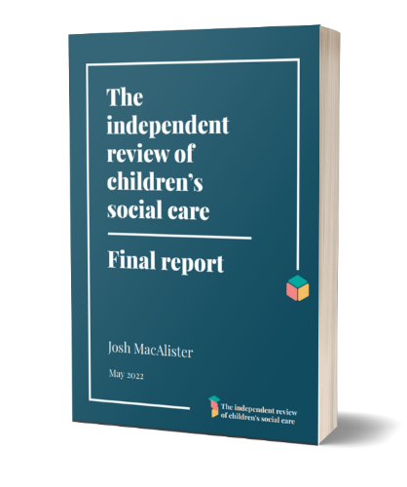
Evidence quoted in the independent review of children's social care, Sacker et al
adults who spent time in care between 1971-2001 were 70% more likely to die prematurely than those who did not, and also more likely to experience an unnatural death (self-harm, accidents, and mental and behavioural causes)
lower rates of long term illness and higher rates of employment for adults with a history of kinship care compared to those that grew up in foster or residential care
care leavers who were in residential care have the highest prevalence of limiting long term illnesses (around 32% on average), followed by adults who lived in foster care (around 16% on average) and adults who lived in kinship care (12% on average) compared with individuals who have not been in care (7%)

Slide 6

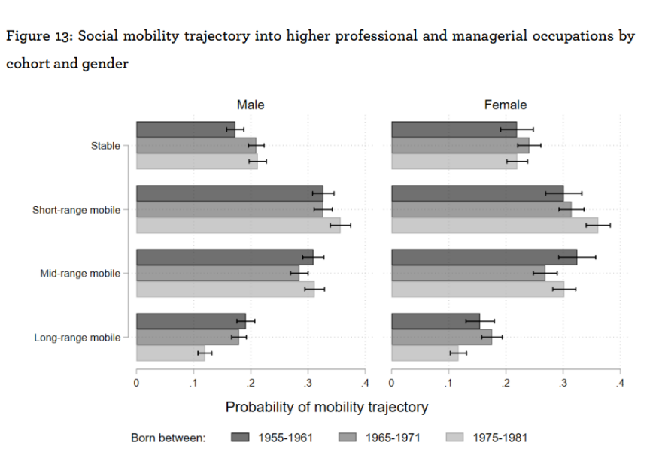
Declining social mobility
Hecht et al for the Sutton Trust

Slide 7
How to access the data

Slide 8
Who can access LS data?
Available for free to all researchers BUT
Research must be in public interest
Protection of confidentiality of data relating to individuals in LS is crucial
Researchers must apply for access
Notes:
Researchers are free to use ONS Longitudinal Study data; they just have to show that their work is in the public interest. But, because maintaining the confidentiality of the data relating to individuals in the LS is crucial, researchers must apply to use it.

Slide 9

Apply!
Apply for Accredited Researcher Status
Complete Safe Researcher Training
Apply for accreditation of your LS project:
research project accreditation form
LS supplementary form
ethics self-assessment form
ONS collates approvals
ONS &LS Research Board checks your form
Final decision made by Research Accreditation Panel
OR UK Statistics Authority
Project is approved & CeLSIUS extract your data
Notes:
If, having looked at the information on the CeLSIUS webpages and talked to us, it looks like LS is the most suitable data for your project you need to jump through a number of hoops to access the data. But CelSIUS is here to help you. The first thing we need to know is…are you an Accredited Researcher? Only researchers with this status can use LS data. So if you’re not already an Accredited Researcher, you need to create a Research Accreditation Service account to apply for Accredited Researcher status and then complete a half day Safe Researcher Training course on statistical disclosure control. Once you’ve applied for Accredited Researcher status, you’ll also need to apply for accreditation of your LS project by completing 3 forms, namely, the research project accreditation form, the LS supplementary form and the ethics self-assessment form. . We’ll provide guidance whilst your write these and submit them online on your behalf to the Research Accreditation Service. You can complete your Accredited Researcher training whilst awaiting a decision on your LS project but won’t be able to access the data until your training is complete. Various teams in ONS and the LS Research Board will check your application and will let us know if they need further information from you. Once approvals have been collated by ONS, your project application will be given to either the UK Statistics Authority or the Research Accreditation Panel for a final decision. ONS will then contact you to let you know that your project has (hopefully) been approved and set up a project area for you within the Secure Research Service and CeLSIUS will extract the data you need for your project.

Slide 10
Where can I access LS data?
Institution with Assured Organisational Connectivity agreement
SRS in office
Institution owned computer at home (sign extended Security Operations Procedures document & get ONS approval)
SRS safe settings
Hampshire (Titchfield)
Wales (Newport)
Remote access
Send code to CeLSIUS
We send output
University-based safe pods
2022 onwards
Notes:
The LS is kept and looked after by the Office for National Statistics (ONS). It can only be accessed from secure locations. Once your project has been approved and your project data has been set up, you can access your data in one of several ways. Pre-covid restrictions, people could access their data at one of the Secure Research Service safe settings in London (Pimlico), Hampshire (Titchfield) or Wales (Newport), in special rooms where access to data is strictly controlled. Due to Covid restrictions and the temporary closure of these rooms, there are now more in-person ways to access the data and these are set to stay post-covid restrictions. If your institution has an Assured Organisational Connectivity agreement with ONS (many institutions already have one and we can tell you if yours does) you can access the data via the Secure Research Service from your institution office or, subject to signing an extended Security Operations Procedures document and ONS approval, you can access it via your institution-owned computer in the UK. Additionally, ONS has plans for 2022 to allow secure access to its data through a network of around 25 Safe Pods, based mainly at universities. Pre-covid, a substantial proportion of researchers using the LS accessed their data remotely by sending code, such as Stata scripts, to CeLSIUS user support officers, who then ran it for them to produce the required output. Remote access is especially useful for researchers who are based outside the UK and therefore cannot readily access their data in-person. Recently, we have seen more people access their data remotely due to covid-related travel restrictions.

Slide 11
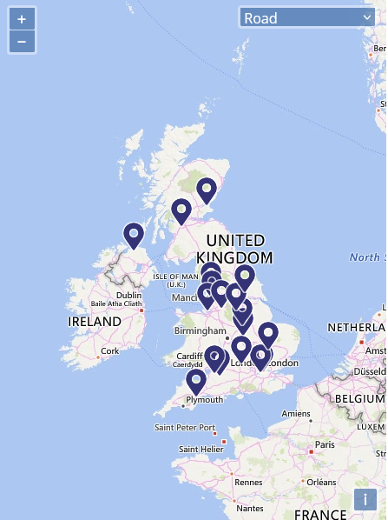
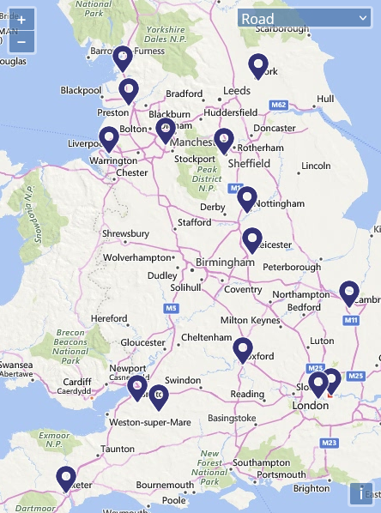
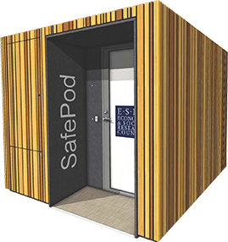
Safepods
Source: https://safepodnetwork.ac.uk/

Slide 12
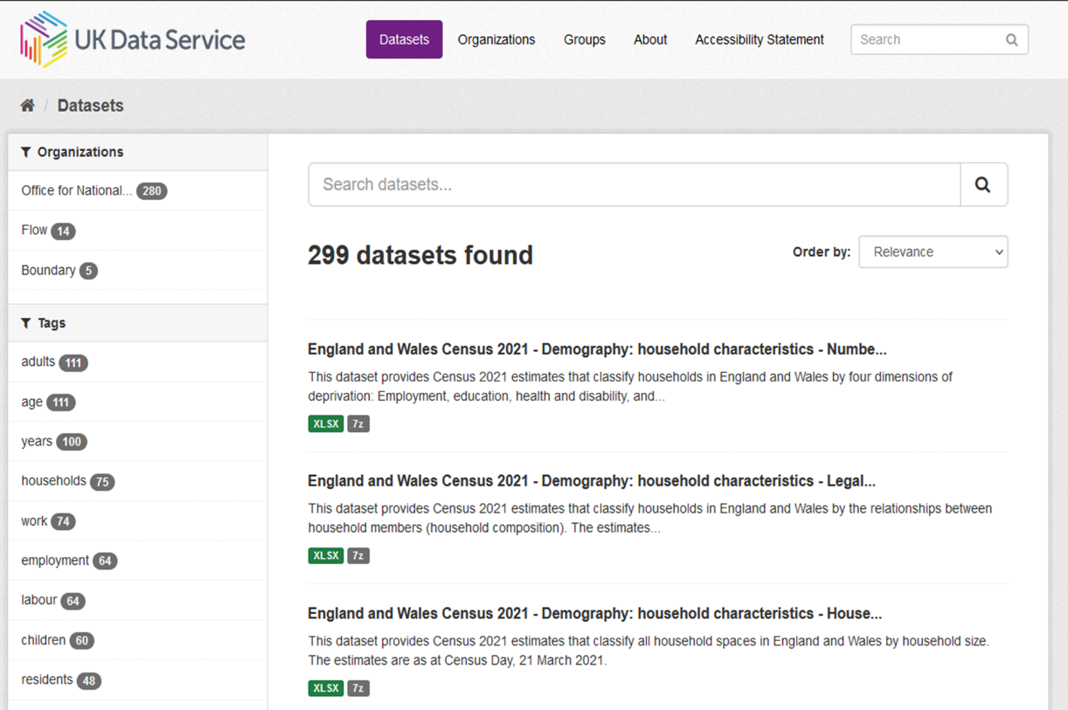
Ad break
2021 Census data
(plus 1971, 1981, 1991, 2001, 2011)
Now available via
https://statistics.ukdataservice.ac.uk/dataset/

Slide 13
Beta test

Slide 14
Beta testing the 2021 data
A beta test will
Test the data for accuracy etc.
Inform the decision whether to release the data

Slide 15
About the beta test programme
Up to ten test projects
  Early access to data
  Involvement with public launch
  Able to publish when data are released more widely
Timeline
  Applications: to end Jan 2023
  Data available to successful projects: mid 2023 (?)
  End of testing period: late 2023 (?)
  Full release: late 2023 / early 2024 (?)

Slide 16
Beta test selection criteria
  All projects must
  Include a longitudinal element
  Include at least one experienced LS user
  Quantify the effect of item imputation
  Produce outputs for England and Wales separately as well as combined
  Obtain the accreditation required by the Secure Research Service

Slide 17
Selection criteria ctd.
The set of projects will cover certain areas
  New questions in 2021 – sexual orientation, gender identity and armed forces veterans
  Migration and mobility – address one year ago, second address, workplace address (COVID-19 relevance?)
  International migration – address one year ago, month and year of arrival, intended length of stay, passport(s) held (Brexit relevance?)

Slide 18
Selection criteria ctd.
Continued...
  Identity and ethnicity – national identity, main language, English proficiency, passport(s) held (first opportunity to look at individual transitions), religion, ethnicity
  Household composition and relationships within the household (COVID-19 relevance?)
  Occupation coding and NS-SEC classifications

Slide 19
Selection criteria ctd.
Continued...
  General health and limiting long-term illness
  Caring – including transitions in caring responsibilities between censuses and analysis of the impact of the change to the response scale (COVID-19 relevance?)
  Mortality – particular focus on 2020 and 2021 checking outcome of new process to link deaths (COVID-19 relevance?)

Slide 20
Desirable additional criteria
Intention to replicate the same or very similar research using one or both of our sister studies in Scotland and Northern Ireland
Involve collaboration between academic groups and government departments or other relevant external agencies where possible
Address themes of key interest to government departments such as:
    the impact of the COVID-19 pandemic
    the effects of the UK leaving the European Union
    topics such as social mobility, ageing, caring and migration

Slide 21

Beta test applications
More info:
  https://www.ons.gov.uk/aboutus/whatwedo/paidservices/longitudinalstudyls/longitudinalstudycensus2021linkagebetatest
  https://bit.ly/ls2021_beta_test

Slide 22
The permission of the Office for National Statistics to use the Longitudinal Study is gratefully acknowledged, as is the help provided by staff of the Centre for Longitudinal Study Information & User Support (CeLSIUS). CeLSIUS is supported by the ESRC Census of Population Programme (Award Ref: ES/V003488/1). The authors alone are responsible for the interpretation of the data.
Census output is Crown copyright and is reproduced with the permission of the Controller of HMSO and the Queen's Printer for Scotland.

