Slide 1
Exploring the Reasons for Labour Market Gender Inequality a Year into the Covid-19 Pandemic: Evidence from the British Cohort Studies SLLS, October 2022 Presenter: Heather Joshi First author: Bożena Wielgoszewska Other co-authors: Alex Bryson, Monica Costa Dias, Francesca Foliano, David Wilkinson

Slide 2
Background and Motivation:
The natural disaster of the Covid-19 pandemic caused unprecedented disruption to economies and employment;
It has been suggested that women’s employment was more adversely affected than men’s by the pandemic, unlike previous economic downturns in Western countries.
UK Government intervened to mitigate employment disruption. Coronavirus Job Retention Scheme ,‘Furlough’ allowed retention of workers in post, on leave rather than being dismissed, at 80% pay (up to a cap of £2,500 per month)
We investigate in data collected in 2021 how far men’s and women’s employment experience differed among members of the British Birth cohorts.
Notes:
And this links to why we decided to do this piece of research, which was not originally planned.
There has been concerned expressed in the literature than covid-19 pandemic has affected women more adversely than men, giving it a name of a shecession, which is contracted against previous economic downturns that were called mancessions, as they predominantly affected men.
Another aspect that differentiates this recession from previous ones is the CJRS – so while in previous recessions employers were forced to issue redundancies this time they could put employees on furlough, which meant that they still received 80% of their pay, although they were unable to work.

Slide 3
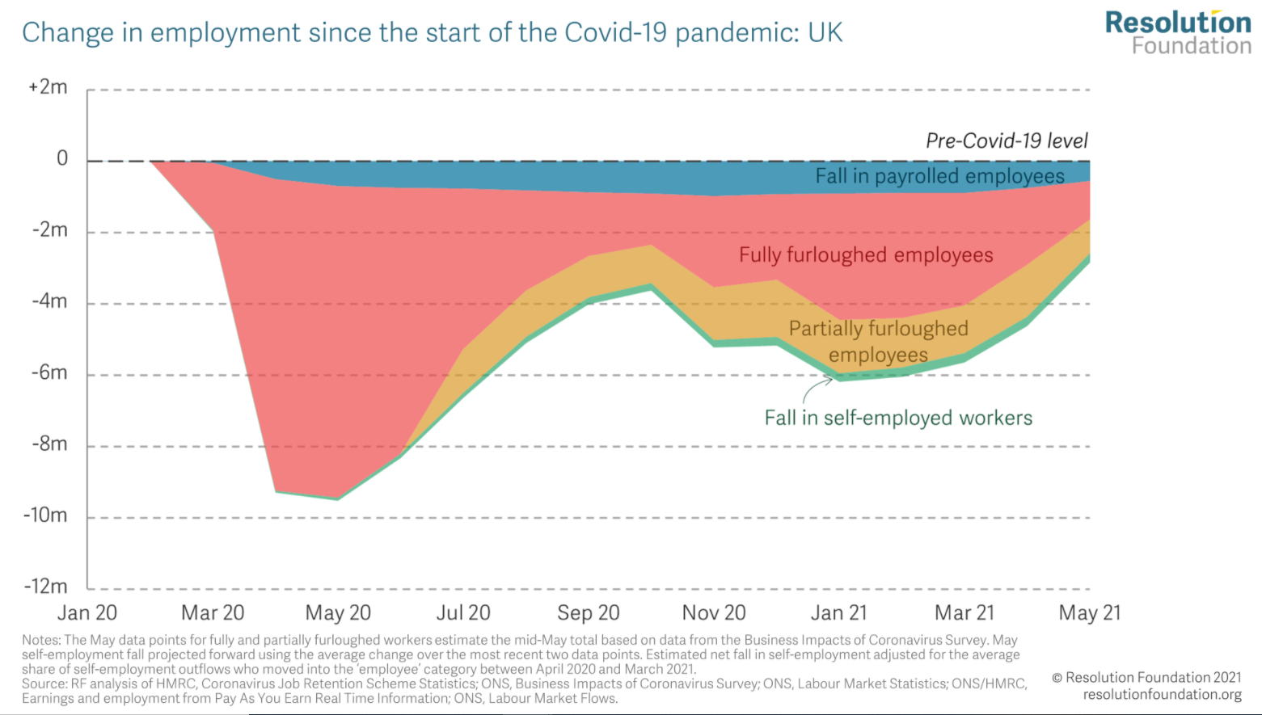
Contribution:
Focus on the year after the pandemic
Include other “family types” than couples with children;
Notes:
So the contribution we hope to make with this study is that most studies looked at the fist lockdown, which was the period when, as shown in this graph there was a lot of people being furloughed, a lot more than later on once tings started to go back to normal. Where we look at the situation a year into covid pandemic, at the time the economy has partially recovered.
And secondly most of the studies looked at couples with children, but we expect that different mechanisms operate in different types of household, so we extend our analysis to those who don’t have a partner and/or children

Slide 4
3 possible hypotheses for a ‘she-cession’
H1: Occupational segregation
Women are over-represented in jobs disproportionately affected by the pandemic (hospitality, tourism etc.) that have been less sensitive to previous disruptions
However, women are also more likely to work in sectors that faced increased demand (health, care etc.)
H2: Efficient household allocation in couples
Decisions on how to organise paid and domestic work reflecting comparative advantage of partners (i.e. earnings/development potential)
H3: In couples with children, childcare responsibilities
Increased childcare needs resulting from restrictions on schools of which mothers taking a bigger share given their lower earnings potential
Notes:
And there have been several explanations put forward as to why women were more likely to be adversely affected, which we are testing in our study
So the first one is that women are over-represented in job that were more likely to be affected. The jobs that were affected are those that typically involve customer service and face to face contact which are the jobs where women are overrepresented, such as hospital and tourism for example. However, women are also more likely to work in sectors that faced increased demand during the pandemic, such as health and care. So that is our first hypothesis..
The second hypothesis is based on Becker’s idea of efficient household allocation. It posits that in the face of school closures, someone had to hake care of childcare responsibilities and since women tend to be the second earner in the family and tend to have lower earnings potential it makes economic sense for them to look after the family. So this is more in terms of comparative advantage of the partners in the household.

Slide 5
Methods
Data: Pooled sample from Covid-19 rounds of NCDS, BCS70, Next Steps, MCS, cohort studies starting 2020
Estimation Sample: employed in March 2020; living in Britain; excluding lone fathers
Model: linear probability of various binary employment statuses,
Weights for design and non-response
Missing Data on covariates: item missing dummy used to retain sample size
Notes:
So for our analyses we use a pooled sample for 4 national cohort studies; we limit the sample to whose who were employed prior to the pandemic and those who live in Britian,; we model the results with weighted linear probability models; and in this study we retain the sample size across all levels of adjustment (to ensure that all analyses are comparable) by adding missing categories for the covariates.

Slide 6
Distribution of family types across cohorts
Notes:
And here is the distribution of our household types across the cohorts. As you can see there is a relationship between age and family type, so it is not straightforward to disentangle these two aspects, which is also why we use pooled sample, because we don’t have a good representation of each family type in each cohort.
So NCDS, our oldest cohort are mainly those who live with partner and children; BCS who are age 51 mostly live with partner and children; Those who are in the 31 yo cohort are quit evenly distributed across the household types and finally the youngest cohort who mostly live with no partner or children.
Could of disclaimers here: this is based on the household grid, so those with no children doesn’t necessarily mean that people don’t have children, just that they don’t live with them anymore, which is quite common amongst our oldest cohort. And those alone, do not necessarily live alone, just don’t live with their partner, so amongst the youngest cohort it can mean they live with parents or in houshares.

Slide 7
Outcomes in Feb/ March 2021:
Remains in employment: employed, furloughed, apprenticeship, voluntary work, self-employed
vs. unemployed, sick, disabled, looking after family, retired, education
Actively working: employed, self-employed, apprenticeship
and currently working
The same job:
employed and currently working in the same job as in March 2020
Furlough: employed but on paid leave including furlough
Notes:
We have 4 outcomes, the first three are progressively the more and more narrow definition of employment participation.
The first one included all those who were employed, furloughed, on apprenticeships, in unpaid work or self-employed.
The second outcome excludes those who were not in active paid work, so those on furlough and voluntary work
The third outcome are only those who remained in the same job in march 2021 and they did before the pandemic started 2020. #
And the final outcome are those on furlough.

Slide 8
Stages of statistical adjustment:
Raw gap by gender
+ Basic controls: Age (NCDS, BCS, Next Steps, MCS),Country (England, Scotland, Wales), London, Education (none, NVQ1-5), parental social class (manual, non-manual), mode of survey (CAWI, CATI)
+ Job characteristics (H1): SOC in March 2020 (1 digit) , part-time (worked less than 30 hours), key worker (based on 4 digit SOC in March 2020)
+ Partner/Partner’s job characteristics (H2; couples only): SOC in March 2020, part-time (worked less than 30 hours), key worker (based o 4 digit SOC in March 2020)
+ Children/Children’s characteristics (H3; couples with children only): number of children in the household; age of the youngest child (5 or less; 6 to 11; 12 to 18; 19 or more)
Notes:
We model the results as described here, so first we look at the raw gaps, we then add family characteristics, age (which in this case corresponds to the cohort), we then add basic controls that we know are replated to likelihood of employment, such as country, whether people live in London, Education, Parental social class, and the mode of survey. We then add job characteristics, so that is SOC at 1 digit level (this is a standard classification that distinguished between: 1 Managers, directors and senior officials 2 Professional occupations 3 Associate professional and technical occupations 4 Administrative and secretarial occupations 5 Skilled trades occupations 6 Caring, leisure and other service occupations 7 Sales and customer service occupations 8 Process, plant and machine operatives 9 Elementary occupations. And also an indicator of whether people work part-time or full-time. We then conduct two sets of subsample analysis: one on those who have a partner, where we exclude all those who do not live with partner and here we also account for partner’s job characteristic's. And finally a subsample analyses on those who have partner and children, where we also account for the number and age of children.

Slide 9
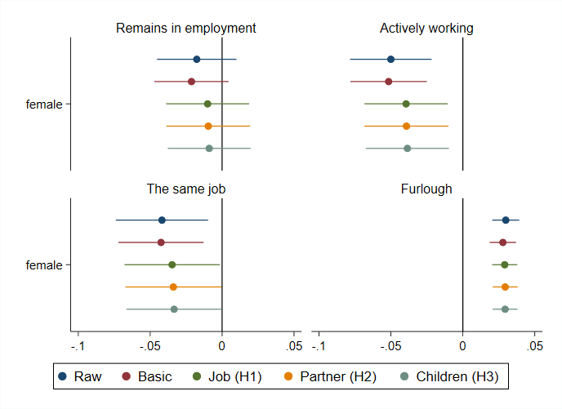
Overall differences: women vs men
Notes:
Ok, moving on to our results: these are our 4 outcomes.
The black vertical line represent men who are our reference category; and female coefficients are shown by these dots with the corresponding confidence intervals And the colours reflect the different stages of adjustment
Effectively no significant differences in terms of remaining in employment, as the lines overlap
However, we find significant differences in the rates of active work and remaining in the same job, which disappear once we account for the job characteristics
We can also see that women are more likely to be furloughed, even when we take job characterises into consideration

Slide 10
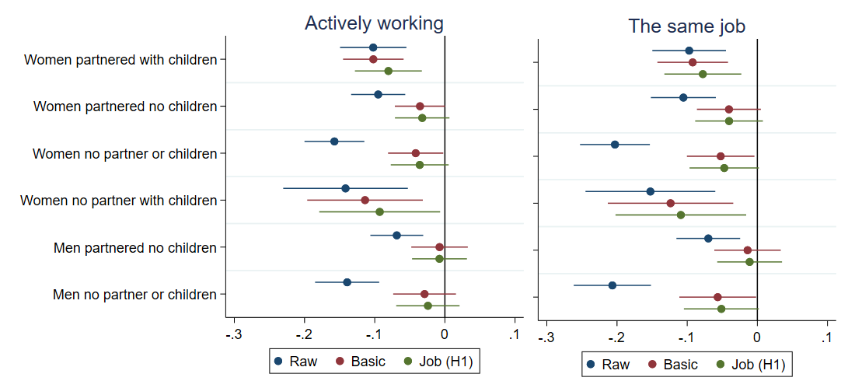
Family types compared to men w partner + children
Notes:
These two outcomes reveal a similar parents, so I put them together here.
The differences are the most persistent for partner women with children and disappear only with the job adjustment. Here in terms of active work the gender difference remain borderline significant even after job adjustment.
For those who have no children the significant difference is substantially reduced or disappears once we control for age, especially for men.

Slide 11
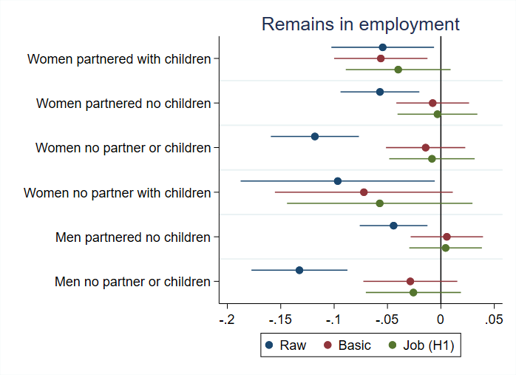
Family types compared to men w partner + children
Notes:
We then look at men and women in different household types; here partnered men with children are our reference category because by the time they have children they had a chance to accumulate enough experience and generally have lower or no child penalty, so we compare these HH types to them
Partner women with children are less likely to remain in employment and age (red) and basic adjustment (the green coefs) do not change things much, but once we account for the job characteristics the differences disappear.
For those who are parented but have no children (second one but last) job characteristics (yellow) make more of a difference for women, but the differences goes away once we account for age
The raw blues/difference are the largest for those who have no partner or children (last, and 3rd from the bottom), but these look quite similar form both men and women and go away once we control for the age
For single mothers we have relatively small sample, so very wide confidence intervals, and no sign difference although the effect sizes are quite large.

Slide 12
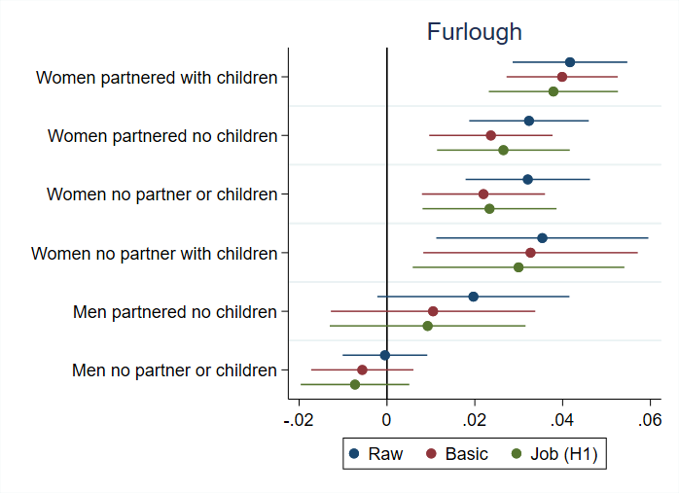
vs Men with partner and children
Notes:
Things look slightly different when we look at the probability of being furloughed
Starting from the bottom, there are no significant difference for men regardless if they have partner or not even in the raw estimates, although men with no children are the only groups that appears to be less likely to be furloughed than partner men with children.
Women, however, in all HH types are more likely to be furloughed
Slightly less so if they haven’t got kids
Age and basic adjustment here do not may much of a difference
Job characteristics make the most of a difference, but women who have kids are still more likely to be furloughed even if we account for their job characteristics

Slide 13
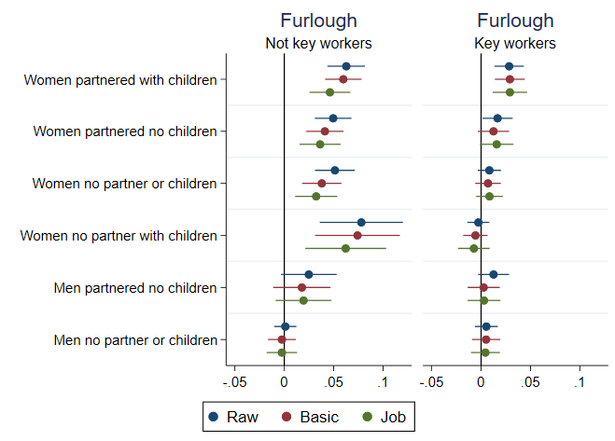
vs Men +partner + children

Slide 14
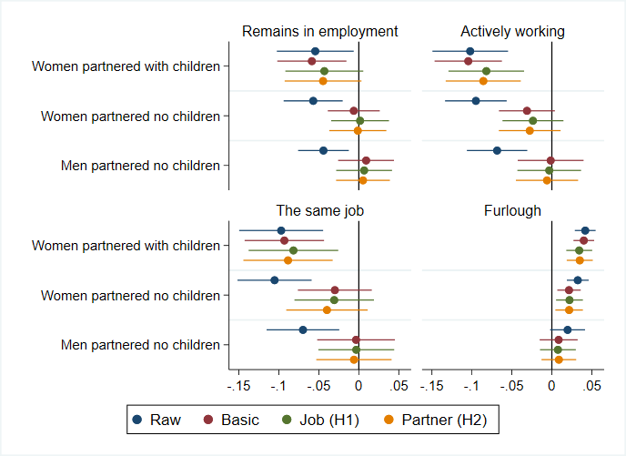
Adjustment for partner characteristics, where present
vs Men +partner
+ children
Notes:
And in order to test the efficient household hypothesis we then account for the partner’s job characteristics as well, which is reflected by the greyish looking estimates
And the results show that does makes very little difference to the remaining estimates – partnered women with children are still less likely to be inactive work and more likely to be furloughed even when we take their partners job characteristics into account

Slide 15
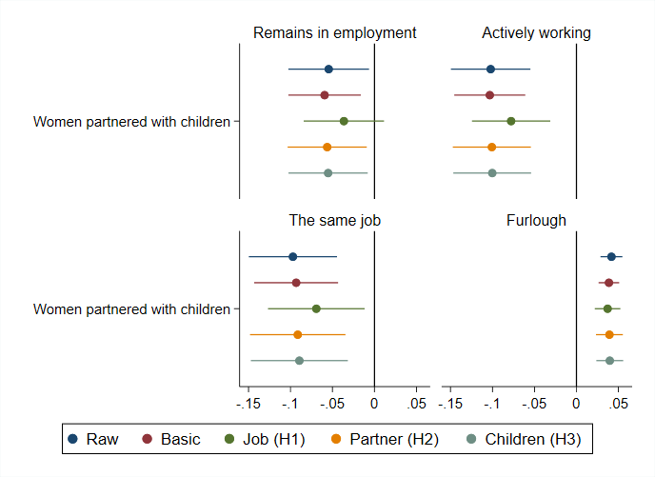
Adjustment for child characteristics, partner and children present
vs Men + partner
+ children
Notes:
And when we look at the subsample of those who have partners and children, so the final slightly more red adjustment here, we can also see that this also makes little difference

Slide 16
Summary:
Women still experienced more employment loss than men a year into the covid pandemic, especially if they live with partners and children, even if they were key workers.
Unexplained female deficit in actual employment and corresponding surplus of women on furlough – ca 3%
H1: Occupational segregation:
Gender differences in the probability of employment are attenuated when we account for the job characteristics (occupation, part-time and key worker status pre-covid) - irrespective of household type
H2: Efficient household allocation:
Adjusting for the presence of a partner in the household, or characteristics of partners, where present, makes little differences to the gender gaps
H3: Childcare responsibilities:
Adjusting for the characteristics of children makes little difference to the previous estimates.
Notes:
So in summary…
We confirm that the adverse effects were more likely to be experienced by women, especially if they live with partner and children
And it terms of our hypotheses:
H1 - we find that job characteristics attenuate the gaps, especially for partnered women with children, so we find some support for the occupational segregation hypothesis
However we find little support for our second hypothesis H2, as we have shown that accounting for partner’s job and the number and age of children makes little difference to the remaining estimates

Slide 17
Alternative explanations for residual gaps:
Employer discrimination:
Women may have been forced to be furloughed at higher rates than men
Preferences:
Women might prefer the conditions offered under furlough scheme more than men
Social norms:
Could have reinforced either.
Notes:
So the remaining gaps are likely to be related to unobserved, or at least unobserved in our data, characteristics, which means they are also les straightforward to test, but in the paper we also discuss several alternative explanations for the residual gap.
So these could be social norms, which are related to the expectations with respect to 9female home-maker, male bread-winner) gender roles.
Some studies argue that this could be related to preferences, so women may simple prefer receiving 80% of pay and not having to work as opposed to having to work for 100% of pay
However, there is also a debate in the literature about whether the expressed preferences may be socially constructed, so if they can can reflect internalised social norms. For example, there is a study that shows that in countries where majority of people agree with the statement that when jobs are scarce men have more a right to them than women, female labour maket participation is lower, which the author argues could reflect the fact that people internalise the social norms.
And alternatively this could be linked to discrimination; although it is illegal to discriminate based on gender in the UK, the pandemic presented unprecedented setting, which may have reinforced some existing stereotypes

Slide 18
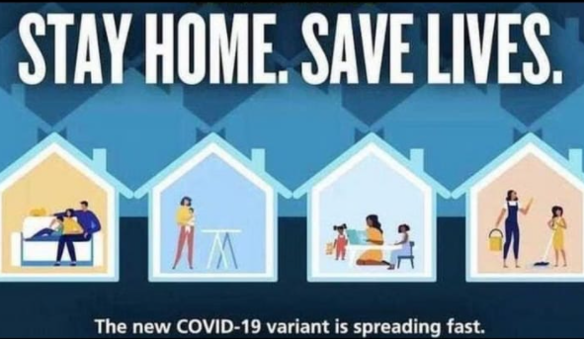
Conclusion
An expectation that looking after children and housework is women’s responsibility to which they are better suited than men was reflected in this official poster, issued, then hastily withdrawn in 2020.
Our findings suggest that gendered norms persisted into the first year of the pandemic
-that they survived the shock
Notes:
However, we still live in a word where gender differences are often highlighted. As an example of this I wanted to show you an add that came outlast year. This advert has been retracted and government issued a statement that it does not reflect their views on gender equality…. But still they put out an avert that features one men that is sitting on the sofa and women who are looking after the children and doing housework.
It is surprising to me that in this day and age someone at executive level has signed this off …

Slide 19
Thank you!
If you are interested in further details the paper has been submitted to Longitudinal and Life Course Studies
ESRC-funded project website:
https://www.ucl.ac.uk/ioe/departments-and-centres/centres/quantitative-social-science/gender-wage-gap-evidence-cohort-studies

