Slide 1
What can we do with millions of records?
Paper presented at:
‘FreeReg and FreeCen @ Twenty’: FreeUKGenealogy Conference, 2019
King’s Manor, University of York, 29/9/19
Dr Oliver Duke-Williams
o.duke-williams@ucl.ac.uk
@oliver_dw
www.ucl.ac.uk/dis/people/oliverdukewilliams

Slide 2
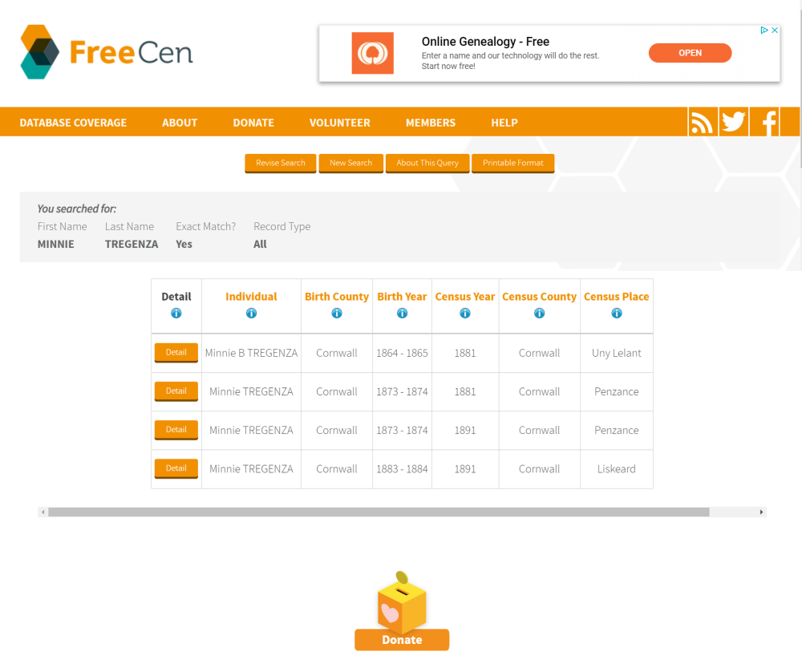
Typical FreeCen use case
Source: freecen.org.uk

Slide 3
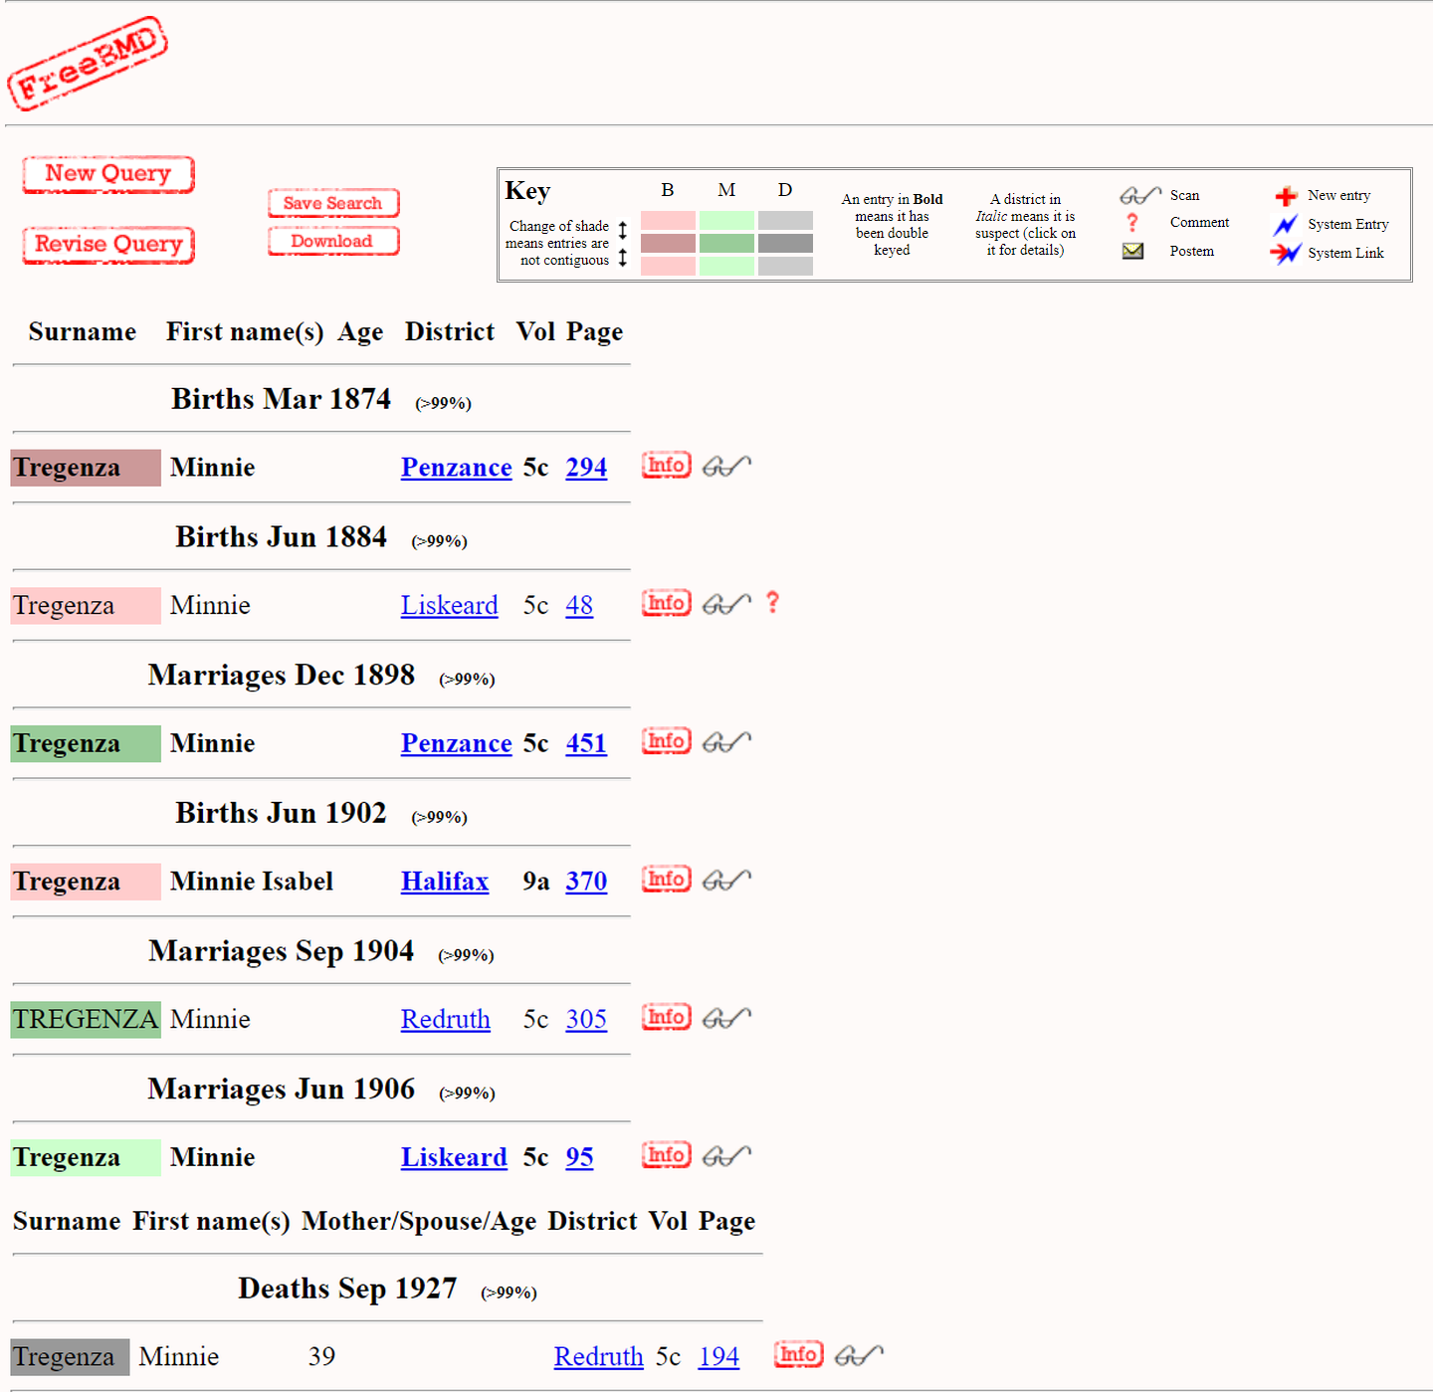
Finding more information about Minnie
Source: freebmd.org.uk
Notes:
We will come back to Minnie one day

Slide 4
FreeCen: Norfolk sample
Sample of raw data from 1861
c. 40,000 records in sample
423,000 records in county (100% transcription)
Source: freecen.org.uk
Notes:
Next few slides from an earlier bit of work, using a small sample of data

Slide 5
County-of-birth of sample members
Generally, county coded as Registration County
‘Yorkshire’ as single county
General references to ‘England’, ‘Wales’, ‘Scotland’
Source: freecen.org.uk

Slide 6
Constructing new tables
It is possible to produce tables that were never published at the time
Multi-generational households
Link generation coding to ‘relation to head of household’
Identify earliest and latest generations per household
Aggregate over other constraints

Slide 7
Multi-generational households
Number of generations in household | Observed cases
1 | 2,381
2 | 5,114
3 | 740
4 | 17
Source: freecen.org.uk

Slide 8
Cornwall in FreeCEN
Cornwall is the only county that is 100% coded for the complete FreeCENrun
Census | Records | %complete
1841 | 340,901 | 100
1851 | 354,744 | 100
1861 | 362,111 | 100
1871 | 358,043 | 100
1881 | 326,187 | 100
1891 | 318,637 | 100
Source: freecen.org.uk

Slide 9
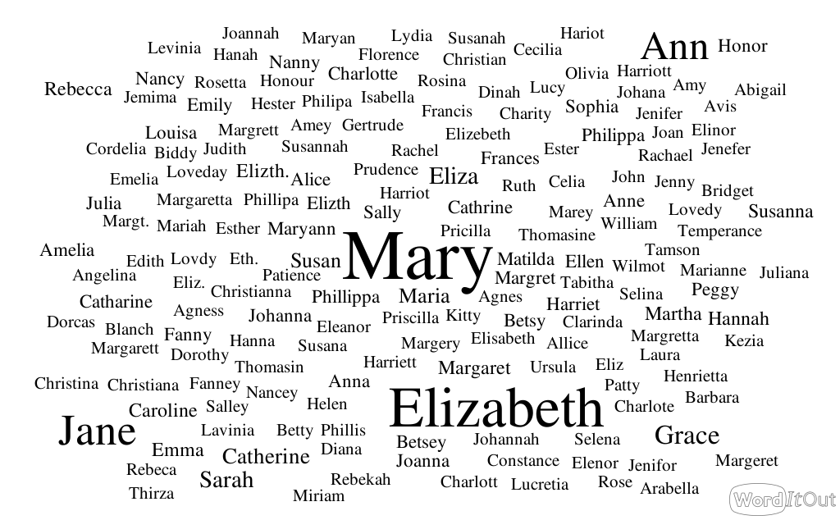
Female names, 1841
Notes:
A very simple example of using large numbers of records: what was the most common name recorded in a given census
Highlighted: Mary is the most common female name, with Elizabeth in second place. But note – there are also various abbreviations given of Elizabeth, not to mention variants such as Betsy.

Slide 10
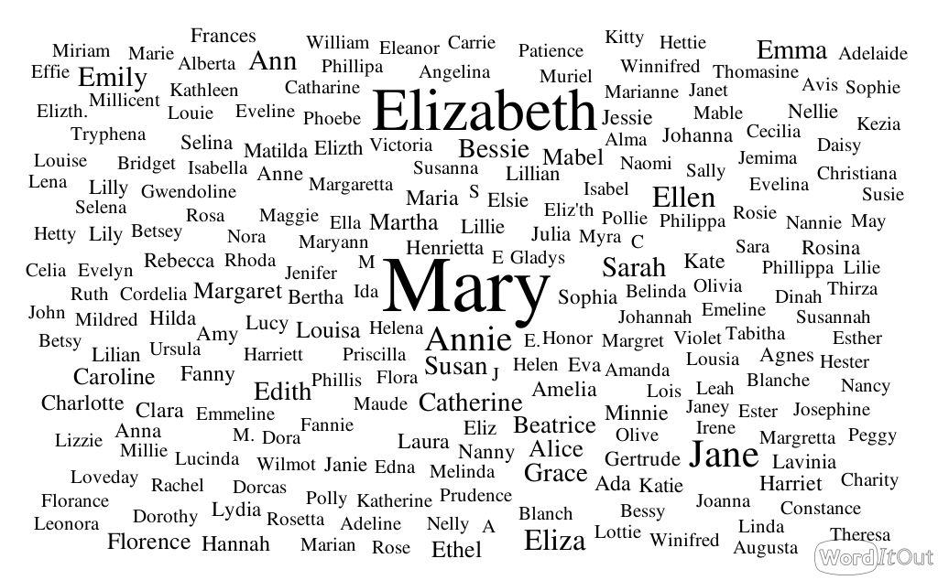
Female names, 1891
Notes:
We can compare across time periods.
In 1891, Mary is still #1, Elizabeth still #2 (NB reminder: these are names recorded in the census, not names for births in that year)
Again, we see variants of Elizabeth.
We also see different names to those that were popular 50 years earlier. An example is Florence (note that there’s also a variant spelling)
Q: these are the 200 or so most common names. Is Minnie one of them (answer: yes. SE of ‘Mary’)

Slide 11
Popularity of the name ‘Florence’
Longfellow, (1857) Santa Filomena, The Atlantic Monthly 1(1)
"Lo! in that house of misery A lady with a lamp I see…"
Source: freecen.org.uk

Slide 12
Constructing longitudinal data
Longitudinal data sets are constructed from modern censuses
ONS Longitudinal Study; Scottish Longitudinal Study; Northern Ireland Longitudinal Study
These rely on name and date of birth for linkage
Date of birth was first asked in the 1971 Census
Can we attempt to build longitudinal data from FreeCen data?
Can we find the same person in two or more censuses
Notes:
Can we find what we think is the same person in more than one census?

Slide 13
Matching people by name
?
?
Source: freecen.org.uk
Notes:
Looking across censuses, we have two Minnie Tregenzas in 1881 and 1891. This gives four possible match combinations. At most two can be correct, but it is also possible that there are no correct matches

Slide 14
Matching people by name
Source: freecen.org.uk
Notes:
Looking at birth year, we can be identify one feasible match, and reject the others

Slide 15
How unique are names?
One person in group:
The name is unique in the data set
Source: freecen.org.uk
Notes:
For women
1841: 27% of the sample (women) have unique names
1891: 52% of the sample (women) have unique names
So, we have quite a few unique names, but not enough to be confidently look for the same people at different times

Slide 16
Source: freecen.org.uk
Notes:
Graph for males is very similar

Slide 17
Increasing the chance of people being unique
We can increase our chances of finding ‘unique’ people by looking at more characteristics than just name
Age
Place of birth
We might increase the chance of having a match by ignoring initials and second names etc

Slide 18
Source: freecen.org.uk

Slide 19
How many people are unique?
Characteristics used | 1851 | 1891
Surname, forename (male) | 25% | 45%
Surname, forename (female) | 33% | 52%
Surname, forename, birth place (persons) | 64% | 76%
Surname, forename, age (persons) | 67% | 84%
Surname, forename, age, birth place (persons) | 98% | 99%
Source: freecen.org.uk
Notes:
Comparisons with 1851 – birthplace not asked in the same way in 1841

Slide 20
A very high proportion of people are unique on
Name
Age (years)
Birth place
This bodes well for potential to match across years
As we move from Cornwall to UK, uniqueness would drop

Slide 21
But…
Just because people are unique within a census, they may not match between censuses
Error in completing census
Variations in spelling or presentation of name
Variation in spelling of birth place
Errors introduced by transcribers

Slide 22
Error in completion: failing to follow instructions
Source: freecen.org.uk

Slide 23
Transcription errors

Slide 24
Transcription errors: extreme marital age differences
TREZISE | William | - | Head | M | M | 17
TREZISE | Mary | - | Wife | M | F | 73
WAITE | Elizabeth | - | Dau | M | F | 38
WAITE | William T | - | Grnson | - | M | 4
KNIGHT | William | - | Head | M | M | 16
KNIGHT | Abigail | - | Wife | M | F | 69
KNIGHT | William | - | Son | M | M | 36
ALLAN | Josia | - | Head | M | M | 16
ALLAN | Mary A | - | Wife | M | F | 69
ALLAN | T K | - | Boardr | - | M | 2

