Slide 1
Parenthood and Paid Work: compatibility in the British Economy
Heather Joshi, UCL Social Research Institute.
Birkbeck Department of Economics,
50th Anniversary Conference

Slide 2
Birkbeck’s contribution to Economic Demography
1976-7 Occasional student of QM. My project resulted in an article in Economica, 1981
                Secondary Workers in the Employment Cycle
1988-1990 – research team hosted at Birkbeck on ESRC Economic Demography project
Economic Inequality, Gender & Demographic Differentials
I helped start an interdisciplinary Women’s Studies Masters
In those day there was not the interest in gender in economics that there is now – Sue Himmelweit excepted. Women’s employment was relevant to population studies. Fears it was taking fertility below reproduction level.
Our group, joined by Hugh Davies already at BBK, looked into the gender wage gap and economic influences on births, but the impact of childbearing on women’s paid work was easier to demonstrate rather than the other way round.
Hugh took over work constructing of lifetime income scenarios until his untimely death in 2000

Slide 3
Employment and Fertility in Britain
Some stylized statistics

Slide 4
Total Fertility, England and Wales 1871-2021
Children per women if each year’s age specific rates prevail, 15-45

Slide 5
Female labour force participation,
England & Wales 1871-2011
Notes:
Overall activity rate did not rise before 1940s Sole male breadwinner.. Then we see married wormen joining the labour force post war until reching the same level as non-married., ca 67% throughout. Emergence of part-time work, largely by married women accounts for growth 1951-1981 and remains a substantial minority of all female employment

Slide 6
Changing Breadwinner Regime
Beveridge’s ideal arrangement was for the male breadwinner to support wife’s vital unpaid work in the home. She had ‘other duties’, namely the reproduction and maintenance of the population.
Although this a middle class ideal rather than working class reality, the implication was that increased female labour force participation in production would jeopardise reproduction.
Instead the baby boom happened at the same time as the emergence of the 1.5 earner couple
It was followed by a weakening of the reliability of marriage as a meal-ticket for life ( 2nd Demographic transition) with other implications for fertility decisions.

Slide 7
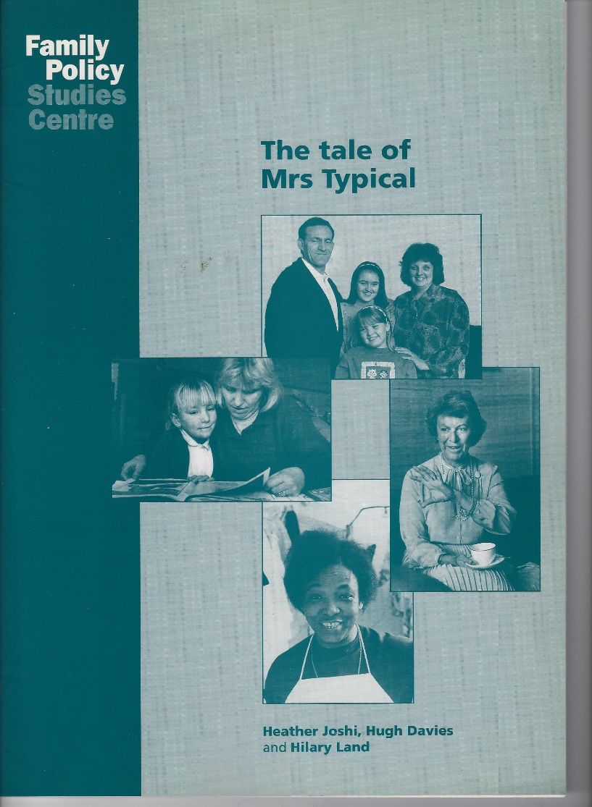
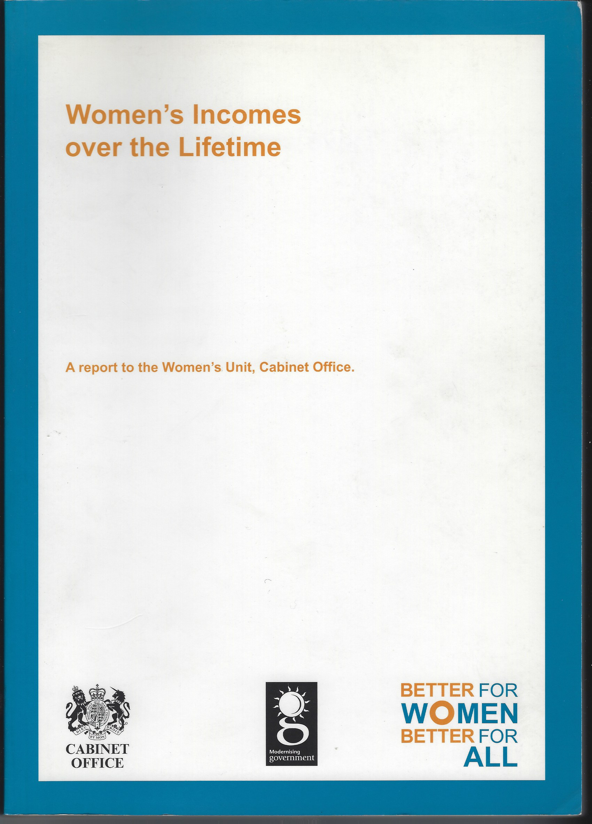
The earnings opportunity cost of motherhood over women’s lifetimes

Slide 8
Illustrative lifetime profiles
  We simulated lifetime earnings for illustrative women,
  by number of children and levels of skill.
  A simple method derived from regressions of employment participation and earnings
  Projected over synthetic lifetime in a time warp – cf the period fertility rate or life expectancy
  The difference between profiles gives the earnings opportunity cost of having n children vs none.
  For Mrs Typical, having two children roughly halved her lifetime earnings.
  That FPSC report based on data gathered in 1980 (WES),
  WOMU report based on 1994 data (BHPS) £ evaluated at 1999 prices,
  Think of the 1994 projection as relevant to those born around 1970, and the earlier one as belonging to a cohort from 1950s, less attached to paid work
  Also done for men and other types of income
  Simple illustrations rely on many simplifying assumptions.
Notes:
The same pattern of social divergence appeared in BHPS in the 1990s, in the study we did for the Women’s Unit of the Cabinet Office (Rake ed. 2000). This used a simulation model developed over a number of years from my first attempt to quanitify the cah opportunity cost of childbearing in Britain ( Joshi 1990). The model relies on generating employment and earnings histories for ‘typical’ individuals. It is based on stylised biographical assumptions and the parameters of models fitted to cross-sectional earnings and participation data, along with a summary of labour market experience . Past work experience helps predict wages which help predict employment and feed into estimated income. The simulation assigns a woman to employment in any year when her predicted probability of employment exceed 50 per cent, and to full-time or part-time work according to whichever is more likely. Unlike Calhoun and Espenshade’s (1988) estimates of lifetime earnings foregone by US mothers, it does not attempt to simulate a whole population. Details of the method are set out in the appendix of the Cabinet Office report ( Rake(ed) 2000) and in Davies et al( 2000). This method has also been applied to France, Germany and Sweden, (Joshi and Davies 1992, Davies and Joshi 1994), and by Dankmeyer (1996) to the Netherlands. In comparison with our 1980-based model for Britain, Germany and the Netherlands looked fairly similar, but mothers’ foregone earnings were much smaller in France and Sweden, as they also appeared in the US on the different methodology of Calhoun and Espenshade. Our simulations of earnings lost to motherhood, based on 1994 data, are very similar to the 1980-based ‘Tale of Mrs Typical ‘ (Joshi et al 1996), but only for some groups of women. These are the low skilled, and indeed the mid-skilled if they embark on childbearing early, i.e. up to their mid-twenties.

Slide 9
Woman's Earnings over the Lifetime
Low qualifications WOMU Report
14
12
10
No kids
8
£ '000s p.a.
1 kid
6
2 kids
4
4 kids
2
0
20
25
30
35
40
45
50
55
60
Woman's Age
Notes:
The gross earnings profiles constructed for the hypothetical low skilled woman using parameters from the 1990s. She is assumed to have her first child at age 23 and to take a nine-year break from employment, if she has two children. She returns to the labour market initially part-time, and when she eventually resumes full-time employment, her pay does not reach the level it would have done had she remained childless and in uninterrupted employment. The earnings trajectory of such a childless counterpart is plotted in the solid black line. The area between this solid line and the others represents forgone earnings for each number of children. For two children this amounts to 58% of earnings after the year of the first birth.

Slide 10
Woman's Earnings over the Lifetime
High Qualifications WOMU Report
35
30
25
No kids
20
2 kids
£ '000s p.a.
15
4 kids
10
5
0
20
25
30
35
40
45
50
55
60
Woman Age
Notes:
Women with degrees had become more numerous by the 1990s and they were also likely to defer motherhood until at least age 30, as assumed here. For them the simulated earning loss from motherhood is minimal. There is no loss of earnings at all associated with the first birth at age 30 ( assuming maternity leave during full-time employment is fully paid), for a second birth there is one year of part-time employment assumed, and two years at each of the third and fourth children for the hypothetical mother of four. In the case of the latter it can be seen how earnings drop after each interruption, and that when she returns to full-time employment her wages are, for some years, marginally below those of graduate women with no or fewer children. Nevertheless the earnings conceded to motherhood by either of the graduate mothers are on a much smaller scale than by the less educated women. These ‘earnings regained’ are likely to be partly offset by increased expenditure on childcare. Women with high earning power are more likely to be afford unsubsidised private services, and more likely unable to afford not to make them..

Slide 11
The earnings cost of two children:
Total and composition by woman’s qualifications
300
250
200
lifetime cost (£'000s)
150
Part-time penalty
Lost experience
Lost hours
100
Lost years
50
0
Low
Mid
High
Qualification of mother

Slide 12
Have rising economic opportunities for women raised the opportunity cost of childbearing?
Earnings opportunity cost of childbearing ironically largest for those with lowest earning power
Because it is possible to make compromises to accommodate earning and caring:
  part-time employment,
  changed domestic technology,
  participation of fathers,
  and the roles of schools and daycare, whose importance was apparent in pandemic.
For some the opportunity costs of child-rearing are replaced by direct expenditure on childcare, particularly those with highest earning potential

Slide 13
Men’s and women’s lifetime earnings

Slide 14
Further Scenarios
Pension cost of motherhood
Net retirement income from own earnings reduced for mid and low skill mothers compared to childless counterparts.
For mother of two reduction 8% is mid-skill, and 12% low-skill.
Moderated by basic pension and credits (cf 23% and 52% for gross earnings)
If married, retirement income augmented by widow’s pension and share of man’s better pension
Consequences of divorce
Likely to increase earnings but lose access to man’s pension and widow’s pension
Splitting couple’s pension rights at divorce would help but not entirely cover this lost ‘transfer’
Extent of compensation depends on length of marriage and a number of other assumptions.

Slide 15
More than mothers’ business
Time cost of raising children are not exclusively born by mothers.
Schools and daycare are clearly involved – as shown in Lockdown
Fathers are or could be increasingly engaged :
‘The transformation of motherhood involves a redefinition of fatherhood’
    ‘The opportunity costs of childbearing: more than mothers’ business’ Journal of Population Economics, 11, 161-183. See Joshi Presential address ESPE 1996
We extended lifetime costing of childrearing to non-market time and its distribution between parents
    Joshi H. and Davies, H. B. (2000) ‘The price of parenthood and the value of children’, in N. Fraser and J. Hills (eds) Public policy for the 21st Century: Essays in Honour of Henry Neuburger. Policy Press
Henry was a Treasury economist where he pioneered paternity leave.

Slide 16
Effect of maternal employment on child ‘quality’?
There was more concern that women’s employment might jeopardize the quality of the next generation than its quantity.
After I left Birkbeck, looked at whether maternal employment might be bad for children –as was commonly supposed.
A growing body of longitudinal evidence linked measures of child development – cognitive and behavioural - with mothers’ working in children’s early years.
  Summary in IOE blog, The Myth of the Working Mother,
The evidence for a negative association/impact, never strong, weakened over the decades when mothers’ employment had been rising
This encouraged public policies in 2000s promoting mothers’ employment and encouraging fathers to take leave

Slide 17
Gender roles and post-Transition Fertility.
The Cairo Declaration on Population and Development in 1994 had emphasized that the enhancement of women’s rights and health should not to be seen as just a means to population control, but as ends in themselves :
  “The full participation and partnership of both women and men is required in productive and reproductive life, including shared responsibilities for the care and nurturing and maintenance of the household.”
It is now believed that equity in gender roles helps to promote, rather than inhibit, childbearing in low fertility countries

Slide 18
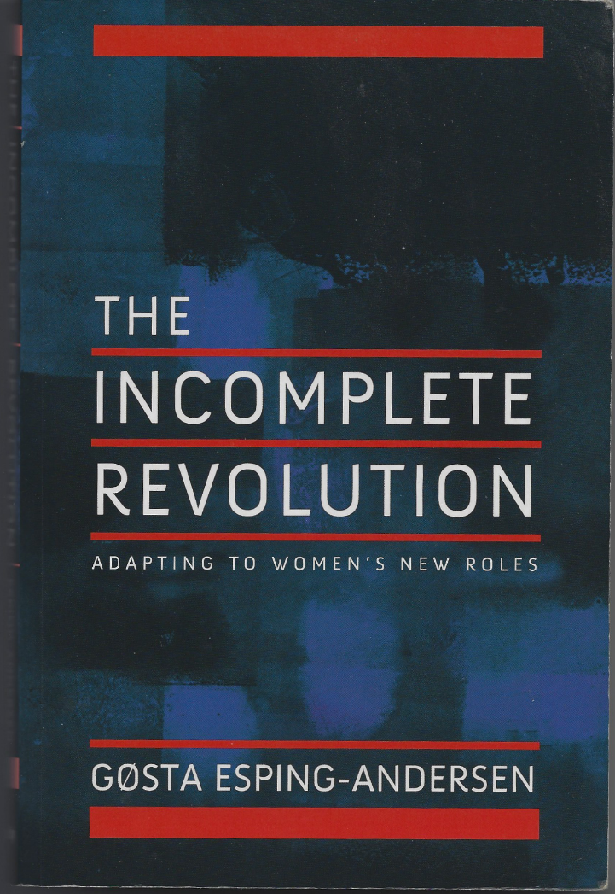
Demographers recognise the Gender Revolution
Retheorizing Family Demography. G Esping Andersen and F Billari, PDR 2015
Gender Equity in Theories of Fertility Transition Peter McDonald 2000
Population and Development Review, Vol. 26, No. 3
The Gender Revolution:
A Framework for
Understanding Changing
Family and Demographic
Behavior
Frances Goldscheider
Eva Bernhardt
Trude Lappegård, PDR 2015
Policy responses to low fertility: How effective are they? T Sobotka, A. Matysiak. and Z Brzozowska, UNPF. 2020.

Slide 19
Total Fertility & Gender Equality: a positive association in EU countries, 2017

Slide 20
Conclusions
Gender roles in production and reproduction, ie paid work and parenthood, need to be considered in conjunction.
Women’s paid work does not necessarily curtail childbearing, nor threaten child development. They are not incompatible.
In Britain it doesn’t not seem to have been necessary to confine Mrs Typical to the home to ensure that her ‘vital duties’ are carried out
but her secondary membership of the dual breadwinner workforce reflects both gender and social inequality.
Motherhood does not necessarily lower a woman’s earnings, although it has for many in Britain. Fathers’ contribution to hands-on parenting, is on the increase.
A gender equitable balance of work and life, of production and reproduction, as called for in Cairo, 1994, still has a way to go. The COVID crisis may be a setback or a watershed.

Slide 21
Reserve

Slide 22

The EU Gender Equality Index
The European Equalities Institute, Vilnius
A weighted aggregation of male-female gaps in multiple indicators
Domains | Sub-domains
Work | Participation; segregation; quality of work
Money | Financial resources; economic situation
Knowledge | Educational attainment; segregation; lifelong learning
Time | Economic activities; care activities; social activities
Power | Political power; social power; economic power
Health | Status; behaviour, access
Also monitored: violence and intersectional inequalities, but not in the Index

