Slide 1
Examining the size of the gender wage gap within and across birth cohorts (ESRC Grant No. ES/S012583/1)
Alex Bryson
UCL
Maynooth University, Department of Economics Seminar
29th April 2022

Slide 2
Project Overview
Began September 2019 ends February 2023
Mainly birth cohort data to explore the gender wage gap (GWG) across cohorts and over the life-course
Plus some papers with linked employer-employee data
Examines GWG across individuals' lives, up to the age of 60+ in the case of the 1958 cohort, and across generations
The UCL team:
Alex Bryson (PI)
Heather Joshi (co-investigator)
David Wilkinson (co-investigator)
Francesca Foliano (Research Fellow)
Bozena Wielgoszewska (Research Fellow)
All information on the project can be found here: https://www.ucl.ac.uk/ioe/departments-and-centres/departments/social-science/gender-wage-gap-evidence-cohort-studies

Slide 3
Research Questions
What does the GWG look like over the life course and across birth cohorts?
How much of the GWG is accounted for by differences in human capital accumulation over the life course?
What roles do family formation and care responsibilities play in the emergence of, and persistence in, the GWG?
How much of the gender wage gap is attributable to the sorts of jobs undertaken by men and women, particularly in relation to full-time/part-time status and occupation? Do these point to mechanisms through which unequal pay for equal characteristics arises?
What role do early childhood attributes and experiences play in determining the subsequent wage gap between men and women and do childhood influences still matter having accounted for early adulthood experiences?

Slide 4
Data
National Child Development Survey (NCDS): a cohort of over 17,000 individuals born in one week in 1958 in Great Britain. They have been surveyed nine times to the age of 55 and, given the length of the proposed project, we will be able to follow them through to age 61 (Sweep 10).
The British Cohort Survey (BCS): a cohort of over 17,000 individuals born in one week in 1970. They have been surveyed 10 times to the age of 47. Data for Great Britain
Next Steps, (previously the Longitudinal Study of Young People in England) which, in 2004, started surveying all young people in Year 9 who attended state and independent schools in England (around 16,000 individuals born in 1989/90). They were surveyed every year until 2010 and were last surveyed in 2015/16 for Sweep 8 at age 25.
National Survey of Health and Development: 1946 Birth Cohort (GB)
Millennium Cohort Study (MCS): a cohort of 19,000 individuals born in UK 2000-2002. Now aged 20.
All participated in the COVID-19 Survey: 3 waves (May 2020, Sept/Oct 2020, Feb/Mar 2021) https://cls.ucl.ac.uk/covid-19-survey/
Pseudo birth cohorts: LFS, ASHE, Understanding Society, BHPS

Slide 5
Why Birth Cohort Data?
Different cohorts are exposed to different labour market and policy conditions during their lifetimes.
For instance, the 1958 cohort left school when the Equal Pay Act was first being implemented whereas the Act had been in place for a decade when the 1970 cohort left compulsory education.
The education gap between men and women has disappeared and even reversed, such that we would expect the pay gap due to educational differences to narrow or even reverse in more recent cohorts.
Attitudes to women's labour market participation and men's household production have shifted. These changes in social norms, together with attendant changes in public policy, have created opportunities for men and women to combine paid and unpaid work and leisure in ways not hitherto possible, with uncertain consequences for the life choices and earnings patterns of men and women across the life-course.

Slide 6
Methodological Advantages of these Data
By analysing nationally representative birth cohort data for people born in 1958, 1970 and 1989/90 this study addresses the topic from three angles:
We consider the evolution of the GWG over the whole life-course. This is important because factors governing both selection into employment and wage determination vary for men and women well into later life.
Because we track people from birth, we obtain a picture of the links between childhood circumstances, skills and experiences and subsequent earnings for men and women - and thus the size of the gender wage gap.
We distinguish between the effects of ageing and birth cohort, something that is only possible with data tracking multiple birth cohorts.

Slide 7
Methodological Challenges
Selection into employment: over the life course and across cohorts
Panel attrition
Imputation to tackle data missingness/item non-response
Consistency in dependent variable
Consistency in independent variables
‘Bad’ controls
Common support problems
Cross cohort comparison

Slide 8
Some Background

Slide 9
100 Years of the GWG

Slide 10
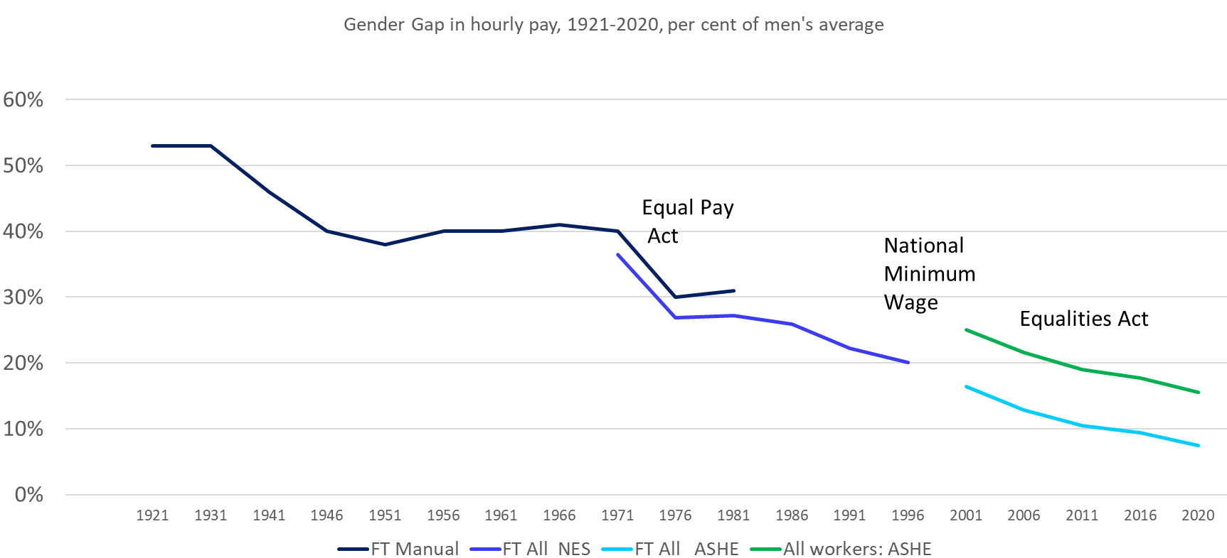

Slide 11
100+ Years of Women’s Economic Activity
All rates for women aged <65 years. From age 20 pre 1981, 16+ thereafter
Notes:
Comment
Notes: (1) Figures through to 1981 are taken from Joshi et al. 2005 Table 1 and relate to women aged 20-64. (2) The 1991, 2001 and 2011 figures are derived from NOMIS economic activity series S08, ST028 and DC6107EW respectively and relate to women in England and Wales aged 16-64

Slide 12
Educational Attainment

Slide 13
Gradual Closure of the GWG

Slide 14
Research Questions for Today
What does the GWG look like across the life-course in NCDS and BCS?
How much smaller is the regression-adjusted gap compared with the raw gap?
Does accounting for selection and attrition matter?
What does the GWG look like among young people and how has this changed over time?
What does the GWG look like in mid-life? Has it changed much across birth cohorts?
What happened during the Covid-19 Pandemic?
What is the size of the GWG using matching estimators?

Slide 15
What does the GWG look like across the life-course in NCDS and BCS?

Slide 16
Notes:
NCDS raw gap is 16pp age 23, doubling to 31pp by age 33, at its maximum (35pp) at age 42, then falling to 28pp at age 55.
Adjustments for sample attrition involved estimating a logistic model of the probability of responding to a survey sweep and taking the inverse of the predicted probability of response. There were separate models for each survey sweep by gender. For each sweep the response variable takes the value 1 when the outcome of the interview was productive for the given person; and 0 if the interview was productive at age 10/11, but not the given sweep. Cohort members who died or emigrated were not included in the target sample for that sweep. Attrition matters little.
BCS raw gap is 9pp age 26, rising to 16pp by age 30, 20pp by age 34, 26pp at age 38 and 31pp at age 42. Again, attrition matters little.
We adjust men’s and women’s wages to account for non-random selection into employment by imputing a wage for four types of individual: those in employment without a
wage observation; the self-employed; the unemployed; and the economically inactive. These imputed wages come from nearest-neighbour wage ‘donors’ defined as those in
the waged employment group at the same sweep from the same sex who are nearest in their propensity for waged employment to the non-waged individual. The nearest neighbours
are identified through propensity score matching where the propensity for waged employment is estimated for each individual for each survey sweep. The probits for the
(0,1) being in waged employment at the time of the survey sweep are run separately for men and women so that nearest neighbours who are ‘donors’ of their wage to the
non-waged are drawn from the same sex.
These gaps are underestimated early in life if one fails to account for non-random selection into employment.
The GWG is around 4pp larger at age 23 in NCDS when selection-adjusted. Similarly the gap is around 3pp larger at age 30 for BCS.

Slide 17
Findings for Raw GWG
The GWG grows until mid-age then falls
The GWG is smaller across the life-cycle in BCS v NCDS
Raw, attrition adjusted and selection adjusted
Results are not particularly sensitive to attrition adjustment
The black lines track the red lines
Attrition adjustment closes the GWG a little later in life in NCDS
Adjusting for selection into employment plays a small, albeit significant, role in the size of the GWG over the life-cycle
Adjusting for selection into employment increases the size of the GWG in early life in both NCDS and BCS

Slide 18
Findings for covariate-adjusted (human capital) GWG
NCDS
Life-course pattern of GWG similar to that for raw gap, but gap begins to close in 30s not 40s
Gap is less pronounced than raw gap due to human capital differences in 30s and 40s
Accounting for attrition gap is larger later in life
Selection-adjustment means gap is larger until 40s
BCS
GWG much flatter between 20s and 40s when covariate adjust due to human capital differences
GWG always smaller than in case of NCDS
GWG smaller with selection-adjustment

Slide 19
What does the GWG look like in mid-life?

Slide 20
This paper conditions on more than human capital
Explore the role of family and job characteristics in accounting for the GWG
Can we account for more of the gap?
Do the earlier finding still hold?
Family
Whether have a partner,
Whether ever had a child
Whether currently have children aged <3, 3-4, 5-15
Job characteristics
Occupation (1 digit SOC)
% of women by occupation (2 digit SOC)
Whether work part-time
% of part-time workers by occupation (2 digit SOC)

Slide 21
Gender Wage Gap at age 42- unexplained and explained components
Raw gap in log mean hourly wage is 40 log points in NCDS and 33 log points in BCS (similar to the 35pp and 31pp gap in median wages on slide 15)
Notes:
Job = PT, Occupation
Experience = FT, PT, current job tenure

Slide 22
What does the GWG look like among young people and how has this changed over time?

Slide 23
Findings
The GWG adjusted for human capital and childrearing falls by half between 1981 and 2015
The GWG increases for those with HE and it more than halves among those without HE
Whereas selection adjustment increases the size of the GWG in 1981 and 1996 it does not affect the gap in 2015
Differences in human capital and marital/parental status account for a small portion of the gap. The nature of jobs (occupation, gender segregation) accounts for a sizeable part of the explained GWG in the most recent cohort.

Slide 24
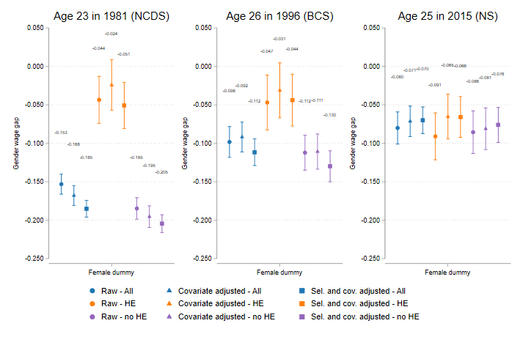
GWG Among Young Workers Y-axis is gap in log points
Notes:
The covariates and selection adjusted gap for the whole sample is statistically different from the covariate adjusted gap in both NCDS and BCS.
The covariates and selection adjusted gap for graduates and non graduates is statistically different from the covariate adjusted gap in NCDS, whereas in BCS this is true only for non-graduates.
Human capital variables: maths and reading standardised test scores, indicators for the highest qualification achieved, indicator for STEM subject in the highest qualification achieved, months of full-time and part-time work experience, squared months of full-time and part-rime work experience, the number of different spells of work experience.
Family formation variables: dummies for family type (married/cohabiting) the presence of at least one child and a dummy for the presence of more than one dependent child.

Slide 25
The role of occupation
Traditionally hard to account for much of the GWG among young people with observed information, leaving an ‘unexplained gap’ often attributed to unequal treatment/ discrimination.
Similar here
Very little of the gap is explained by differences in human capital attributes and marital/parental status
But occupation matters
For individuals with observed wages (and occupations) we estimate the contribution of type of occupation (SOC 1 digit), proportion of women in the occupation and whether the job is high-skilled to the gender wage gap.
Proportion of women in the occupation explain some additional part of the gap in 1981 and 1996 and most of the gap in 2015.

Slide 26
What happened to the GWG during the COVID-19 pandemic?

Slide 27
Motivation
Wielgoszewska et al (forthcoming) find that in terms of employment adverse effects are still experienced by women a year into the covid pandemic, especially if they live with partners and children
…but what about those who remained in employment?
Research questions:
Has the pay gap between men and women changed during COVID?
If so did this differ across different generations?

Slide 28
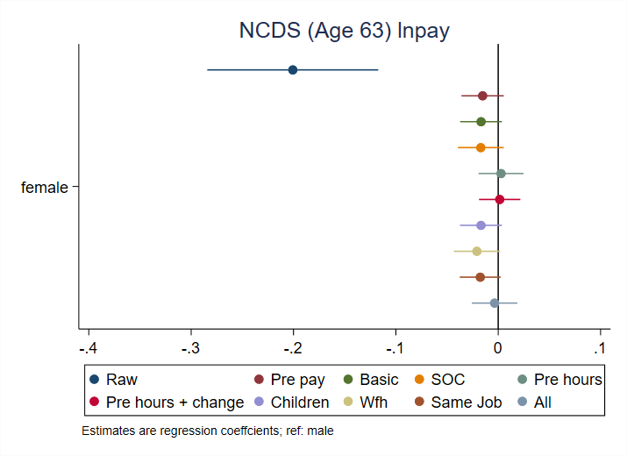
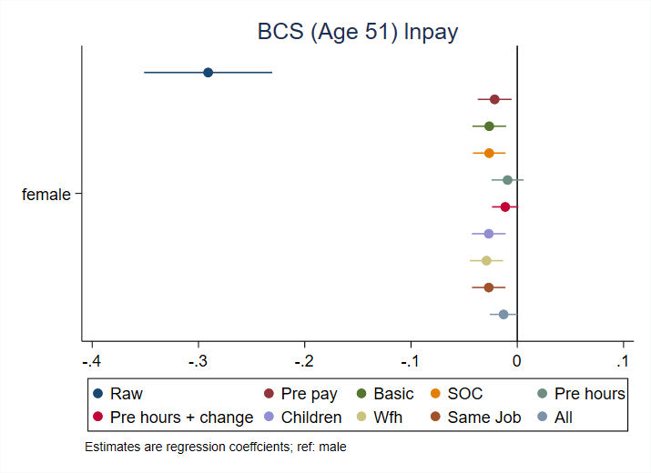
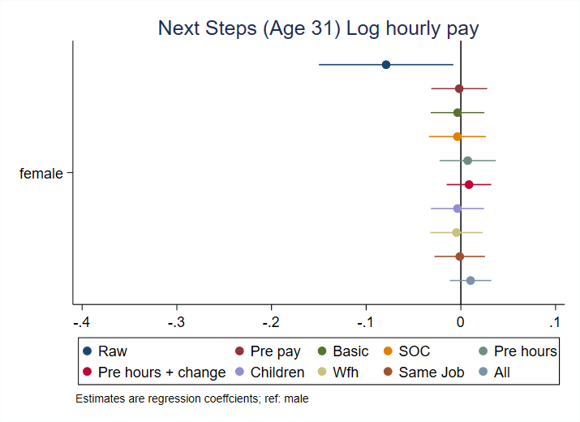
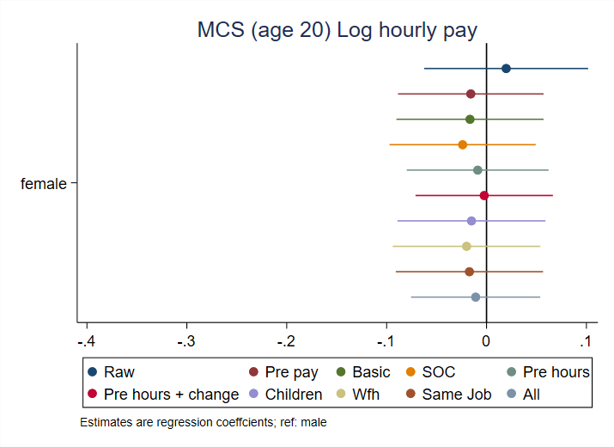

Slide 29
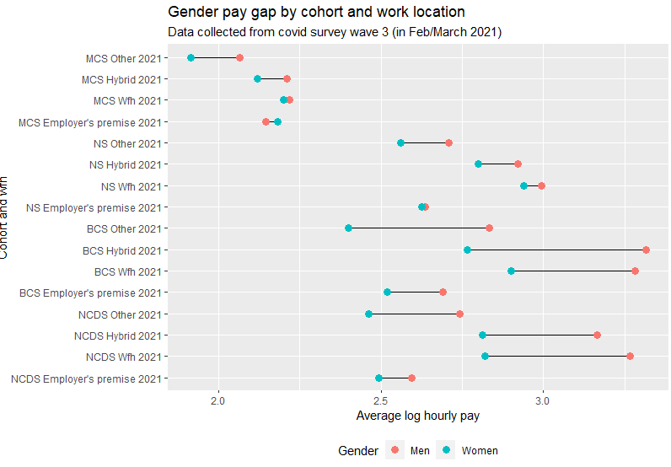

Slide 30
The Gender Wage Gap Among Those Born in 1958: A Matching Estimator Approach (ESRC Grant No. ES/S012583/1)
Alex Bryson
UCL

Slide 31
Motivation
Drawbacks in parametric estimation of the gender wage gap (GWG)
Failure to compare ‘like’ men and women
Common to condition on potentially endogenous variables
Biases ‘true’ estimates of the GWG
Data from the National Child Development Survey (NCDS) provide good basis for tackling these issues:
Match men and women on a rich set of variables liable to impact wage formation over the life cycle which might conceivably differ by gender
Measured pre-labour market entry and thus less liable to be endogenous with respect to wage formation
Birth, 7, 11 and 16 years collected prospectively

Slide 32
Preview of Results
Large raw GWG rising until 40s then falls but remains sizeable to age 55
Raw GWG is larger when use propensity score matching (PSM)
Very different to usual regression-adjusted estimates which are often half the size of the raw GWG
Implication: women have pre-labour market traits which reduce their earnings later in life relative to men
Chief among these is occupational expectations
Not true for all traits

Slide 33
Future Work
Completion of on-going papers:
GWG among young people
Decomposing the GWG at age 42
The GWG during COVID
Convergence in the GWG among university Vice Chancellors (under review)
The effects of female managers on the GWG (under review)
Upcoming papers
Occupational aspirations
Sequence analysis
Meta-analysis (with Patrice Laroche)
Use of matching estimators for the GWG
Do genetic factors play any role in the GWG?

Slide 34
Detail on Some of the Issues Discussed
Bryson, A., Joshi, H., Wielgoszewska, B. and Wilkinson, D. (2020) ”A Short History of the Gender Wage Gap in Britain”, Oxford Review of Economic Policy, 36, 4: 836-854
Supplementary Appendix to Bryson et al 2020
Joshi, H., Bryson, A., Ward, K. and Wilkinson, D. (2021) ”The Gender Gap in Wages over the Life Course: Evidence from a British Cohort Born in 1958”, Gender, Work & Organization, 28: 397-415

