Slide 1
Climate crisis continues: Early career science teachers as key facilitators of compassionate engagement with, and action on, local and global issues through blended learning
Ruth Amos, Teacher Educator and Lecturer in Science Education
University College London, Institute of Education ruth.amos@ucl.ac.uk

Slide 2
Provocative pictures and information statements
Why they aren’t making an impact

Slide 3
The IPCC conclude that the main causes of climate change are associated with human activity
35% of British survey responders don’t agree! (Phillips et al., 2018)
After years of learning about climate change (eg in PARRISE 2014-17), we have raised some awareness, but struggle to take positive actions
Notes:
IPCC = Intergovernmental Panel on Climate Change

Slide 4
UCL IOE trainee teachers 2019-20
School students now crave collaborative learning, and enjoy the interactivity that virtual resources afford
Moving forward, capitalising on blended learning
Key interactive online learning resources to teach about climate, biodiversity, ecology in our virtual Outdoor Learning in Science programme (OLiSp), and teaching during lockdown

Slide 5
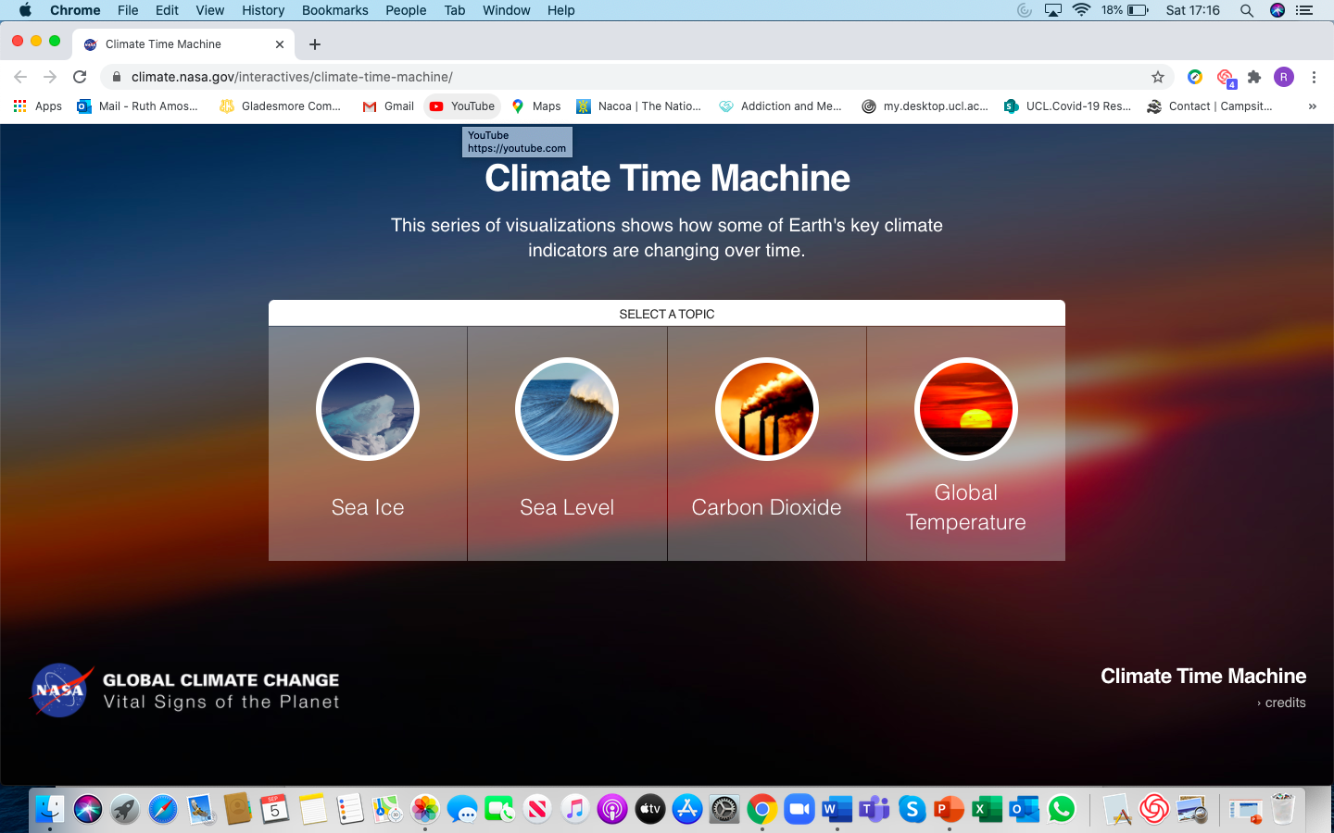
Convey the data
Julie: simulations actively explore changing climate. The NASA climate time machine

Slide 6
Action on climate beyond lessons learnt

Slide 7
Taking action from the classroom
Quizlet live and Kahoot to work together on understanding
Take personal pledges to reduce, reuse / upcycle and recycle
Make the pledges individual and collective (class, Year, school)
Public display, using motivational socially-related tactics

Slide 8
Instead of: Try this:
Please turn off the lights when you leave the classroom
80% of classroom users in our school turn off the lights when they leave the classroom –well done!
Making the most of socially-motivated pledges

Slide 9
THANKS A WATT
for saving energy by turning off the lights when the room is not being used
From your School Conservation Team

Slide 10
Early career science teachers 2020
opportunities for NQTs to focus their developing practice on well-being issues about key challenges within socio-scientific issues
re-focus on the climate crisis science AND action

Slide 11
Looking for local initiatives: taking pledges

Slide 12
References
Promoting Attainment of Responsible Research and Innovation in Science Education (2014-2017). An FP7 EU funded project promoting socio-scientific inquiry based learning (SSIBL) https://www.parrise.eu/wp-content/uploads/2018/04/parrise-en-rgb.pdf
Phillips, D., Curtice, J., Phillips, M. and Perry, J. (eds.) (2018), British Social Attitudes: The 35th Report, London: The National Centre for Social Research

