Slide 1
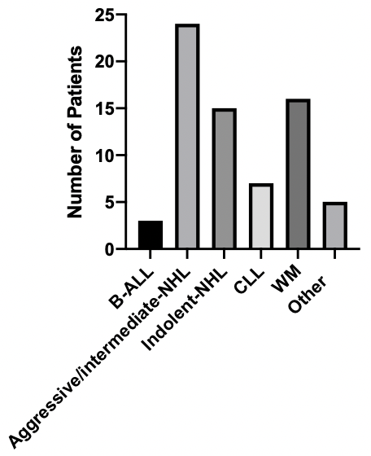
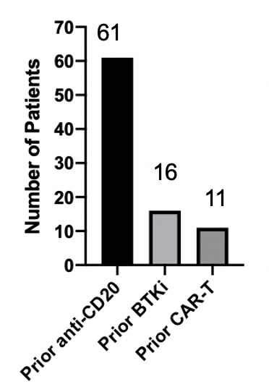
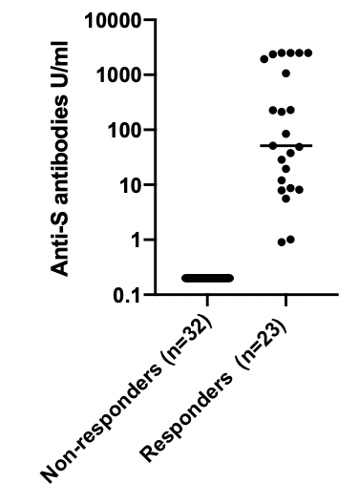
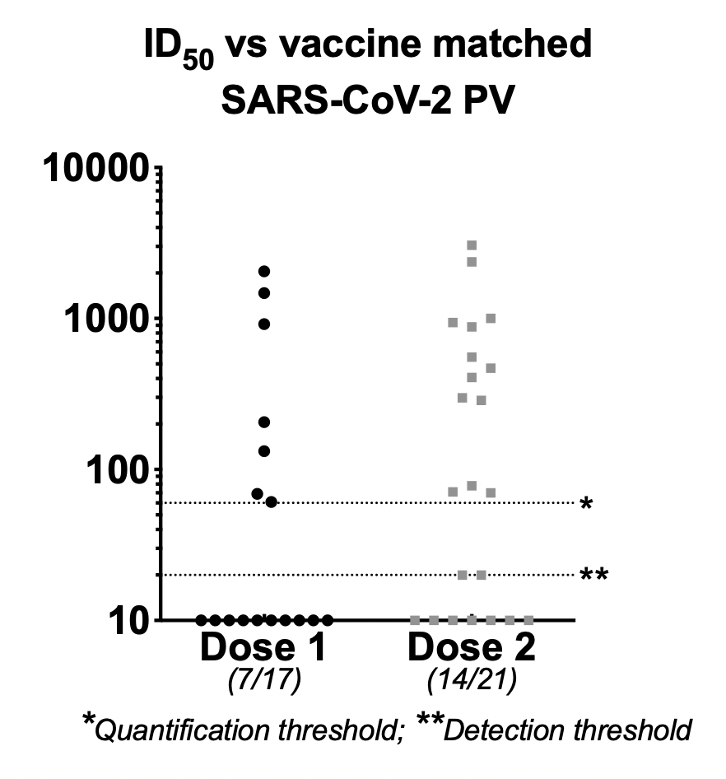
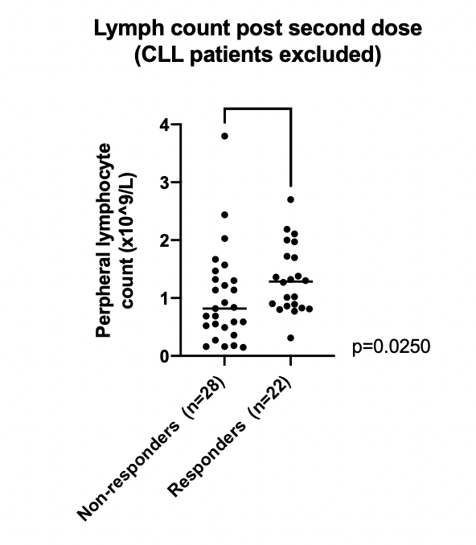
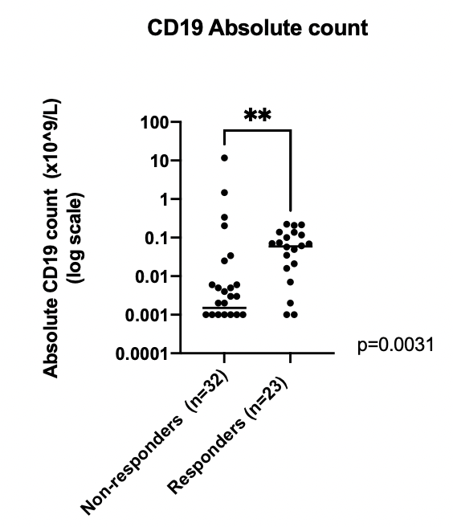
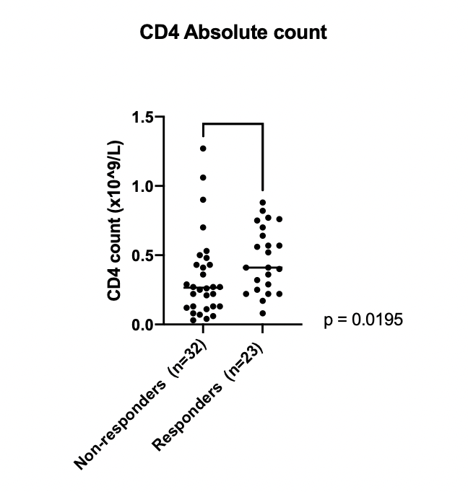
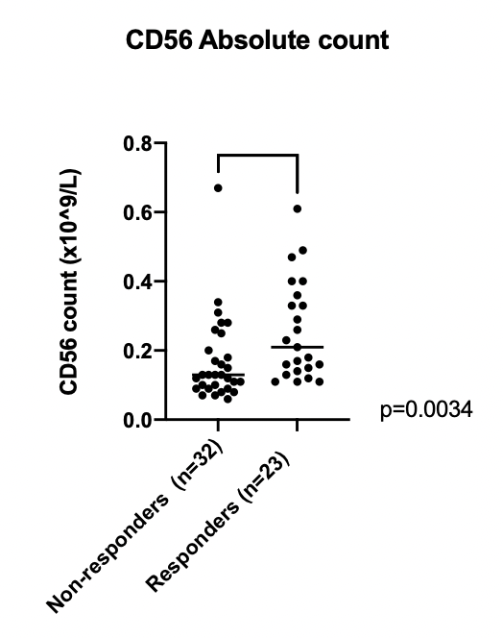
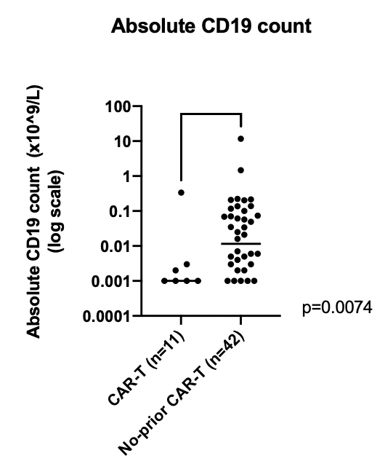
A
B
C
Diagnoses
Treatment Type
Anti-S antibodies
quantitative immunoassay
24
61
15
16
3
7
5
16
11
D
E
F
G
H
I
Figure 1: (A) Number of patients by diagnostic group recruited to the study to date (n=70); (B) Number of patients (whole cohort) exposed to common therapeutic modalities; (C ) Anti-S antibody levels 1 month post 2nd vaccination quantified by Elecsys Roche Anti-SARS-CoV-2 S assay (Spike); (D) ID50s of serum (from seropositive patients) able to neutralise SARS-CoV-2 pseudotyped virus after first dose (7/17) and second dose (14/21); (E) Peripheral lymphocyte count (excluding CLL patients) in responders (n=22) and non-responders (n=28) post 2nd vaccination (p=0.0250); (F) Peripheral CD19 counts in responders (n=23) and non-responders (n=32) post 2nd vaccination (p=0.031); (G) Peripheral blood CD4 count in responders (n=23) and non-responders (n=32) post 2nd vaccination (p=0.00195); (H) Peripheral blood CD56 count in responders (n=23) and non-responders (n=32) post 2nd vaccination (p=0.0034); (I) Peripheral CD19 count in patients who had received CAR-T therapy (n=11) versus those who had received a different SACT (n=42) (p=0.0074). ‘Responders’ have anti-S antibody level >0.4U/ml.

