Slide 1
Education, Equity, and Development in Cambodia: All Education for Some?
William C. Brehm
This Life Cambodia
Development Research Forum
8 September 2011

Slide 3
Background
The 1990s Education For All (EFA) initiative
Liberalization policies by the international financial institutions: marketization and decentralization
Increasing privatization of/in public education worldwide
Private tutoring central feature of the privatization of education in Cambodia

Slide 4
Background
Literature on PT:
expanding knowledge and interests for individuals (Bray, 2007)
accumulating human capital for societies (Psacharopoulos, 1994),
providing new strategies for coping with rapid geopolitical transitions for a variety of education stakeholders (Silova, 2009).
Literature on Cambodia:
informal fees (Bray & Bunly)
“tricks of the teacher” (Dawson)

Slide 5
Main Argument
EFA has overemphasized access in lieu of quality in an underfunded public system of education, which has resulted in a “quality gap” in school.
The “quality gap” has been filled by the exclusionary practice of private tutoring, but at the cost of undermining EFA goals.
Thus, the push for EFA has actually resulted in All Education for Some.

Slide 6
Methodology

Slide 7
Types of Private Tutoring
PT on national curriculum by public teachers during school year
PT on national curriculum by public teachers during summer break
Extra Special PT
PT on subjects outside national curriculum
Courses offered by low-fee private schools

Slide 8
Types of Private Tutoring
PT on national curriculum by public teachers during school year
PT on national curriculum by public teachers during summer break
Extra Special PT
PT on subjects outside national curriculum
Courses offered by low-fee private schools

Slide 9
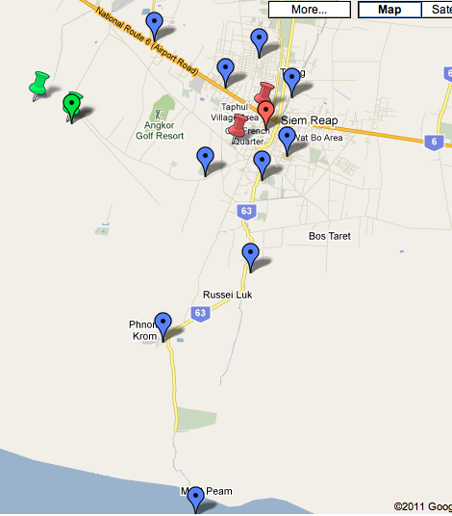
Sample
6 Schools
in 1 district
3 Semi-Urban
2 primary, 1 LSS
3 Semi-Rural
2 Primary, 1 LSS
Education Stakeholders: Parents, teachers, students, and principals

Slide 10
Methods
Compared two UNESCO sponsored documents on compulsory education
28 classroom observations to find differences and similarities between government school (14) and private tutoring (14)
18 focus groups and interviews to unpack equity issues resulting from private tutoring

Slide 11
Key Findings
History of compulsory education: same descriptions, different prescriptions
The Quality Gap: Private tutoring is a continuation of government school
All Education for Some: Students who don’t go to private tutoring do not receive a “full” education and are stigmatized

Slide 12
Description of Problems
Problem | 1955 | 2010
Too few teachers | “shortage of trained teachers” | “not enough teachers”
Too few learning materials | “the school premises are inadequate” | “limited education resources”
Limitations of society | “a largely illiterate public” | “The Cambodian society… [exhibits] irregular practices”
Economic troubles | “economic backwardness” | “dependent on international aid”
Limited pedagogy | “endless repetition and the pupils were quite incapable of reading the words separately” | “time is spent on academic upgrading as opposed to teaching methodology”
Class size too big | “classes are large…60, 80, and even 100 pupils” | “pupil teacher ratio: 49.3:1 in 2007”

Slide 13
Prescription to problems
1955: “Compulsory schooling cannot be suddenly imposed; it must be prepared several years in advance…it is the moral duty of the state, before making education compulsory, to offer the pupils proper schools with hygienic conditions, qualified teachers, and a suitable curriculum” (p. 31).
2010: “Inclusive Education” for the “hard to reach children.” Quality is to be addressed by Child Friendly Schools, which states “All children have access to schooling” as the first dimension

Slide 14
Compulsory Education and fees
1955: “Entrance fees have never been asked for, textbooks have always been provided free of charge…and many resident scholarships and various allowances have been awarded” (p. 36).
2010: “For many rural families that rely on agriculture for subsistence, education cost are the highest expense they face annually. Often they cannot afford to educate all of their children and choose only certain children to attend school” (p. 28).

Slide 15
The Quality gap
Private tutoring is perceived to complete the government school curriculum.
Private tutoring is found to be an extension of government school in terms of content delivered and teaching methodology.
One of the differences is in how students are practicing sample problems (exercises).
Achievement differences between students who go to PT and those who do not (Brehm & Silova, Forthcoming)

Slide 16
Curriculum Too long
“We cannot finish the curriculum by only attending government school...this is why we need private tutoring.” (9th grade student)
“There are too many lessons and too many students [in class].” (primary school teacher)
“If we want quality, we will not finish the curriculum. But if we want to finish the curriculum, students will not be qualified.” (primary school teacher)
Teachers held accountable for finishing curriculum.
Results: “cut examples from lessons”; “summarize”; and “rush.”

Slide 17
Activity | Government School N= 14 % of classes observed (number of classes observed) | Private Tutoring N=12 % of classes observed (number of classes observed)
High ability students work with low ability students | 28.6 (4) | 16.7 (2)
High ability students help teach whole class | 71.4 (10) | 50 (6)
Call of weak students to answer questions | 50 (7) | 50 (6)
Students answer multiple choice questions | 14.3 (2) | 16.7 (2)
Students answer questions at board | 100 (14) | 75 (9)
Assigns homework | 64.3 (9) | 41.7 (5)
Teacher presents new material | 78.6 (11) | 41.7 (5)
Provides whole class instruction | 100 (14) | 91.7 (11)
Students answer in chorus | 71.4 (10) | 66.7 (8)
Teacher gives example to whole class | 78.6 (11) | 83.3 (10)
Source: Brehm & Silova (Forthcoming)

Slide 18
Activity Observed | Private Tutoring N=7 % of class time (minutes) | Government School N=6 % of class time (minutes)
Teacher gives lesson | 30.26 (115) | 29.40 (102)
Students speak individually or as a whole class | 6.84 (26) | 10.38 (36)
Classroom management (attendance, assign HW, collects money, etc.) | 14.74 (56) | 8.93 (31)
Non-practice sub-total | 51.84 (197) | 48.71 (169)
Student/teacher solves example problem at board | 28.69 (109) | 26.80 (93)
Students solve example problem individually | 17.63 (67) | 7.20 (25)
Students solve example problems in groups (3+ students) | 0.00 (0) | 17.29 (60)
Students work in pairs | 1.84 (7) | 0.00 (0)
Practice sub-total | 48.16 (183) | 51.29 (178)
TOTAL | 100 (380) | 100 (347)

Slide 19
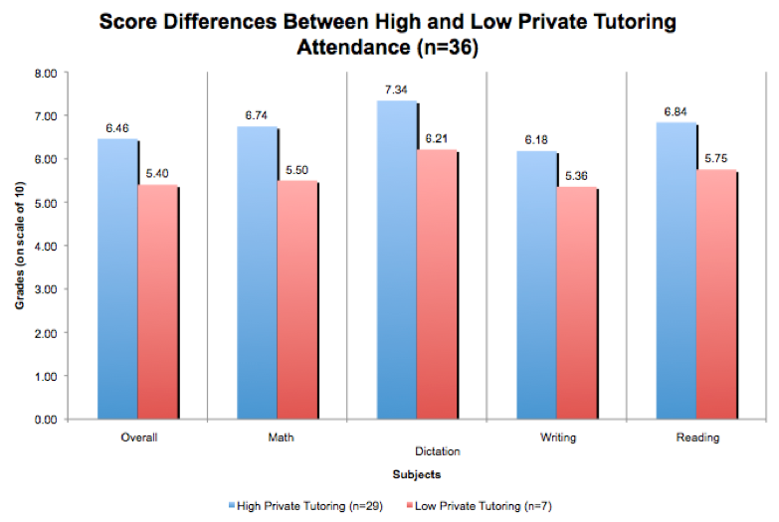
Academic Achievement
Source: Brehm & Silova (Forthcoming)

Slide 20
The Stigma of Private Tutoring
Students who do not go to private tutoring are stigmatized
Personal and intellectual differences
Socio-economic status differences
Family differences

Slide 21
Personal and Intellectual Differences
“I want to attend private tutoring because it can make me become a smart student.”
“If I attend private tutoring, I’ll be clever and it makes my family happy.”
“I want to attend private tutoring because I don’t want other students to look down on me as I am not smart.”
“I am very jealous of those who attend private tutoring.”

Slide 22
Socio-economic status differences
“Students who go to private tutoring are the students from fairly rich families.”
“I feel sorry for [students who don’t go to private tutoring] because they can’t afford private tutoring.”
“The students who go to private tutoring are the children from the families which do not have many members, are able to earn enough money to spend on food and education for their children.”

Slide 23
Family differences
Parents who send children to private tutoring “care” more.
“The students who go to private tutoring are from families who give enough time for their children to study and only have to help a little with housework.”
Adding, these families have “a concrete house with tile roof...large land...and sell something in the village.”

Slide 24
Conclusions
The push for EFA has increased the number of students in school (this is good)
But increased enrollments at a faster pace then the building of schools and training of teachers has resulted in the privatization of public education in the form of private tutoring
Cost barriers to private tutoring prevent many students from receiving a full (quality) education

Slide 25
Conclusions
Since private tutoring is perceived to provide all of the content that cannot be taught in government school, many students are left behind.
This has real societal effects by stigmatizing those students who do not attend private tutoring.
A system that was designed to be inclusive under the heading of Education for All has actually resulted in the exclusion of poor children.
We therefore can describe this system as All Education for Some.

