Slide 1
Influence of geometrical defects in the elastic-plastic failure of lattice materials
B. Boonkongchuen¹, C.K. Lim¹, W. Ronan², E. Bele¹
¹University College London, Mechanical Engineering, London, UK
²NUI Galway, Biomedical Engineering, Galway, Ireland

Slide 2
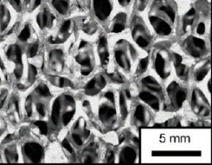
Introduction: Foams and Lattice Materials
[2]
[3]
[4]
[4]
[1]
1. Hybrids: Materials to fill holes in material property map
2. Most attractive region: Low ρ – High E (High σ)
[1] M. F. Ashby, Philos Mag, 2008 [3] D. J. Sypeck, Adv Compos Mat, 2005
[2] T. Miyoshi et al., Adv Eng Mat, 2000 [4] H. N. G. Wadley, Philos Trans Royal Soc, 2006

Slide 3

Introduction: Stretching vs Bending-Dominated Architectures
Maxwell’s stability criterion in 3D:
c struts, j joints, s states of self-stress, m mechanisms
c - 3j +6 = s – m
Bending-dominated deformation: Dictated by rotational rigidity of joints, e.g. in compression σ varies with and E varies with [2].
[1]
[2]
Stretching- dominated deformation: Dictated by tensile tension/compression of constituent members, e.g. in compression, σ and E vary with [2].
[1]
[2]
[1] M. F. Ashby, Philos Mag, 2005; [2] V. S. Deshpande et al., Acta Mater, 2001

Slide 4
Introduction: Ductility of Foams and Lattices
[1]
Large-scale deformation in tension present in e.g. tensile fibres of sandwich panels Prediction of ductility becomes significant
Tensile ductility of many foams is lower than that of the parent material, perplexing for bending-dominated structures
[1] W. Ronan, V.S. Deshpande, N..A. Fleck, Int J Solids Struct, 2016

Slide 5
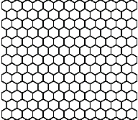
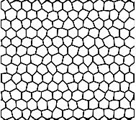
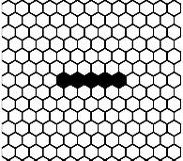
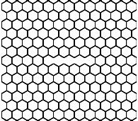
In This Talk
Mechanisms of tensile failure in additively manufactured periodic honeycombs (bending-dominated geometries)
Deformation Mechanisms In Tension
Influence of Strut Aspect Ratio
Effect of Macroscopic (periodic, semi-confined) Boundary Conditions
Effect of geometric imperfections on tensile properties
Geometric Perturbations
Inclusions
Missing Cell Walls (cracks)

Slide 6
Overview
Introduction to cellular materials
Tensile response of periodic honeycombs
  Effect of relative density: periodic boundary conditions
  Towards experimental tests: specimen size effects
Tensile response of semi-confined experimental honeycombs
Effect of geometrical perturbations on ductility and tensile strength
Effect of crack and inclusion size on tensile ductility

Slide 7
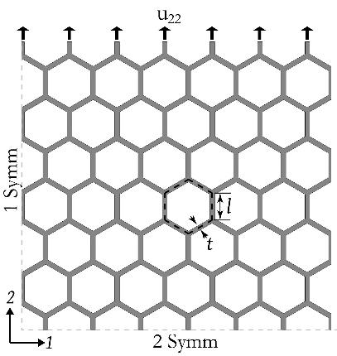
FE Model: Honeycombs with Periodic BCs
Finite Element Model: ¼ of a 13x13 unit cell RVE modeled
Symmetry BCs on bottom/left boundaries. u₂₂ prescribed on top boundary. Plane strain conditions.
Around 10 through-thickness elements
Solver: ABAQUS Standard

Slide 8
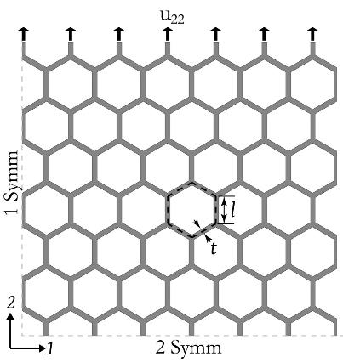
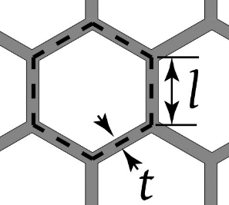
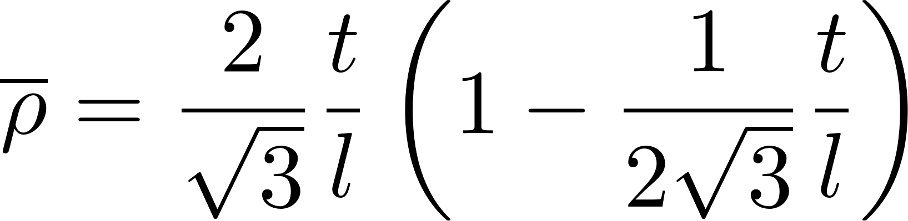
FE Model: Honeycombs with Periodic BCs
Relative density:
Strut Aspect Ratio

Slide 9
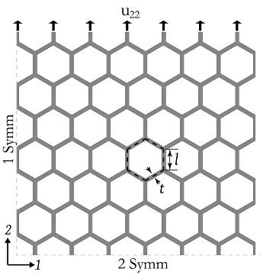
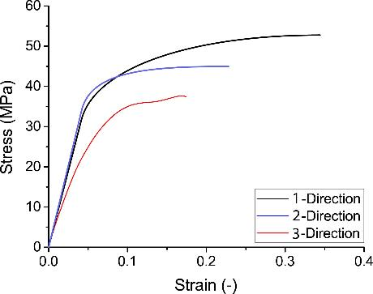
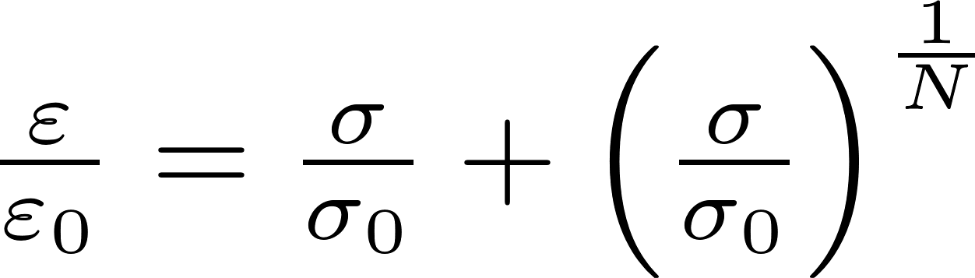
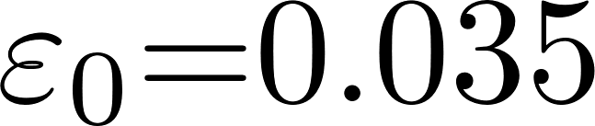
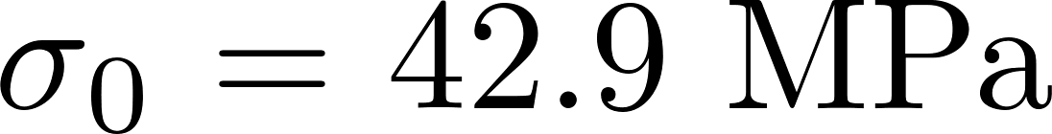
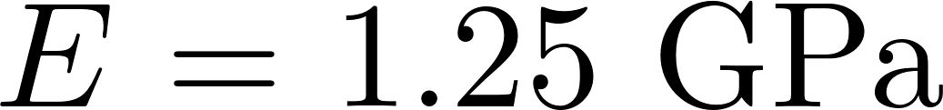
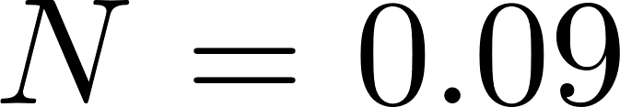
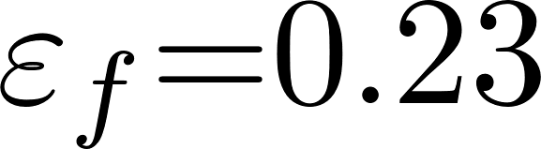
FE Model: Honeycombs with Periodic BCs
Constituent Material: Nylon (SLS Manufacturing)
Material: fitted to SLS Nylon experimental tests (2-Direction)
with: , , , , .

Slide 10
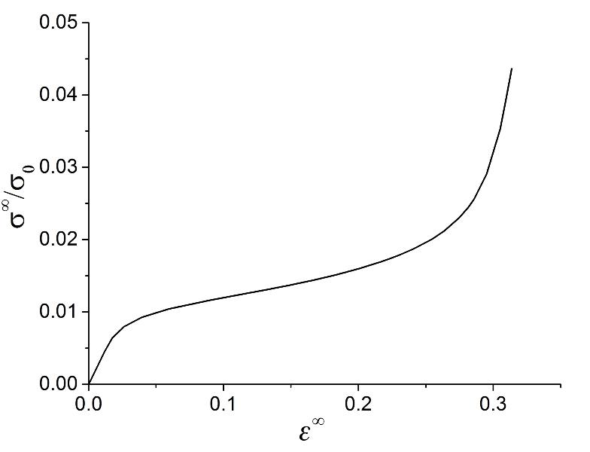
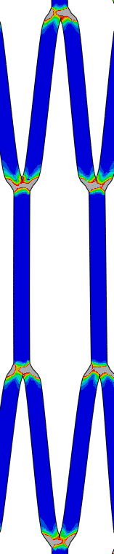

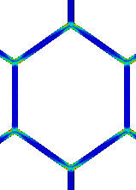
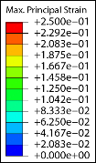
Tensile Response of Honeycombs with Periodic BCs
Low Relative Density Model ( )
2) Plastic Bending
2) Lock-up
1) Elastic Bending

Slide 11
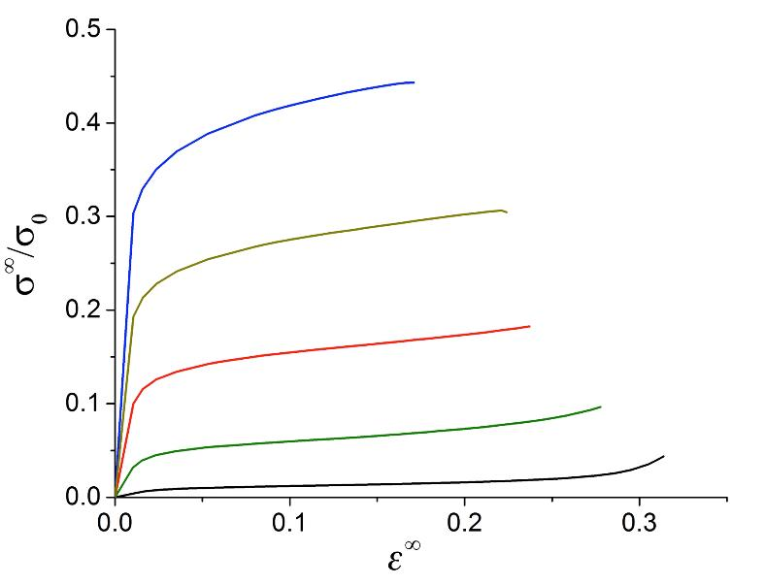
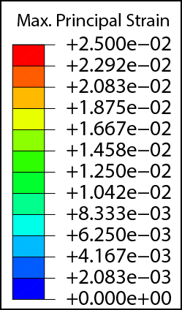
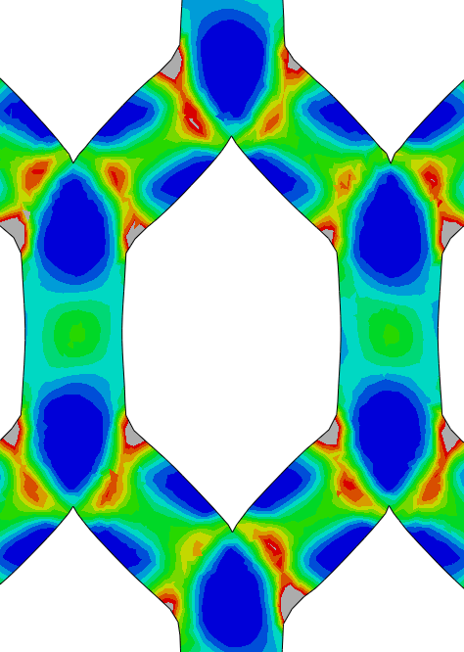
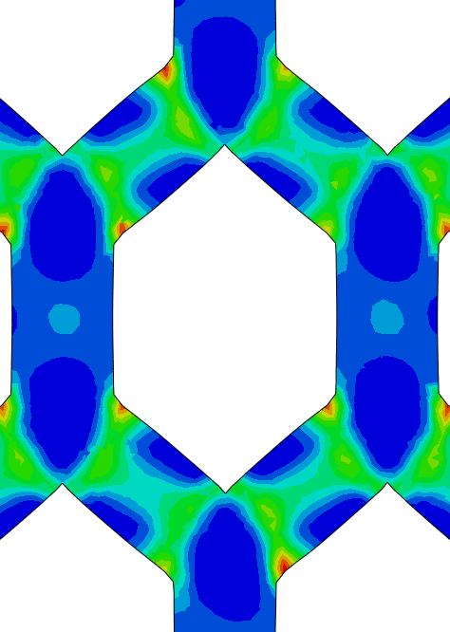
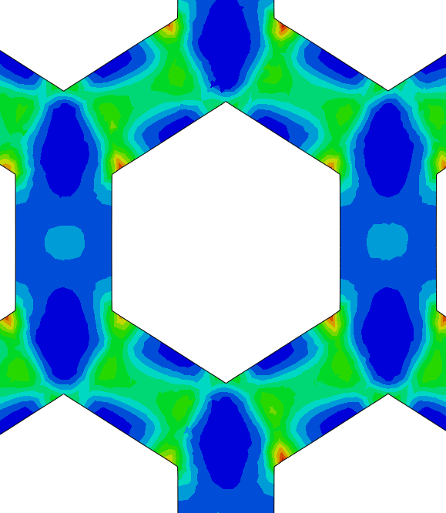
Tensile Response of Honeycombs with Periodic BCs
2) Plastic Bending
1) Elastic Bending

Slide 12
Tensile Response of Honeycombs with Periodic BCs
Macroscopic tensile failure strain defined at first occurrence of:
lock-up in low density honeycombs,
tensile necking in high density honeycombs
Initiation of Lock-Up
Tensile Necking
Material ε_{f}
Replication of Boundary Conditions in Experimental Tests?

Slide 13
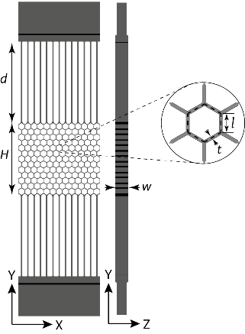
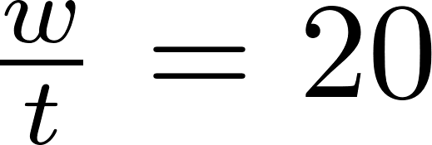
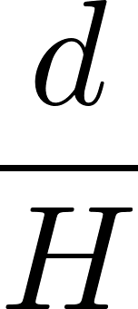
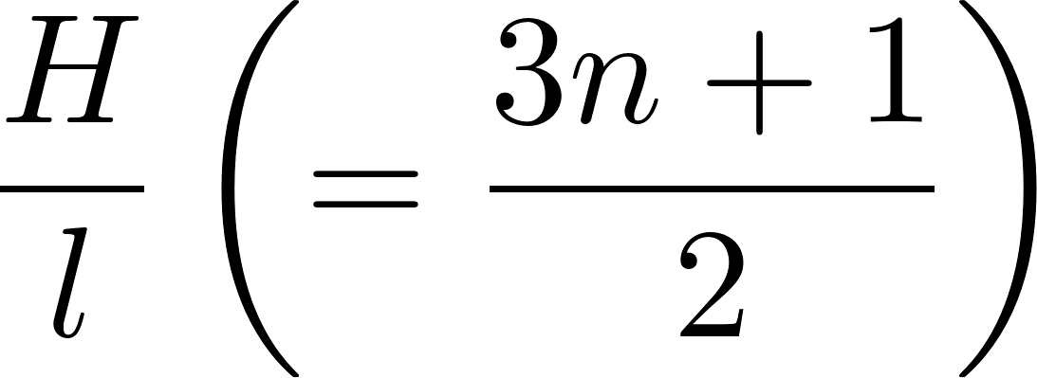
Additively Manufactured Honeycomb Geometries
Honeycomb specimens fabricated with selective laser sintering – base material Nylon powder. Resolution: 0.5 mm
Geometry design criteria:
a) Plane strain conditions:
b) Minimisation of lateral constraints in top nodes
c) Minimisation of specimen size effects
Free variables: and

Slide 14
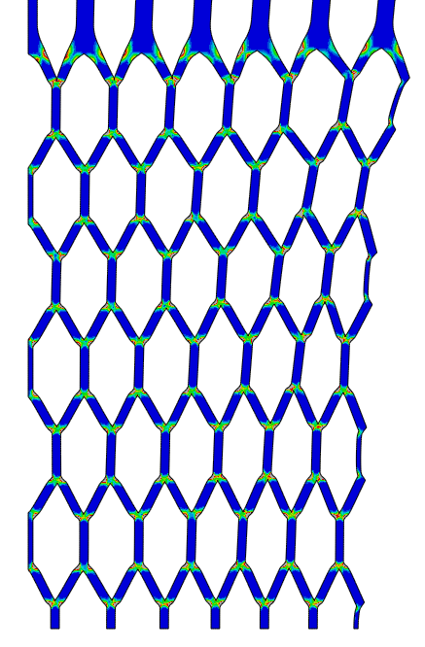
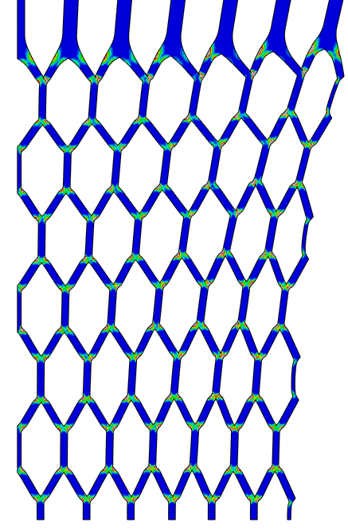
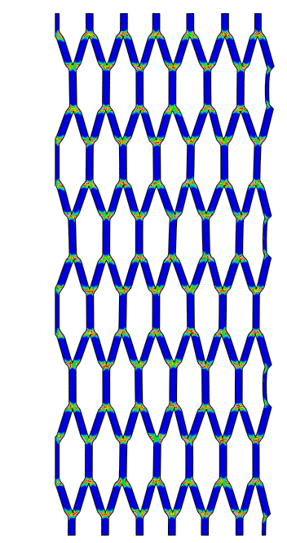
Effect of Lateral Constraints (Ligament Size d/H)
Rho = 0.2 chosen for illustration; similar parametric studies were done on other relative densities.

Slide 15
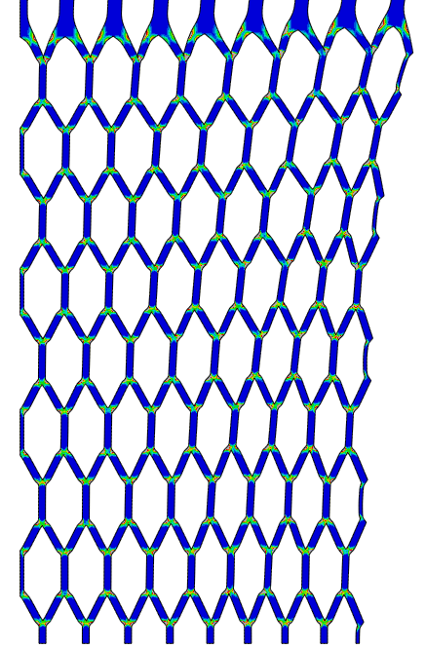
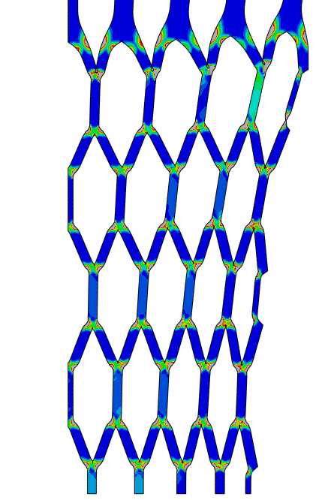
Effect of RVE Size (R/l)
Rho = 0.2 chosen for illustration; similar parametric studies were done on other relative densities.

Slide 16
Effect of Lateral Constraints and RVE Size
Mechanisms of failure: strut lock-up for low density honeycombs, tensile necking for high density ones
Introduction of ligaments preserves these mechanisms
Have not eliminated the effect of lateral constraints, but due consistent differences can predict ductility in periodic conditions

Slide 17
Overview
Introduction to cellular materials
Tensile response of periodic honeycombs
  Effect of relative density: periodic boundary conditions
  Towards experimental tests: specimen size effects
Tensile response of semi-confined experimental honeycombs
Effect of geometrical perturbations on ductility and tensile strength
Effect of crack and inclusion size on tensile ductility

Slide 18
Tensile Response of Additively Manufactured Periodic Honeycombs
Static tensile tests carried at a remote strain rate of 10⁻³ s⁻¹
Tests recorded with a DSLR camera (frame acquisition rate 50 Hz)
Image analysis (Matlab) used to calculate macroscopic strains in the honeycomb assembly, and local strut strains

Slide 19
Tensile Response of Additively Manufactured Periodic Honeycombs
Characteristic deformation mechanisms: similar to numerical calculations
Notes:
add honeycomb struts with labels
add tensile limit line
make this two slides – add conclusions

Slide 20
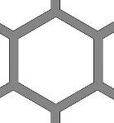
Tensile Response of Additively Manufactured Periodic Honeycombs
Strut B
Strut A
Strut B
Strut A
Strut B
Low-density honeycombs: Plastic bending failure precedes local tensile strain
High-density honeycombs: Macrosopic failure due to achievement of local tensile strain
Notes:
add honeycomb struts with labels
add tensile limit line
make this two slides – add conclusions

Slide 21
Overview
Introduction to cellular materials
Tensile response of periodic honeycombs
  Effect of relative density: periodic boundary conditions
  Towards experimental tests: specimen size effects
Tensile response of semi-confined experimental honeycombs
Effect of geometrical perturbations on ductility and tensile strength
Effect of crack and inclusion size on tensile ductility

Slide 22

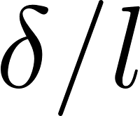
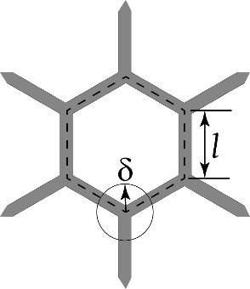
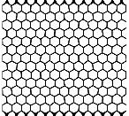
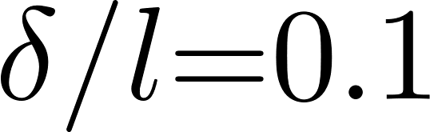
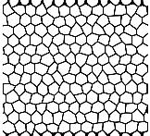
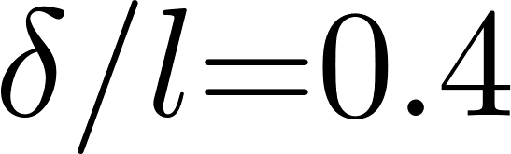
Effect of Geometrical Perturbations on Ductility and Tensile Strength
Geometrical perturbations generated by displacement of nodal junctions on an arbitrary position in a circle of radius
Nodal perturbation magnitude characterized by
Honeycomb with rel. density = 0.2 chosen as baseline
Notes:
add arrows
add ref

Slide 23
Effect of Geometrical Perturbations on Ductility and Tensile Strength
Both tensile ductility and strength shortcut by nodal perturbations
Moderate reductions: ≈ 0.7 for δ/l = 0.4
Notes:
Arrows to show trends
Video

Slide 24
Overview
Introduction to cellular materials
Tensile response of periodic honeycombs
  Effect of relative density: periodic boundary conditions
  Towards experimental tests: specimen size effects
Tensile response of semi-confined experimental honeycombs
Effect of geometrical perturbations on ductility and tensile strength
Effect of crack and inclusion size on ductility and tensile strength

Slide 25
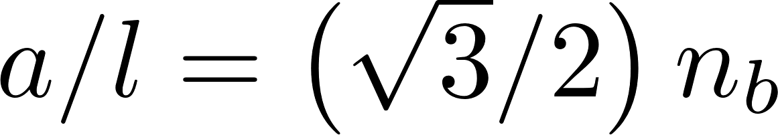
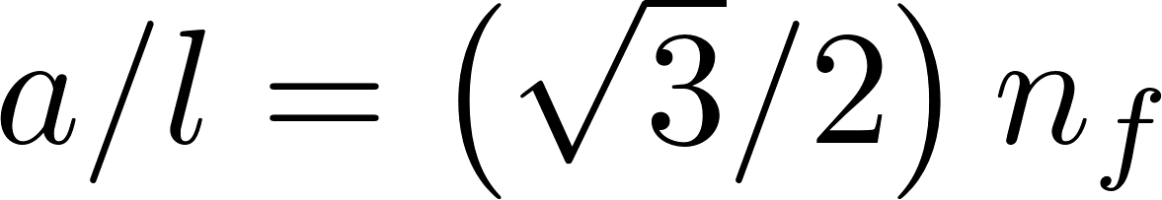
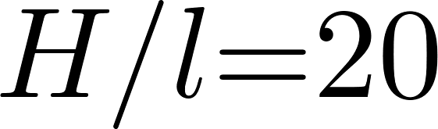
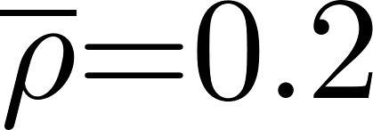
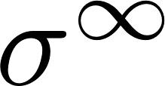
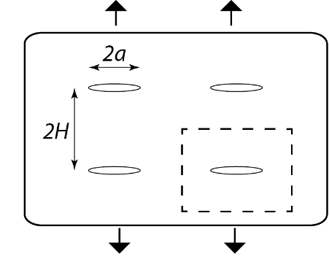

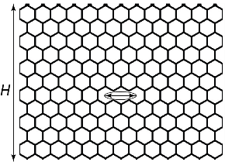
5. Effect of Crack and Inclusion Size on Ductility and Tensile Strength
Missing cells (cracks) or inclusions, of size 2a, spaced a distance 2H apart are explored
Cracks created by n_{b} broken walls:
Inclusions created by n_{f} filled cells:
All tests carried on RVE with and (13x13 unit cells)

Slide 26
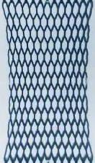

5. Effect of Crack Size on Ductility and Tensile Strength
Macroscopic tensile strength and ductility controlled by tensile fracture of crack tip ligament
Ductility reduced by less than crack/specimen size ratio
Notes:
Trends, Location of failure

Slide 27

5. Effect of Inclusion Size on Ductility and Tensile Strength
Macroscopic tensile strength and ductility controlled by tensile fracture of confined ligaments
Ductility reduced by more than crack/specimen size ratio
Notes:
Trends, Location of failure

Slide 28
6. Summary of Influence of Imperfections
Presence of all 3 types of imperfections shortcuts ductility and tensile strength
In bending-dominated geometries: largest effects on tensile strength strength reduction is caused by presence of cracks
Tensile ductility shortcut is most sensitive to hard inclusions
Cooperative influence of multiple imperfection types is very possible
Notes:
Trends, Location of failure

Slide 29


Acknowledgements
Notes:
Trends, Location of failure

